Slide 1
Welcome to CPO 3303 Politics of Latin America

Slide 2
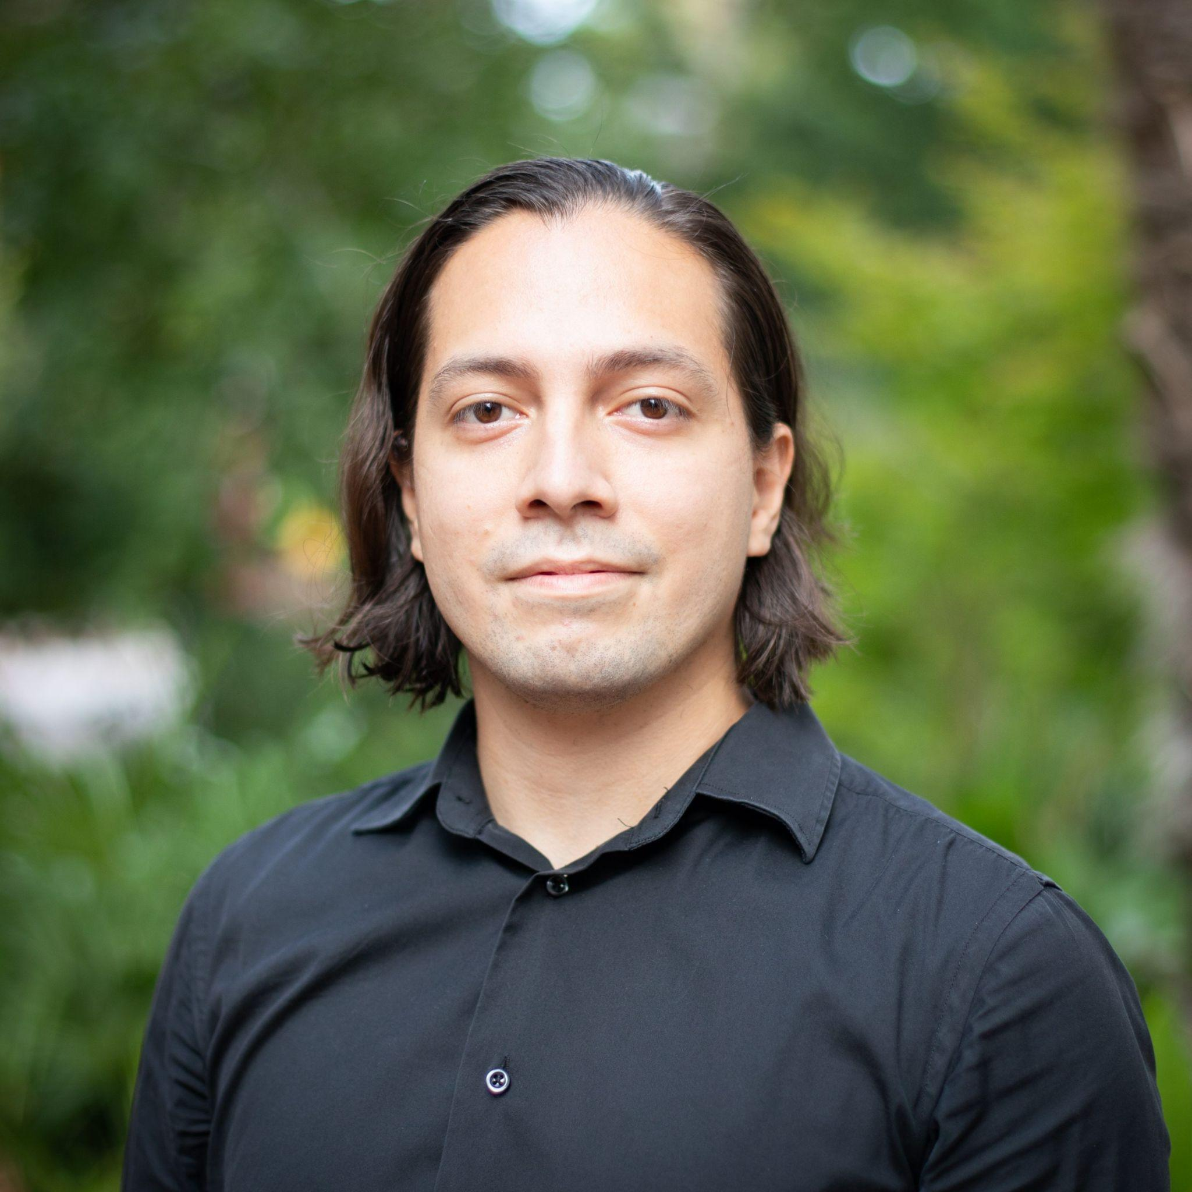
Hi!
I AM CLAUDIO ROBELO
PhD Candidate from Argentina studying Military Cooperation
You can reach me at:
crobeloguzman@fsu.edu or over zoom

Slide 3
What This Course Is About
An introduction to modern Latin American politics
Focus on institutions, political developments, and regional trends
Emphasis on Argentina, Brazil, and Mexico
Case studies from other countries to illustrate broader phenomena

Slide 4
Course Goals
Recognize historical and institutional patterns in Latin America
Analyze contemporary political developments using key concepts
Critically engage with news and scholarship
Apply what you learn to a country of your choice

Slide 5
Course Structure
State formation and struggles
Democratization and institutional designs
Individual Case studies
1
3
5
2
4
6
Nationalism and liberalism
Political challenges and new instabilities
Democracy in the region

Slide 6

Required Readings
Main text: Born in Blood and Fire by John Charles Chasteen (5th ed.)
All other materials available on Canvas
Complete readings before assignments

Slide 7
Major Assignments
6 Quizzes (30%): Based on readings, 30 minutes each
1 Midterm Exam (15%): Covers Weeks 1–7
1 Final Exam (25%): Covers the entire course
1 Individual Video Presentation (30%): Political update of a selected country
5 Discussion Boards (up to 10% extra credit): Apply readings to current events

Slide 8
Video Presentation
5–10 minute video due Week 14
Analyze political developments in your chosen country
Address institutions, conflict, regional and U.S. relations
Optional one page draft and five page report due June 5 for feedback
Upload final video to Canvas by November 5

Slide 9
Discussion Boards
Analyze a recent news article (last month)
Apply concepts from readings and lectures
Focus on your selected country when possible
Engage with classmates

Slide 10
Policies and getting started
No makeups unless documented
Follow all deadlines; stay on track weekly
Check Canvas regularly
Use FSU resources: library, tutoring, office hours
Ask for help early if needed
Complete syllabus quiz and first-day attendance
Do Week 1 readings
Watch the video lectures for Module 1

Slide 11
Thanks!
ANY QUESTIONS?
You can find me at:
crobeloguzman@fsu.edu

