Slide 1
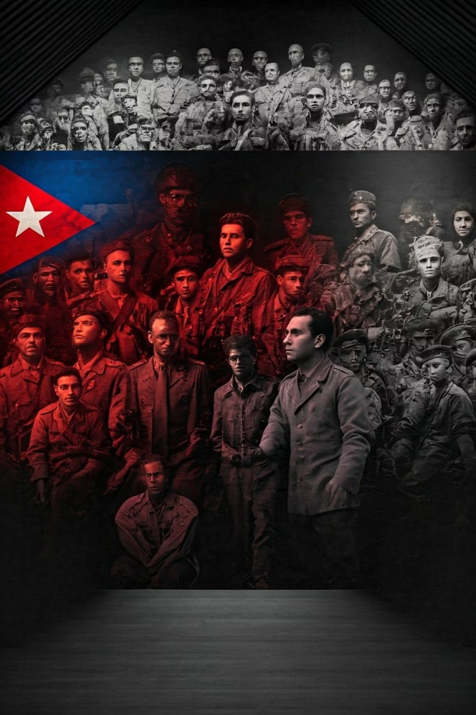

The Cold War in Latin America: Power, Resistance, and Transformation
This presentation examines the complex dynamics of Latin America during the Cold War period, a time when global ideological tensions between communism and capitalism profoundly shaped regional political landscapes. Far from being passive participants, Latin American nations and peoples actively navigated these turbulent waters—sometimes aligning with superpower interests, sometimes resisting them.
We'll explore the rise of military dictatorships, revolutionary movements, and social resistance that characterized this transformative era, highlighting how Cold War politics intertwined with local conditions to produce unique national experiences that continue to influence contemporary Latin American politics and society.
by Claudio Robelo

Slide 2






Cold War Context and the National Security Doctrine
U.S. Anti-Communist Strategy
Regional containment policy
Military Politicization
Armed forces as ideological enforcers
Strategic Partnership
U.S.-Latin American security cooperation
The Cold War transformed Latin America into a critical battleground in the global struggle against communism. The United States, viewing the region as its strategic backyard, systematically exported anti-communist ideology through military training programs, economic aid, and diplomatic pressure. This strategy crystallized in the National Security Doctrine, a comprehensive security framework that fundamentally altered civil-military relations.
Under this doctrine, a division of labor emerged: while the United States defended against external Soviet threats, Latin American militaries were tasked with eliminating "internal enemies"—often broadly defined to include students, labor activists, and intellectual critics. This reconceptualization of security profoundly politicized armed forces across the region, transforming them from defenders of national sovereignty into active participants in domestic politics and ideological warfare.

Slide 3




Military Dictatorships and Bureaucratic Authoritarianism
Brazil 1964
Military coup against Goulart establishes dictatorship lasting until 1985
Chile 1973
Pinochet overthrows Allende's democratically elected government
Argentina 1976
Military junta initiates "Process of National Reorganization"
Uruguay 1973
Democratic institutions dismantled as military seizes control
The military regimes that dominated Latin America during the Cold War adopted a distinctive form of governance known as "bureaucratic authoritarianism." This system combined technocratic governance with brutal repression, positioning the armed forces as the ultimate guardians of national interests against perceived subversion. Brazil's 1964 coup established a paradigmatic model, maintaining a veneer of constitutional order while systematically dismantling democratic institutions.
Argentina and Uruguay witnessed particularly brutal manifestations of military rule through their "dirty wars"—clandestine campaigns of state terrorism that targeted not only armed insurgents but also students, intellectuals, labor leaders, and human rights activists. These regimes institutionalized disappearances, torture, and extrajudicial killings as tools of governance, creating a climate of fear that silenced opposition and traumatized society for generations.

Slide 4
Populism and Revolutionary Currents
Enduring Populism
Cuban Revolution
Regional Response
Despite repression, populist movements maintained significant influence across the region. The political legacies of charismatic leaders like Argentina's Juan Perón and Brazil's Getúlio Vargas proved remarkably resilient, having fundamentally transformed class relations and political participation. Their movements created durable political identities that continued to shape opposition even under military rule.
The 1959 Cuban Revolution represented a watershed moment that profoundly altered political imaginaries throughout Latin America. Fidel Castro's successful overthrow of the Batista regime and subsequent alignment with the Soviet Union demonstrated that a socialist revolution was possible in the Western Hemisphere, inspiring revolutionary movements while heightening U.S. anxieties about communist expansion.
The Organization of American States became a key instrument for coordinating anti-communist policies across the hemisphere. The 1954 Declaration of Caracas formalized this approach, creating institutional mechanisms to combat "international communism" that effectively legitimized intervention against leftist governments and movements throughout the region.
The interplay between populism and revolutionary politics created a dynamic political landscape despite the constraints of Cold War binaries. While U.S. policy often treated all leftist movements as Soviet proxies, the reality was far more complex, with nationalist, reformist, and revolutionary currents expressing diverse local grievances and aspirations that transcended superpower rivalry.

Slide 5
Revolutionary Movements and Proxy Warfare
U.S. Counter-Revolution
Nationalist Revolutions
The United States responded through proxy warfare—training, funding, and arming counter-revolutionary forces while providing economic aid packages like the Alliance for Progress that aimed to undermine revolutionary appeal through limited reforms and development.
Revolutionary Inspiration
Guatemala under Arbenz, Bolivia's MNR, Nicaragua's Sandinistas, and El Salvador's FMLN all pursued radical political and economic transformations that challenged U.S. interests and the regional status quo, combining nationalist and socialist elements in their revolutionary programs.
Cuba's successful revolution provided both ideological and practical inspiration for revolutionary movements across Latin America. Che Guevara's foco theory suggested that small guerrilla units could create conditions for broader revolution, influencing insurgent strategies throughout the region.
The dynamics of proxy warfare transformed local conflicts into internationalized struggles, with both the United States and Soviet Union providing material support to their respective allies. Guatemala's 1954 CIA-orchestrated coup against Jacobo Arbenz and the failed Bay of Pigs invasion of Cuba exemplified direct U.S. intervention, while more subtle forms of influence operated through military assistance programs that trained thousands of Latin American officers in counter-insurgency tactics at the School of the Americas.

Slide 6

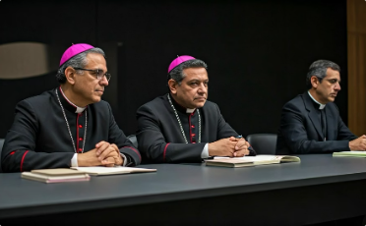
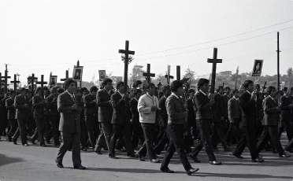
Liberation Theology: Faith-Based Resistance
Grassroots Ministry
Rural priests adopted new approaches to pastoral work, forming Christian base communities that combined religious education with political consciousness-raising and community organizing.
Theological Innovation
Liberation theologians like Gustavo Gutiérrez reinterpreted Catholic teaching through Marxist analysis, viewing poverty as a structural sin requiring concrete political action rather than just spiritual remedy.
Prophetic Witness
Church leaders like Archbishop Oscar Romero of El Salvador became powerful voices against military repression, often paying with their lives for speaking truth to power.
Liberation Theology emerged as a distinctive form of religious-political resistance during the Cold War, challenging both traditional Catholic conservatism and secular revolutionary models. Inspired by the Second Vatican Council's call for the Church to engage with modern social problems, this movement reinterpreted Christian faith from the perspective of the marginalized, advocating for structural change to address poverty and inequality.
While the Vatican hierarchy remained suspicious of Liberation Theology's Marxist influences, the movement gained significant traction at the grassroots level, particularly in rural communities where priests often became important organizers and advocates. This religious dimension added moral authority to resistance movements and complicated Cold War narratives that reduced all opposition to communist subversion.

Slide 7








Cases of Resistance and Repression
Armed Insurgencies
Civil Resistance
FARC and ELN in Colombia, Montoneros in Argentina
Las Madres de Plaza de Mayo, student movements
Accountability Efforts
State Repression
Human rights documentation, international pressure
Disappearances, torture, exile, censorship
The dialectic between resistance and repression manifested in diverse ways across Latin America. Colombia's FARC and ELN insurgencies, rooted in Cold War radicalism and rural grievances, evolved into protracted guerrilla campaigns partially financed through involvement in coca production. In the Southern Cone, urban guerrilla groups like Argentina's Montoneros and Uruguay's Tupamaros adopted tactics of kidnapping, bank robberies, and targeted assassinations before being brutally suppressed by military forces.
Perhaps the most powerful symbol of resistance emerged through Las Madres de la Plaza de Mayo—mothers who defied Argentina's military junta by publicly demanding information about their disappeared children. By mobilizing maternal identity as political resistance, they created a moral challenge to state terrorism that the regime struggled to suppress, demonstrating how new forms of civil resistance could emerge even under extreme repression.

Slide 8
Exceptional Cases: Costa Rica and Peru
Costa Rica's Democratic Exception
Peru's Revolutionary Military
Regional Significance
Peru developed a contradictory model under General Juan Velasco Alvarado (1968-1975), whose military government pursued nationalist reforms including agrarian reform, nationalization of industries, and diplomatic relations with socialist countries.
These exceptions illustrate the diversity of political paths in Cold War Latin America and demonstrate how local conditions could produce outcomes that defied simplistic East-West binary frameworks.
Following its 1948 civil war, Costa Rica abolished its military and established a stable democracy with strong social welfare institutions. This unique path allowed the country to navigate Cold War pressures while avoiding the authoritarian turn experienced by its neighbors.
Models of alternative development possibilities
Expropriation of foreign companies like International Petroleum
Challenge to deterministic Cold War narratives
Constitutional abolition of armed forces in 1949
Radical land redistribution to peasant communities
Important comparative cases for understanding regime variation
Investment in education and healthcare instead of military
Non-aligned foreign policy challenging U.S. hegemony
Maintenance of democratic institutions throughout Cold War
Costa Rica and Peru represent fascinating counterpoints to the dominant Cold War narratives, demonstrating how specific historical circumstances could produce divergent outcomes even within the constraints of great power competition. Costa Rica's abolition of its military following the 1948 civil war allowed the country to invest in social services rather than security forces, creating a democratic exception in a region dominated by militarism.

Slide 9




The Collapse of Military Rule and Democratic Transitions
Regime Crisis
Negotiated Transitions
Democratic Elections
Transitional Justice
Economic failures, human rights pressure, legitimacy loss
Pacts between military and civilian elites
Return to civilian rule with constraints
Truth commissions, trials, memorialization
By the 1980s, military regimes across Latin America faced mounting crises that undermined their grip on power. Economic failures—particularly the debt crisis that followed Mexico's 1982 default—eroded technocratic legitimacy, while persistent human rights advocacy both domestically and internationally highlighted the moral bankruptcy of authoritarian rule. The collapse of the Soviet Union further weakened justifications for authoritarian "national security" states.
Democratic transitions varied significantly in their timing and character. In Argentina, military defeat in the 1982 Falklands/Malvinas War precipitated rapid regime collapse, while Brazil saw a more gradual abertura (opening) process controlled by the military. These transitions often involved implicit or explicit pacts that protected military interests and limited accountability for human rights abuses—compromises that would shape the quality and depth of new democracies for decades to come.

Slide 10
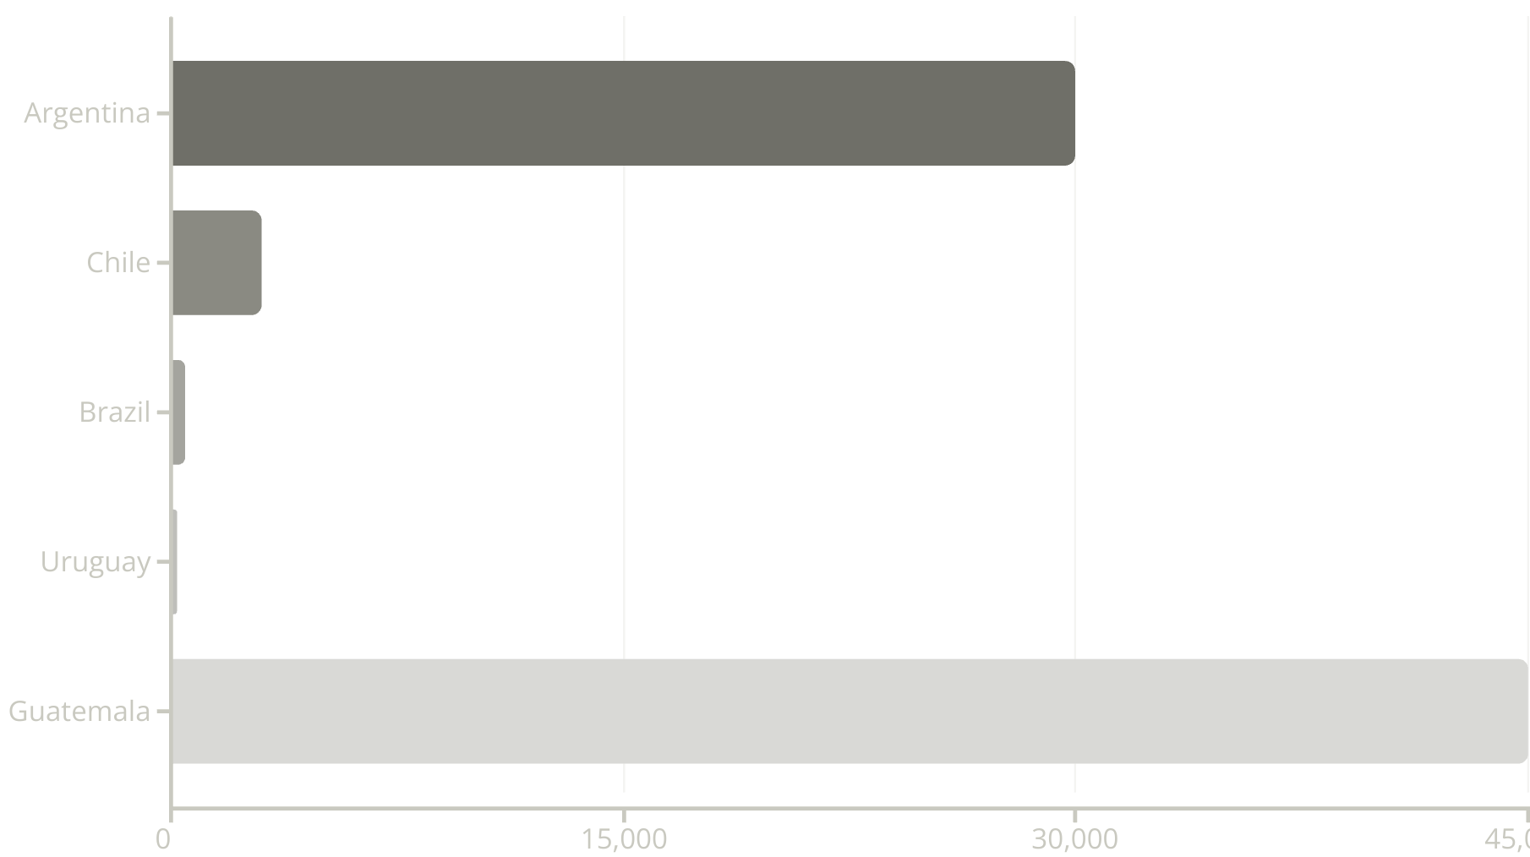
Legacy and Contemporary Implications
The Cold War's legacy continues to shape Latin American politics and society in profound ways. The human toll—tens of thousands disappeared, tortured, and killed—created intergenerational trauma that continues to reverberate through affected communities. Memory struggles over how to interpret and commemorate this violent past remain contentious, with competing narratives from military apologists, human rights advocates, and various political actors.
Democratic institutions established during transitions often retain authoritarian enclaves—constitutional provisions, judicial biases, and security apparatus structures that constrain full democratic consolidation. Meanwhile, economic policies implemented during military rule, particularly neoliberal reforms, transformed social relations and state capacity in ways that continue to influence development trajectories. Understanding this complex Cold War heritage is essential for comprehending contemporary challenges to democracy, human rights, and social justice across Latin America.

