Slide 1
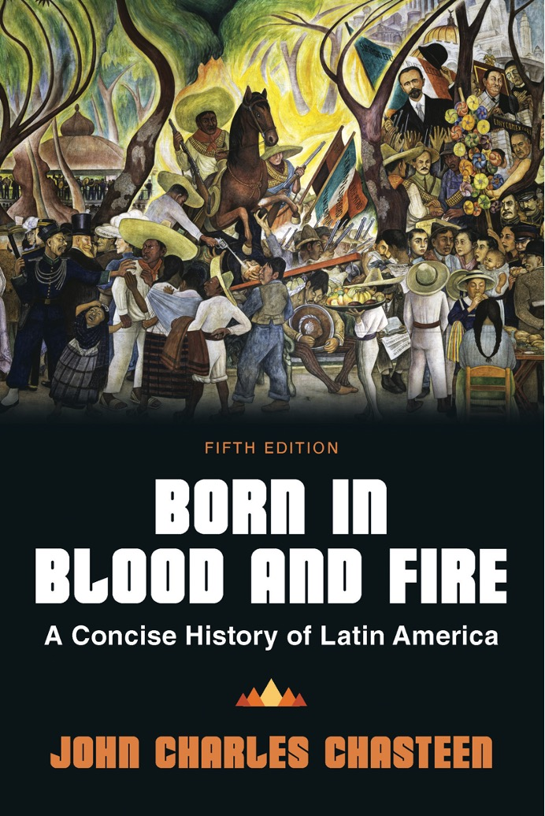
Born in Blood & Fire A Concise History of Latin America 5th Edition
By
John Charles Chasteen
Chapter 1:
Welcome to Latin America

Slide 2
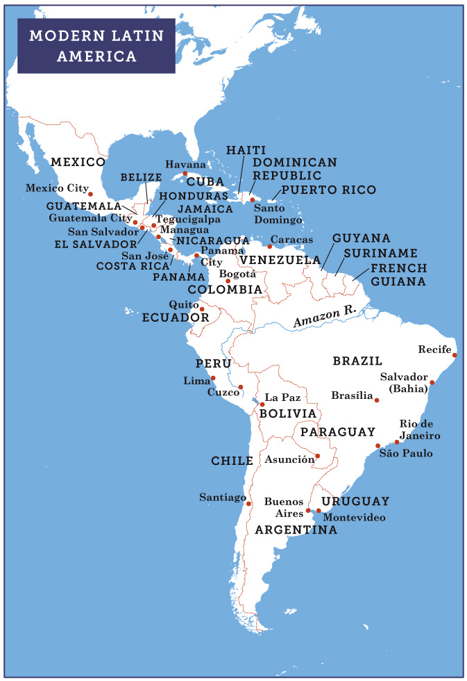
Modern Latin America
Deep roots in indigenous cultures
Nine out of ten people speak a European language.
Largest population of Roman Catholics live in Latin America
Notes:
MODERN LATIN AMERICA.

Slide 3
Climate
Many countries are located in the tropics.
Higher altitudes help to calm the heat.
“Southern Cone” of South America (Chile, Argentina, and Uruguay) lies outside of the tropics.
The southern tip is a land of glaciers and Antarctic influences.

Slide 4
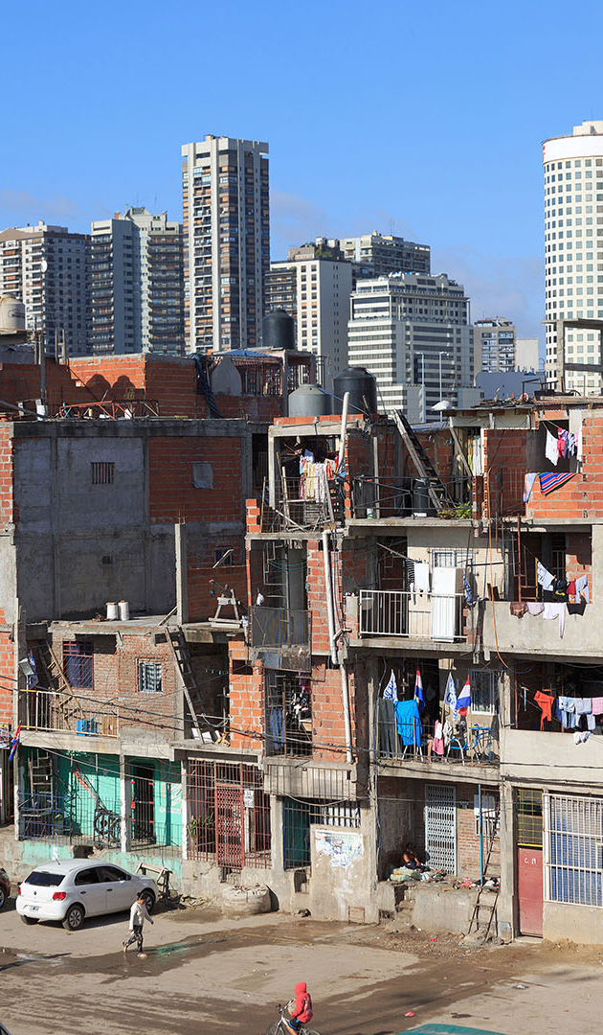
Standard of Living
Large income inequality exists throughout the region.
Many Latin Americans live and work in the cities.
Southern Cone countries hold higher rankings in social development than most of Latin America.

Slide 5
Diversity
Ancestry linked to indigenous groups, Europe, and Africa
Countries such as Guatemala, Bolivia, Ecuador, and Peru have large indigenous populations.
Main destination for slaves between 1500 and 1850
Influx of European immigrants in the early twentieth century

Slide 6
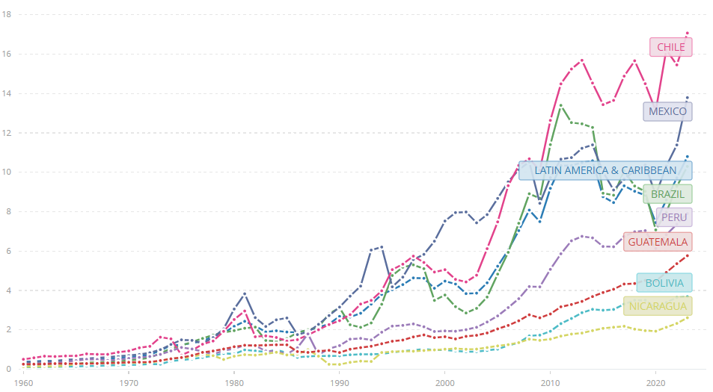
Development
High index of wealth inequality
Slow economic growth
High population growth in the mid-twentieth century
Revolutionary movements emerge in the 1970s.
GDP per capita (current US$ in thousands)

Slide 7
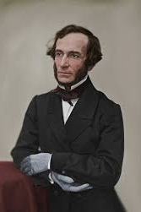
Liberalism
Principles
Limited government
Economic laissez-faire
Favor progress over tradition
Favor reason over faith
Push for equality of citizenship
Juan Bautista Alberdi

Slide 8
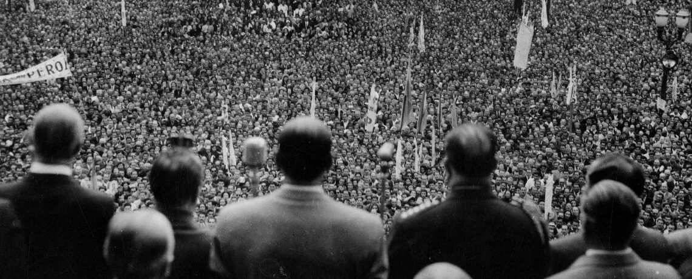
Nationalism
Links ruling elites to lower levels of society
Builds a national bond
Principles
National autonomy
Resisting outside control and influence

Slide 9
Outdated Thinking
Considers Latin America as dependent
Racially charged
The question of “modernity”
Dependency theory

