Slide 1
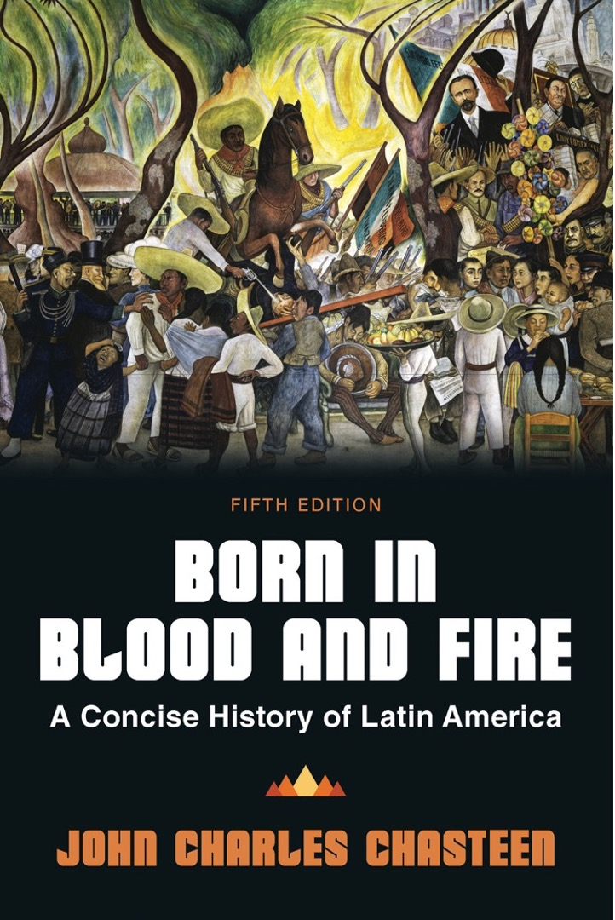
Born in Blood & Fire A Concise History of Latin America 5th Edition
By
John Charles Chasteen
Chapter 2:
Encounter

Slide 2
Encounter
Indigenous Americans, Europeans, and Africans
Encounter shaped by:
Religion
Geography
Culture

Slide 3
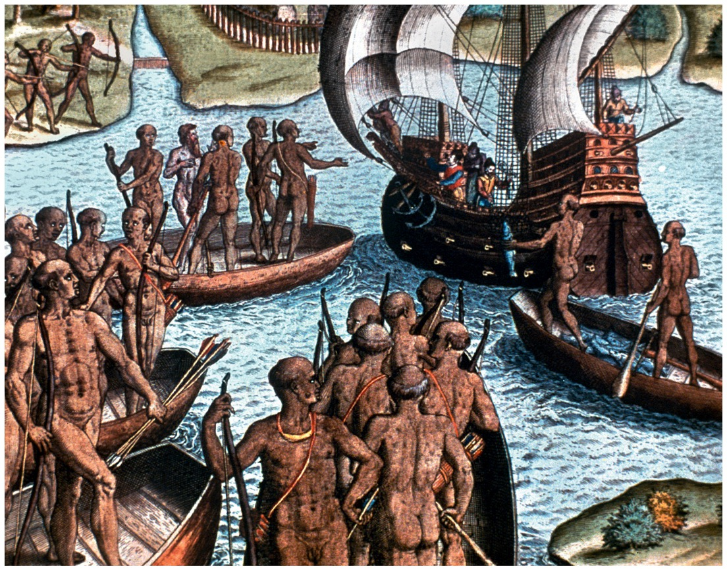
Columbus and Cabral
Born in Blood and Fire, Fifth Edition
Copyright © 2024 W. W. Norton & Company
Notes:
COLUMBUS AND CABRAL ESTABLISHED SPANISH AND PORTUGUESE CLAIMS TO MUCH OF THE NEW WORLD. This early engraving by Theodor de Bry shows how these momentous encounters were pictured in Europe, where the nakedness of the indigenous people attracted great interest, suggesting comparisons with the biblical Garden of Eden. The Granger Collection, New York.

Slide 4
Forms of Social Organization
Nonsedentary peoples
Mobile communities
Hunters and gatherers
Relatively simple

Slide 5
Semisedentary Peoples
Often lived in forests
Relied on agriculture and hunting
Built villages, but moved frequently
“Shifting cultivation”

Slide 6
Fully Sedentary Peoples
Permanent settlements
Settled on high plateaus
Stability allowed for complex societies
Used irrigation
City-states or empires
Highly stratified
Examples: Aztec, Inca, Maya

Slide 7
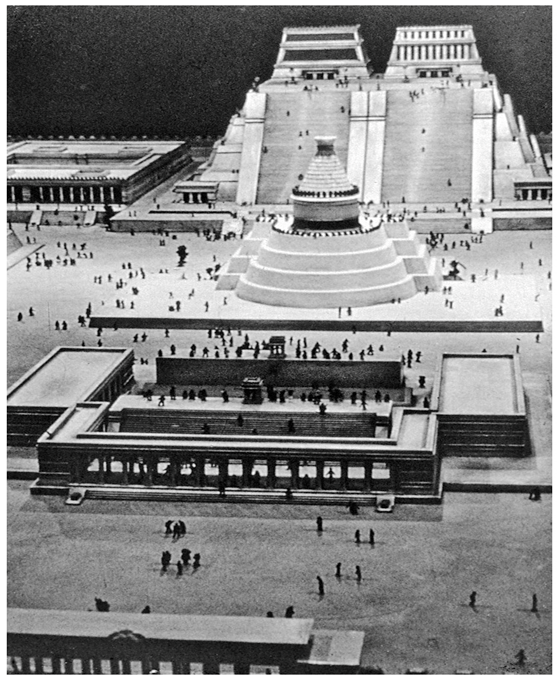
Aztec Empire
Refers to empire, not people
In modern-day Mexico
Ruled by Mexican people
Nahuatl-speaking
Tenochtitlan – capital city

Slide 8
Inca Empire
Refers to emperor and empire, not people
Located in the Andes of South America
Capital at Cuzco: “navel of the universe”
Quechua speakers

Slide 9
Mayan Empire
In modern-day Central America
More decentralized than Aztec or Inca
Highly advanced art, architecture, and astronomy
Declined before Europeans arrived

Slide 10
Origins: Crusading Mentality
Iberians: history of conquest and crusade
Iberian Peninsula—Spain and Portugal
Moors (from North Africa)
Seized peninsula from its former Christian rulers
Scientific, mathematic, agricultural advancements
Ruled for more than 800 years

Slide 11
Reconquest
“Re-conquest” of Iberia
Christian kingdoms took over territories in Iberia.
Subjugated and converted populations
Kingdom of Castile
Granada fell in 1492, completing conquest of Iberia

Slide 12
Role of Religion
Religious foundations of overseas exploration
Defeat of Moors solidified crusading mentality
Queen Isabel committed to spreading Catholicism
Catholic monarchies purged non-Catholics

Slide 13
Early Exploration
Portuguese explore West Africa after reconquest.
They explore with goal of reaching Asia (the Indies).
Queen Isabella bankrolls Columbus expedition.

Slide 14
Brazilian Counterexample
1500: first Portuguese fleet makes landfall in Brazil
Pedro Alvares Cabral
Portuguese did not initially see Brazil as an important find.
Trade routes in Asia and Africa already profitable
Access to spices, silk, gold, and silver in Asia

Slide 15
Initial Forays into Brazil
Portuguese compared to Garden of Eden
Red dye from “brazilwood” tree
Spreading Christianity
Trade between Portuguese and Tupi
Some Portuguese “went native.”

Slide 16
Conquest of Brazil
Arrival of French
Sugarcane
Major export potential
Required lots of land and labor
Portuguese invaded to secure land and labor
Terrain
Successful plantations minimized conflict

Slide 17
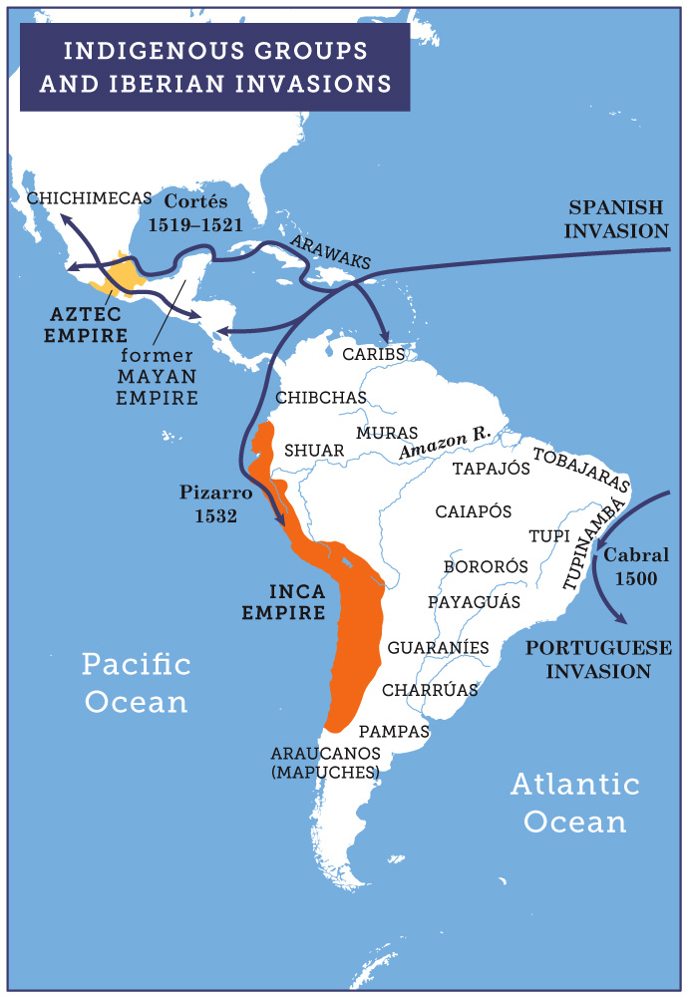
Indigenous Groups and Iberian Invasions
Born in Blood and Fire, Fifth Edition
Copyright © 2024 W. W. Norton & Company
Notes:
INDIGENOUS GROUPS AND IBERIAN INVASIONS.

Slide 18
Rebellion and Resistance
Indigenous rebellions threatened to destroy settlements by mid 1540s.
Portuguese king sought to secure settlements
Built capital city, Salvador (Bahía)
Appointed royal governor

Slide 19
Demographic Catastrophe
Conquest wiped out Tupinambá
Diseases ravaged indigenous communities.
No immunities to European diseases
Jesuits tried to defend indigenous people.
Unable to stop disease

Slide 20
Africa and Slave Trade
The collapse of indigenous populations created the need for new labor.
Europeans began importing enslaved Africans.
Exposure to European diseases, experience with agriculture, livestock, iron working
Slavery was part of African societies.
War captives
Descendents integrated back into free society
Trading of slaves took off after arrival of Portuguese

Slide 21
Portugal Slave Trade
Portuguese traded along western coast
African traders exchanged slaves for goods.
Profitability = new stimulus for more wars
Portuguese used Christianity as justification.
Dominated slave trade for more than a century
More than a million people died in passage to America.
15–20 percent of captives died on voyage
Olaudah Equiano

Slide 22
West Coast Trade
West Africa most affected by slave trade
Between modern Senegal to Nigeria
Along Niger River, kingdoms famous for gold
Brought traders from Europe and Middle East
Portuguese dominated Angola and Mozambique

Slide 23
Cortés and the Aztec Empire
Spanish subjugated Caribbean before moving on to Mexico
Spanish invaders were private adventurers and fortune seekers.
Hernán Cortés

Slide 24
Power and Strategy
Aztec Empire had greater forces, but Spanish had strategic advantages.
Moctezuma did not know about Spanish.
Cortés could plan for conquest.
Moctezuma may have believed Spaniards to be supernatural, but not gods, contrary to the myth.

Slide 25
Colonial Introductions
Spanish brought things Mexica had never seen:
Horses
Attack dogs
Tall ships
Cannons
Steel blades
Body armor

Slide 26
Defeat of the Aztec Empire
Moctezuma invited Spanish into Tenochtitlan.
Spanish took Moctezuma hostage.
Indigenous allies fought with Cortés, evening their numbers.
Disease ravaged the Aztec Empire.
Tenochtitlan fell in 1521, followed by the rest of the empire.

Slide 27
Conquest of Inca
Francisco Pizarro
Taken Inca ruler Atahualpa hostage
Massacred Inca nobles
Spanish horses and steel

Slide 28
Role of Indigenous Allies
Cortés vs. Aztec
Tribute requirements and taxes
Religious sacrifices
Expansion
Pizarro vs. Inca
Broken up rival city-states
Power struggle after death of emperor and successor

Slide 29
Encomienda
Encomienda system rewarded Spanish conquerors with people to work land.
Responsibility to Christianize them
Based on system used during Moors conquest
Farmers who paid tribute to Aztec or Inca now paid to the Spanish.
Caciques

Slide 30
Birth of Spanish America
Mexico becomes “New Spain.”
Importance of women
Intermarriage
Malinche
Techichpotzín
Children of Spanish-indigenous union were known as “mestizo.”
Usually inherited little or nothing from their fathers
Faced discrimination

Slide 31
Role of Spanish Women
Spanish women arrived in greater numbers.
Mostly after fighting was complete, but there were exceptions
Isabel de Guevara
Inés Suárez

Slide 32
Religious Conversions
Indigenous Americans accustomed to accepting religion of rulers
Spanish erected churches on sites already holy to indigenous Americans.
Spanish often converted indigenous people in mass ceremonies.

Slide 33
Spanish Rule
Transitions to Spanish rule
Sedentary peoples survived conquest far better than Tupi.
Former imperial subjects suffered.
Greater tributes
Mita labor draft

