Slide 1
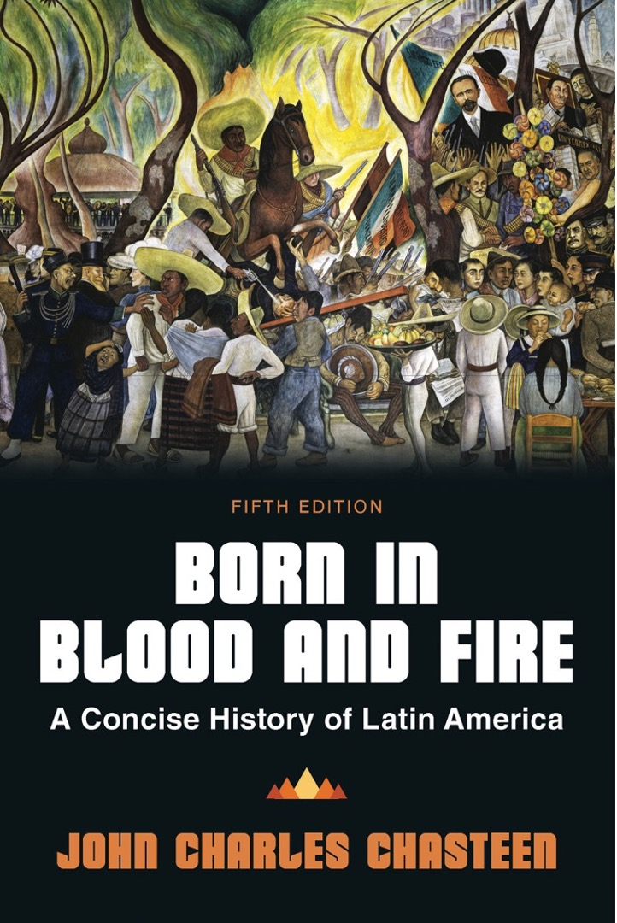
Born in Blood & Fire A Concise History of Latin America 5th Edition
By
John Charles Chasteen
Chapter 3:
Colonial Crucible

Slide 2
Colonial Crucible
Colonization was a process.
African, Indigenous and European descendants
Society
Culture
Psychology

Slide 3
Role of Mining
Mining shaped economics and organization.
Gold
First precious metal sought by Europeans
From Aztec and Inca, treasures were quickly exhausted
Helped destroy Arawak population
Silver
Mines opened in 1540s
Zacatecas (Mexico)
Potosí (Peru)
Mingling of indigenous and European peoples
Created primary export and secondary supply activities

Slide 4
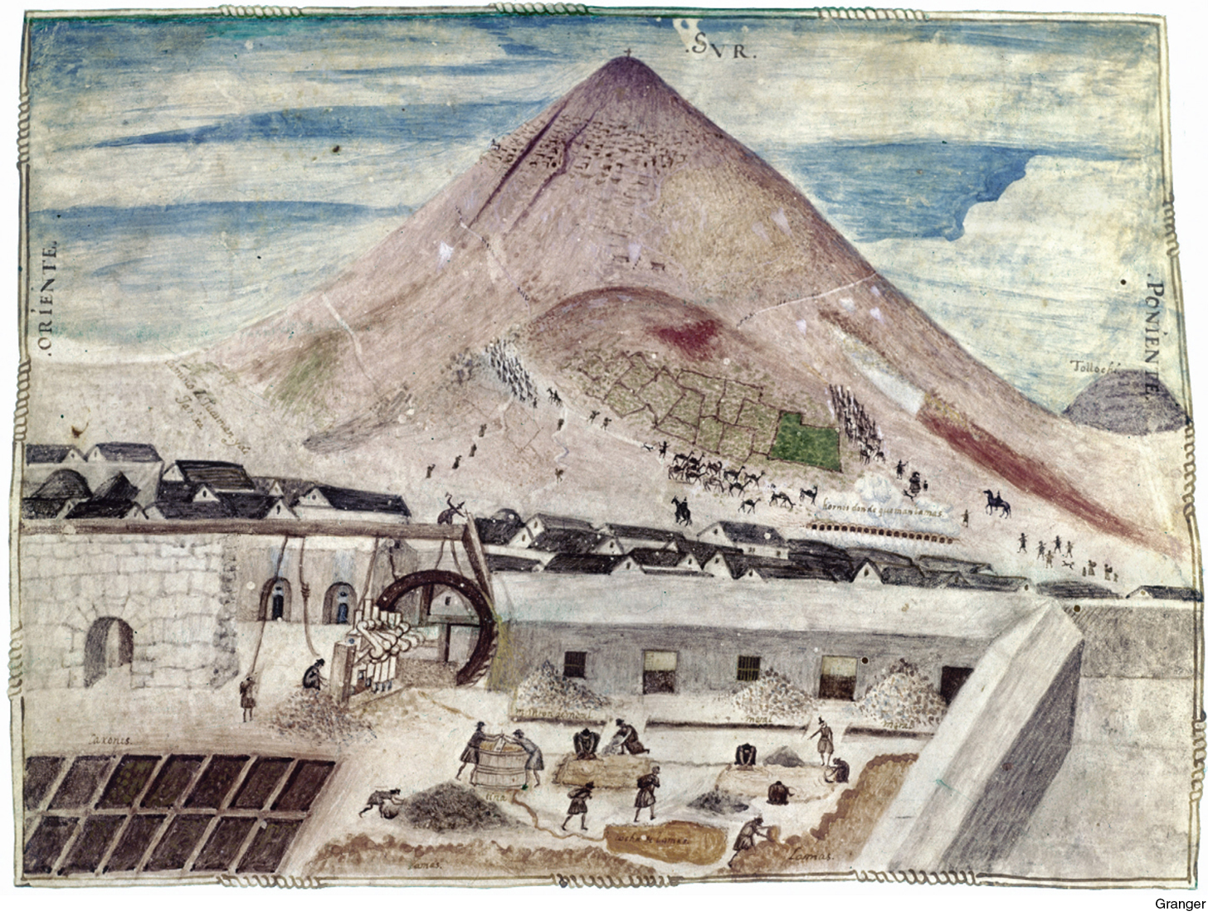
Potosí
Born in Blood and Fire, Fifth Edition
Copyright © 2024 W. W. Norton & Company
Notes:
POTOSÍ. Honeycombed with mine shafts, the “mountain of silver” looms over the city of Potosí in modern Bolivia—called Upper Peru at the time of this 1584 painting. In the foreground, silver ore is being crushed by water-powered machinery and mixed with mercury to extract the precious metal. The Granger Collection, New York.

Slide 5
Colonial Economics
Economic priorities of Spanish crown shaped political organization.
The “royal fifth”
Colonial governments organized into viceroyalties to secure tax.
“New Spain”
“Peru”
“New Grenada”
“Rio de la Plata”
Peru and New Spain (Mexico) remained the center of Spanish colonization.

Slide 6
Sugar
Sugar: central economic activity of Brazil
Rich soil in northeast Brazil
Pernambuco and Bay of All Saints
Taxes on sugar = income for Portuguese crown
Sugar shapes society.
“Mill Lords” – senhores de engenho
Hundreds of enslaved on each plantation
Plantations undercut the growth of urban centers.

Slide 7
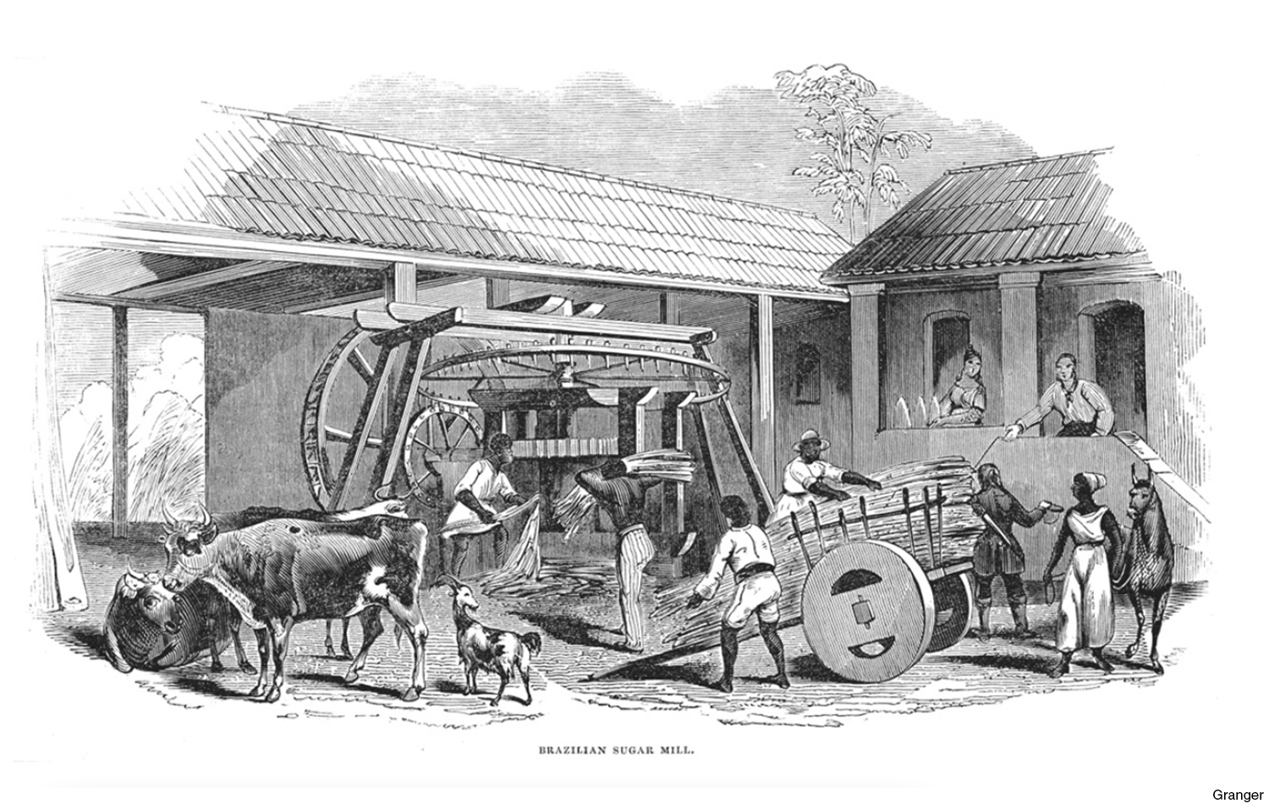
A Brazilian Sugar Mill
Born in Blood and Fire, Fifth Edition
Copyright © 2024 W. W. Norton & Company
Notes:
A BRAZILIAN SUGAR MILL. In this nineteenth-century engraving, sugarcane is being unloaded from an oxcart and fed into an engenho’s grinding mechanism, producing gallons of sweet sap that will be boiled down into bricks of sugar for shipment. The senhor de engenho looks on. The Granger Collection, New York.

Slide 8
Brazil
Brazil remained less populous and profitable than Spanish America.
Outside of the Northeast, Brazil was sparsely settled.
Portugal focused on profitable outposts in Africa and Asia.
More loosely governed by viceroys

Slide 9
Silver
Linked Latin America to the Pacific World
Trade with Asia between Acapulco and Manila (Philippine Islands)
Voyages made by “Manila Galleons”
Traded Mexican silver for Chinese porcelain and silk (among other items)
Brought in Asian migrants to Latin America
Pacific ports such as Lima also participated
Exchange impacted Asian diets and Latin American fashion

Slide 10
A Power Called Hegemony
Does not rely on force
Some consent
Resilient, powerful, damaging to bottom
Convinces people to accept inferior place
Sor Juana Inés de la Cruz

Slide 11
Hegemonic Forces: Religion
Catholic church was means of European control
“Divine right”
Close relationship between religious and royal authority
Church was omnipresent in colonial life.
Controlled educational institutions
Calendars structured daily life
Sacraments marked life events
Towns and cities named for saints; each had patron saint

Slide 12
Hegemonic Forces: Patriarchy
Fathers ruled at all levels of colonial society.
Iberian concepts of honor, for men:
Defending daughters’ virginity
Sexual exclusivity of wives
For women, honor dictated avoiding extramarital contact with men.
Independent-minded women were targeted.
Women often resisted.
Spanish and Portuguese Inquisition were often used against women.

Slide 13
Transculturation
New Latin American cultures emerged from the interaction of European, African, and Indigenous peoples.
Power relations
Give and take
Religion
The church had great power.
Resistance occurred in spiritual sphere.

Slide 14
Town and Country
Cities
Colonial governance existed in cities.
Many Indigenous people migrated to urban areas.
Urban slaves had greater freedom.
Slaves and free blacks worked as artisans, often alongside poor whites.
Rural areas
Plantation slaves were highly restricted and isolated.
Rural Indigenous people lived more separately.
Whites were also more isolated.

Slide 15
Transculturation and Power
Transculturation was a blessing and a curse for subjugated groups.
Virgin of Guadalupe
Garcilaso and Guaman Poma
Antonio Vieira
Transculturation and hegemony often went hand-in-hand.

Slide 16
Fringes of Colonization
Fringes lay outside economic centers of colonies.
More sparsely populated
Less economic stratification
More subsistence living
Not much to export
Those at the bottom of the hierarchy became more important.

Slide 17
Paraguay: Case Study
Missions for conversion of indigenous people
Remote and landlocked
Became permeated by Guaraní influence

Slide 18
Rio de la Plata – “River of Silver”
Less isolated than Paraguay
Cattle ranching economy
Ongoing raids by indigenous societies
Abundance of cattle and horses

Slide 19
Fringes of Colonization: Chile
Isolated despite huge coastline
Subordinate to viceroyalty of Peru
Chile could not offer settlers many indigenous servants.
Grew wheat to supply Peruvian mines

Slide 20
Elsewhere on the Fringe
Spanish fringe areas were often cattle frontiers.
Gauchos (Rio de la Plata), guasos (Chile), vaqueros (Mexico)
Many Caribbean islands remained as fringe area.
New Granada was a complex mix.
Dense populations of fully sedentary indigenous people
No silver mines
Rain forests and cattle frontier

Slide 21
Fringe Economic Boom
Rio de la Plata found European markets for cattle hides.
Cuba and Venezuela found plantation crops.
Cuba = sugar and coffee
Venezuela = cacao
Caribbean plantations produced a huge influx of slaves.

Slide 22
Brazilian Fringe
Portuguese colonial settlement focused on coastal regions.
Missions were chief representatives of Iberian control.
Cattle ranching
São Paulo
Bandeirantes

Slide 23
Gold Boom
Growth of inland settlements
Influx of slaves to mines
“Royal fifth”
Cities built near mines
Vila Rico de Ouro Preto
Minas Gerais
Financed art of Aleijadinho
Aided the economic integration of Brazil

Slide 24
Late Colonial Transformations
In the 1750s, Iberian crowns seek to tighten control.
Bourbon or Pombaline reforms
Effort to rationalize and modernize overseas government

Slide 25
Late Colonial Reforms
Raised taxes
Improved administration to collect taxes
State-controlled monopolies oversee trade and production.
Limited European products
Loosened shipping restrictions but asserted trade exclusivity

Slide 26
Reaction in the Americas
Taxes fell on poorest
Monopolies increased prices
Unemployment
Widespread economic revolts and protests
Native-born Spanish Americans and Portuguese Americans had the most at stake.
Lost influence in a range of ways

Slide 27
Racial Mixing
Social and professional interaction
Occupied the middle tier of the social ladder
Intermarriage and consensual partnerships were common among the lower class.
Xica da Silva

Slide 28
Caste System
Fixed categories corresponding to race
Categories accounted for, and ranked, racial mixtures
European
African
European-African
European father–indigenous mother
Indigenous-African
Indigenous

Slide 29
New Categories of Race
Intermarriage between groups created new categories.
Caste paintings were commissioned to illustrate categories.
Spanish crown began selling gracias al sacar.

Slide 30
Colonial Rebellions
Aftershocks of conquest
Rebellion of Gonzalo Pizarro
Indigenous revolts, 1500–1800
Rebellions against Bourbon Reforms
Mostly economic rebellions
Uprisings created cross-caste alliances.
Rebellions often claimed loyalty to the king, against bad government

Slide 31
Colonial Rebellions (cont’d)
Quilombos and Palenques
Palmares in Brazil
Called palenques in Caribbean
French-style conspiracies in Brazil
Republican ideas inspire some Brazilians.
Conspiracy in Ouro Preto
Tailors’ Rebellion in Bahia

Slide 32
Rebellion of Tupac Amaru II
1780–1783
Mestizo Tupac Amaru II
“Anti-Peninsular”
Called for alliance between American-born whites, mestizos, and indigenous
Primarily indigenous
Tupac Catari
Killed perhaps 100,000
Affected behavior of Peru’s elite

Slide 33
This concludes the PowerPoint presentation for Chapter 3: Colonial Crucible
For additional resources, visit https://digital.wwnorton.com/bornfire5

