Slide 1
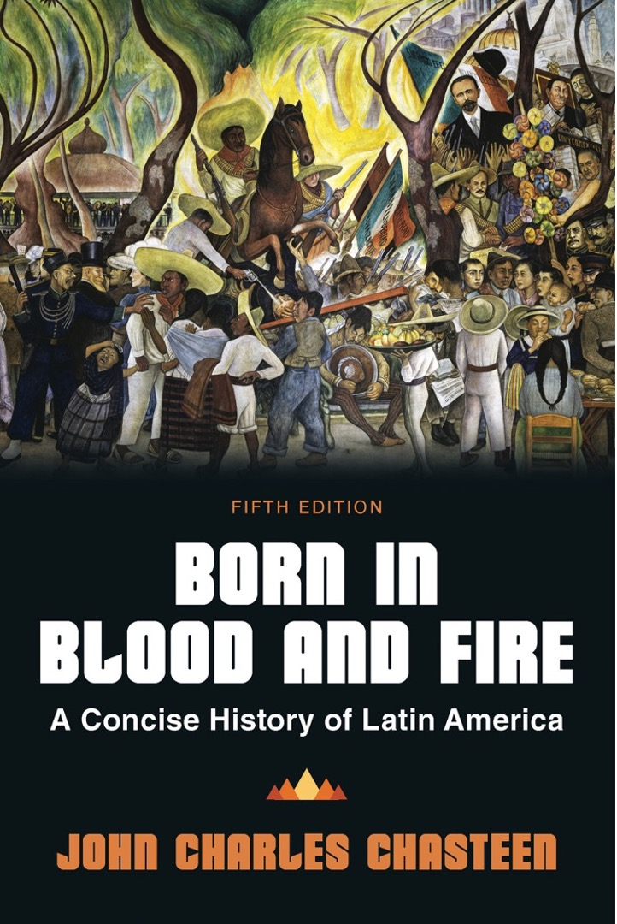
Born in Blood & Fire A Concise History of Latin America 5th Edition
By
John Charles Chasteen
Chapter 4:
Independence

Slide 2
Independence
Sudden and unexpected
Course of fighting shaped societies that would emerge as independent nations
Led to the creation of a dozen of the world’s first constitutional republics
Required a sense of belonging and shared purpose

Slide 3
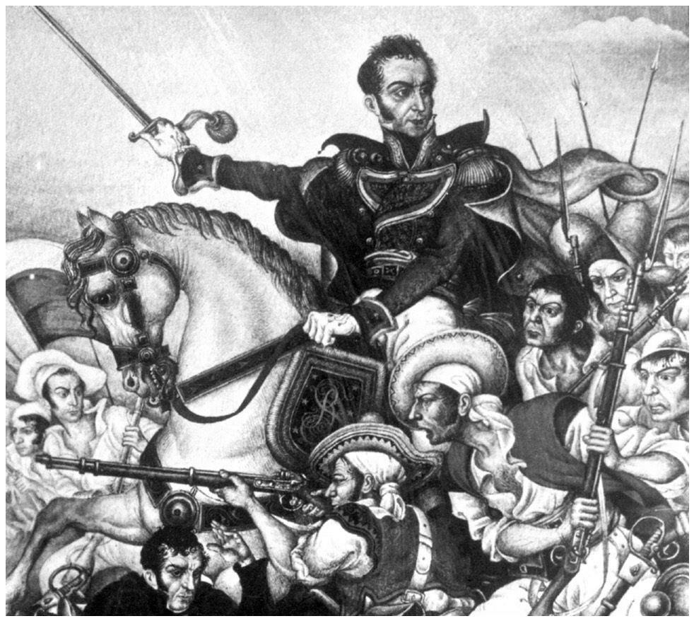
The Liberator, Simón Bolívar
Born in Blood and Fire, Fifth Edition
Copyright © 2024 W. W. Norton & Company
Notes:
THE LIBERATOR SIMÓN BOLÍVAR. Bolívar, who helped create five nations, was the single greatest general of independence. Bolívar was from Caracas, the son of a plantation-owning family who gave him a privileged education–including a European walking tour with his brilliant tutor, Simón Rodríguez, a man afire with new ideas. But white, upper-class generals like Bolívar could not win in­de­pen­dence without the support of Latin America’s nonwhite majority. Courtesy of Hulton Getty Picture Collection.

Slide 4
Spanish Rule
The incompetent rule of Carlos IV in Spain
Shirked duties of governance
Allowed a hated minister to rule
Costly wars bankrupted the government
War with England 1796
Portugal remained allied with England

Slide 5
Revolution and War in Europe (1/3)
The French Revolution
Challenged monarchy based on divine right
Executed king and queen
Argued for popular sovereignty
Napoleon set out to “liberate” Europe.

Slide 6
Revolution and War in Europe (2/3)
England
Liberal reforms
Elected legislature, limited monarchy
Allied against Napoleon

Slide 7
Revolution and War in Europe (3/3)
Portugal
1807: Portuguese refused to declare war on England.
France invades in response.
Prince João, royal court flee to Rio de Janeiro.
Spain
Carlos IV and his heir imprisoned by Napoleon.
Napoleon places brother Joseph on throne of Spain.

Slide 8
Portuguese Court in Brazil (1/2)
Maintains legitimacy of government
Crown inspired obedience
Royal court now operating within Brazil
Wealthy Europeans flood Rio de Janeiro

Slide 9
Portuguese Court in Brazil (2/2)
Presence of court favors Brazilian elite
New wealth
Access to the King’s ear
João ends Portuguese trade monopoly
Brazil allowed to trade with other powers

Slide 10
Spanish Crisis
Imprisonment of King creates legitimacy crisis
Central Junta
Chosen entirely from within Spain
No representation of Spanish Americans
Spanish Americans reject rule of Junta
Constitution of Cadiz

Slide 11
Spanish American Rebellions
Who were the rebels?
Creole patriots
American-born whites
In 1700s, growing resentment toward privilege of Peninsular Spanish
Nonwhites care little for rivalry at top
Resentment directed at Creoles
Creoles kept people of mixed-race down.
Plenty of reasons to rebel, but not against Peninsulares

Slide 12
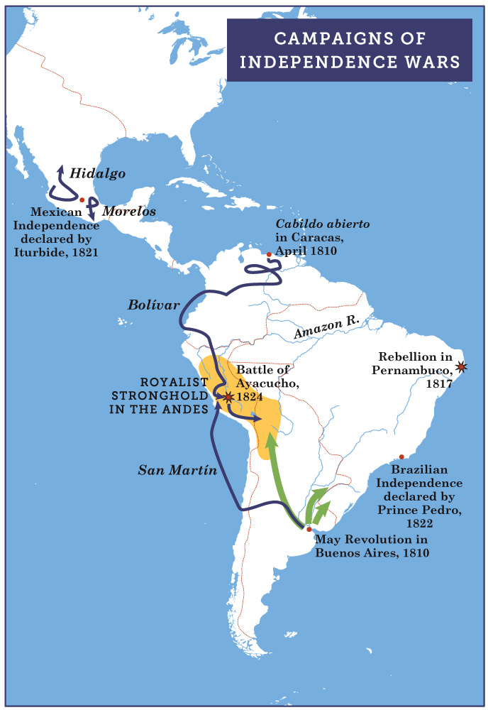
Campaigns of Independence Wars
Born in Blood and Fire, Fifth Edition
Copyright © 2024 W. W. Norton & Company
Notes:
CAMPAIGNS OF INDEPENDENCE WARS

Slide 13
Mexican Independence
Background to rebellion
Most profitable colony
Peninsulares were only 1 percent of population.
Creole resentment ran high.
1808 cabildo of Mexico City
Representative assembly to rule for Fernando VII
Peninsulares unseated viceroy
1810 Creole conspiracy in mining regions sparks rebellion of indigenous and mestizo peasants.

Slide 14
Father Miguel Hidalgo
Nonconformist intellectual priest
Declared need to defend Mexico against Peninsular usurpers of Fernando VII’s authority
Poor, rural people joined rebellion
Weapons were farming tools.
Peninsulares and Creoles were killed in large numbers.
Undisciplined and out of control
Army dispersed after few months
Hidalgo was captured and executed.

Slide 15
Father José María Morelos
Officer in Hidalgo’s rebellion
Mestizo
More organized and disciplined army
Clear goals
Declared Mexican independence in 1813
Attracted few Creoles
Morelos was captured and executed.
Small bands of rebels continued fighting colonial rule.

Slide 16
Peru’s Slower Start
Creoles were wary of mobilizing the indigenous population due to the history of Tupac Amaru II.
Remained relatively quiet as rebellions began elsewhere

Slide 17
Creoles
Creoles need support from below to win independence.
The exploited majority was uninterested in or unaware of Republicanism or liberal ideas.
Creoles had little interest in changing a social hierarchy they dominated.

Slide 18
Nativism
American identity based on birthplace
All born in Americas were Americanos
Joins classes and races against Spanish
Emotionally appealing, mobilized anti-foreign resentments
Few Creole patriot leaders wanted actual equality.
Needed to mobilize support
Intended to replace Peninsulares

Slide 19
Brazilian Independence
Discontent begins
Royal court in Brazil was expensive.
Unpopular and costly war with Spanish neighbors
João restricts slave trade
Moves toward independence
Influx of foreigners
1817: attempted liberal revolution in Pernambuco

Slide 20
Portuguese Response
Portuguese actions
Assembly demands João’s return
João declares Brazil a kingdom.
Assembly wants Brazil returned to colonial status
João returns to Lisbon in 1821.
Leaves Prince Pedro in Rio
Rio control falters
Several provinces create liberal juntas.
Send their own representatives to Lisbon

Slide 21
Political Antagonisms
Brazilian Party
Rio de Janeiro elites form party to resist recolonization
Uses nativist rhetoric
Independence
Portuguese demand Pedro return to Lisbon.
Pedro refuses to return.
Declares Brazilian independence
Calls for representatives to write a constitution
Portuguese army resistance quickly defeated

Slide 22
Return of Fernando
Napoleon is defeated at Waterloo.
Fernando returns to power.
Renounces constitution of Cádiz
Sets out to crush Spanish American rebellions
Rebels forced to commit to independence.

Slide 23
“Fringe Colonies”
Argentina and Venezuela
Creoles were less cautious.
Both countries had horses and horsemen.
Cabildos abiertas in Caracas and Buenos Aires
“Taking off the mask of Fernando”

Slide 24
Patriot Victories in Mexico
Mexico
Morelos’s armies fight, unable to defeat Royalists
1820: Fernando faces revolt.
Creole-guerrilla alliance
Creole army under Agustín de Iturbide allies with Vicente Guerrero, leader of guerrilla movements.
The monarchical solution
Iturbide
Rule lasted one year before he was ejected
Republic established afterward

Slide 25
United Army
Armies from Venezuela and Argentina converge on Peru.
Simón Bolívar
“The Liberator”
Involved in Venezuelan independence from the start

Slide 26
Simón Bolívar
Participated in Venezuelan independence struggle
Convinced royalists to fight for independence causes
Captured the viceregal capital of Bogota
By 1822, his forces controlled all of northern South America.
Captured Caracas and Quito

Slide 27
José de San Martín
Led combined Argentine-Chilean army
Crossed Andes to surprise Spanish
Captured Chilean capital
Marched north to Lima
Unable to complete victory in Peru

Slide 28
Final Battles
Meeting in Guayaquil
San Martín and Bolívar meet.
Confidential discussions
San Martín returns to Chile.
Bolívar prepares final assault on Spanish power.
Final battles
Bolívar takes two years to equip an army.
1824: liberates two more countries
Only Cuba and Puerto Rico remained Spanish.

Slide 29
Unfinished Revolutions (1/2)
Creoles took control of new republics.
Postcolonial: independent, but still shaped by colonialism
Hierarchy did not change except at the top.
Patriarchy was unchanged.

Slide 30
Unfinished Revolutions (2/2)
Patriot women became powerful symbols.
Manuela Beltrán
Juana Azurduy
Policarpa Salavarrieta
Leaders become disillusioned.
Bolívar believes Spanish Americans are unfit for government.
Becomes authoritarian
Nativist rhetoric created expectations for social change among lower classes.

Slide 31
Foreign Travelers
Foreign travelers to Latin America after independence
Missionaries
Business
Scientists

Slide 32
Foreign Commerce
Explosion of foreign companies in Latin America
Sixty British firms were established in Rio de Janeiro, twenty in Lima and thirty-four in Mexico City and Veracruz.
In 1833, Brazil is Great Britain’s third largest market.
French, British, and US individuals were attracted by exoticism of Latin America.
Many brought scornful, arrogant attitudes.

Slide 33
Frances Calderón de la Barca
Scottish woman married to Spanish diplomat in Mexico City
Called Mexico City “one of the noblest-looking cities”
Wrote sympathetically on religion, indigenous peoples
Critiqued lack of education for women

Slide 34
Distorted Archive
Travelers’ accounts offer subtle problems for historians.
Example: multiple view of wet nurses in Brazil

Slide 35
This concludes the PowerPoint presentation for Chapter 4: Independence
For additional resources, visit https://digital.wwnorton.com/bornfire5

