Slide 1
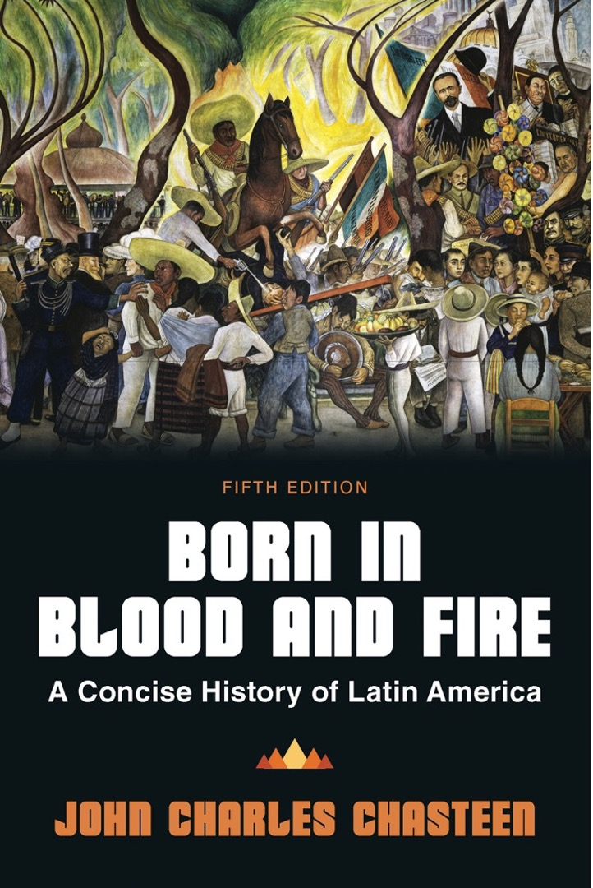
Born in Blood & Fire A Concise History of Latin America 5th Edition
By
John Charles Chasteen
Chapter 5:
Postcolonial Blues

Slide 2
Postcolonial Blues
First governments of Latin America
Few resources and many obstacles
Postcolonial hierarchies
Economic stagnation imperiled idealistic hopes of American patriots.

Slide 3
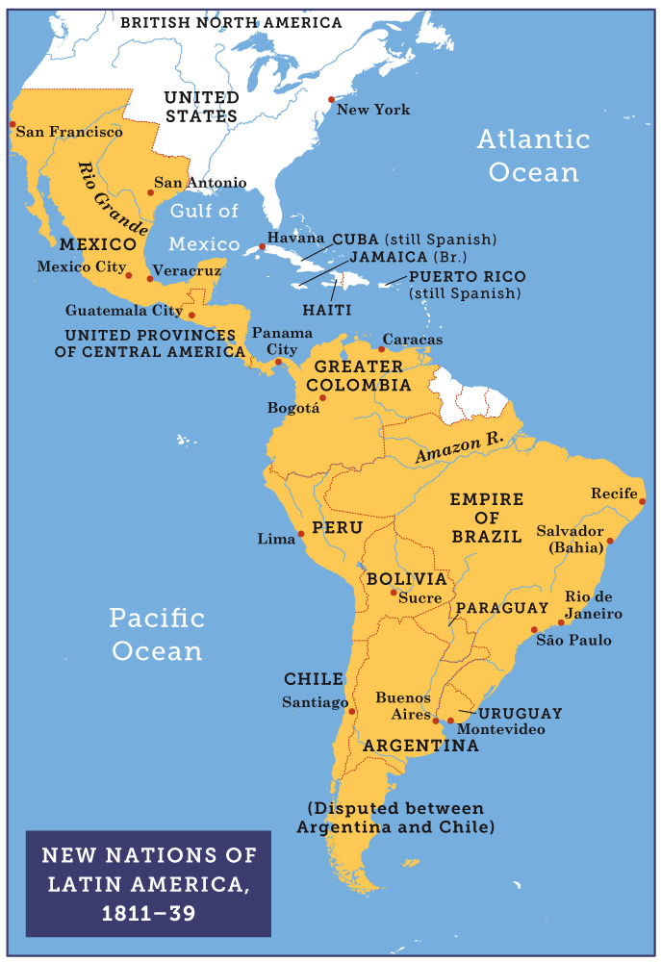
New Nations of Latin America, 1811–39
Born in Blood and Fire, Fifth Edition
Copyright © 2024 W. W. Norton & Company
Notes:
NEW NATIONS OF LATIN AMERICA, 1811–39

Slide 4
Liberal Disappointment
Promise of legal equality for all races
Caste classifications were removed from census forms and parish records.
White leaders still looked at mixed-race populations as a problem.
Strongly traditional societies
Collective over individual
Religious orthodoxy over freedom
Hierarchy with exploitative labor system

Slide 5
Defending Tradition
Conservative leaders emerged in defense of traditional values.
Keep common people in “their place”
Rule by elites
Conservative ideas appealed to many common people.
The liberal-conservative divide shaped Latin America.
Liberal Party/Conservative Party conflict
Centerpiece of electoral debates in new republics

Slide 6
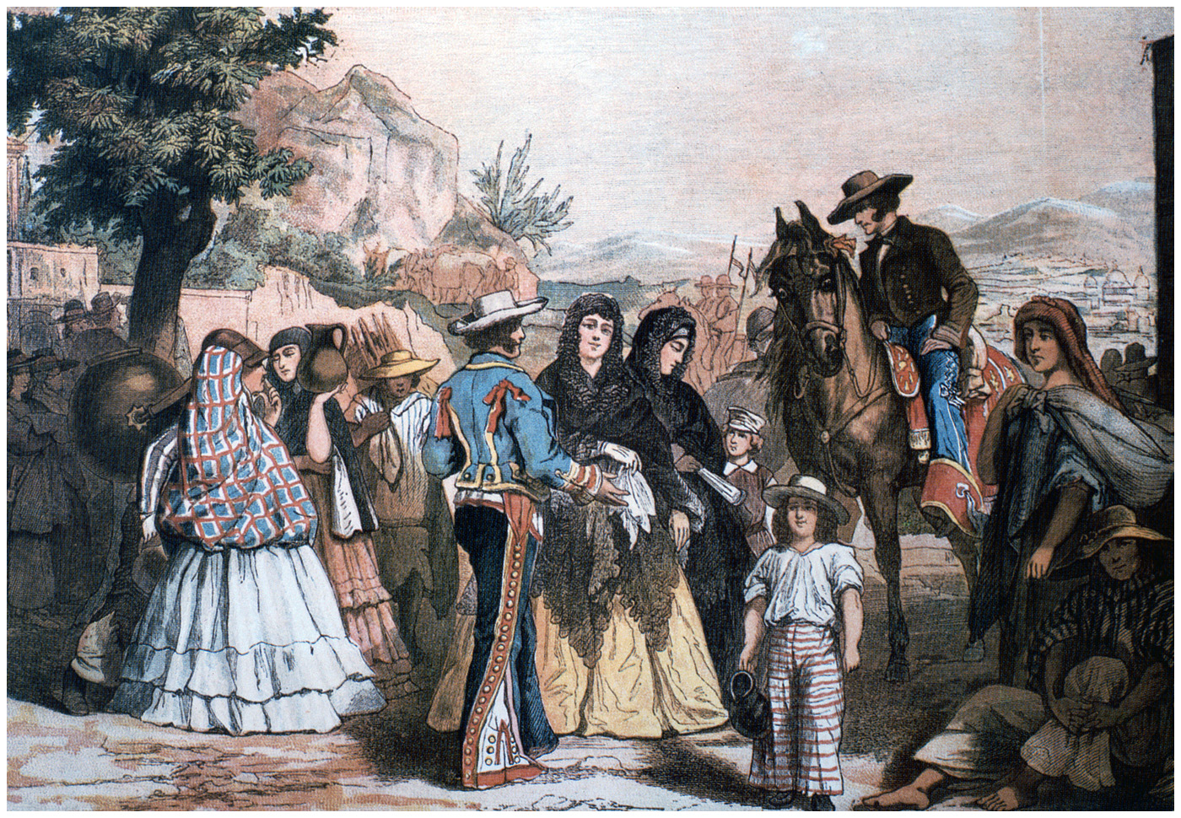
Costumbrismo
Born in Blood and Fire, Fifth Edition
Copyright © 2024 W. W. Norton & Company
Notes:
COSTUMBRISMO. In search of distinctive national identities, costumbrista painting often focused meticulously on clothing presented as “typical,” in this case, of various classes in mid-nineteenth-century Mexico. Biblioteca National de Mexico, Mexico/Bridgeman Images.

Slide 7
Economic Devastation
Wars for independence destroyed economies.
Little capital available
Lack of transportation infrastructure
Struggle to create governing institutions

Slide 8
Fragile Republics
Understaffed governments
Difficult to make people pay taxes
Liberals had no resources for sweeping changes
Collapse of republics
Conservative ascendancy by 1830s

Slide 9
Personal Enrichment
Many politicians viewed government as a means of personal enrichment.
Control of government jobs, pensions, public works through patronage
Reward loyalty
Personal relationships replaced political platforms
“Don Miguel”
Highest patron would be a caudillo.

Slide 10
Caudillo Leadership
Who was a caudillo?
Highest party or faction leader
Frequently large landowners
Use wealth to maintain private armies
Often war heroes
Cultivated common touch—identify with average people
Communicate, manipulate followers
Focus on personal leadership

Slide 11
Examples of a Caudillo
Juan Manuel de Rosas (Argentina)
Antonio López de Santa Anna (Mexico)
José María Obanda (Colombia)
José Antonio Páez (Venezuela)
Central America
Rafael Carrera (Guatemala)
José Gaspar Rodríguez de Francia (Paraguay)

Slide 12
Constitutions
Constitution and republic
Constitutions were constantly rewritten.
Most countries ruled by conservative caudillos.
Federalism broke up large countries.
Greater Colombia = Colombia, Venezuela, Ecuador
Central American Republic = five parts: Costa Rica, El Salvador, Guatemala, Honduras, and Nicaragua

Slide 13
Brazil’s Different Path
Maintained colonial institutions
European monarchy
Church–state link
Embrace of slavery
Stable and prosperous
Provincial governors appointed
Army loyal to emperor
Coffee produced revenue

Slide 14
Liberal Hopes and Disappointments
Pedro I claimed to be liberal; ruled authoritarian.
Pedro became unpopular, giving liberals hope.
Death of his father made Pedro the heir to the Portuguese throne.
Pedro renounced the throne; left it to young son Pedro II (who was 5 years old)
Regents had to rule for son until he came of age.

Slide 15
Regency Years, 1831–1840
Liberals quickly sought to regain greater power.
Liberals needed support of common people.
Nativist rhetoric
Rebelled in four provinces
Slaves became involved in rebellions.
Some elite liberals became afraid.
Prince Pedro elevated to throne at age 14.
Rebuilt imperial army
Canceled other liberal reforms

Slide 16
Continuities in Daily Life
Daily life remained mostly unchanged.
Indigenous people maintained their autonomy.
Subsistence farming
Little contact with republican institutions
Mixed-race peasants
Outnumbered indigenous in some places
Worked as attached workers, or peons
Many cleared forests to tend own plots.

Slide 17
People and Power
Africans and African-descended people
Enslaved in Brazil and Cuba
Devoted to cultivating export crops
Brazil had a record number of African slaves.
Cuba benefitted from the outlawing of slavery in other islands.
Landowners held the most power.
Eliminated merchant guilds to promote free trade
The reliance on agricultural exports gave landowners more clout.

Slide 18
Transculturation
Transculturation encouraged by nativist rhetoric and landowner power.
Mestizo cultural forms gain acceptance.
Distinction between Americanos and Spanish
Folk dances seen as signifiers of national culture
Mexico (Jarabes), Colombia (bambucos)
Latin American literature
Helped create national identity in mid-1800s
Costumbrismo

Slide 19
Nativism and Unrest
Nativism
Expulsion of Spaniards from Mexico
Rosista publicists created Pancho Lugares
Lower-class unrest
Few challenges to elite, Creole authority
Caste War of Yucatán
Bahian slave conspiracy, 1835

Slide 20
Cultural Hegemony
White minority rule
Relied on the idea of “civilization” for control
Connected to Europe
Writing in Spanish and Portuguese
These were the languages of the law.
Most Latin Americans could not read or write in early decades of independence.

Slide 21
Lives of Women
Women excluded from major changes of independence
Achieved fame by connections to powerful men or by breaking gender rules, or both
Domitila de Castro
Encarnación Ezcurra
Camila O’Gorman

Slide 22
Patriarchal Rule
Women remained largely confined to home life.
Poor women worked in homes of elites.
Prostitution was a standard feature of urban life.
Eugenia Castro
Upper-class women were confined by the honor system.

Slide 23
The Caste System
Caste system less rigid
Depended on wealth
Multiple racial categories were collapsing.
Two basic class categories
Mostly white, wealthy at top
“El pueblo” or “o povo” — the people
Upper class defended their position harshly
Strict standards of behavior and fashion
Based on European models

Slide 24
The Power of Outsiders
Latin American republics remained oriented toward England, France, and the United States.
For liberals, these epitomized progress and civilization.
Monroe Doctrine – US called for “European hands off” the Americas
Remained mostly theoretical in the early decades

Slide 25
International Trade
Strong desire for trade with these countries
Peru’s guano boom 1840s
Export of nitrogen-rich fertilizer – seabird manure
Highly prized by European markets
Created foreign investment in Peru
Enriched the state
Profits used to build railroads
Little of the boom reached the sierra beyond Lima.

Slide 26
Diplomacy and Aggression
Gunboat diplomacy
England, France, and the United States sent warships to the region.
Defend trade
Punish governments, often for debt-payment delays

Slide 27
US War on Mexico
The Mexican government allowed slave-holding US southerners to settle in Texas.
After losing at the Alamo, Texas won independence.
It was annexed by the United States in 1845.
Fighting renewed amid Mexican fears of US expansion.
The United States took half of Mexico’s territory, now the West and Southwest.

Slide 28
This concludes the PowerPoint presentation for Chapter 5: Postcolonial Blues
For additional resources, visit https://digital.wwnorton.com/bornfire5

