Slide 1
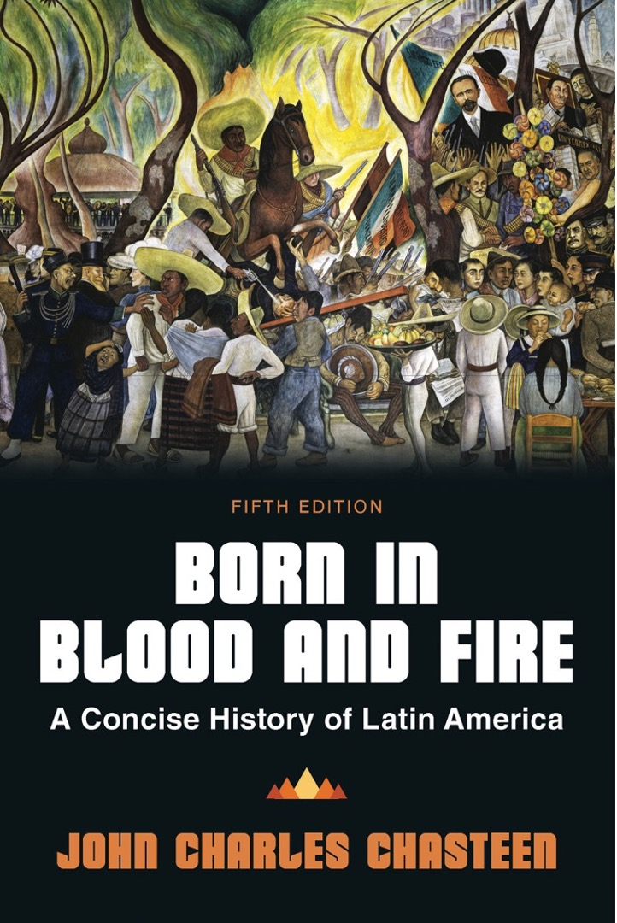
Born in Blood & Fire A Concise History of Latin America 5th Edition
By
John Charles Chasteen
Chapter 6:
Progress

Slide 2
Conservatism
Conservatism was dominant in the aftermath of independence.
After 1850, liberals made a comeback.
They initiated social and economic changes that mobilized them during the struggle for independence.

Slide 3
Rise and Reaction
Conservative ascendance
Promised security, tradition
Ill-distribution of benefits
Those outside patronage system look for change
Liberal reaction
Landowners wanted greater export possibilities.
Urban dwellers wanted public works.
Industrialization in Europe
Increased international investment in Latin America

Slide 4
Transportation Revolution
Steamships overtook old wood sailing ships.
Steam-powered railroad replaces mules and carts.
Mules and carts limited the quantity of exportable material.
Railroads were expensive, but valuable.
Telegraph lines
Allowed instant communication
Carried electricity
1874: transatlantic telegraph connects Brazil to Europe

Slide 5
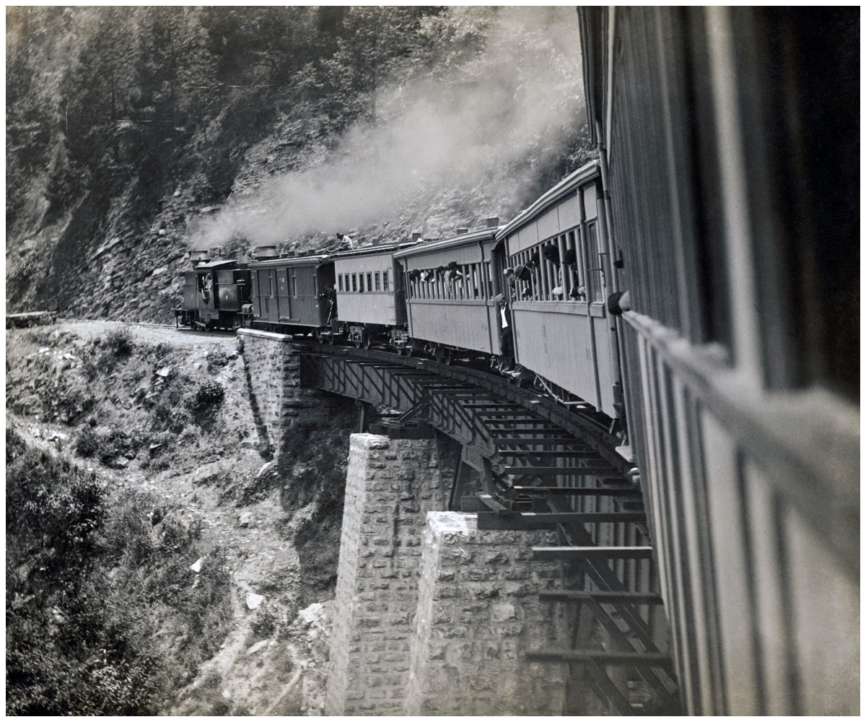
Railroads and Trestles
Born in Blood and Fire, Fifth Edition
Copyright © 2024 W. W. Norton & Company
Notes:
RAILROADS AND TRESTLES created crucial transportation infrastructure for Latin American export economies, in Mexico and elsewhere, in the mid- to late 1800s. AS400 DB/Bettman/Corbis.

Slide 6
Progress
The idea of progress becomes the new hegemonic ideal.
Focused on model, products, culture of Europe
Export earnings could bring in European goods
Fixated on technology
Liberal parties ride this wave to power.

Slide 7
Catholicism
The Church was more powerful in Mexico than anywhere else.
Held vast properties
Chief moneylending institution
Fuero
10 percent of income went to the Church
Ultramontane conservatism
Church turned away from progressive priests
Coming from Rome

Slide 8
Power of Church
Church and politics
Independence articulated in religious language
Church became conservative, liberals became anti-Church
Power of Church was an affront to Progress
Liberals attacked fuero
Unproductive wealth of church
Ultramontane – church conservatism led by priests who refused to accept government control over church affairs
Conservatives adopt rallying cry: “religion and fueros!”

Slide 9
Liberal Ascendance
Reaction against rule of Santa Anna
Juan Alvarez
Melchor Ocampo
Benito Juárez

Slide 10
Liberal Reforms
Juárez Law
Attacked military and ecclesiastical fueros
Lerdo Law
Abolished collective landholding (Catholic Church and Indigenous villages)
Liberals hoped to encourage individual effort and responsibility.
Turned many indigenous against the Liberal Party
Indigenous joined conservatives in defense of tradition

Slide 11
Civil War
A conservative general overthrew the president and dissolved congress.
Juárez was chosen to command liberal forces.
Liberals retake Mexico City.
War bankrupted the state.
It suspended payment of foreign debts.
France, Spain, and Britain retaliated by occupying Veracruz.
Mexican conservatives appealed for the French to stay.

Slide 12
Installing a Monarchy
Conservatives appeal to Napoleon III in search of a monarch.
Maximilian
The French invade Mexico in 1862.
Maximilian installed as emperor in 1864.

Slide 13
Nationalist Reaction
Juárez leads nationalist reaction.
More convincing nationalist leader
United States aids Juárez, threatened by French incursion in the Americas
French withdraw troops.
Maximilian is captured and executed.
Juárez becomes president
Conservatives are permanently discredited.
The Church never regains past power.

Slide 14
Liberal Trend in Colombia
Liberals attack the church with independence.
Conservative post-independence surge
Reinstates Catholic Church privileges
Brings back Jesuits
Liberal resurgence in 1850s
Anticlerical moves again
Throws out Jesuits again
Tomás Cipriano de Mosquera

Slide 15
Liberal Trend in Chile
Very different from Mexico
Politics marked by conservative stability
Only three presidents in three decades
Joaquín Prieto, Manuel Bulnes, Manuel Montt
Mapuches are not part of national society.
Liberals attacked traditional Church-State connections.
Liberals remained in control for three decades.
Significant modernization projects

Slide 16
Liberal Trend in Central America
Followed similar path as other Latin American states
Guatemala, El Salvador, Costa Rica, and Honduras all joined liberal swell.
Only Nicaragua resisted.
Nicaraguan liberals invited foreign intervention.
William Walker

Slide 17
Limits of Progress for Women
In mid-1800s, women saw few benefits from liberalism.
Education expanded very slowly.
Still confined to home life
Few occupied leading roles in public life.

Slide 18
Women and Writing
A few women achieved fame through writing.
Gertrudis Gómez de Avellaneda
Juana Manuela Gorriti
Clorinda Matto de Turner

Slide 19
Models of Progress
Argentine liberal leaders exemplify European obsession, focus on written culture
Juan Bautista Alberdi
Bartolomé Mitre
Domingo Faustino Sarmiento

Slide 20
Scientific Racism
Liberals accepted European scientific racism as well.
They viewed racial mixing as a national tragedy.
Sarmiento derided Argentina’s gauchos as subhuman.

Slide 21
Brazilian Liberalism
Society was not well-suited to liberal thinking.
Monarchy
Slavery
Mixed-race population

Slide 22
Catalyst for Change
The Triple Alliance War becomes the catalyst for change.
1865–1870
Argentina, Brazil, and Uruguay defeated Paraguay.
War created disillusionment in Brazil.
Called up hundreds of thousands of volunteers to fight Paraguayan “tyranny”
War was in the service of liberalism and civilization.
Caused many to question Brazilian civilization

Slide 23
Re-emergence of Liberalism
Liberalism re-emerged.
Elite Brazilians believed Brazil was unready for democracy.
Emperor Pedro II argued that Brazil was backward.
In the 1860s, many conservatives broke away to join the liberals.
Pedro II sided with the conservative military commander against the liberal prime minister during the Triple Alliance War.
Infuriating liberals

Slide 24
Manifestos of Liberalism
Liberal manifesto of 1869
Calls for democratic reform
Gradual emancipation of slaves
More radical group issues second manifesto
Demands limitations on emperor’s power
Immediate abolition of slavery
Third manifesto in 1870
Calls for ouster of the emperor
End of slavery
Creation of Brazilian republic

Slide 25
March of Progress
1871, “free birth” law
Conservative governments ruled, but progress caught on.
Joaquim Nabuco becomes leading abolitionist.
Pedro’s daughter Isabel signs “Golden Law” of freedom in 1888.
Brazilian monarchy collapses in 1889.

Slide 26
International Wars (1/2)
Wars have been rare but catalyzing events in Latin America.
Mexican-American War
Triple Alliance War

Slide 27
International Wars (2/2)
Chaco War (1932–1935)
Paraguay fought Bolivia over the Chaco.
War emerged after oil discovered.
Paraguayan victory doubled national territory.
Bolivia
Defeat was third defeat on Pacific coast
War of Peruvian-Bolivian Confederation (1836–1839)
War of the Pacific (1879–1884)

Slide 28
This concludes the PowerPoint presentation for Chapter 6: Progress
For additional resources, visit https://digital.wwnorton.com/bornfire5

