Slide 1
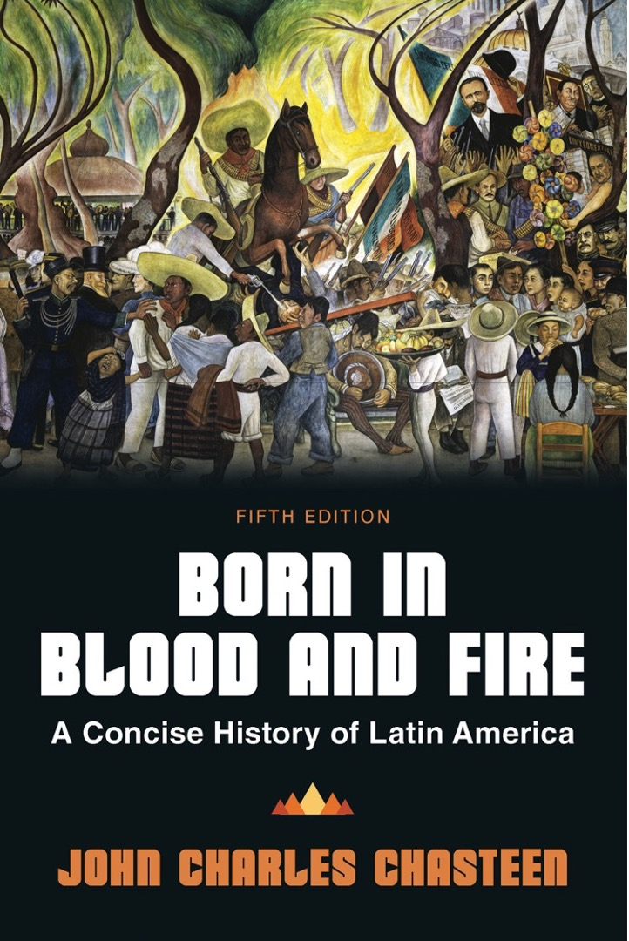
Born in Blood & Fire A Concise History of Latin America 5th Edition
By
John Charles Chasteen
Chapter 7:
Neocolonialism

Slide 2
Embracing Progress
Countries that were models of modernity installed it in Americas.
Foreign investment and influence became more powerful.
1880–1930: neocolonial period

Slide 3
The Great Export Boom (1/2)
More than half century of rapid, sustained economic growth
Mexican trade increased 900 percent.
By 1900, Brazil produced two-thirds of coffee.
Cuba’s sugar production reached 5 million tons by 1929.

Slide 4
The Great Export Boom (2/2)
Chilean nitrates, copper, iron worth hundreds of millions
Argentina’s wheat exports increased 1,000 times by 1900.
Smaller countries had their own version of an export boom focused on specific products.

Slide 5
New Infrastructure
Increase in railroads integral to boom
Beneficiaries were large landowners and urban merchants.
Land values soared with railroads.
Merchants and workers with secondary functions in import/export economy
The middle class grew rapidly.

Slide 6
Who Benefits?
The majority of Latin Americans saw no benefit from progress.
Railroads pushed peasants off land in Mexico.
Displaced peasants = employees of landowners
Indigenous people with communal land in Mexico now forced out by landowners.
Only 3 percent of Mexicans owned land in 1910.
Most lived as peons on rural haciendas.
Lost land that they had used for centuries for subsistence farming
Landowners pushed vagrancy laws, forcing more people to work.

Slide 7
Argentina’s Boom
Italian immigrants served as labor for wheat production.
Gauchos vanished from pampa.
Trade in chilled beef more profitable than dried beef.

Slide 8
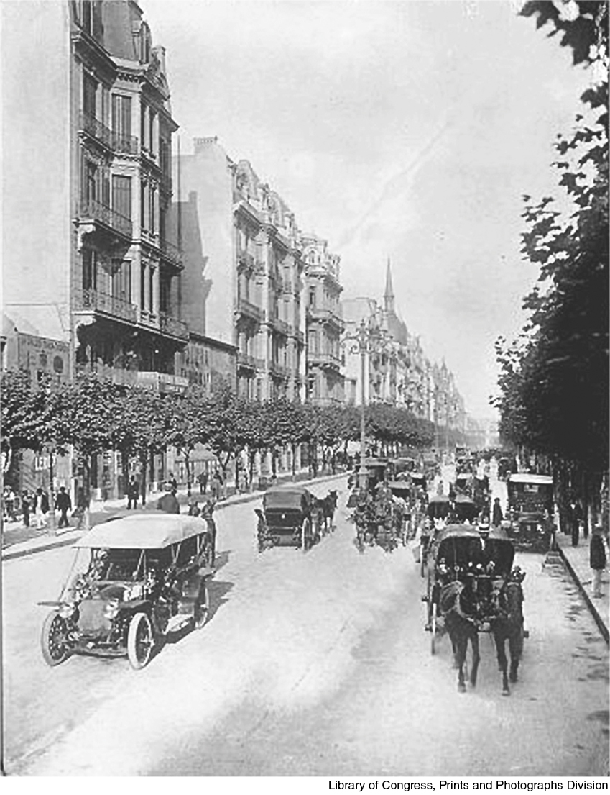
La Avenida de Mayo
Born in Blood and Fire, Fifth Edition
Copyright © 2024 W. W. Norton & Company
Notes:
LA AVENIDA DE MAYO. Completed in the 1890s, the spacious main avenue of downtown Buenos Aires was flanked by impressive buildings in a variety of modern styles. It exemplified the transformation of capital cities in neocolonial Latin America. Library of Congress, Prints and Photographs Division.

Slide 9
Coffee Boom
Coffee booms in the tropics.
European immigrants needed in Brazil after the abolition of slavery.
El Salvador, Guatemala and southern Mexico
Family farms grow some crops profitably.
Contributed to a rural middle class in Colombia, Costa Rica, and Puerto Rico

Slide 10
Sugar and Mining
Massive, industrialized operations
Divided societies into rich and poor
Sugar dominated in northern Brazil, coastal Peru, and Caribbean.
Mining in Mexico, Peru, Bolivia, Chile
Usually foreign owned

Slide 11
Rubber Boom in Amazonia
Latex sap used in United States for tires
Rubber trade produced huge profits for international traders.
In 1910, rubber accounted for a quarter of Brazil’s export earnings.
Rubber boom ravaged indigenous communities.
By 1920s, Malaysian rubber undercut price, killing the Amazon industry.

Slide 12
Bananas
US companies came to Caribbean basin in the 1880s–1890s.
Creation of the United Fruit Company
Banana companies had far greater economic power than host countries.
“Banana Republics”
Contributed little to the development of host nations

Slide 13
Migration to Cities
Cities remained small.
Migration from countryside and overseas
Commercial, administrative, service centers
Landowners spent export profits in cities.

Slide 14
Education
Education was important to landowning families.
Most studied law.
Intended for politics
Urbanization meant education
Education opened doors to mixed-race people.
Joaquim Maria Machado de Assis
Rubén Dário

Slide 15
“Order and Progress”
Democracy takes back seat to export growth and progress.
“Scientific rule” by “best and brightest”
“Positivism” prescribes authoritarian rule for order and progress.
“Order and progress” becomes slogan on Brazilian flag.

Slide 16
Authoritarian Rule
Government becomes more orderly.
Tax revenue increases
National armies and police receive modern weapons, training
European military advisers
Railroads and telegraphs
Increased revenue increases size of government.
Greater stability attracts foreign investment.
Stable, authoritarian governments become the norm.

Slide 17
Managed Elections
Keep rural majorities from influencing politics
Tug of war between patronage networks
Powerful named election officials
Many ballots per person
Landowners controlled votes of clients.
Authorities disqualified rival’s clients from voting.
Corruption protested, difficult to thwart

Slide 18
Oligarchies and Dictatorships
Oligarchies
Rule by few
Narrow ruling class of economic elites
Dictatorships
Rule by powerful individual
Sometimes supported by managed elections

Slide 19
Porfirio Díaz
Ruled Mexico from 1876 to 1911 – time period known as the Porfiriato
Epitome of neocolonial dictatorships in Latin America
Allowed elections but only his candidates won
Created technological advances in urban areas
Founded rurales, to secure rural areas for foreign investors
Allowed significant foreign investment

Slide 20
Neocolonial Brazil
Oligarchic
Decentralized federation of twenty states
São Paulo and Minas Gerais
Resistance in northeastern Brazil
Peasants rioted
Burned records and archives used to evict families who had no title to land
Bandits with Robin Hood reputations became folk heroes.
Tradition of wandering holy men
Canudos

Slide 21
Neocolonial Colombia
1860–1880
Emerged slower as a major exporter
Oligarchical rule with managed elections
Lack of success in international trade due to terrain
1880–1930
Conservative party in control
Restored Catholic Church
Created centralized system
Coffee and tobacco as primary exports

Slide 22
Feminism
Rise of feminist movements
Feminist movements emerge where international influence was greatest.
Patriarchy was largely unchallenged in rural areas.
Many feminist leaders had non-Iberian surnames.
Paulina Luisi of Uruguay
Berta Lutz of Brazil

Slide 23
Colonialism
Until the late 1800s, Britain was most powerful in Latin America.
Military exploits were limited.
Commercial and financial expansion
US involvement began to displace British in 1890s.
Latin America as a market
Military expansion into Latin America

Slide 24
US Intervention in Cuba
In 1898, United States declares war on Spain and intervenes in Cuba.
Outcome of the war benefits US economic and strategic interests.
Seizure of Cuba, Philippines, and Puerto Rico
Platt Amendment

Slide 25
US Foreign Policy
Theodore Roosevelt
War in Cuba boosted political career
As president, acquired US base in Panama
US attitudes toward Latin Americans shaped by racial prejudice.
Rudyard Kipling’s “white man’s burden”
Roosevelt Corollary
US newspapers caricature Latin American nations
Intervention needed to discipline Latin America

Slide 26
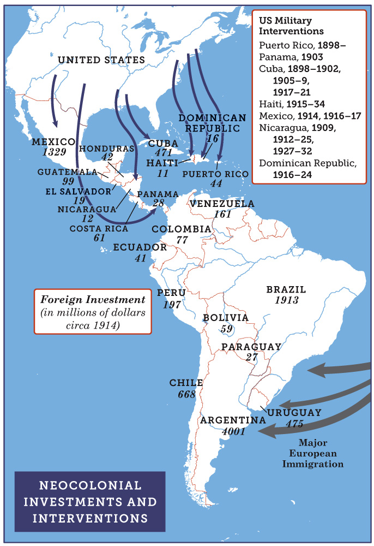
Neocolonial Investments and Interventions
Born in Blood and Fire, Fifth Edition
Copyright © 2024 W. W. Norton & Company
Notes:
NEOCOLONIAL INVESTMENTS AND INTERVENTIONS

Slide 27
Pan-American Union
Promote free trade
Initially composed of ambassadors to the United States
Pan-American conferences

Slide 28
Protests
Latin American protest
US intervened in Cuba, Puerto Rico, Panama, Nicaragua, Haiti, and Dominican Republic.
US engaged in a war with Nicaraguan rebels.
Augusto Sandino
Latin American writers protest.
Darío condemns “Godless” Roosevelt.
José Martí defends “our America.”
José Enrique Rodó
The rise of cinema helped bind Latin America to the United States.

Slide 29
The Great Depression
The neocolonial model was shattered by the depression.
US market crashed in 1929.
Demand for Latin American exports plummeted.
The importation of progress halted.

Slide 30
Mass Movement
Mass movement of laborers from southern Europe
Nine-tenths of immigrants went to the Southern Cone countries.
Climate for farming allow European crops
Land sparsely settled
The poorest colonial areas would become the richest parts of Latin America.
Argentina, Brazil

Slide 31
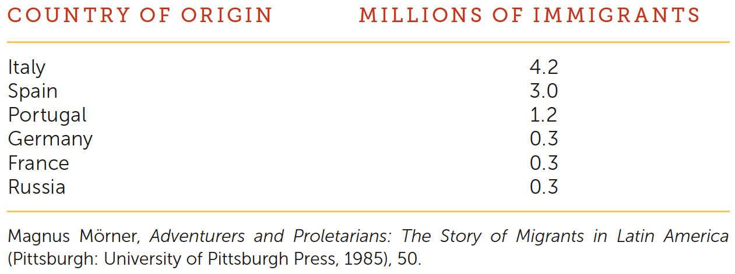
Migration to Latin America
Born in Blood and Fire, Fifth Edition
Copyright © 2024 W. W. Norton & Company

Slide 32
Argentina
Five million European immigrants
Half of the population of Buenos Aires was European in 1914.
Italian, Spanish, Irish, Jewish, German, Austrian, French, English, and Swiss
Conventillos
Many immigrants began as farmers, then moved to Buenos Aires.
Tango lyrics written in lunfardo.

Slide 33
New Immigration
Southern Brazil
Italy, Portugal, Spain, Germany, eastern European Jews
São Paulo attracted Japanese immigrants.
Ethnic colonies emerged in the south as immigrants were granted land.
Spanish immigration to Cuba
Middle Eastern immigrants all over the region

Slide 34
This concludes the PowerPoint presentation for Chapter 7: Neocolonialism
For additional resources, visit https://digital.wwnorton.com/bornfire5

