Slide 1
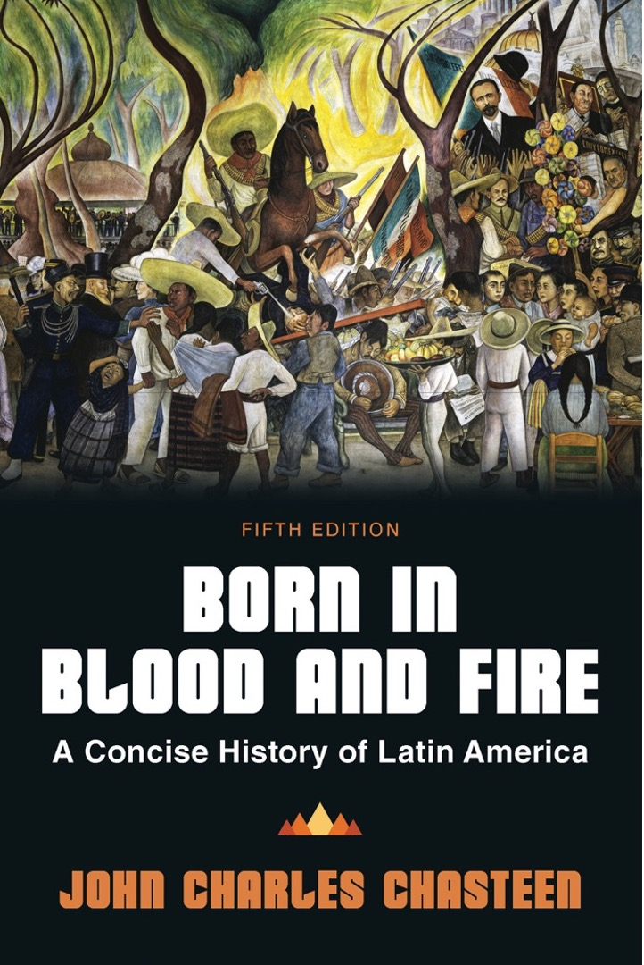
Born in Blood & Fire A Concise History of Latin America 5th Edition
By
John Charles Chasteen
Chapter 8:
Nationalism

Slide 2
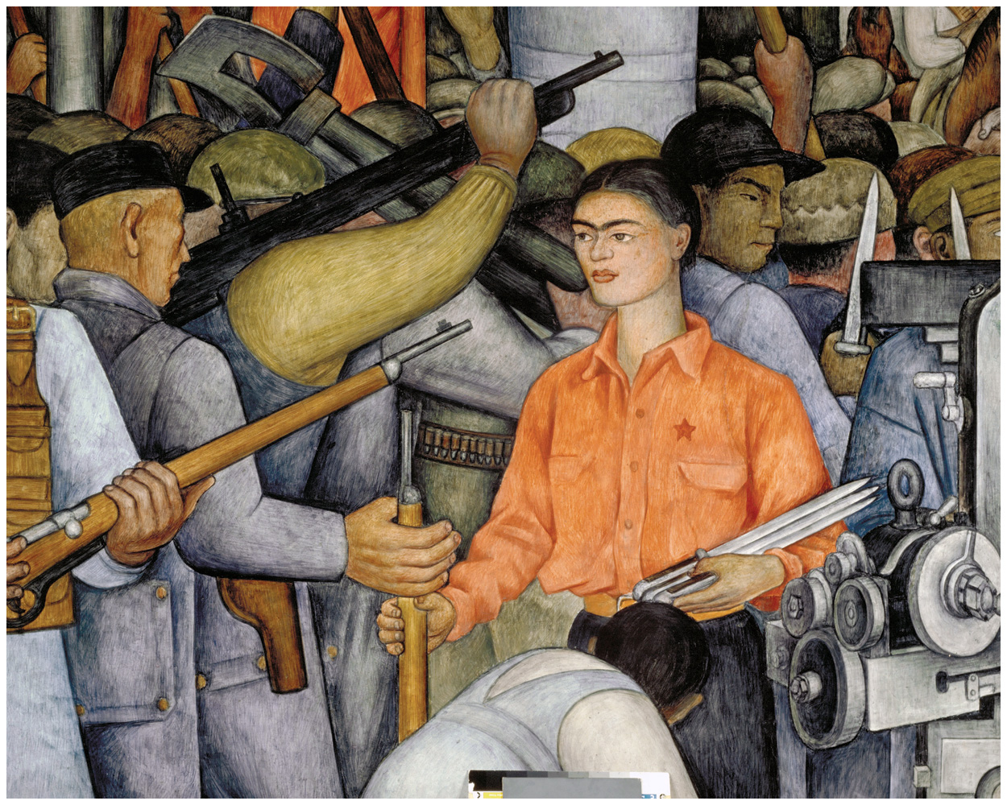
Distributing Arms
Born in Blood and Fire, Fifth Edition
Copyright © 2024 W. W. Norton & Company
Notes:
DISTRIBUTING ARMS. Nationalist movements transformed Latin America in the mid-1900s. This mural, painted on the walls of Mexico’s Department of Public Education in 1928 by Diego Rivera, exemplifies the militant nationalist mood. Rivera depicted his wife, Frida Kahlo, among those distributing arms to Mexican revolutionaries. © 2024 Banco de México Diego Rivera Frida Kahlo Museums Trust, Mexico, D.F. / Artists Rights Society (ARS), New York. Photo Credit: Schalkwijk / Art Resource, NY.

Slide 3
Internal Diversity
Latin American nations were defined by internal diversity.
Transculturation
Racial mixing
Europeans associated this diversity with negatives.
Nativism challenged this attitude.
Nativism faded after independence.
Nativism reemerged during foreign interventions.

Slide 4
Who Were Nationalists?
New nationalism was another wave of nativism with a strong economic agenda.
Who were nationalists?
Often urban, middle class
Mixed-race or recent immigrants
Benefitted less than landowners from export boom

Slide 5
Challenging European Culture
Nationalism challenged the superiority of European culture.
Reinterpretation of racial/cultural difference as positive
Use of local cultural forms
Critique of foreign intervention
Military intervention
Economic power

Slide 6
Ethnic Nationalism
Differs from US “civic nationalism”
Employs signs of ethnic identity
Celebrates racial mixing
Nicolás Guillén (Cuba) & Euclides da Cunha (Brazil)
Writers use indigenous, African descended themes
Alejo Carpentier (Cuba)
Ciro Alegría (Peru)
Miguel Ángel Asturias (Guatemala)

Slide 7
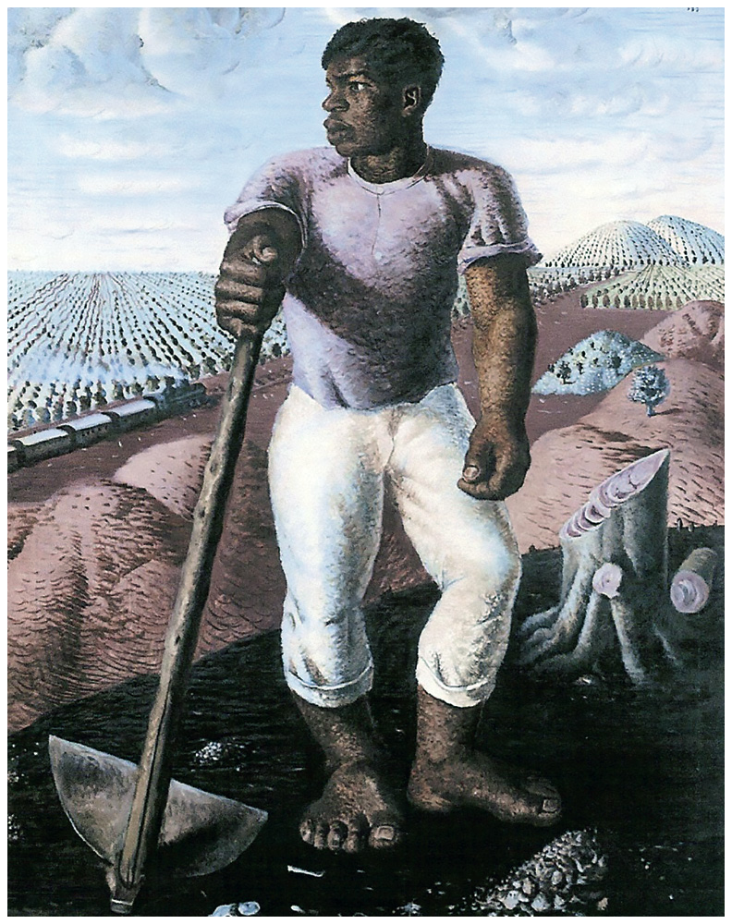
The Coffee Grower
Born in Blood and Fire, Fifth Edition
Copyright © 2024 W. W. Norton & Company
Notes:
BROWN PRIDE. The Coffee Grower (1934) by the internationally recognized Brazilian painter Cândido Portinari is a confident and powerful figure in no need of whitening. Like many nationalists, Portinari artistically celebrated the dignity of the working class. São Paulo Museum of Art.

Slide 8
Nationalists Take Power
Porfirio Díaz had ruled for 34 years by 1910.
Mexican Revolution
Francisco Madero
Emiliano Zapata
Pancho Villa

Slide 9
Constitutionalists
Third movement along with Villa and Zapata
Urban, middle class
Drafted new constitution in 1917
Article 27 of constitution
Article 123 of constitution
More typical of Latin American nationalists
Considered “winners” of revolution

Slide 10
Constitution of 1917 (1/2)
Reclaims oil rights from foreign companies
Paved way for villages to recover ejidos
Distribution of land
Labor regulations

Slide 11
Constitution of 1917 (2/2)
Limited privileges of foreigners
Curbed Catholic church
Defeated Villa and Zapata
Fought off Catholic “Cristero” rebellion
Created single-party system

Slide 12
Effects of Revolution (1/2)
Revolution was transformative
Created new loyalties
Occupied a central space in the national imagination
Two US interventions added nationalist luster

Slide 13
Effects of Revolution (2/2)
New government initiatives
Road initiative decreases isolation of rural areas
Land redistribution
Public education initiative reduced illiteracy
José Vasconcelos

Slide 14
Revolutionary Nationalism
Artists Diego Rivera and Frida Kahlo illustrate revolutionary nationalism.
Indigenous past
Cultural symbols
Nationalism was en vogue in the 1920s–1930s.
The nationalist movement had Marxist overtones.

Slide 15
Taking Power in Uruguay
Export boom rivaled Argentina’s
Ruled through managed elections
José Batlle y Ordóñez
Country’s great nationalist reformer
Vanquished political rivals
Broad support among immigrant working and middle class

Slide 16
Batllismo (1/2)
Civic and economic nationalism
State action against “foreign economic imperialism”
Hemisphere’s first welfare state
Relied on prosperity to sustain reforms

Slide 17
Batllismo (2/2)
Left rural Uruguay largely untouched
Aggressively anticlerical
Tried to abolish presidency for council
“Civil caudillo”

Slide 18
Taking Power in Argentina
Argentina—Hipólito Yrigoyen
“Revolution of the ballot box” (1916)
Man of the people
Rejected European and US initiatives
Repressed labor action
Returned to power in 1928

Slide 19
Taking Power in Peru
Peru—Víctor Raúl Haya de la Torre
Exiled for protesting US-backed dictatorship
Influenced by Mexican Revolution
Popular American Revolutionary Alliance (APRA)
“Indo-America” instead of Latin America
Indigenismo
APRA
Ciro Alegría

Slide 20
Nationalist Influence
Nationalists influential even when kept from power
Colombia
Nationalists tried to outflank conservative client networks.
Jorge Eliécer Gaitán
Venezuela
Oil money kept leaders entrenched.
Outreach by communist or socialist activists

Slide 21
Nationalism in Chile and Cuba
Chile
Thirteen-day “Socialist Republic”
Nationalists prevented the consolidation of government.
Cuba
Broad nationalist coalition ousted a neocolonial dictator.
Students and noncommissioned army officers
Fulgencio Batista

Slide 22
ISI and Activist Governments
Import Substitution Industrialization (ISI)
Depression = international trade collapses
Latin American manufacturers fill void left by collapsed trade.
Began during trade disruption during World War I

Slide 23
Industrialization
Industrialization central to nationalism
Economic activism
State ownership of banks, utilities, key industries
Largest markets benefitted
Smaller markets didn’t see much industrialization.
Light industry vs. heavy industry

Slide 24
Brazilian Economy
Industry surpassed agriculture.
Getúlio Vargas
Oligarchic republic begins collapse in the 1920s.
Young army officers—Tenentes—stage symbolic uprisings.
Coffee industry is in crisis from overproduction.

Slide 25
Brazil’s Revolution of 1930
Vargas was governor of non-coffee state.
Candidate from coffee-producing São Paulo won managed election.
Opposition forces gather to dispute result.
Vargas takes presidency with support of army.
Brought together diverse political movements
Young Tenentes absorb radical ideologies.

Slide 26
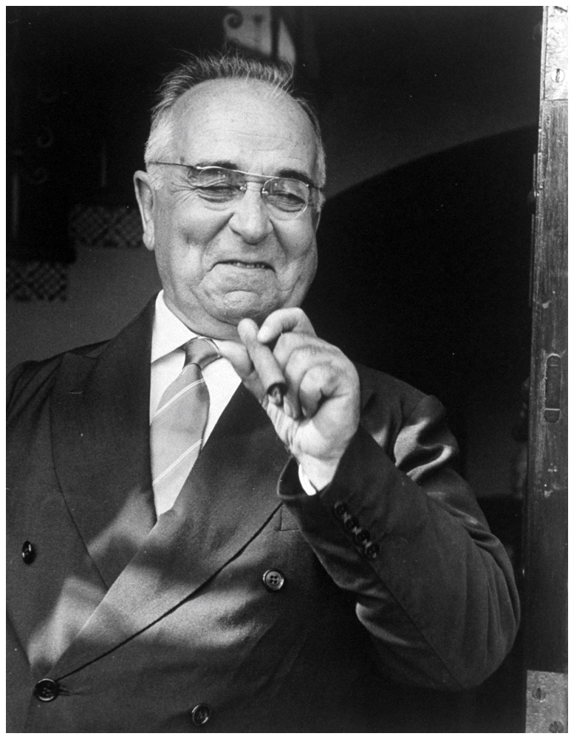
Getúlio Vargas
Born in Blood and Fire, Fifth Edition
Copyright © 2024 W. W. Norton & Company
Notes:
GETÚLIO VARGAS. Between 1930 and 1945, Vargas ruled Brazil as a revolutionary, then as constitutional president, and finally, as dictator. In 1951, he was elected for a final, truncated term. Leonard Mccombe/The LIFE Images Collection/Getty Images.

Slide 27
Vargas Presidency
Ruled more-or-less constitutionally for seven years
Played political factions against each other
Took dictatorial power in 1937
Announced Estado Novo (New State)
Nationalism helped maintain his popularity.

Slide 28
Brazilian Culture
Promotion of Afro-Brazilian heritage
Gilberto Freyre
Samba became Brazil’s national dance.
Carmen Miranda
São Paulo Modern Art Week, 1922
Heitor Villa-Lobos
Oswald de Andrade
Jorge Amado

Slide 29
Politics of Vargas
Placing Vargas on the left-right spectrum
Organized labor unions
Protected workers
Paternalistic—no worker control

Slide 30
Lázaro Cárdenas in Mexico
Humble beginnings, unlike Vargas or FDR
Fought in the Revolution
Governor of Michoacán, his home state
Ran unopposed for Revolutionary Party
Distributed nearly 45 million acres of land

Slide 31
Mexican Government and Labor
Supported labor, defended right to strike
Led to major international confrontation in 1938
Strikers employed by US, British companies
Companies and strikers submitted to Mexican government for arbitration
Cárdenas expropriated the oil companies under Article 27.
Britain cut off diplomatic relations.

Slide 32
FDR’s “Good Neighbor Policy”
Need for Latin American allies in unstable 1930s
1933, Pan-American Conference
US forswears intervention in Latin America
Cuba and Panama
Rise of “Good Neighbor” movies
Carmen Miranda
Disney’s “Three Caballeros”

Slide 33
World War II
Latin America and the United States were allies.
Central American, Caribbean countries first to join
Chile and Argentina aloof, Brazil was greatest ally
Mexican fighter pilots flew in the Pacific.
War spurred ISI
US demand for agricultural exports increased.
The United States and Europe were unable to produce industrial goods.
Demand up and competition low

Slide 34
Nationalism in 1945
A cultural shift had taken place.
Rivera’s murals in Mexico’s government buildings
Acclaim for Afro-Brazilian samba dancers
Carlos Gardel
Gabriela Mistral
Many things remained unchanged.
Central America was virtually untouched by nationalism.

Slide 35
Guatemala and El Salvador
Guatemala
German coffee growers had no interest in developing the country.
Jorge Ubico
United Fruit Company becomes the single dominant economic enterprise.
El Salvador “worst-case scenario”
Dictator Maximiliano Hernández Martínez
Indigenous Salvadorans gave up signs of identity.

Slide 36
Stopping the Rise of Nationalism
The United States stopped nationalism in Central America and Caribbean.
Batista in Cuba
Several rulers owed power to US intervention.
Anastasio Somoza of Nicaragua
Trujillo of Dominican Republic

Slide 37
Nationalism in Practice
Rhetoric often outran reality in nationalist countries.
Racism lingered
Urbanization created shantytowns.
Most rural areas saw no improvements.
Latin American countries remained technologically behind Europe and United States.

Slide 38
Populist Leaders
A populist politician addresses the poor and lower-middle-class voter.
Folksy style
Paternalism (“father knows best”)
Critical of oligarchy and imperialism
Confusion about whether they are left- or right-wing

Slide 39
Populism in Peru and Ecuador
Victor Raúl Haya de la Torre (Peru)
Failed run for presidency in 1932
Cultural pride and nationalism
Called communist by Peruvian elites
Criticized by Peruvian communists
José María Velasco Ibarra (Ecuador)
“National Personification”
Elected five times during 1930s–1960s
Expelled by army before ending any of his terms

Slide 40
Populist Leaders in Colombia and Mexico
Jorge Eliécer Gaitán (Colombia)
Emphasized poor upbringing and early humiliations
Dark mestizo coloring
Bogotazo
Lázaro Cárdenas (Mexico)
Reenergized institutional revolution in 1930s
Grassroots campaigner
Traveled around Mexico listening to grievances

Slide 41
Populist Leaders in Brazil and Argentina
Getúlio Vargas (Brazil)
Estado Novo
Pro-labor rhetoric
Critical of Communist Party
“Father of the Poor”
Evita and Juan Perón (Argentina)
Loyalty of Argentine workers
Famous smile
“Third position”

Slide 42
This concludes the PowerPoint presentation for Chapter 8: Nationalism
For additional resources, visit https://digital.wwnorton.com/bornfire5

