Slide 1
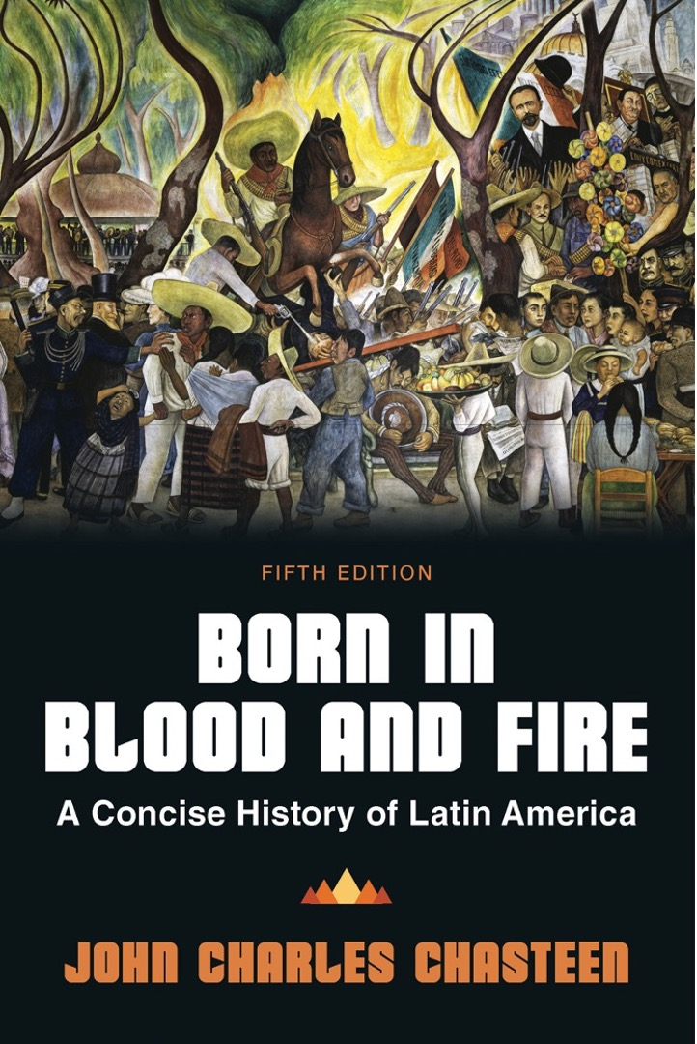
Born in Blood & Fire A Concise History of Latin America 5th Edition
By
John Charles Chasteen
Chapter 9:
Revolution

Slide 2
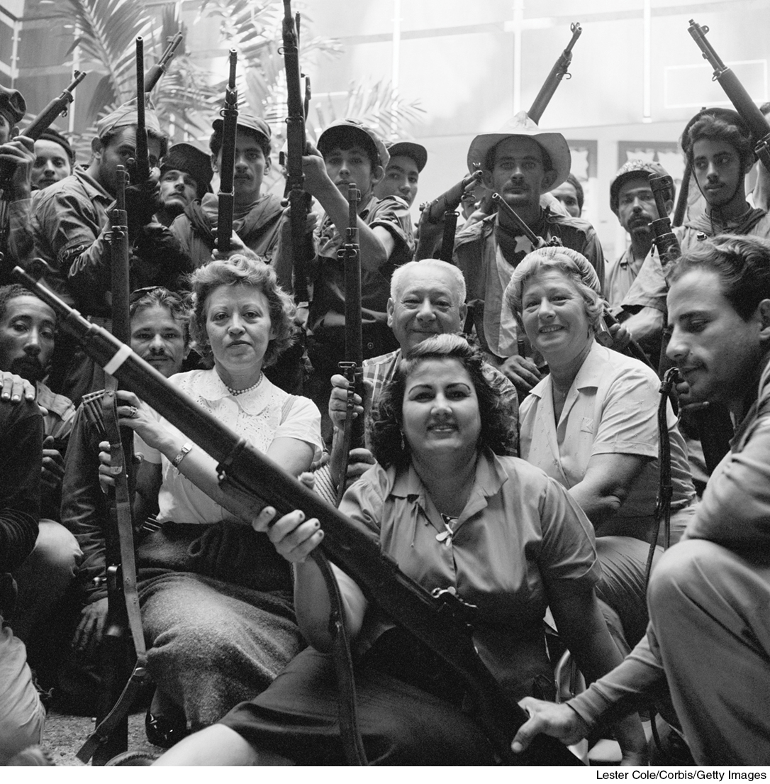
Cuban Revolutionaries of 1959
Born in Blood and Fire, Fifth Edition
Copyright © 2024 W. W. Norton & Company
Notes:
CUBAN REVOLUTIONARIES OF 1959. The Cuban Revolution was a truly popular movement that helped put a Marxist tilt on nationalism throughout Latin America. Marxist ideology offered a persuasive explanation of Latin American problems as well as a clear prescription for direct revolutionary action. Leaders Che Guevara and Fidel Castro quickly became heroes for young revolutionaries in many countries. Lester Cole/CORBIS.

Slide 3
Postwar Latin America
Wartime industrialization slowed.
Population growth accelerated.
Cities grew rapidly.

Slide 4
Revolution
Carolina Maria de Jesús
Shantytowns
Revolutionary option
Many believed change was necessary.
Revived accusations of U.S. imperialism
Some joined nationalism with Marxism.
Populists looked to common people without becoming Marxist.

Slide 5
Post–World War II Populism
Populism was leadership style focused on:
Mass politics
Winning elections
Voting changes in postwar Latin America
Women’s suffrage
Lowered voting age to 18
Literacy requirements struck down

Slide 6
Voting Coalitions
Populist leaders depended on voting coalition of middle-class and industrial workers.
Populist political tactics
Mass rallies
Radio
Bashed old hierarchies
Attracted working-class voters with promise of improved living conditions
Avoided class warfare
Kept power from old power class of oligarchic and foreign interests

Slide 7
Economic Policy Options
US economists recommend return to pre-1929 economy.
“Comparative advantage”—countries should embrace what they do best
Industrial countries focus on producing finished products.
Improved living standards everywhere
“Developmentalist” approach
Economic Commission for Latin America (ECLA)
Set up by United Nations
Raúl Prebisch
Prebisch’s “dependency” model

Slide 8
Obstacles to Nationalists
Postwar nationalists confronted difficult problems.
Social inequality
Dwindling internal markets
Resurgent pre-war oligarchy
Hostility of United States
Populist politics responded to these problems.

Slide 9
Peronism
The military governed Argentina through 1930s.
Juan Perón was a nationalist army officer and secretary of labor.
Strong following among working class
“Peronist Loyalty Day”
Perón’s presidency, 1946–1955
Rapid unionization of industrial workforce
Raged at landowning class

Slide 10
Eva Perón
Evita
Eva Perón became very popular.
Glamorous radio actress
Grew up poor
Came from the countryside, like many workers
Social Aid Foundation
Helped reinforce patriarchal traditions
Death prompted mass demonstrations of grief

Slide 11
Peronist Policy
Nationalism guided Peronist economics.
Sought to nationalize foreign-owned companies
Expanded social services
Expanded bureaucracy
Five-year industrialization plan
Conflict with Vatican
Perón was exiled by the military in 1955.
Remained popular even from exile
In 1957, a quarter of the electorate voided ballots.

Slide 12
Post–World War II Brazil
Vargas ousted by the military in 1945.
Founded two political parties
Brazilian Workers’ Party
Returned to presidency in 1950
Committed suicide in office in 1954
New capital at Brazilia
Ultramodern design by Oscar Niemeyer
Located in sparsely populated interior
Period of great hardship

Slide 13
Post–World War II Mexico
Institutional Revolutionary Party
One-party system
Industrialization continues.
Landowner power is shattered.
PRI maintained loyalty.
Government marketed food grown on ejidos.
Mexican currency was steady in contrast to inflation.
The economic pie grew but was ill-distributed.

Slide 14
Post–World War II Colombia
Assassination of Gaitán
La Violencia
Conservatives versus Liberals violence
Largest impact in rural areas
Massive migration to cities
Gustavo Rojas Pinilla

Slide 15
Onset of the Cold War
The United States represents modern prosperity.
Postwar boom
Consumer goods out of reach for Latin Americans
Latin American disenchantment with the United States
Marshall Plan in 1947
Latin American allies hope for similar aid.
Rio Pact

Slide 16
US-Latin American Economics
The US market for agricultural products booms.
Few Latin American industries appeared.
Subsidiaries of US companies
The United States pushes spread of free-market capitalism.

Slide 17
Organization of American States
Beefed-up version of Pan-American Union
Postwar US anticommunist panic
Latin American opposition viewed as “creeping communism.”
Dictators allied with US overpowered opposition votes
Declaration of Caracas (1954)

Slide 18
Post–World War II Venezuela
Marcos Pérez Jiménez
US-endorsed dictator
Preferred him to nationalist Democratic Action Party
Makes Democratic Action and Communist Party illegal
Friendly to US oil companies

Slide 19
Post–World War II Guatemala
Voted against the Caracas Declaration
Called for Latin American resistance to US pressure
US invades Guatemala by proxy
Abandons 1933 pledge of nonintervention in Latin America
Guatemalan “decade of Spring” 1944–1954
United Fruit Company
Jacobo Arbenz

Slide 20
Post–World War II Bolivia
National Revolutionary Movement 1952
Nationalist, Marxist
US maintained good relations, sent aid
Bolivian wealth based on tin mines
Began land redistribution
Decreased power of army
Change affected middle class
Conservative elements gain influence

Slide 21
Literature and the Cold War
Pablo Neruda (Chile)
Most popular poet of twentieth-century Latin America
Diplomat
Revolutionary politics
Jorge Luis Borges (Argentina)
Traveled and educated around world
Gauchos, poor neighborhoods as literary motifs
Supported military against Perón

Slide 22
The Cuban Revolution
The Marxist perspective was on the rise in Latin America in the 1950s.
Little to do with Soviet Union
Take on capitalism matched Latin American realities
Leninist critique of imperialism rang true
Marxist diagnosis of Latin America was injustice

Slide 23
“Che” Guevara
Argentine medical student
Believed Latin American countries should overthrow international imperialist economic system
Traveled to Guatemala to witness reforms of Arbenz
Fled to Mexico after Arbenz removed from power in 1954

Slide 24
Fidel Castro
Cuban nationalist revolutionary
From wealthy, sugar-growing family
Inspired by nationalist student movements
Exiled with brother Raúl
Fidel and Raúl Castro, Che Guevara led guerrilla actions from mountains
Tumultuous arrival in Havana

Slide 25
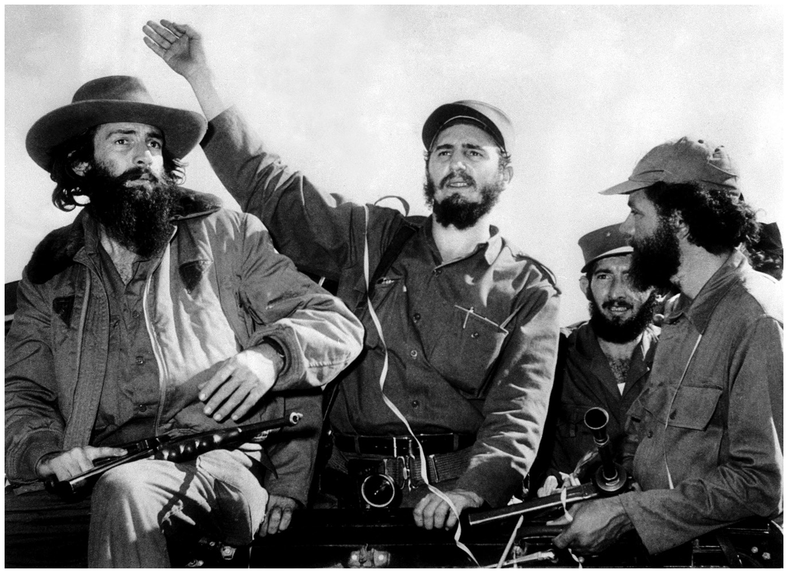
Los Barbudos
Born in Blood and Fire, Fourth Edition
Copyright © 2016 W. W. Norton & Company
Notes:
LOS BARBUDOS, "the bearded ones." To show that the revolution was only beginning, the Cuban revolutionaries did not shave their beards after their 1959 victory. In the center is Fidel Castro. Another barbudo, not pictured here, was Che Guevara. Popper Foto/Getty Images.

Slide 26
Defiance of US
Castro refused to appease US concerns.
Lectured on US imperialism in New York City
Arranged alternative Russian market for Cuban sugar
Bought Russian oil cheap
US stopped purchases of Cuban sugar
Responds by expropriating more US property
US declare embargo on Cuba in 1960
Cubans learn US training army for proxy invasion

Slide 27
US Response
Bay of Pigs invasion, 1961
Cuban army created by and loyal to Castro
Quickly defeated invasion
Cuban alliance with Soviet Union
Cuban Missile Crisis
US ultimatum to Soviet Union: remove missiles or war
Russia agreed to remove missiles for promise to never invade Cuba
US continued to make attempts on Castro’s life

Slide 28
Economic Tensions
Embargo
US blocked trade between Cuba and its allies.
Crippled Cuban trade
Cuba trades primarily with Soviet bloc countries.
Cuba is the focal point of anti-US resistance.
Cuba expelled from OAS.
Becomes training ground for revolutionaries
Moscow did not support revolutionary movements.
Che Guevara and guerrilla warfare

Slide 29
Revolutionary Spirit
Revolutionaries return to sugar.
Tamara Bunke
Musical reverberations of revolution
Violeta Parra
Havana eventually became the international center of the “new song” movement.

Slide 30
Revolutionaries in Power
The Cuban Revolution in power
Worldwide symbol of resistance to US power
Important social achievements
Increased literacy
Medical care
Improved housing
Ended racist practices
Leader in Latin American culture
Revolution restricted civil liberties
No freedom of speech
Cubans not allowed to travel outside country

Slide 31
Role of the Church
The Catholic Church played no major role in the Cuban Revolution.
Many priests were active in the fight for social justice.
Father Camilo Torres
Religious revolutionaries saw Latin America like Marxists.
Paulo Freire
“Consciousness raising”

Slide 32
Liberation Theology
1968 Conference of Latin American Bishops
Discussed Freire’s approach
“Preferential option for the poor”
Discussed creation of “base communities” similar to literacy groups
Discussed liberating people from “institutionalized violence” of poverty
Ideology known as “Liberation theology”

Slide 33
Conservative Reaction
Conservatives accused followers of communism.
Liberation theologians never majority of Catholic leaders
1978, Conference of Latin American Bishops
Pope John Paul II
Appointment of conservative bishops
Official silencing of liberation theologians
Pope supported conservative archbishop against Sandinista revolutionaries in Nicaragua

Slide 34
This concludes the PowerPoint presentation for Chapter 9: Revolution
For additional resources, visit https://digital.wwnorton.com/bornfire5

