Slide 1
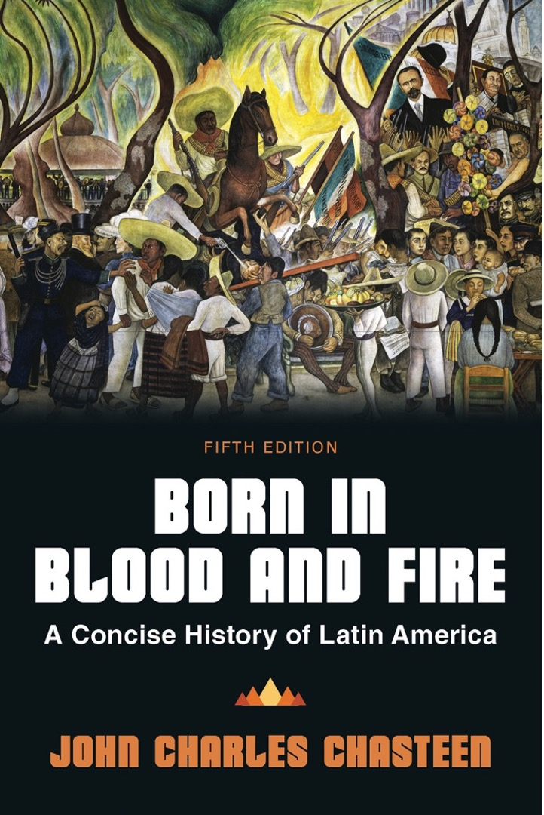
Born in Blood & Fire A Concise History of Latin America 5th Edition
By
John Charles Chasteen
Chapter 10:
Reaction

Slide 2
Cuban Revolution
Hope for revolutionaries, danger for others
Government training revolutionaries from other governments
Little to offer in arms or money
US policy encouraged a conservative counterrevolutionary reaction.

Slide 3
Role of the Soviet Union
Soviet Union was not heavily involved outside of Cuba.
Nationalism remained the basis of revolutionary movements.
The Soviet Union had little interest or presence.
Anticommunists nevertheless branded Marxist revolutionaries as foreign.

Slide 4
Anticommunism
Armed forces were the greatest ally of anticommunist efforts.
Alliance between Latin American militaries and the United States was forged during World War II.
Became explicitly anticommunist
School of the Americas for counterinsurgency
National Security Doctrine
The US alliance strengthened Latin American militaries.

Slide 5
Alliance for Progress
US aid program in response to Cuban Revolution .
Similar to Marshall Plan
Intended to reduce revolutionary pressure
Kennedy declared reform necessary to prevent revolution.
Failed to make serious reforms
By 1970s, Latin American generals took control.

Slide 6
Culture of Revolution
The momentum toward revolution seemed to grow in the 1960s.
Marxism is the most popular political philosophy among students and intellectuals.
Revolutionary filmmaking
Novelistic “Boom”
Colombia’s Gabriel García Márquez
Mexico’s Carlos Fuentes
Peru’s Mario Vargas Llosa

Slide 7
Military Response
Latin American militaries reacted with violence and brutality.
Widespread use of kidnapping, torture, murder
Targeted suspected sympathizers
Urban guerrilla movements
Relied on secrecy and hiding
Brutal tactics to root out revolutionaries

Slide 8
National Security Doctrine
National Security Doctrine maintained a climate of emergency that produced brutality.
Military had increasingly active role in national life.
Generals believed civilian politicians were unnecessary.
Civil liberties hindered efforts to crush opposition.
Juntas
Executive committees of generals and admirals
Came to rule many Latin American countries
“Bureaucratic authoritarianism”

Slide 9
The Brazilian Experience
Military fought alongside the United States in World War II
Armed forces on red alert after Cuban Revolution
Jõao Goulart
Peasant leagues demand land reform
Brazilian generals seize control of government in 1964

Slide 10
Military Rule in Brazil
Ruled by decree
Outward appearance of constitutional government
Changed inconvenient laws
Enemies had no political rights for ten years
Two legal political parties, neither in opposition
Laws allowing them to legally dissolve congress

Slide 11
Revolutionary Response
Rise of an opposition
Urban guerrilla movements arose in 1960s–1970s.
Junta attacked with “death squads.”
Kept meticulous files on political prisoners
Currents within the military
Moderate constitutionalists in power 1964–1967
Hard-line authoritarians dominated from 1968–1974.
Right-wing nationalists sought to make Brazil a world power.

Slide 12
Industrial Development
Industrialization creates economic boom.
Protests subsided by mid-1970s.
Generals called it an economic miracle.
New industries could thrive at the expense of the poor.
Held down wages
“Disappeared” anyone who complained
Attract capital with “safe climate for foreign investment”
Most people got little benefit from economic “miracle.”
Massive construction projects were started.

Slide 13
End of the Miracle
Government got loans from oil-rich countries to fund development.
Interest rates rose, mushrooming international debt.
By the early 1980s, Brazil had the world’s largest foreign debt.
Brazil’s industrial exports surpassed coffee exports.
Massive strikes announce the return of opposition.
Generals ready to bow out.

Slide 14
Military Rule in Argentina
In the early 1960s, Argentine generals were still dealing with Perón.
Ousted leader still directing followers from abroad.
Generals suspected working-class followers had Marxist tendencies.
Military annulled Peronist electoral victories.
1962 and 1965

Slide 15
The Military’s Agenda
Similar goals to Brazilian military rule
Eliminate revolutionary threat
Hold down wages
Encourage investment
Similarly brutal repression
Argentine revolutionaries not easily repressed
Turned quickly to violence
Military did not have the economic growth seen in Brazil

Slide 16
Argentina’s Dirty War
Killing began in 1960s, escalated in 1970s
Marxist guerrilla movements
Military death squads
Continued even after Perón’s return
New military president in 1976
Counterinsurgency moved into high gear.
The military exterminated its opponents.
Announced victory of “Judeo-Christian Civilization”

Slide 17
Las Madres de la Plaza de Mayo
Argentine mothers begin parading with pictures of disappeared children in the late 1970s.
The military dismissed them as crazy.
White scarves embroidered with names of children
The military was unable to challenge mothers and motherhood.
Mothers became the conscience of the nation.

Slide 18
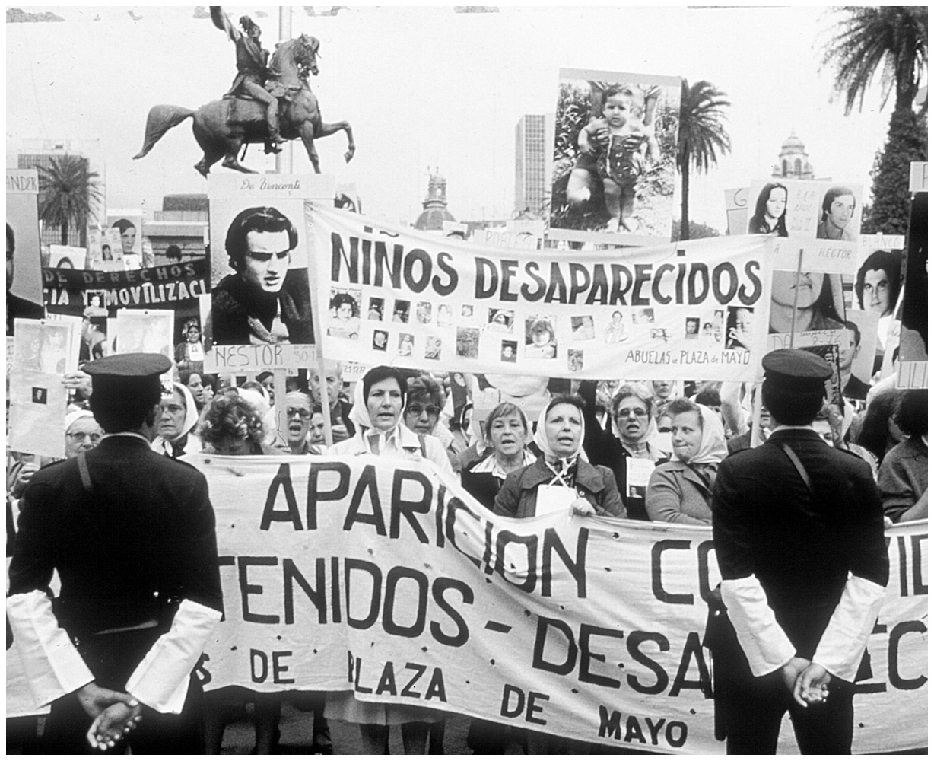
Mothers of the Plaza de Mayo
Born in Blood and Fire, Fifth Edition
Copyright © 2024 W. W. Norton & Company
Notes:
MOTHERS OF THE PLAZA DE MAYO. The return of niños desaparecidos, “disappeared children,” is what these Buenos Aires protestors demanded, day after day, in front of the presidential palace during the 1980s. Carrying banners and poster-size photos of the children whom they wanted back alive, the courageous mothers had to settle more often for news of their children’s abduction and clandestine murder by the Argentine military during its “dirty war” against Marxist guerrillas called Montoneros. Photograph by Enrique Shore, Woodfin Camp and Associates Inc.

Slide 19
Military Rule in Uruguay
Relatively placid since World War II
No Peronist-type opposition
Implemented Batlle’s idea of executive committee instead of president
High standard of living despite weak economic growth

Slide 20
Guerrilla Uprising
Tupamaro urban guerrilla movement, 1964
Attempted to follow Che Guevara’s tactics
Carried out daring attacks to attract public support
Martial law declared in 1967.
Military began gradual takeover.
Completed in 1973
Annihilated opponents
By the end of the 1970s, Uruguay had more political prisoners by proportion than any country in world.

Slide 21
The Communist Party of Chile
No Latin American country could match the record of constitutional government.
Communist Party was one of the oldest and strongest in the hemisphere.
Did not advocate armed revolution
Participated in electoral coalitions with other leftist parties
Salvador Allende

Slide 22
Chilean Road to Socialism
The Popular Unity government announced “a Chilean road” to socialism.
New government hoped to achieve significant reform
Nationalization of copper, coal, steel
Nationalization of banks
Land reform
Proposals outran electoral strength.
Sought to raise living standards for poor
Maintained support of urban workers

Slide 23
Military Coup
Military coup on September 11, 1973
Allende died under attack in presidential palace.
Bloodiest takeover in history of Latin America
Thousands disappeared and were tortured.
Military ruled by decree for 17 years.
Supported by US State Department
Augusto Pinochet

Slide 24
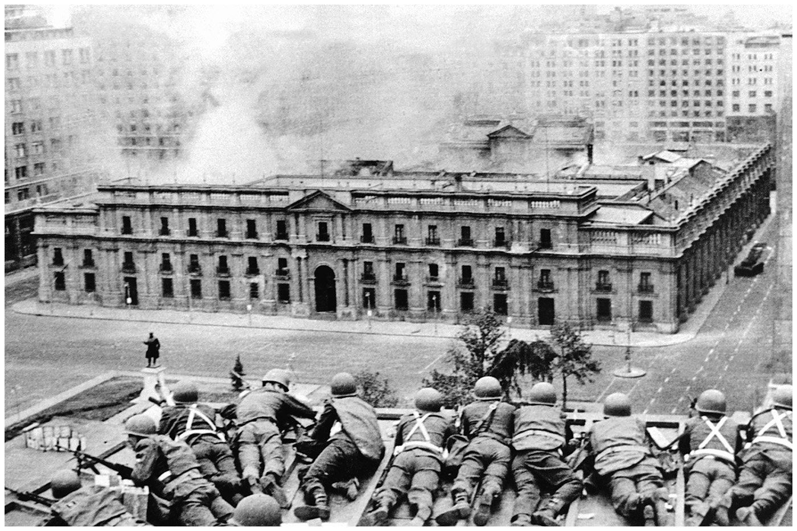
The Chilean Coup
Born in Blood and Fire, Fifth Edition
Copyright © 2024 W. W. Norton & Company
Notes:
THE CHILEAN COUP. Positioned on a rooftop, Chilean soldiers fire on the palace of government during the military overthrow of President Salvador Allende in 1973. The coup leader, General Augusto Pinochet, took over Chile with US support. OFF/AFP/Getty Images/Newscom.

Slide 25
The Peruvian Experience
Military government not motivated by anticommunism
The government announced a military program that was neither communist nor capitalist.
Program to serve poor and marginalized
Ruled from 1968–1980
Difficult to categorize in Cold War terms
Was not guilty of heinous human rights violations

Slide 26
The Cuban Experience
Revolutionary government supported Peru’s dictatorship
Authoritarian regime supported by military
Military headed by Raúl Castro
Prioritized improving lives of poorest
Did not commit massive human rights violations seen elsewhere

Slide 27
The Mexican Experience
Bucked military trend entirely
PRI (Institutional Revolutionary Party)
Although revolutionary only in name, used revolutionary themes
Oil boom allowed PRI to absorb challenges
Massacre of protesting students in 1968
Example of state panic against opposition

Slide 28
The Last Cold War Battles
Bureaucratic authoritarian governments began to fall.
Inflation and Excessive Debts
Success of anticommunist efforts
Lack of external enemies for military regimes
Falklands/Malvinas War (Argentina/Great Britain)
Return to constitutional rule (Argentina, Bolivia, Brazil, Ecuador, Peru, Uruguay)
The revolutionary tide in Central America began turning in the late 1970s.

Slide 29
Revolution in Central America
Central American nations had barely felt the benefits of ISI.
Depended on few agricultural exports
Small populations and small cities
Landowners’ power remained unchecked.
Dominated by rural oligarchies
Ruled by greedy tyrants who enjoyed US support for anticommunism

Slide 30
The Guatemalan Experience
Ruled by military or military-controlled governments since 1954
Landowners lived in fear of peasant uprisings.
Military carried out dirty war against rural guerrillas.
Rigoberta Menchú
The death toll spiraled to 200,000.

Slide 31
The Costa Rican Experience
Largely escaped violence of Cold War
Less burdened by colonial hierarchies
Small pre-conquest indigenous community
Remaining people killed by conquerors
Abolished army in the 1940s

Slide 32
The Nicaraguan Experience
Home of anti-imperialist Augusto Cesár Sandino
Ruled by the Somoza family since the 1930s
Various Somozas ran the country from the 1930s to the 1970s.
Anticommunist allies of US
Revolutionary movement forms in Havana in 1961.
Sandinista National Liberation Front (FSLN)

Slide 33
Beginning of the Revolution
Dictator assassinated Joaquín Chamorro in 1978.
Editor of a conservative opposition newspaper
Widespread revolution began
Somoza fled, assassinated in Paraguay.
Sandinistas took control of Nicaragua.
Revolutionary program inspired, aided by Cubans
Reagan is elected in the United States.
Viewed Sandinistas as Cold War communist threat

Slide 34
Revolution (cont’d)
Anti-Sandinista factions regroup
Somoza’s National Guard reforms in Honduras.
Actions of Contras
Raided Nicaragua from Honduras
Called “Freedom fighters” by Reagan
Honduras filled with US military personnel and supplies
Gained recruits among Nicaraguan opposition
Disrupted Nicaraguan economy, wreaked havoc
War destabilized the Nicaraguan economy.
In 1990, Sandinista Daniel Ortega lost the election.
Violeta Chamorro

Slide 35
The Situation in El Salvador
Undemocratic, anticommunist government
Landless poor made it a social pressure cooker.
Salvadoran Communist Party
Military governments followed for nearly fifty years.
In 1970s, Salvadoran church turned away from anticommunism.
Archbishop Oscar Romero

Slide 36
Uprising in El Salvador
Farabundo Martí National Liberation Front
The Reagan administration argued that communism was spreading.
Military murders of four nuns from US
Public opposition to US policy in Latin America arose
Successes
Held large portions of countryside
Strong backing among rural people
Blew up bridges and power lines
Levied war taxes on vehicles traveling through territory

Slide 37
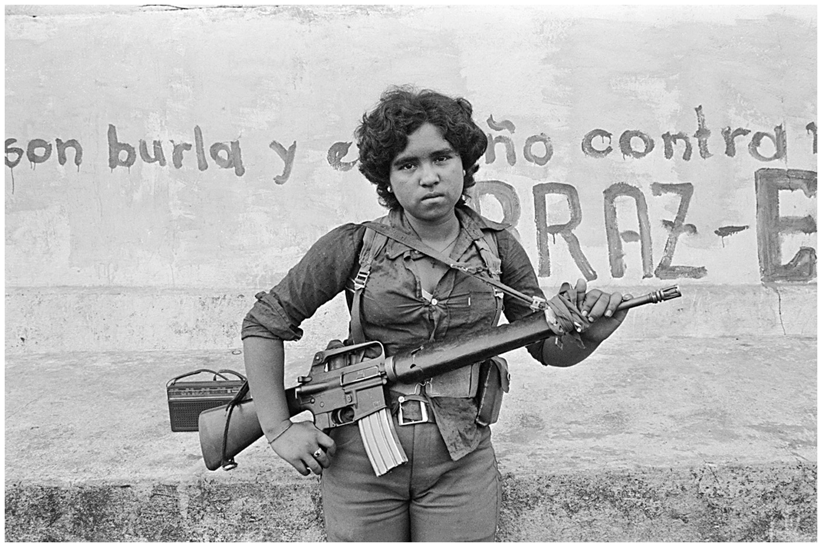
Salvadoran Guerrilla
Born in Blood and Fire, Fifth Edition
Copyright © 2024 W. W. Norton & Company
Notes:
SALVADORAN GUERRILLA. An FMLN fighter, one of many women in the guerrilla ranks, stands guard in 1983. On the wall behind her is one of the revolutionary slogans that covered walls all over Latin America from the 1960s through the 1980s. Photograph by Ivan Montecino; image by Bettmann/CORBIS.

Slide 38
Defeat of the Uprising
Unable to defeat the army
Salvadoran military had US troops and training
Helicopters
Massacre at El Mozote
Hundreds of thousands fled El Salvador, many for the United States.
Refused to participate in elections, believing them fraudulent
War reached a stalemate in 1990.
Peace treaty signed in 1992

Slide 39
Peru’s Shining Path
Insurgency in Peruvian highlands
Abimael Guzmán
Indigenismo
Quasi-religious spirit led to cataclysmic violence
Strong following in indigenous Andes
Followed indigenous migration into Lima
Coca production as means of financing revolution
Lost momentum after leader’s capture in 1992

Slide 40
Challenges: Zapatistas
Rebelled when NAFTA went into effect
Mayas from southern Mexico
Demands related to land, but had broader vision
Subcomandante Marcos
Media-savvy
Government armed anti-insurgent militias.
Support of Catholic Church in Chiapas

Slide 41
Colombia’s Long Torment
Colombia’s politics were often exceptional.
Conservatives, rather than liberals, ruled during neocolonial period.
Colombian military never ruled during the Cold War.
Avoided debt and inflation in 1980s
Guerrilla activity expanded in Colombia while ending elsewhere.

Slide 42
Explosion of Violence
Assassination of Jorge Eliécer Gaitán
“La Violencia”
Less politics, more socioeconomics
Many fled the countryside for cities.
Violence increased even in petty street crime.
Death rates set records for a country not at war.

Slide 43
Pablo Escobar
Smuggled drugs to US
Created mafia empire
Medellín cartel
Easy money added to violence
Colombian-grown marijuana and cocaine

Slide 44
Conflict Escalates
Rural guerrilla armies
Born out of La Violencia
FARC, ELN, and others—Marxist revolutionaries
Nineteenth of April Movement
Conflict escalates
FARC and ELN force landowners to pay war taxes.
Landowners create forces to fight guerrillas.
Rural people were caught in the middle.
Guerrillas turned to kidnapping for funds.

Slide 45
End of Escobar
Narco-terrorism
Escobar offered surrender in exchange for non-extradition pledge.
Deal made in 1991
Escobar escaped prison, killed by police
Drug trade became a source of income for guerrillas.

Slide 46
This concludes the PowerPoint presentation for Chapter 10: Reaction
For additional resources, visit https://digital.wwnorton.com/bornfire5

