Slide 1
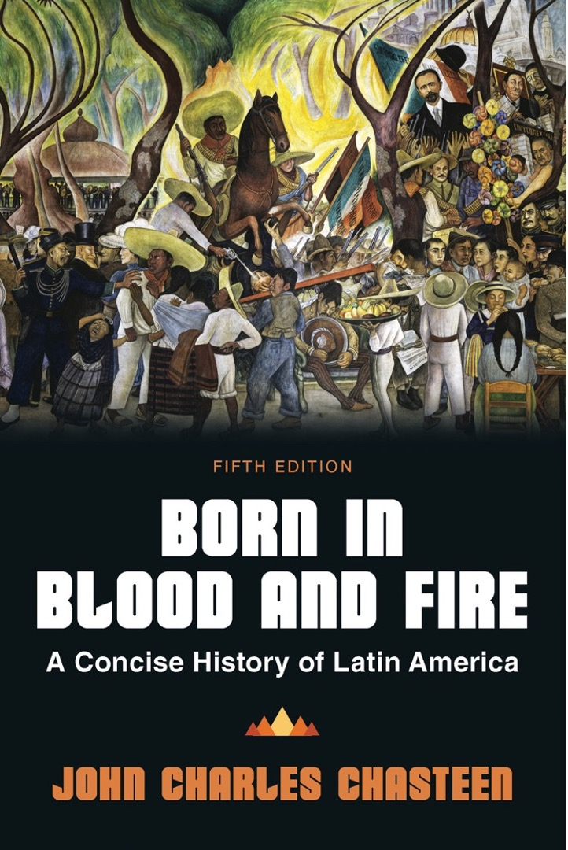
Born in Blood & Fire A Concise History of Latin America 5th Edition
By
John Charles Chasteen
Chapter 11:
Neoliberalism and Beyond

Slide 2
Nationalism Discredited
Marxist revolutionaries had been strongly nationalist.
Reactionary dictatorships had strong nationalist inclinations.
Revolutionary and reactionary violence discredited nationalism.
Collapse of communism in Europe and liberalization of Chinese economy discredited nationalism.

Slide 3
Liberalism Returns
Neoliberals emphasized free trade, export production, and comparative advantage.
Neoliberalism reigned supreme at the turn of the millennium.
Fernando Henrique Cardoso
Carlos Menem
PRI presidents of Mexico embraced neoliberalism.

Slide 4
Neoliberalism
Neoliberals embraced the free market and rejected nationalism.
Sold off, or privatized, state-run corporations
Privatized social services
Slashed import tariffs
Deregulated capital flows
Reduced subsidies on basic foodstuffs
All-out assault on inflation

Slide 5
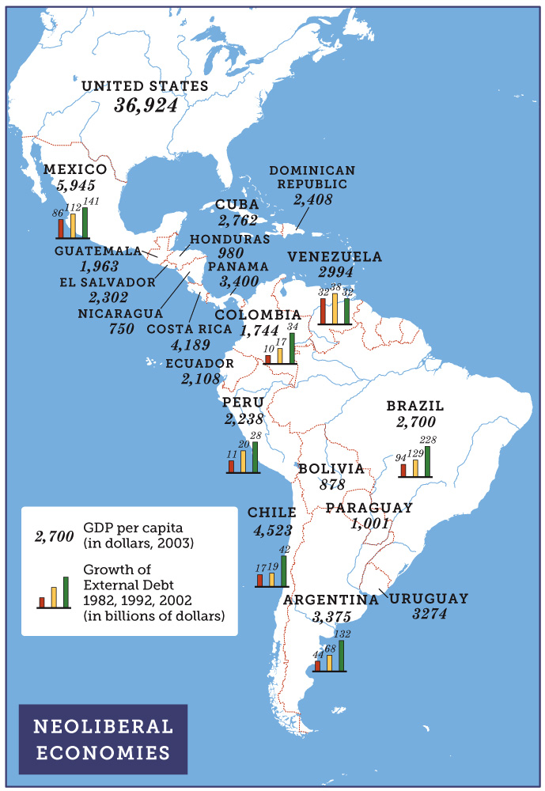
Neoliberal Economies
Born in Blood and Fire, Fifth Edition
Copyright © 2024 W. W. Norton & Company
Notes:
NEOLIBERAL ECONOMIES

Slide 6
Taming the Debt Crisis
Neoliberals gained momentum by taming the 1980s debt crisis.
Debt huge in 1980s
High oil prices
Heavy, short-term borrowing in 1970s
Short-term loans refinanced at higher rates
Latin American debts were owed to foreign banks.
Defaulting on debt would leave either country bankrupt and isolated.

Slide 7
Implementing Reforms
Foreign lenders encouraged neoliberal policies.
The IMF believed the solution lay in neoliberal reforms.
Lenders rolled debts into long-term bonds to encourage reforms.
Strategies successfully tamed debt
Hyperinflation halted in Argentina and Brazil.
Latin America heralded as emerging market for investment.
Billions of dollars in foreign capital flowed in.

Slide 8
Free Trade
Free trade agreements
North American Free Trade Agreement (1994)
Brazil, Argentina, Paraguay, Uruguay (MERCOSUR)
Tariff reductions for consumer products
Maquiladora
Assembly plants using cheap, often women’s, labor to assemble imported parts
Facilitated by low tariffs

Slide 9
The Chilean Experiment
Chile was a neoliberal success story.
Pinochet dictatorship
Advised by “Chicago Boys”
By the 1990s, Chile had low inflation, good credit, steady growth, and diversified exports.
Growth benefited all classes somewhat.
The distribution of wealth remained among the most unequal in region.

Slide 10
Consequences
Neoliberalism benefited middle-class consumers but hurt producers.
The poorer majority did not benefit from products.
Collapse of local industry created unemployment.
Social consequences of neoliberal reforms:
Dismantling of bureaucracies
Providing water and electricity not profitable
Neoliberalism replayed patterns of the pre-nationalist liberal era (1870-1930)
Focus on extractive industries
Mining and agriculture

Slide 11
New Left Turn
By 2000 a shift in perspective and push from neoliberalism emerged.
Economic crisis returns to Latin America
Protests in Mexico
Argentina defaults on debts
Voters rejected neoliberal vision.
Election of nationalist and socialist presidents

Slide 12
Rejecting Neoliberalism
Countries began to reject neoliberal model.
Many elected presidents with nationalist bent.
US media characterized leaders as “leftist.”
Few turned toward socialist economic policies.
Embraced nationalist vision of anti-imperialism and active government
Sought to mitigate impact of free-market capitalism
By 2010, most Latin American presidents fit this description.

Slide 13
Luis Inácio da Silva, or “Lula”
Elected president of Brazil in 2002
“Zero hunger” initiative difficult to achieve given Brazil’s debts
Approached social goals more timidly than some supporters liked
“Family scholarship”
Brazilian economy was resilient in face of the 2008 economic crisis.

Slide 14
Post-Lula in Brazil
Dilma Rousseff
Opposition response
Convicted Rousseff and Lula of insubstantial crimes
Jair Bolsonaro

Slide 15
Hugo Chávez
President of Venezuela
Channeled support to poor Venezuelans in exchange for support
Use of government authority against his adversaries alienated middle class
Won referendum allowing him to be reelected indefinitely
Reforms based on oil revenue
Unfinished reforms after Chavez’s death in 2013

Slide 16
Evo Morales
Took office in Bolivia in 2006
Indigenous Aymara
Resisted US efforts to eradicate coca crops
Base of support in Andean highlands
Opposed by lowland eastern region around Santa Cruz
Oversaw a new constitution

Slide 17
Mexico’s “New Left Turn”
Andrés Manuel López Obrador (AMLO)
MORENA party
2018 election
Mexican Cartels

Slide 18
Continued Left Turn
Chile elected leftist president in 2006.
Michelle Bachelet
Replaced by neoliberal businessman in 2010
Returned to presidency in 2014
Uruguay elected former Tupamaro president in 2010.
José Mujica
Passing new laws
Argentina
Several Peronist presidents led not-very-transformative governments

Slide 19
Left Turn Continued
Early 2020s, new leaders emerge.
Focus on racial equality, women’s and minority rights, environmentally focused
Gabriel Boric of Chile
Gustavo Petro of Colombia
Vice-president Francia Márquez

Slide 20
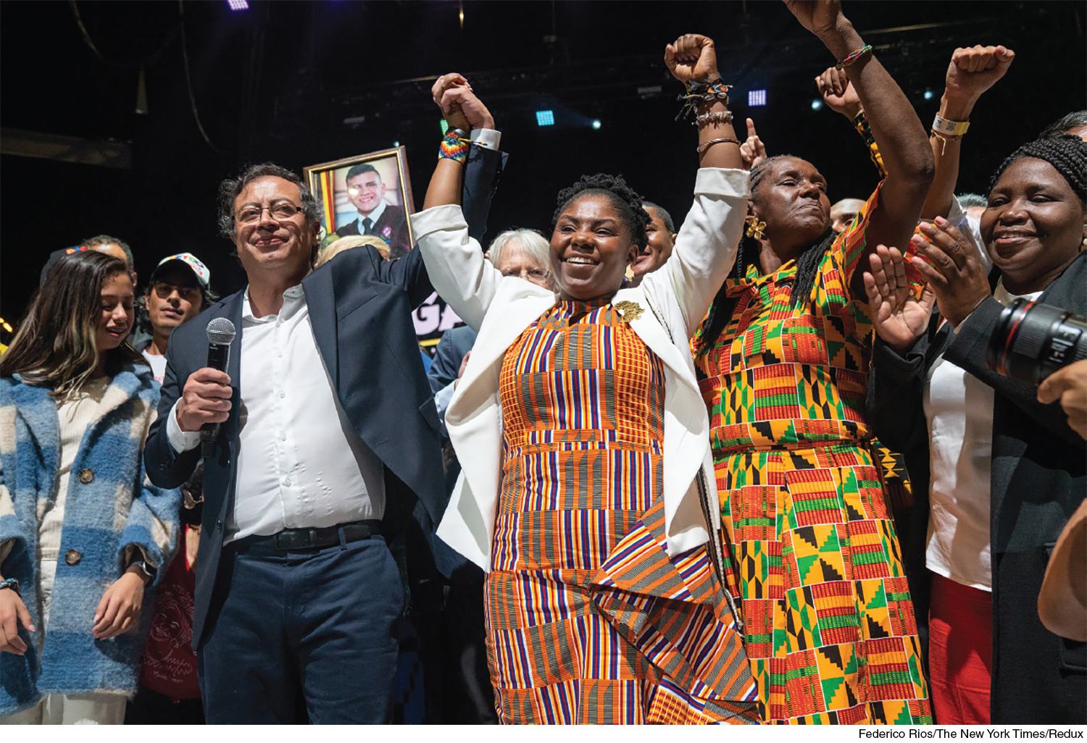
Petro and Marquez
Born in Blood and Fire, Fifth Edition
Copyright © 2024 W. W. Norton & Company
Notes:
PETRO AND MARQUEZ. The 2022 election of Colombia’s new president and vice president marked a dramatic new beginning in the long-tormented political history of Latin America’s third largest nation, the first government of the democratic socialist left and the first woman of African descent to rise to national leadership. Federico Rios/The New York Times/Redux.

Slide 21
Latin America in the World
Economic rise of China
Linked to Latin American globalization
Manufactures from China shipped to Latin America
China’s importation of food and raw materials
Relations with the US

Slide 22
Challenges: Indigenous Uprising
Indigenous movements
500th anniversary of Columbus’s landing prompted international meeting in Bolivia
Reflected multiculturalist intellectual trend
Indigenous collided with strong legacies of nationalism
Celebration of mestizo identity (mestizaje/mestiçagem)
Mestizo nationalism sometimes obscured, co-opted or led to racism

Slide 23
A Changing Culture
Honored non-European cultural heritage
Transculturation
Capoeira, an Afro-Brazilian combination of dance and martial arts, has adherents worldwide.
Latin American variants of West African religions
Rise of Protestantism

Slide 24
Unified Black Movement
The effort to advance civil rights of black Brazilians encountered nationalist resistance.
Nearly half of Brazilians are pure or mixed African descent.
Disproportionately poor
Brazil’s Unified Black Movement (MNU)
Ideal of “racial democracy” had been the keystone of national identity since 1930s.

Slide 25
Environmental Degradation
Environmental challenges in Latin America
Worse in developing countries
Avoiding or fixing problems is expensive.
Allowing factories to pollute attracts investment.
Human activities have depleted the Amazon rain forest.
Relatively untouched until 1960s
Brazilian government launched World Bank-funded development.
Ecuadorian Amazon

Slide 26
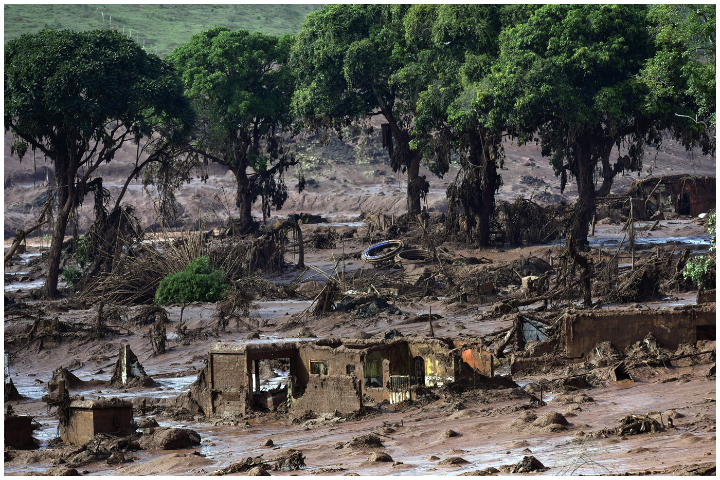
Mining Waste, Brazil
Born in Blood and Fire, Fifth Edition
Copyright © 2024 W. W. Norton & Company
Notes:
MINING WASTE. A wave of toxic mud washed over this Brazilian village when a dam collapsed in 2015, killing at least seventeen people. The devastation associated with
mining affects many countries in Latin America. Douglas Magno/AFP/Getty Images.

Slide 27
Developing the Amazon
Governments are determined to develop the Amazon.
US development of its forested areas
Rain forest uniquely diverse, fragile
Thin Amazonian soil quickly washes away.
Northwest Brazilian state of Rodônia
Ranching accounts for much of deforestation.
Uses much land and little labor
Bulldoze, graze cattle until land becomes unusable
Sell land and move on

Slide 28
Immigration
Latin American population is growing in the United States.
Largest minority group
“Latino” means little outside of the United States.
Immigration is changing US culture.
Spanish-language television, magazines
Changing food culture and preferences
Latin American dance
Large-scale immigration poses challenges.
All the causes of emigration from Latin American nations

Slide 29
This concludes the PowerPoint presentation for Chapter 11: Neoliberalism and Beyond
For additional resources, visit https://digital.wwnorton.com/bornfire5

