Slide 1
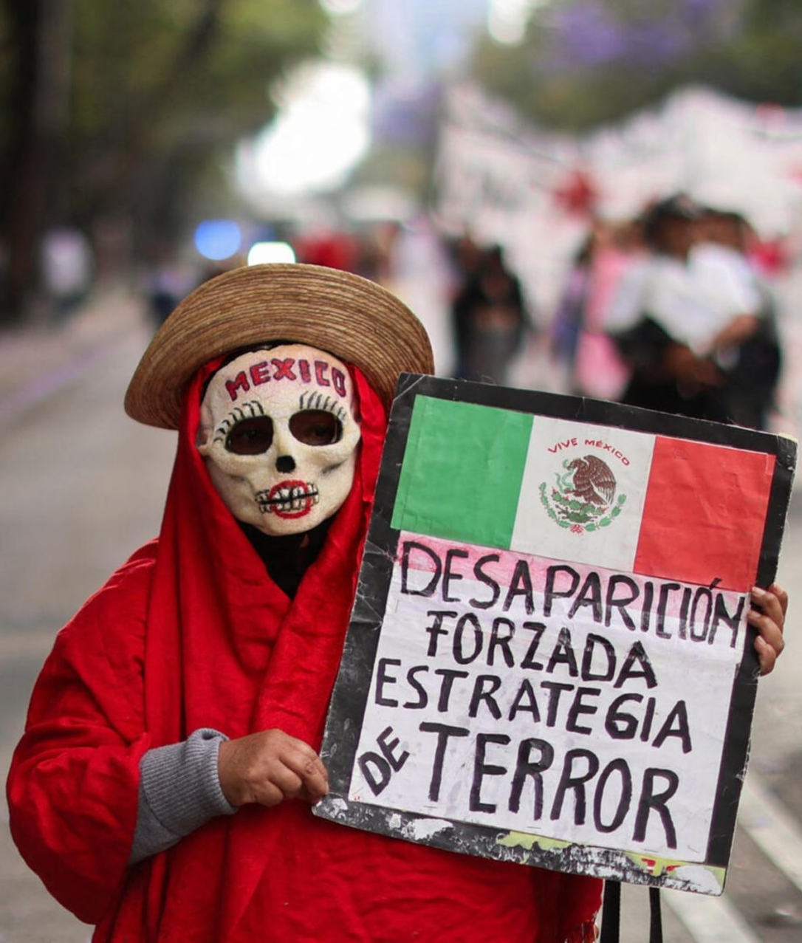
Two Faces of Mexico's Institutional Crisis
Contemporary Mexico reveals a paradoxical governance crisis operating through two opposing forces. From above, populist plebiscitarianism under President Andrés Manuel López Obrador strains traditional checks and balances. From below, criminal organizations like the Cártel Jalisco Nueva Generación erode territorial sovereignty and impose alternative governance structures.
Both phenomena challenge the Mexican state's monopoly on legitimate authority—one by politicizing popular legitimacy against institutions, the other by privatizing coercive power and local governance.

Slide 2
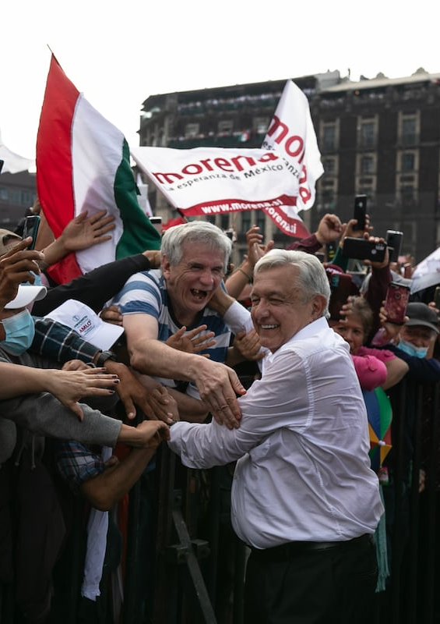
Plebiscitarianism and the Erosion of State Capacity
Since AMLO's 2018 victory, Mexico has faced two simultaneous "stress tests" that reveal the fragility of democratic governance:
Democratic backsliding: Attempts to centralize power and delegitimize horizontal accountability institutions
State capacity erosion: Deep insecurity, pervasive violence, and militarization of civilian life
The nuanced reality: democratic erosion has been contained, but state capacity erosion has intensified dramatically.

Slide 3
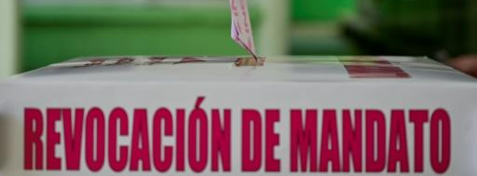
Belligerent Plebiscitarianism in Action
2018
1
AMLO assumes presidency with sweeping electoral victory, promising transformation and direct democracy
2
2022: Recall Referendum
MORENA-promoted referendum intended to re-legitimize president. Low turnout blamed on INE "sabotage"
2022: Reform Campaigns
3
Energy and electoral reforms framed as struggles of "the people" against elites. Blocked reforms prompt "Traidores a la Patria" rhetoric

Slide 4

The Militarization Paradox
AMLO's most profound impact comes not through dismantling democracy, but through transforming the state itself—creating what scholars term a "hollow state."
Military Expansion
Autonomous Agency Erosion
Bureaucratic Hollowing
Armed forces now handle security, airport construction, customs operations, and major infrastructure like Tren Maya
Technical and neutral capacities that stabilized Mexican governance reduced under efficiency and anti-corruption justifications
Budget cuts and unfilled appointments weaken oversight bodies: INE (elections), COFECE (antitrust), INAI (transparency), IFETEL (telecommunications)
Mexico's primary danger may not ne authoritarianism but institutional depletion—a weakened administrative core increasingly reliant on military rather than civilian structures.

Slide 5
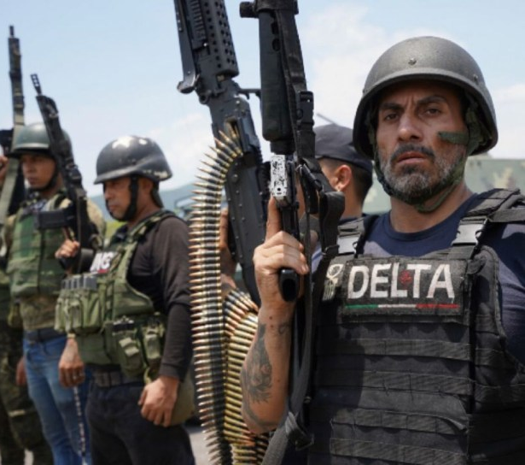
Criminal Governance: The CJNG Model
While the presidency expands plebiscitarian reach, the Cártel Jalisco Nueva Generación has built an alternative governance system combining violent coercion with selective legitimacy.
The CJNG exercises territorial control through:
Paramilitary organization with disciplined structure
Network alliances and flexible local ties
Economic diversification beyond drug trafficking
By 2022, the CJNG operated in approximately 20% of Mexican municipalities, with international cells across continents.

Slide 6
Ruling Violently: Coercion and Legitimacy
Spectacular Violence
Media Propaganda
Internal Discipline
Public displays of brutality enforce obedience and deter rivals. Quasi-military tactics against state forces, including drones and armored convoys.
Strategic use of social media to broadcast power, create fear, and maintain internal cohesion through visibility.
Executions of traitors and forced recruitment create governance mechanism, not merely by-product of operations.
The Legitimacy Paradox
In areas of weak state presence, the CJNG provides rudimentary public goods: protection against petty crime, distribution of food and medicine during crises, and selective charity framed as "defending Mexicans" from corruption.
This produces paradoxical criminal legitimacy—citizens may tolerate or support the cartel in exchange for security and stability, creating dual sovereignty with the Mexican state.

Slide 7
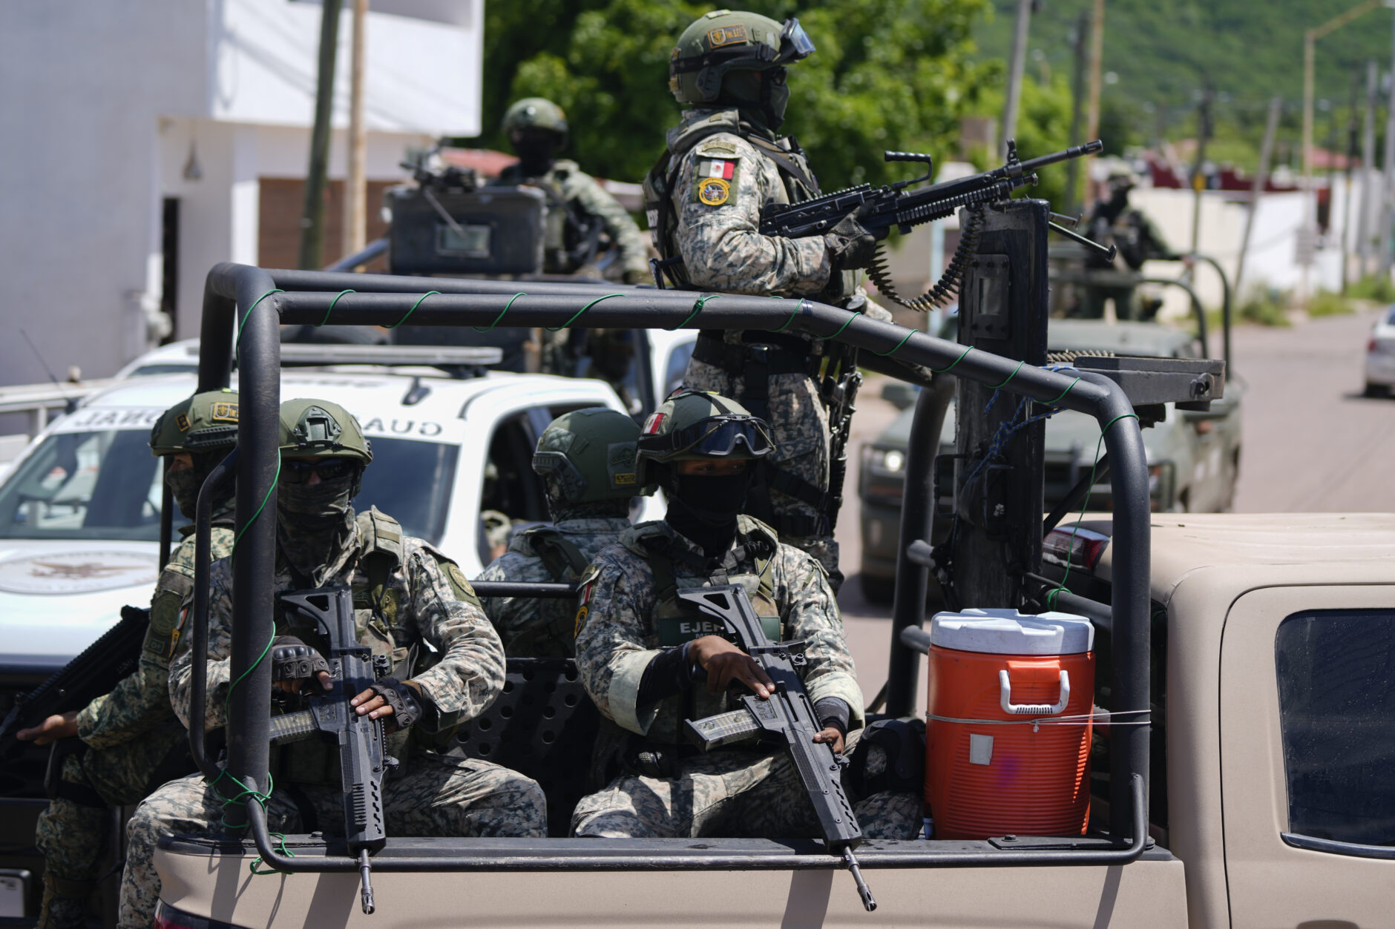
Dual Erosion of State Authority
Plebiscitarianism
Institutional Vacuum
Criminal Governance
Populist executive challenges from above through politicization and militarization
Weak trust and uneven state presence create governance gaps
Organizations challenge from below through coercion and shadow institutions
Both logics reveal the same underlying crisis: the state loses capacity to govern through institutions, relying instead on personal, charismatic, or coercive forms of power.

Slide 8
Governing Through Fear and Faith
Mexico's governance crisis operates along two intertwined frontiers: the populist frontier where leaders claim to embody the nation directly, and the criminal frontier where nonstate actors fill vacuums with violence and patronage.
The Militarization Mirror
Hybrid Conditions Persist
The Path Forward
AMLO's reliance on armed forces as the most effective institution mirrors cartel logic: substituting rule-based authority with personalized or militarized control.
Citizen dissatisfaction, weak institutions, and uneven legitimacy form the soil where both populism and criminal governance thrive. Rebuilding trust requires transparency, social inclusion, and local security.
Neither democracy nor state has collapsed, but both operate under duality: elections coexist with militarized governance; formal legality coexists with informal criminal rule.
Reclaiming democratic institutions means addressing not only horizontal accountability but also the vertical legitimacy crisis that allows alternative forms of authority to flourish.

