Slide 1
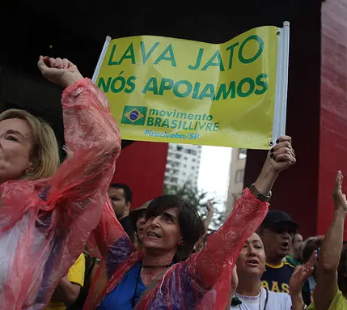
Party Systems, Governance, and Citizen Disaffection in Latin America
As we close our exploration of Latin American politics, we turn to two democracies that illuminate the region's defining paradox. Both Brazil and Chile entered 2022 with robust institutional frameworks and recent histories of democratic stability. Yet both confronted profound crises of citizen confidence.
The tension we examine today centers not on democracy's survival, but on its representation crisis: the weakening of political parties as mediators between citizens and the state, and the widening mismatch between governance capacity and social expectations.
These cases remind us that elections can remain competitive even as governability and legitimacy erode.

Slide 2
Brazil 2022: Party Disintegration and the Politics of Memory
The Erosion of Party Anchors
Brazil's 2022 election was fundamentally a contest between two presidents — Lula and Bolsonaro — rather than between two party programs. The traditional partisan structure that once organized Brazilian politics has collapsed into stark personalization.
The PSDB-PT Era
Bolsonaro's Trajectory
New Mobilization
Traditional center-right and left anchors that structured Brazilian democracy for decades have lost their organizing capacity
Eleven parties in three decades, constant congressional conflict, and failed party creation epitomized partisan disarticulation
Social networks, evangelical churches, and direct affective appeals bypassed traditional representation machinery
Lula's PT: A Party of Memory
Governance and Fragmentation
The PT stands as one of few surviving programmatic parties in Latin America. Its internal discipline and brand identity — petismo — gave Lula an enduring electoral base even after corruption scandals and imprisonment.
Bolsonaro's legislative relationships were purely transactional, relying on the Centrão — ideologically fluid parties trading budgetary amendments for loyalty.
Yet this success reveals critical limits: the PT has become more capable of reactivating nostalgia than articulating new projects.
This short-term coalition logic blurred accountability and deepened public cynicism about corruption and opportunism, transforming policy debates into identity battles.

Slide 3

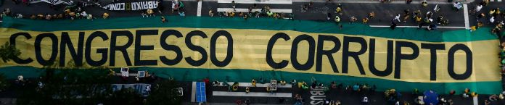
When Identity Replaces Trust
When programmatic parties weaken, affective identity fills the gap. Citizens continue to participate, but through emotional polarization rather than institutional confidence.
Lula's "Party of Memory"
Bolsonaro's "Movement of
Resentment"
The Mirror Effect
Mobilizes nostalgia for past achievements and workers' movement identity, offering continuity with the PT's founding ideals but limited vision for future transformation
Channels anti-establishment anger and cultural grievances, creating cohesion through opposition rather than programmatic proposals
Both mobilize passion and cultivate fierce loyalty. Neither rebuilds institutional trust or creates sustainable governance frameworks
This dynamic explains a recurring regional pattern: citizen support for democracy remains high in the abstract, yet support for democratic institutions remains profoundly fragile. Lula's narrow 2022 victory restored procedural legitimacy but did so without rebuilding the institutional bridges that make democratic governance sustainable.

Slide 4
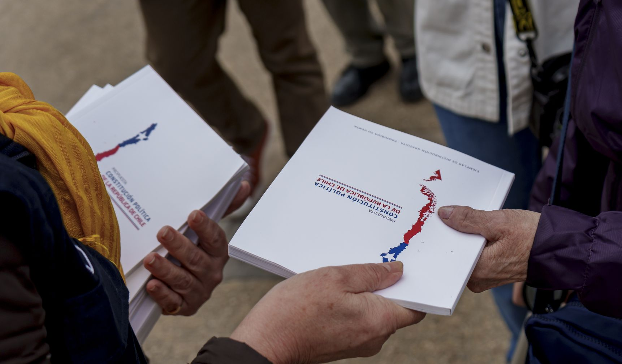
Chile 2022: The Constitutional Moment and the Post-Partisan Dream
Chile entered 2022 with the promise of generational renewal. The Constitutional Convention and the Boric government emerged from a common impulse: to replace elite party politics with participatory, moralized politics.
01
02
Institutional Innovation
The Hidden Cost
Gender parity, reserved indigenous seats, open lists for independents — all designed to bypass traditional parties
Dismantling parties' mediating role in aggregating interests, filtering demands, and disciplining negotiation
03
04
Atomization
Voter Rejection
Independent delegates pursued symbolic causes — animal rights, gastronomy, spirituality — disconnected from material priorities
62% rejected the draft constitution, signaling rejection not just of text but of politics without organization
Boric's Coalition and Governance Limits
President Gabriel Boric faced a parallel dilemma. His coalition, Frente Amplio, emerged from student movements rather than party hierarchies. Its legitimacy derived from moral authority and generational freshness, not institutional experience.
The challenge: outsider structures proved ill-suited for governing a fragmented Congress and managing crises like inflation and the Mapuche conflict.

Slide 5

From Euphoria to Disillusionment
October 2019
1
Social explosion and protests demand new constitution
2
May 2021
Constitutional Convention elected with unprecedented participation
March 2022
3
Boric inaugurated with promises of transformational change
4
September 2022
Constitution rejected by 62% — hopes collapse
Late 2022
5
Pragmatic pivot to experienced politicians stabilizes but alienates base
Political innovation without organizational backbone breeds volatility. Parties once derided as obsolete re-emerged as necessary for stability. Yet in the process, citizens grew profoundly disillusioned.
Early missteps by ministers, internal rivalries, and inconsistent messaging revealed that moral legitimacy cannot replace bureaucratic competence. When the constitutional process collapsed, Boric had to turn to the older, more experienced Socialismo Democrático parties — the very establishment his generation sought to transcend.

Slide 6
Comparative Reflection: Two Paths, One Crisis
Party System
Form of Polarization
Brazil: Hyper-fragmented, with only PT retaining coherence
Brazil: Bipolar personalization (Lula vs. Bolsonaro)
Chile: Collapsing, replaced by independents and movement parties
Chile: Institutional overreach and disconnection
Governance Mode
Citizen Relationship
Brazil: Transactional and clientelistic (Centrão)
Chile: Moral and generational (Frente Amplio)
Brazil: Affective partisanship anchored in memory
Chile: Participatory fatigue and disappointment
Outcome
Brazil: Competitive democracy with weak governability
Chile: Stable democracy with eroded trust
In both countries, citizen engagement persists but confidence in representation weakens. When parties lose credibility, citizens seek immediacy — a direct connection to leaders or causes. Yet these personalized or moralized links cannot sustain the long time horizons that governance requires.
In Brazil
In Chile
Populism substitutes for institutions, creating passionate followings without building sustainable governance capacity
Activism exhausts itself without institutional support, leading from revolutionary enthusiasm to managerial pessimism
Both point to a regional paradox: citizens continue to believe in democracy as an ideal, but not in its intermediaries.

Slide 7
From Representation Crisis to Governance Crisis
1
2
3
Citizen Disaffection
Delegative Democracy
Affective Polarization
The gap between expectations and performance widens when party systems fail to translate social diversity into coherent policy. Citizens disengage not from politics itself, but from its institutional forms.
Presidents claim direct legitimacy from the people, bypassing parties and legislatures. This logic appears in both Bolsonaro's populism and Boric's moral voluntarism, creating governance without mediation.
Emotional attachment replaces institutional confidence. Citizens define themselves "against" others rather than "within" a collective project, transforming democracy into a zero-sum arena.
These dynamics redefine the nature of citizen support: participation remains high, but patience and trust are thin. Without credible parties and effective governance, citizens oscillate between populist enthusiasm and technocratic resignation.
High Participation
Weak Mediation
Citizens continue voting, protesting, debating
Parties fail to connect demands to governance
Eroded Trust
Cyclical Crisis
Institutions lose legitimacy despite democratic procedures
Oscillation between enthusiasm and resignation

Slide 8




Conclusion: After the Cycle of Disaffection
If we zoom out, Latin America's recent experience is not of democratic collapse but of democratic fatigue. Citizens are still voting, protesting, debating — but increasingly against something rather than for something.
Where Governance Works
Where Governance Underperforms
Uruguay and Costa Rica: party systems still mediate expectations, creating stability through institutional trust
Brazil and Chile: citizens swing between the charisma of leaders and the moral urgency of movements
Democracy's endurance no longer guarantees its vitality. Competitive elections and civil liberties persist, but the connective tissue between citizens and governance continues to fray.
Trust Rebuilding
Mediation Restoration
Demonstrating that democratic institutions can deliver responsive, accountable governance
Institutional Reconstruction
Reconnecting citizen expectations to governance realities through transparent processes
Parties must rebuild capacity to aggregate interests and filter demands
For the region — and for us as analysts — the path forward requires recognizing that democratic infrastructure matters as much as democratic ideals. Only by rebuilding the mediating institutions that connect everyday struggles to policy outcomes can Latin American democracies move from survival to genuine vitality.

