Slide 1
Cyclistic Case Study
Analyzing member vs. casual rider behavior to improve conversions
Notes:
Generated by Copilot In this case study, we delve into the behaviors of two distinct groups: members and casual riders. Understanding these differences is crucial for enhancing our conversion strategies. By analyzing how each group interacts with our services, we can identify opportunities to tailor our offerings and marketing efforts. This analysis will ultimately help us convert more casual riders into loyal members, driving growth for Cyclistic. ______

Slide 2

Business Task
Understand differences in behavior between annual members and casual riders. Use insights to inform a marketing strategy to increase memberships.
Notes:
Generated by Copilot The primary objective here is to gain a deeper understanding of the behavioral differences between our annual members and casual riders. By leveraging these insights, we can craft a targeted marketing strategy that not only appeals to casual riders but also encourages them to transition into annual memberships. This approach will help us increase our overall membership base and enhance customer loyalty. ______

Slide 3

Data Source
• Q1 2019 and Q1 2020 Divvy bike-share data
• Public data with anonymized user types
• Cleaned, merged, and prepared for analysis
Notes:
Generated by Copilot The data we are utilizing for this analysis comes from the Divvy bike-share program, specifically from Q1 2019 and Q1 2020. This dataset is publicly available and features anonymized user types, ensuring privacy while allowing us to draw meaningful insights. The data has been meticulously cleaned and merged, making it ready for in-depth analysis, which is essential for our findings. ______

Slide 4
Key Findings
• Members ride more frequently on weekdays
• Casual riders take longer trips, mostly on weekends
• Casual ride durations average 3x longer than members
Notes:
Generated by Copilot Our key findings reveal significant patterns in rider behavior. Members tend to ride more frequently during weekdays, indicating a reliance on our service for daily commutes. In contrast, casual riders prefer longer trips on weekends, suggesting a different usage pattern. Notably, casual rides are, on average, three times longer than those of members, highlighting a potential area for targeted marketing efforts. ______

Slide 5
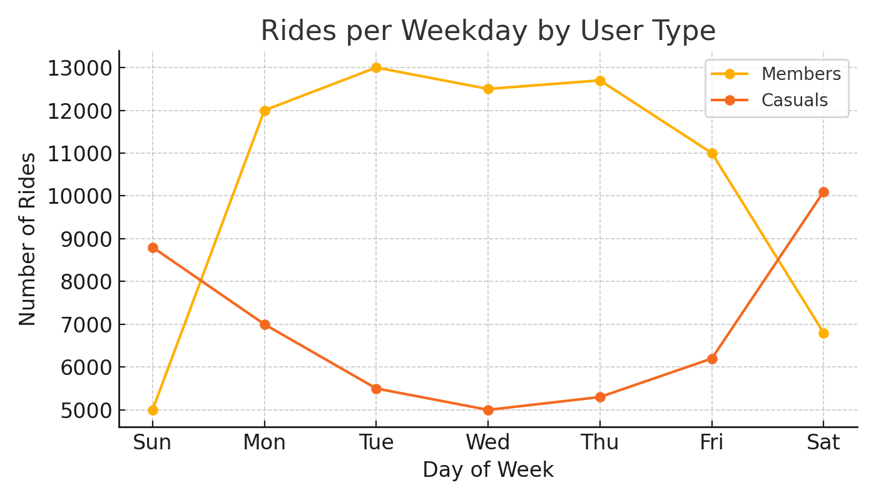
Rides By Weekday by User Type

Slide 6
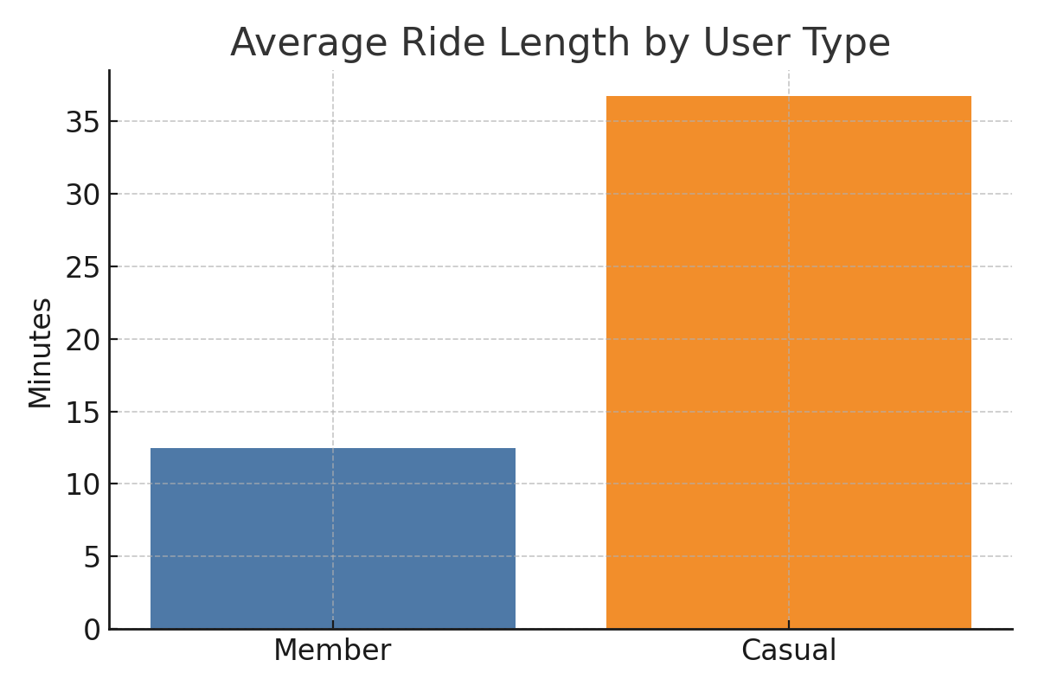
Average Ride Length by User Type

Slide 7
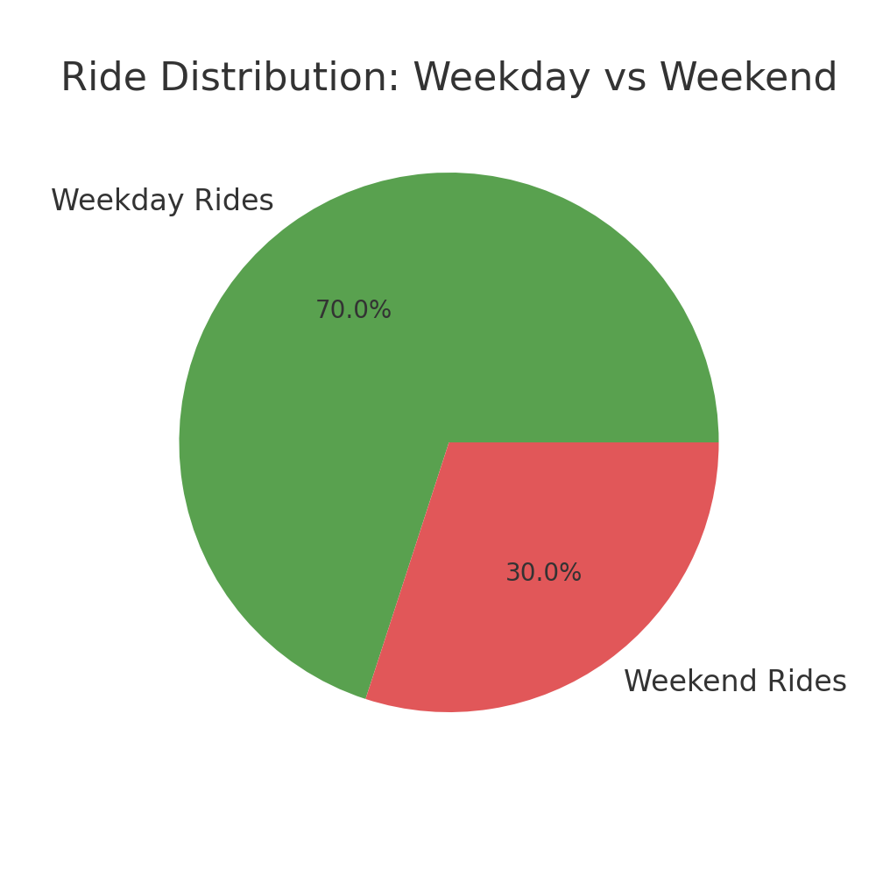

Slide 8
Recommendations
1. Launch weekend offers for casual users
2. Trigger membership prompts after 3 rides
3. Highlight cost savings for commuters
Notes:
Generated by Copilot Based on our findings, we propose several actionable recommendations. First, launching weekend offers could attract casual users and encourage more frequent usage. Second, implementing membership prompts after three rides can effectively convert casual riders into members. Lastly, emphasizing cost savings for commuters can further incentivize membership, making it a more appealing option for potential users. ______

Slide 9

Final Thoughts
Comprehensive Understanding
The presentation provided an in-depth look into the topic, covering key points and significant details.
Informed Decisions
The insights gained empower informed decision-making and strategic planning.
Future Research
The presentation highlights areas for future research to further enhance our understanding.
Notes:
In conclusion, we have explored the various aspects of our topic, delving into key points and significant details. The insights gained from this presentation provide a comprehensive understanding, paving the way for informed decisions and future research. Thank you for your attention and consideration.

Slide 10

Source References
Data Source: Divvy Trip Data (Q1 2019 and Q1 2020) provided by Motivate International Inc.
Data Analysis Tools: Python (Pandas, Matplotlib), Excel
Charts and Visuals created using Python's Matplotlib library based on cleaned and aggregated trip data.
Case study scenario and business questions adapted from Google Data Analytics Certificate Capstone.
Notes:
Please refer to the following sources for more detailed information and further reading: [Insert references here]. Ensuring accurate and reliable references is crucial for substantiating the information provided in this presentation.

