Slide 1


Slide 2
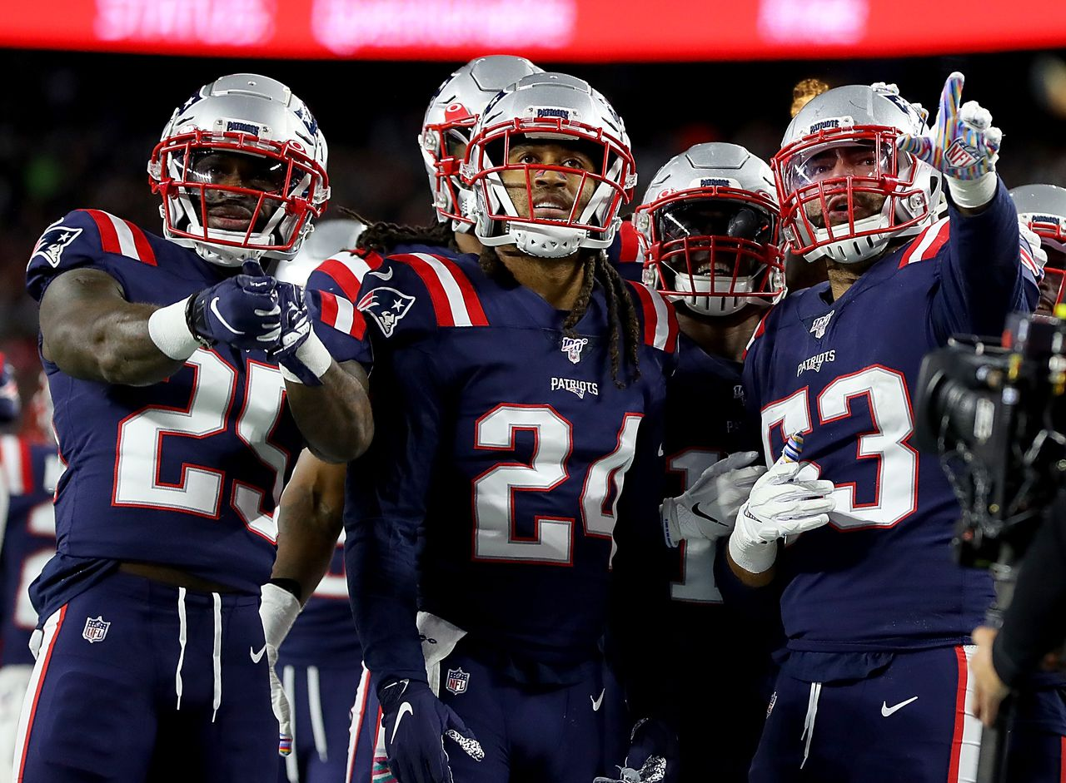

Slide 4
References:
"we are not fukeep-calm-and-dont-be-fussy.png (600×700) (keepcalms.com)ssy" - Bing images
4H77JB6VPBALNKMYL5TZQXW43I.jpg (1280×941) (masslive.com)
NFL and AFL Draft History | Pro-Football-Reference.com (pro-football-reference.com)

