Slide 1

Default Risk Assessment
Yuri Croci
Personal Project

Slide 2
Project Overview
Context & Challenge:
Home Credit provides loans to customers with limited or no credit history, typically rejected by traditional banks.
Traditional credit scoring is insufficient, making it difficult to identify creditworthy applicants and manage default risk.
Project Objective:
Build a predictive model to assess loan default risk and inform lending decision.
Segment customers by risk level to enable differentiated lending strategy.
1

Slide 3
Data Overview
Dataset:
307,511 loan applications containing application details and applicant profile characteristics.
Additional data from external sources including credit bureau history and previous Home Credit applications, decisions, and transactions.
Key characteristics:
Highly unbalanced class with 8% defaulted application over the 92% repaid.
High data sparsity with complex missing value patterns where some missing information carries predictive signal.
Mixed data types including categorical, numerical, and binary variables.
2

Slide 4
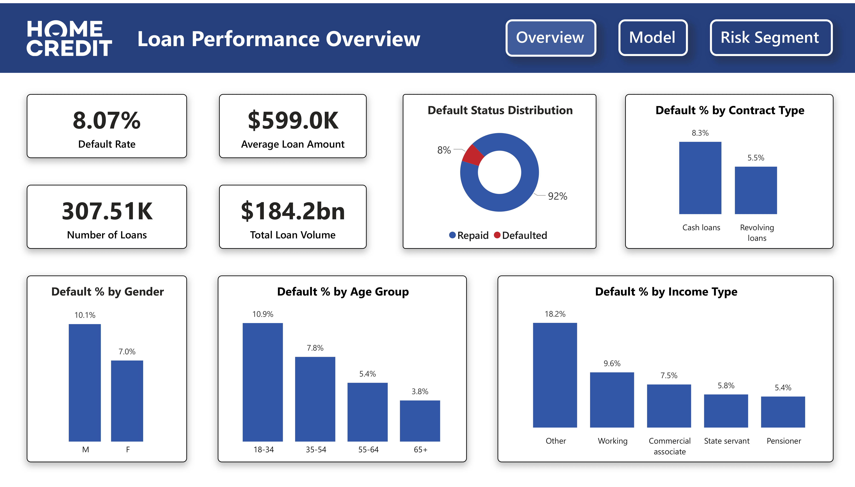
Home Credit Overview
3

Slide 5
Methodology Overview
01
02
03
04
Data Integration
&
Preprocessing
BigQuery
Feature Engineering
&
Modelling
Python
Risk Segmentation
&
Insights
Python
Interactive Dashboard
Power BI
4

Slide 6
Data Preparation & Feature Engineering
Data Preparation:
Data cleaning including outlier treatment, sentinel value normalization, and category consolidation.
Missing value handling with informative flags, temporal feature transformation, and data type conversions.
Feature Engineering:
Multi-table integration aggregating bureau and previous application data to construct historical credit behavior profiles.
Feature selection using phi-k correlation for mixed variable types followed by multicollinearity analysis, reducing from 100+ to 36 relevant features.
5

Slide 7
Modelling Development
Modelling Setup:
80/20 stratified split with cross-validation for hyperparameter tuning to ensure robust performance estimates.
Baseline logistic regression compared against LightGBM for native handling of missing values and mixed data types.
Model Selection:
Threshold optimization via cross-validation folds to prevent data leakage.
Evaluation prioritizing recall and AUC given asymmetric costs of misclassification in default prediction.
LightGBM selected for improved performance and computational efficiency.
6

Slide 8
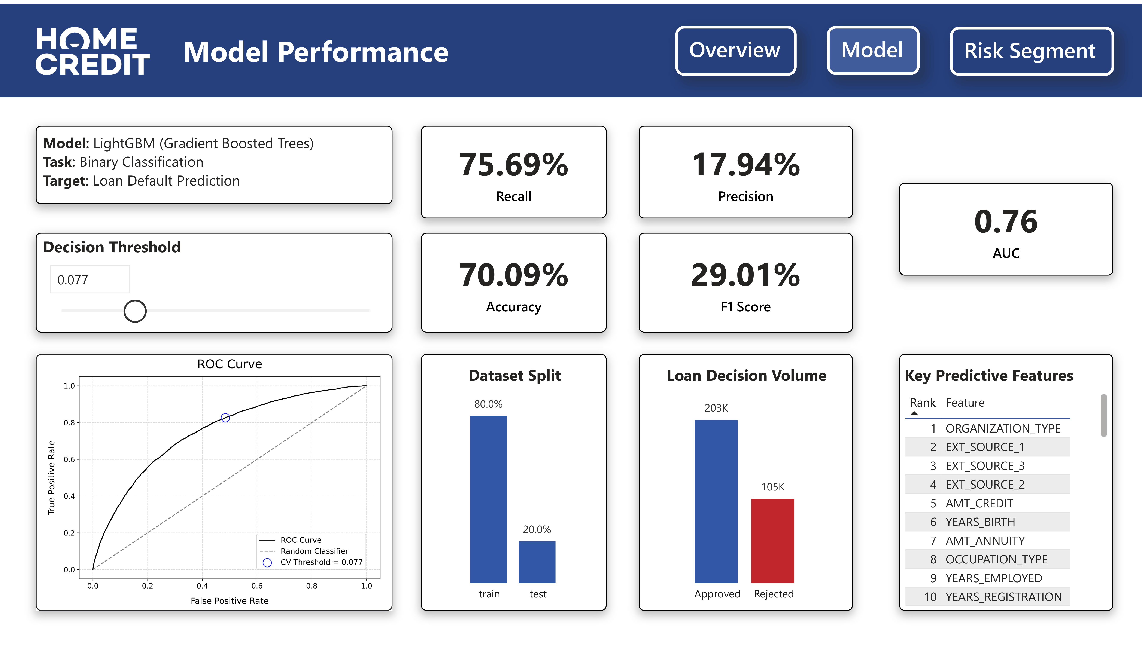
Model Performance
7

Slide 9
Risk Segmentation
Segmentation Approach:
Four-tier risk classification with Very Low (<5%), Low (5-10%), Medium (10-20%), and High (≥20%) based on model predicted probabilities of default.
Feature profiling of the risk segment across demographic, employment, and credit dimensions.
Key Findings:
Increasing average default rates across segments validating risk separation.
Negative correlation between age, employment tenure, education level, and default risk.
Positive correlation with prior loan refusals and multiple active bureau loans.
8

Slide 10
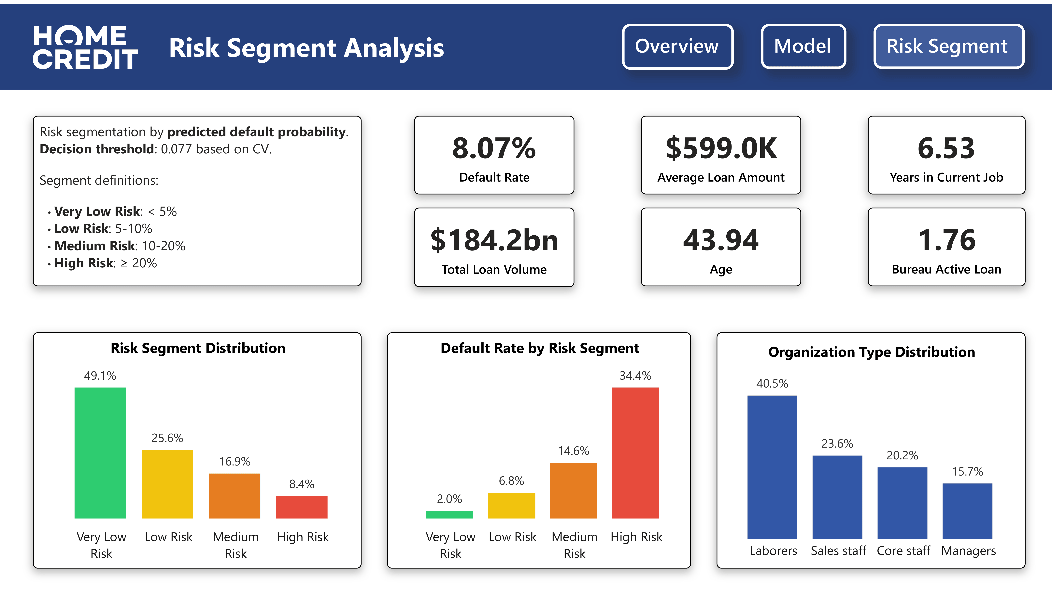
Risk Segment Analysis
9

Slide 11
Recommendations
Streamline approval process through automation for the Very Low Risk segment (49% of applications, 2.0% default rate) while concentrating manual screening resources on Medium and High Risk tiers requiring deeper evaluation.
Implement risk-based pricing strategy with differentiated interest rates and flexible repayment schedules across segments to enable approvals for higher-risk segments through appropriate risk compensation.
Enhance credit evaluation workflows by integrating insights on feature-risk relationships to support decision-making in borderline or uncertain application cases.
10

