Slide 1
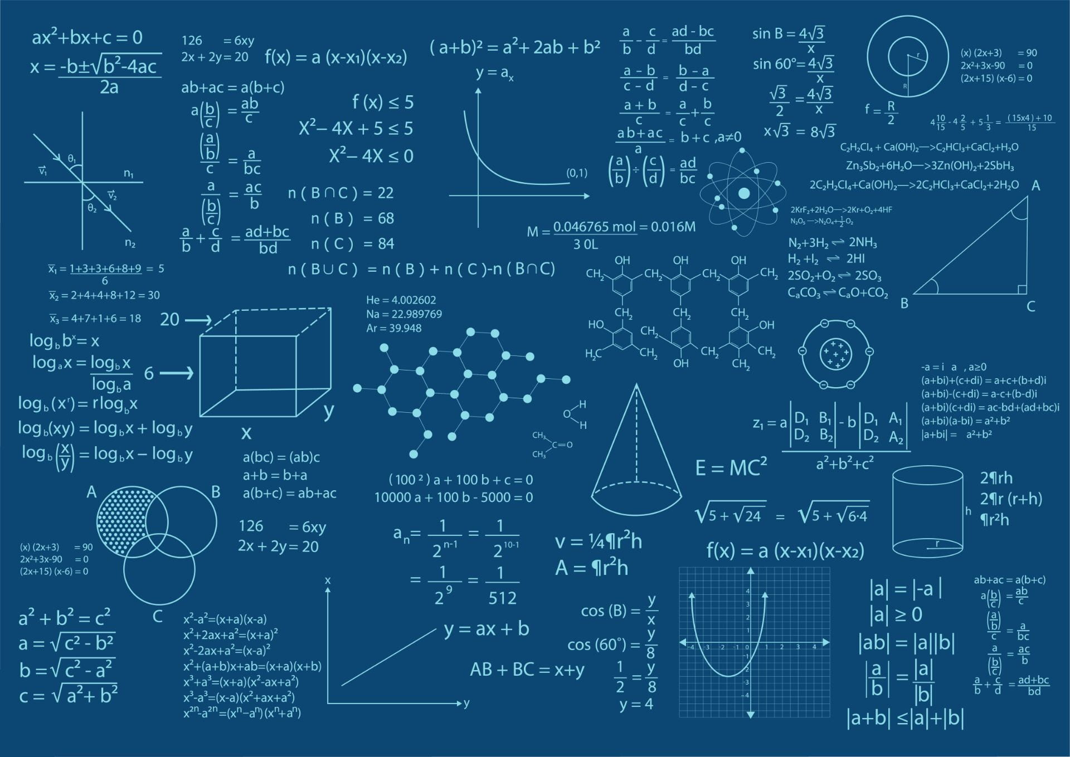
Differential Equation
BASIC CONCEPT OF DIFFERENTIAL EQUATION

Slide 2

DIFFERENTIAL EQUATION
Differential Equation – is an equation involving an unknown function and its derivatives, or simply denoted as DE
If the unknown function depends on only one independent variables the equation is an Ordinary DE. If the unknown function depends on two or more independent variables the equation is a Partial DE.
ODE – ORDINARY DIFFERENTIAL EQUATION
PDE – PARTIAL DIFFERENTIAL EQUATION
Notes:
In mathematics, a partial derivative of a function of several variables is its derivative with respect to one of those variables, with the others held constant (as opposed to the total derivative, in which all variables are allowed to vary). Partial derivatives are used in vector calculus and differential geometry.
In mathematics, a differential equation is an equation that relates a function with its derivatives. It describes how a function changes over time or space, based on the rate of change of the function itself.
"Differential" refers to the derivatives of the function involved in the equation, and "equation" indicates that the expression is set equal to something else.

Slide 3


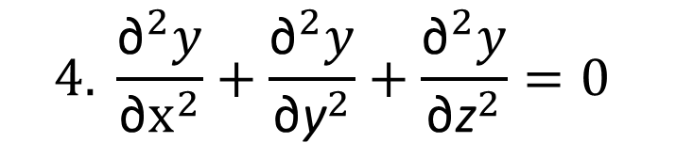

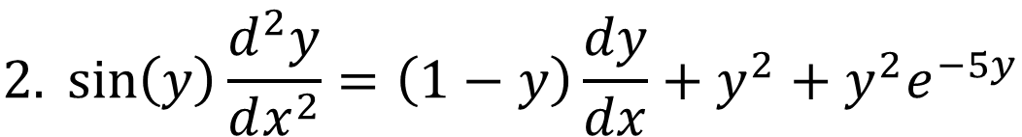

EXAMPLES OF ODE AND PDE
$$1. ay^{′′}+by^{′}+cy=g(t)$$
$$ODE$$
$$2.\sin\left(y\right)\frac{d^{2}y}{dx^{2}}=\left(1−y\right)\frac{dy}{dx}+y^{2}+y^{2}e^{−5y}$$
$$ODE$$
$$3. { y}^{(4)}+10y^{′′′}+4y^{1}+2y=cos⁡(t)$$
$$ODE$$
$$4. \frac{{\text{∂}}^{2}y}{{\text{∂}\text{x}}^{2}}+\frac{{\text{∂}}^{2}y}{{\text{∂}\text{y}}^{2}}+\frac{{\text{∂}}^{2}y}{{\text{∂}\text{z}}^{2}}=0$$
$$PDE$$

Slide 4
ORDER AND DEGREE
Order – The Order of a Differential Equations is the order of the highest derivatives, appearing in equation.
Degree - The Degree of a Differential Equations is the power to which the highest order derivative is raised when differential coefficient are free radicals and Functions

Slide 5



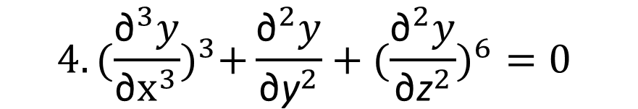
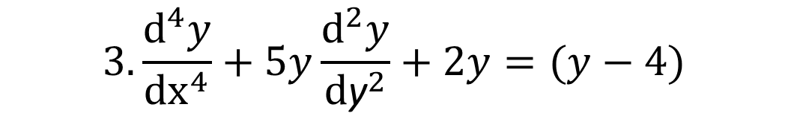



EXAMPLES OF ORDER AND DEGREE
$$1.\frac{d^{′′}y}{dx^{′′}}+y^{3}+1=0$$
$$Order :2$$
$$Degree :1$$
$$2.{x(\frac{d^{2}y}{dx^{2}})}^{3}={−e}^{x}\frac{dy}{dx}$$
$$Order :2$$
$$Degree :3$$
$$3.\frac{{\text{d}}^{4}y}{{\text{d}\text{x}}^{4}}+5y\frac{{\text{d}}^{2}y}{{\text{d}\text{y}}^{2}}+2y=(y−4)$$
$$Order :4$$
$$Degree :1$$
$$4. {(\frac{{\text{∂}}^{3}y}{{\text{∂}\text{x}}^{3}})}^{3}+\frac{{\text{∂}}^{2}y}{{\text{∂}\text{y}}^{2}}+({\frac{{\text{∂}}^{2}y}{{\text{∂}\text{z}}^{2}})}^{6}=0$$
$$Order :3$$
$$Degree :3$$

Slide 6

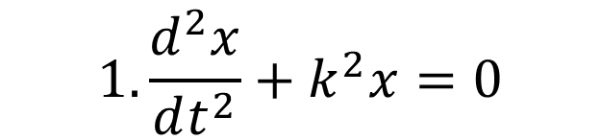
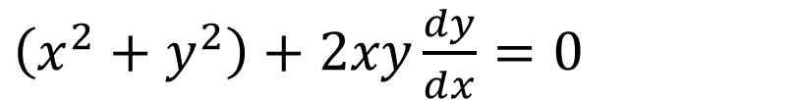

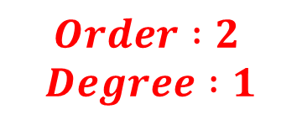
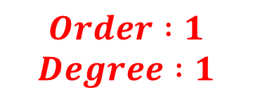

Exercises
State whether the DE is an ODE and PDE and States its Order and Degree.
$$1.\frac{d^{2}x}{dt^{2}}+k^{2}x=0$$
$$Order :2$$
$Degree :1$
$$ODE$$
$2. \left(x^{2}+y^{2}\right)dx+2xydy=0$
$$ODE$$
$$\frac{1}{dx}[\left(x^{2}+y^{2}\right)dx+2xydy=0]\frac{1}{dx}$$
$\left(x^{2}+y^{2}\right)+2xy\frac{dy}{dx}=0$
$$Order :1$$
$Degree :1$

Slide 7
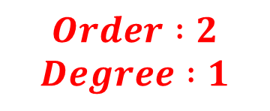
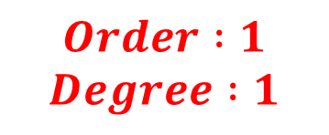
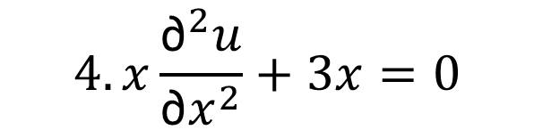

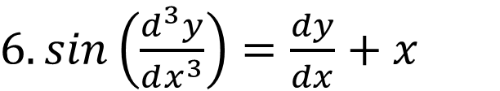


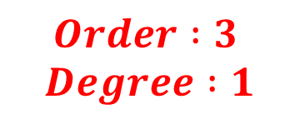
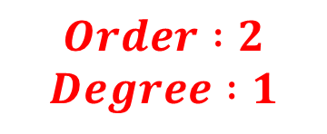
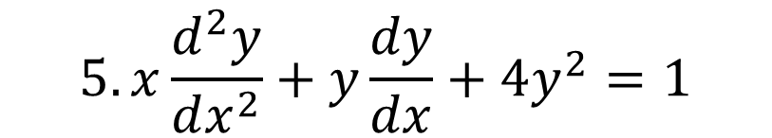

$$ODE$$
$$Order :3$$
$Degree :1$
$3. y^{′′′}−3y^{′}+2y=0$
$$4. x\frac{{\text{∂}}^{2}u}{\text{∂}x^{2}}+3x=0$$
$$Order :2$$
$Degree :1$
$$PDE$$
$$5. x\frac{d^{2}y}{dx^{2}}+y\frac{dy}{dx}+4y^{2}=1$$
$$ODE$$
$$Order :2$$
$Degree :1$
$6. sin\left(\frac{d^{3}y}{dx^{3}}\right)=\frac{dy}{dx}+x$
$$ODE$$
$$Order :1$$
$Degree :1$

Slide 8
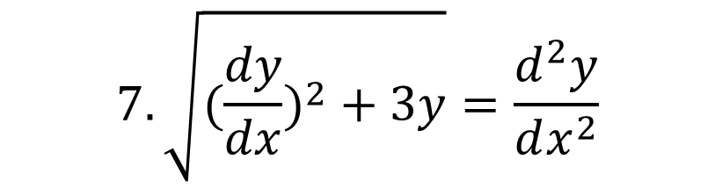
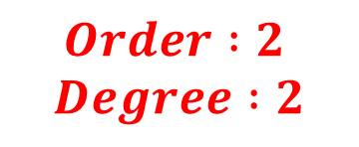
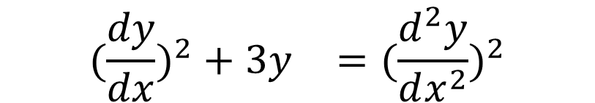
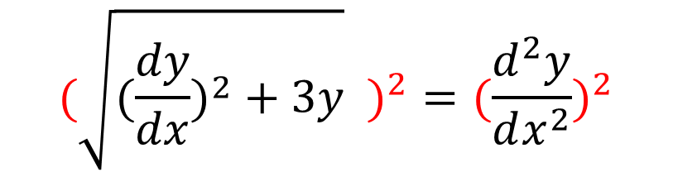

$$7. \sqrt{({\frac{dy}{dx})}^{2}+3y}=\frac{d^{2}y}{dx^{2}}$$
$$ODE$$
$$(\sqrt{({\frac{dy}{dx})}^{2}+3y} )^{2}=(\frac{d^{2}y}{dx^{2}})^{2}$$
$$({{\frac{dy}{dx})}^{2}+3y}^{}=(\frac{d^{2}y}{dx^{2}})^{2}$$
$$Order :2$$
$Degree :2$

Slide 9
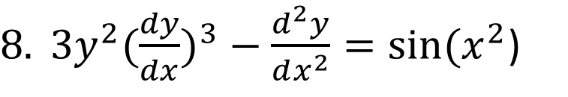

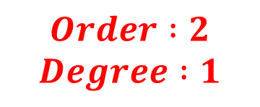
$8. 3y^{2}({\frac{dy}{dx})}^{3}−\frac{d^{2}y}{dx^{2}}=sin⁡(x^{2}$)
$$ODE$$
$$Order :2$$
$Degree :1$

Slide 10
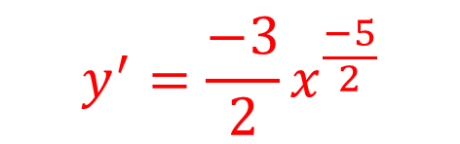
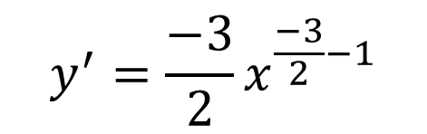



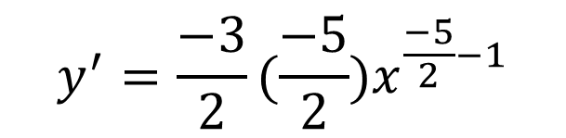
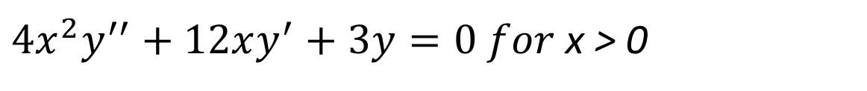
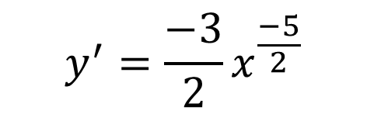
$Show that y\left(x\right)= x^{−\frac{3}{2}} is a solution to$
$4x^{2}y^{′′}+12xy^{′}+3y=0 for$ x > 0
$$Solution:$$
$$y=x^{\frac{−3}{2}}$$
$$y^{′}={\frac{−3}{2}x}^{\frac{−3}{2}−1}$$
$$y^{′}={\frac{−3}{2}x}^{\frac{−5}{2}}$$
$$y^{′}={\frac{−3}{2}(\frac{−5}{2})x}^{\frac{−5}{2}−1}$$
$$y^{′}={\frac{−3}{2}x}^{\frac{−5}{2}}$$
$$y^{′′}={\frac{15}{4}x}^{\frac{−7}{2}}$$

Slide 11
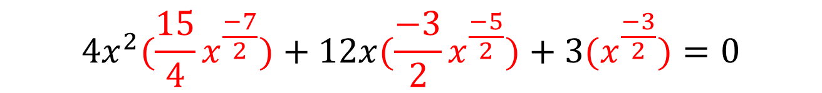
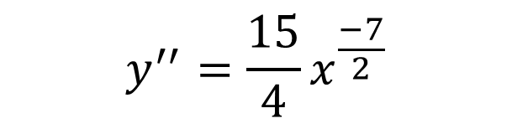
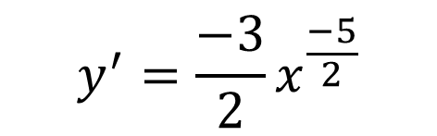

$4x^{2}y^{′′}+12xy^{′}+3y=0 for$ x > 0
$$y=x^{\frac{−3}{2}}$$
$$y^{′}={\frac{−3}{2}x}^{\frac{−5}{2}}$$
$$y^{′′}={\frac{15}{4}x}^{\frac{−7}{2}}$$
$$4x^{2}({\frac{15}{4}x}^{\frac{−7}{2}})+12x{(\frac{−3}{2}x}^{\frac{−5}{2}})+3(x^{\frac{−3}{2}})=0$$
$$15x^{2}\left(x^{\frac{−7}{2}}\right)−18{x(x}^{\frac{−5}{2}})+3(x^{\frac{−3}{2}})=0$$
$$15x^{\frac{−3}{2}}−18x^{\frac{−3}{2}}+3x^{\frac{−3}{2}}=0$$
$$0=0$$

Slide 12

THANK YOU
Rios, Meiko G. (COEDT)

