Slide 1
Data Bases 2
Telcom Service Application
2021-2022
Matteo Savino
Giacomo Vinati

Slide 2
Index
Specification
Revision of the specifications
Conceptual ER and logical data models with SQL DDL
Explanation of the ER diagram
Explanation of the logical model
Trigger design and code
ORM relationship design
Entities code
Interface diagrams of functional analysis of the specifications
List of components
Explanation of the components
UML sequence diagram (for salient events)

Slide 3
Specifications (Consumer Application)
Telco service Applications
A telco company offers prepaid online services to web users. Two client applications using the same database need to be developed.
Consumer Application
The consumer application has a public Landing page with a form for login and a form for registration. Registration requires a username (which can be assumed as the unique identification parameter), a password and an email. Login leads to the Home page of the consumer application. Registration leads back to the landing page where the user can login.The user can log in before browsing the application or browse it without logging in. If the user has logged in, his/her username appears in the top right corner of all the application pages.The Home page of the consumer application displays the service packages offered by the telco company.

Slide 4
Specifications (Consumer Application 2)
Consumer Application 2
A service package has an ID and a name (e.g., “Basic”, “Family”, “Business”, “All Inclusive”, etc). It comprises one or more services. Services are of four types: fixed phone, mobile phone, fixed internet, and mobile internet. The mobile phone service specifies the number of minutes and SMSs included in the package plus the fee for extra minutes and the fee for extra SMSs. The fixed phone service has no specific configuration parameters. The mobile and fixed internet services specify the number of Gigabytes included in the package and the fee for extra Gigabytes. A service package must be associated with one validity period. A validity period specifies the number of months (12, 24, or 36). Each validity period has a different monthly fee (e.g., 20€/month for 12 months, 18€/month for 24 months, and 15€ /month for 36 months). A package may be associated with one or more optional products (e.g., an SMS news feed, an internet TV channel, etc.). The validity period of an optional product is the same as the validity period that the user has chosen for the service package. An optional product has a name and a monthly fee independent of the validity period duration. The same optional product can be offered in different service packages.
From the Home page, the user can access a Buy Service page for purchasing a service package and thus creating a service subscription. The Buy Service page contains a form for purchasing a service package. The form allows the user to select one package from the list of available ones and choose the validity period duration and the optional products to buy together with the chosen service. The form also allows the user to select the start date of his/her subscription. After choosing the service packages, the validity period and (0 or more) optional products, the user can press a CONFIRM button. The application displays a CONFIRMATION page that summarizes the details of the chosen service package, the validity period, the optional products and the total price to be pre-paid: (monthly fee of service package * number of months) + (sum of monthly fees of options * number of months).

Slide 5
Specifications (Consumer Application 3)
Consumer Application 3
If the user has already logged in, the CONFIRMATION page displays a BUY button. If the user has not logged in, the CONFIRMATION page displays a link to the login page and a link to the REGISTRATION page. After either logging in or registering and immediately logging in, the CONFIRMATION page is redisplayed with all the confirmed details and the BUY button. When the user presses the BUY button, an order is created. The order has an ID and a date and hour of creation. It is associated with the user and with the service package, its validity period and the chosen optional products. It also contains the total value (as in the CONFIRMATION page) and the start date of the subscription. After creating the order, the application bills the customer by calling an external service. If the external service accepts the billing, the order is marked as valid and a service activation schedule is created for the user. A service activation schedule is a record of the services and optional products to activate for the user with their date of activation and date of deactivation. If the external service rejects the billing, the order is put in the rejected status and the user is flagged as insolvent. When an insolvent user logs in, the home page also contains the list of rejected orders. The user can select one of such orders, access the CONFIRMATION page, press the BUY button and attempt the payment again. When the same user causes three failed payments, an alert is created in a dedicated auditing table, with the user Id, username, email, and the amount, date and time of the last rejection.

Slide 6
Specifications (Employee Application)
Employee Application
The employee application allows the authorized employees of the telco company to log in. In the Home page, a form allows the creation of service packages, with all the needed data and the possible optional products associated with them. The same page lets the employee create optional products as well. A Sales Report page allows the employee to inspect the essential data about the sales and about the users over the entire lifespan of the application:
Number of total purchases per package.Number of total purchases per package and validity period.
Total value of sales per package with and without the optional products.
Average number of optional products sold together with each service package.
List of insolvent users, suspended orders and alerts.
Best seller optional product, i.e. the optional product with the greatest value of sales across all the sold service packages.

Slide 7
Revision of the specifications
The aggregate data of the sales report is computed by triggers that populate materialized view tables.
The payment will be simulated, for demonstration purposes, by allowing the user to choose if the payment will be successful or rejected.
Triggers regarding service packages, for the sales report page, consider paid orders.
Once a user has failed two payments in a row, every following failed payment will generate an alert, conceivably more alerts for the same order will be created.
Any alert will be deactivated as soon as the user pays the related order.
The system is optimistic so whenever an insolvent user complete a payment he is no longer considered insolvent even if he still has some suspended orders. The system expects the user to pay them as soon as possible.
Activation schedules and alerts are not shown in the home pages of either the consumer or the employee.
Telco service mobile and internet additional data are not shown because in the application they would be used just for displaying purposes.

Slide 8
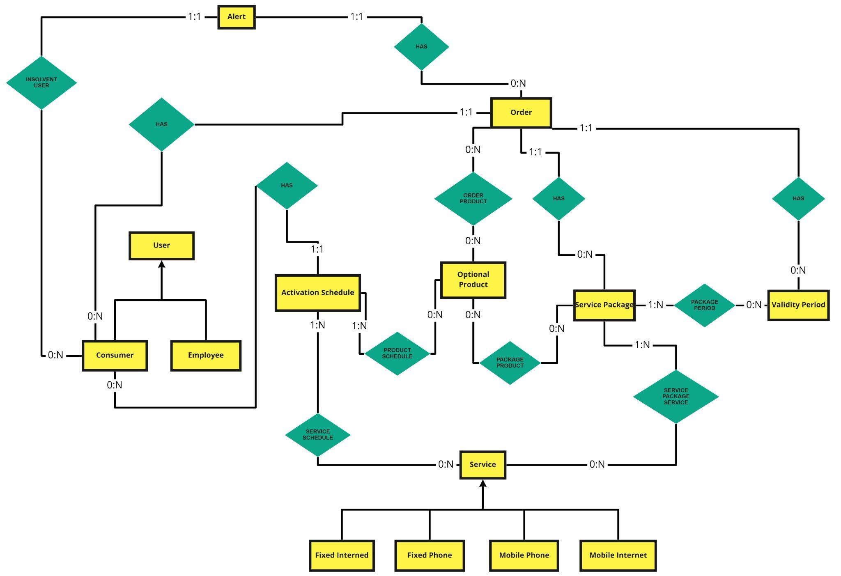
Entity Relationship model 1

Slide 9
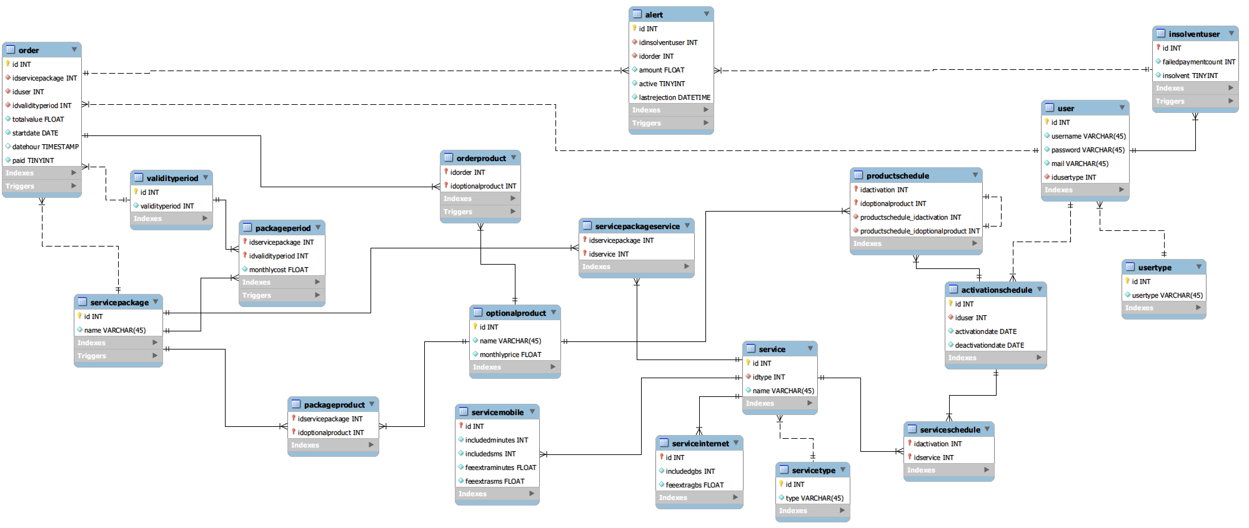
Entity Relationship model 2 (from MySqlWorkbench)

Slide 10
Explanation of ER diagram
The materialized view tables for the sales report page are not in the ER diagram. They would have decreased readability without enhancing the completeness.

Slide 11
Relational model (Logical Data Model) 1
ActivationSchedule(id, iduser, activationdate, deactivationdate)
Alert(id, idinsolventuser, idorder, amount, active, lastrejection)
InsolventUser(id, failedpaymentcount, insolvent)
OptionalProduct(id, name, monthlyprice)
Order(id, idservicepackage, iduser, idvalidityperiod, totalvalue, startdate, datehour, paid)
OrderProduct(idorder, idoptionalproduct)
PackagePeriod(idservicepackage, idvalidityperiod, monthlycost)
PackageProduct(idservicepackage, idoptionalproduct)
ProductSchedule(idactivationschedule, idoptionalproduct)
Service(id, idtype, name)

Slide 12
Relational model 2
ServiceInternet(id, includedgbs, feeextragbs)
ServiceMobile(id, includedminutes, includedsms, feeextraminutes, feeextrasms)
ServicePackage(id, name)
ServicePackageService(idservicepackage, idservice)
ServiceSchedule(idactivationschedule, idservice)
ServiceType(id, type)
User(id, username, password, mail, idusertype)
Usertype(id, usertype)
Validityperiod(id, validityperiod)

Slide 13
Relational model 3 (materialized view)
mv_alerts(id, idalert)
mv_bestproduct(id, idoptionalproduct, value, sales)
mv_insolventuser(id, idinsolventuser)
mv_package(id, idservicepackage, sales, value, valuewithproducts, avgoptionalproducts)
mv_packageperiod(id, idservicepackage, idperiod, sales)
mv_suspendedorders(id, idorder)

Slide 14
Explanation of relational model
In order to increase readability we did not include edges (arrows) in the model. We just underlined the columns that are foreign keys. The table they reference to is easily inferable by column names.
We decided to aggregate the User table and to create additional tables for the columns that are related to the possible specializations.
We decided to aggregate the Service table and to create additional tables for the columns that are related to the possible specializations.

Slide 15
SQL DDL 1
CREATE TABLE `alert` (
`id` int NOT NULL AUTO_INCREMENT,
`idinsolventuser` int NOT NULL,
`idorder` int NOT NULL,
`amount` float NOT NULL,
`active` tinyint NOT NULL DEFAULT '1',
`lastrejection` datetime NOT NULL DEFAULT CURRENT_TIMESTAMP,
PRIMARY KEY (`id`),
UNIQUE KEY `id_UNIQUE` (`id`),
KEY `FK_AlertUser_idx` (`idinsolventuser`),
KEY `FK_AlertOrder_idx` (`idorder`),
CONSTRAINT `FK_AlertOrder` FOREIGN KEY (`idorder`) REFERENCES `order` (`id`) ON DELETE CASCADE ON UPDATE CASCADE,
CONSTRAINT `FK_AlertUser` FOREIGN KEY (`idinsolventuser`) REFERENCES `insolventuser` (`id`) ON DELETE CASCADE ON UPDATE CASCADE
)
CREATE TABLE `activationschedule` (
`id` int NOT NULL AUTO_INCREMENT,
`iduser` int NOT NULL,
`activationdate` date NOT NULL,
`deactivationdate` date NOT NULL,
PRIMARY KEY (`id`),
UNIQUE KEY `id_UNIQUE` (`id`),
KEY `FK_UserActivationSchedule_idx` (`iduser`),
CONSTRAINT `FK_UserActivationSchedule` FOREIGN KEY (`iduser`) REFERENCES `user` (`id`) ON UPDATE CASCADE
)

Slide 16
SQL DDL 2
CREATE TABLE `insolventuser` (
`id` int NOT NULL,
`failedpaymentcount` int NOT NULL DEFAULT '0',
`insolvent` tinyint NOT NULL DEFAULT '0',
PRIMARY KEY (`id`),
UNIQUE KEY `id_UNIQUE` (`id`),
CONSTRAINT `FK_InsolventUser` FOREIGN KEY (`id`) REFERENCES `user` (`id`) ON DELETE CASCADE ON UPDATE CASCADE
)
CREATE TABLE `mv_alerts` (
`id` int NOT NULL AUTO_INCREMENT,
`idalert` int NOT NULL,
PRIMARY KEY (`id`),
UNIQUE KEY `id_UNIQUE` (`id`),
UNIQUE KEY `idalert_UNIQUE` (`idalert`),
CONSTRAINT `FK_idalert` FOREIGN KEY (`idalert`) REFERENCES `alert` (`id`) ON DELETE CASCADE ON UPDATE CASCADE
)

Slide 17
SQL DDL 3
CREATE TABLE `mv_bestproduct` (
`id` int NOT NULL AUTO_INCREMENT,
`idoptionalproduct` int NOT NULL,
`value` float NOT NULL,
`sales` int NOT NULL,
PRIMARY KEY (`id`),
UNIQUE KEY `id_UNIQUE` (`id`),
KEY `FK_MvBestProduct_idx` (`idoptionalproduct`),
CONSTRAINT `FK_MvBestProduct` FOREIGN KEY (`idoptionalproduct`) REFERENCES `optionalproduct` (`id`) ON DELETE CASCADE ON UPDATE CASCADE
)
CREATE TABLE `mv_insolventuser` (
`id` int NOT NULL AUTO_INCREMENT,
`idinsolventuser` int NOT NULL,
PRIMARY KEY (`id`),
UNIQUE KEY `id_UNIQUE` (`id`),
UNIQUE KEY `idinsolventuser_UNIQUE` (`idinsolventuser`),
CONSTRAINT `FK_MVInsolventUser` FOREIGN KEY (`idinsolventuser`) REFERENCES `user` (`id`) ON DELETE CASCADE ON UPDATE CASCADE
)

Slide 18
SQL DDL 4
CREATE TABLE `mv_package` (
`id` int NOT NULL AUTO_INCREMENT,
`idpackage` int NOT NULL,
`sales` int DEFAULT NULL,
`value` float DEFAULT NULL,
`valuewithproducts` float DEFAULT NULL,
`avgoptionalproducts` float DEFAULT NULL,
PRIMARY KEY (`id`),
UNIQUE KEY `id_UNIQUE` (`id`),
UNIQUE KEY `idpackage_UNIQUE` (`idpackage`),
KEY `FL_MVPackage_idx` (`idpackage`),
CONSTRAINT `FL_MVPackage` FOREIGN KEY (`idpackage`) REFERENCES `servicepackage` (`id`) ON DELETE CASCADE ON UPDATE CASCADE
)
CREATE TABLE `mv_packageperiod` (
`id` int NOT NULL AUTO_INCREMENT,
`idpackage` int NOT NULL,
`idperiod` int NOT NULL,
`sales` int NOT NULL,
PRIMARY KEY (`id`),
UNIQUE KEY `id_UNIQUE` (`id`),
KEY `FK_MVPackagePeriod_idx` (`idpackage`),
KEY `FK_MVPackagePeriodPeriod_idx` (`idperiod`),
KEY `FK_MVPackagePeriodVP_idx` (`idperiod`),
CONSTRAINT `FK_MVPackagePeriod` FOREIGN KEY (`idpackage`) REFERENCES `servicepackage` (`id`) ON DELETE CASCADE ON UPDATE CASCADE,
CONSTRAINT `FK_MVPackagePeriodVP` FOREIGN KEY (`idperiod`) REFERENCES `validityperiod` (`id`) ON DELETE CASCADE ON UPDATE CASCADE
)

Slide 19
SQL DDL 5
CREATE TABLE `mv_suspendedorders` (
`id` int NOT NULL AUTO_INCREMENT,
`idorder` int NOT NULL,
PRIMARY KEY (`id`),
UNIQUE KEY `id_UNIQUE` (`id`),
UNIQUE KEY `idorder_UNIQUE` (`idorder`),
CONSTRAINT `FK_MVSuspendedOrders` FOREIGN KEY (`idorder`) REFERENCES `order` (`id`) ON DELETE CASCADE ON UPDATE CASCADE
)
CREATE TABLE `optionalproduct` (
`id` int NOT NULL AUTO_INCREMENT,
`name` varchar(45) NOT NULL,
`monthlyprice` float NOT NULL,
PRIMARY KEY (`id`),
UNIQUE KEY `id_UNIQUE` (`id`)
)

Slide 20
SQL DDL 6
CREATE TABLE `order` (
`id` int NOT NULL AUTO_INCREMENT,
`idservicepackage` int NOT NULL,
`iduser` int NOT NULL,
`idvalidityperiod` int NOT NULL,
`totalvalue` float NOT NULL,
`startdate` date NOT NULL,
`datehour` timestamp NULL DEFAULT CURRENT_TIMESTAMP,
`paid` tinyint NOT NULL DEFAULT '0',
PRIMARY KEY (`id`),
UNIQUE KEY `id_UNIQUE` (`id`),
KEY `OrderUser_idx` (`iduser`),
KEY `OrderPackage_idx` (`idservicepackage`),
KEY `FK_OrderValidityPeriodOfPackage_idx` (`idvalidityperiod`),
CONSTRAINT `FK_OrderPackage` FOREIGN KEY (`idservicepackage`) REFERENCES `servicepackage` (`id`) ON UPDATE CASCADE,
CONSTRAINT `FK_OrderUser` FOREIGN KEY (`iduser`) REFERENCES `user` (`id`) ON UPDATE CASCADE,
CONSTRAINT `FK_OrderValidityPeriodOfPackage` FOREIGN KEY (`idvalidityperiod`) REFERENCES `validityperiod` (`id`) ON UPDATE CASCADE
)

Slide 21
SQL DDL 7
CREATE TABLE `orderproduct` (
`idorder` int NOT NULL,
`idoptionalproduct` int NOT NULL,
PRIMARY KEY (`idorder`,`idoptionalproduct`),
KEY `FK_OptionalProductOrder_idx` (`idoptionalproduct`),
CONSTRAINT `FK_OptionalProductOrder` FOREIGN KEY (`idoptionalproduct`) REFERENCES `optionalproduct` (`id`) ON DELETE CASCADE ON UPDATE CASCADE,
CONSTRAINT `FK_OrderOptionalProduct` FOREIGN KEY (`idorder`) REFERENCES `order` (`id`) ON DELETE CASCADE ON UPDATE CASCADE
)
CREATE TABLE `packageperiod` (
`idservicepackage` int NOT NULL,
`idvalidityperiod` int NOT NULL,
`monthlycost` float NOT NULL,
PRIMARY KEY (`idservicepackage`,`idvalidityperiod`),
KEY `ValidityPeriod_idx` (`idvalidityperiod`),
KEY `ServicePackage_idx` (`idservicepackage`),
CONSTRAINT `FK_ServicePackageValidityPeriod` FOREIGN KEY (`idservicepackage`) REFERENCES `servicepackage` (`id`) ON DELETE CASCADE ON UPDATE CASCADE,
CONSTRAINT `FK_ValidityPeriodServicePackage` FOREIGN KEY (`idvalidityperiod`) REFERENCES `validityperiod` (`id`) ON DELETE CASCADE ON UPDATE CASCADE
)

Slide 22
SQL DDL 8
CREATE TABLE `packageproduct` (
`idservicepackage` int NOT NULL,
`idoptionalproduct` int NOT NULL,
PRIMARY KEY (`idoptionalproduct`,`idservicepackage`),
KEY `ServicePackage_idx` (`idservicepackage`),
CONSTRAINT `FK_OptionalProductServicePackage` FOREIGN KEY (`idoptionalproduct`) REFERENCES `optionalproduct` (`id`) ON DELETE CASCADE ON UPDATE CASCADE,
CONSTRAINT `FK_ServicePackageOptionalProduct` FOREIGN KEY (`idservicepackage`) REFERENCES `servicepackage` (`id`) ON DELETE CASCADE ON UPDATE CASCADE
)
CREATE TABLE `productschedule` (
`idactivation` int NOT NULL,
`idoptionalproduct` int NOT NULL,
PRIMARY KEY (`idactivation`,`idoptionalproduct`),
KEY `FK_OptionalProductActivation_idx` (`idoptionalproduct`),
KEY `FK_ProductActivation_idx` (`idactivation`),
CONSTRAINT `FK_ActivationOP` FOREIGN KEY (`idactivation`) REFERENCES `activationschedule` (`id`) ON DELETE CASCADE ON UPDATE CASCADE,
CONSTRAINT `FK_OptionalProductActivation` FOREIGN KEY (`idoptionalproduct`) REFERENCES `optionalproduct` (`id`) ON UPDATE CASCADE
)

Slide 23
SQL DDL 9
CREATE TABLE `service` (
`id` int NOT NULL AUTO_INCREMENT,
`idtype` int NOT NULL,
`name` varchar(45) NOT NULL,
PRIMARY KEY (`id`),
UNIQUE KEY `id_UNIQUE` (`id`),
UNIQUE KEY `name_UNIQUE` (`name`),
KEY `idtype_idx` (`idtype`),
CONSTRAINT `FK_Type` FOREIGN KEY (`idtype`) REFERENCES `servicetype` (`id`) ON DELETE CASCADE ON UPDATE CASCADE
)
CREATE TABLE `serviceinternet` (
`id` int NOT NULL,
`includedgbs` int NOT NULL,
`feeextragbs` float NOT NULL,
PRIMARY KEY (`id`),
UNIQUE KEY `id_UNIQUE` (`id`),
CONSTRAINT `FK_ServiceInternet` FOREIGN KEY (`id`) REFERENCES `service` (`id`) ON DELETE CASCADE ON UPDATE CASCADE
)

Slide 24
SQL DDL 10
CREATE TABLE `servicemobile` (
`id` int NOT NULL,
`includedminutes` int NOT NULL,
`includedsms` int NOT NULL,
`feeextraminutes` float NOT NULL,
`feeextrasms` float NOT NULL,
PRIMARY KEY (`id`),
UNIQUE KEY `id_UNIQUE` (`id`),
CONSTRAINT `FK_ServiceMobile` FOREIGN KEY (`id`) REFERENCES `service` (`id`) ON DELETE CASCADE ON UPDATE CASCADE
)
CREATE TABLE `servicepackage` (
`id` int NOT NULL AUTO_INCREMENT,
`name` varchar(45) NOT NULL,
PRIMARY KEY (`id`),
UNIQUE KEY `id_UNIQUE` (`id`),
UNIQUE KEY `name_UNIQUE` (`name`)
)

Slide 25
SQL DDL 11
CREATE TABLE `servicepackageservice` (
`idservicepackage` int NOT NULL,
`idservice` int NOT NULL,
PRIMARY KEY (`idservicepackage`,`idservice`),
KEY `FK_ServicePackageService2_idx` (`idservice`),
CONSTRAINT `FK_ServicePackageService` FOREIGN KEY (`idservicepackage`) REFERENCES `servicepackage` (`id`) ON DELETE CASCADE ON UPDATE CASCADE,
CONSTRAINT `FK_ServicePackageService2` FOREIGN KEY (`idservice`) REFERENCES `service` (`id`) ON DELETE CASCADE ON UPDATE CASCADE
)
CREATE TABLE `serviceschedule` (
`idactivation` int NOT NULL,
`idservice` int NOT NULL,
PRIMARY KEY (`idactivation`,`idservice`),
KEY `FK_ServiceActivation_idx` (`idservice`),
KEY `FK_ActivationS_idx` (`idactivation`),
CONSTRAINT `FK_ActivationS` FOREIGN KEY (`idactivation`) REFERENCES `activationschedule` (`id`) ON DELETE CASCADE ON UPDATE CASCADE,
CONSTRAINT `FK_ServiceActivation` FOREIGN KEY (`idservice`) REFERENCES `service` (`id`) ON UPDATE CASCADE
)

Slide 26
SQL DDL 12
CREATE TABLE `servicetype` (
`id` int NOT NULL AUTO_INCREMENT,
`type` varchar(45) NOT NULL,
PRIMARY KEY (`id`),
UNIQUE KEY `id_UNIQUE` (`id`)
)
CREATE TABLE `user` (
`id` int NOT NULL AUTO_INCREMENT,
`username` varchar(45) NOT NULL,
`password` varchar(45) NOT NULL,
`mail` varchar(45) NOT NULL,
`idusertype` int NOT NULL,
PRIMARY KEY (`id`),
UNIQUE KEY `username_UNIQUE` (`username`),
UNIQUE KEY `id_UNIQUE` (`id`),
UNIQUE KEY `mail_UNIQUE` (`mail`),
KEY `FK_UserType_idx` (`idusertype`),
CONSTRAINT `FK_UserType` FOREIGN KEY (`idusertype`) REFERENCES `usertype` (`id`)
)
CREATE TABLE `usertype` (
`id` int NOT NULL AUTO_INCREMENT,
`usertype` varchar(45) NOT NULL,
PRIMARY KEY (`id`),
UNIQUE KEY `id_UNIQUE` (`id`),
UNIQUE KEY `usertype_UNIQUE` (`usertype`)
)

Slide 27
SQL DDL 13
CREATE TABLE `validityperiod` (
`id` int NOT NULL AUTO_INCREMENT,
`validityperiod` int NOT NULL,
PRIMARY KEY (`id`),
UNIQUE KEY `id_UNIQUE` (`id`)
)

Slide 28
Triggers design and code
The triggers are used to fill materialized view tables to allow the employee to get this data:
Insolvent Users, Suspended orders, Alerts
Best seller optional product
Number of sales per package and validity period (Package period)
Number of sales, value of sales, value of sales with optional products, average number of optional product sold per package (Package)

Slide 29
Triggers 1.1 (Insolvent Users)
CREATE TRIGGER db2_savino_vinati.MV_UserBecomesInsolventUpdate
AFTER UPDATE
ON db2_savino_vinati.insolventuser
FOR EACH ROW
BEGIN
IF (OLD.insolvent = 0 AND NEW.insolvent= 1) THEN
INSERT INTO mv_insolventuser(idinsolventuser)
VALUES(new.id);
ELSEIF(OLD.insolvent = 1 AND NEW.insolvent = 0) THEN
DELETE FROM mv_insolventuser WHERE idinsolventuser = new.id;
END IF;
END

Slide 30
Triggers 1.2 (Suspended orders)
CREATE
TRIGGER db2_savino_vinati.MV_SuspendedOrderInsert
AFTER INSERT
ON db2_savino_vinati.`order`
FOR EACH ROW
BEGIN
IF (NEW.paid = 0) THEN
INSERT INTO mv_suspendedorders(idorder)
VALUES(new.id);
END IF;
END
CREATE
TRIGGER db2_savino_vinati.MV_SuspendedOrderUpdate
AFTER UPDATE
ON db2_savino_vinati.`order`
FOR EACH ROW
BEGIN
IF (OLD.paid = 0 AND NEW.paid = 1) THEN
DELETE FROM mv_suspendedorders
WHERE idorder = old.id;
END IF;
END

Slide 31
Triggers 1.3 (Alerts)
CREATE
TRIGGER db2_savino_vinati.MV_AlertUpdate
AFTER UPDATE
ON db2_savino_vinati.alert
FOR EACH ROW
BEGIN
IF (OLD.active = 1 AND NEW.active = 0) THEN
DELETE FROM mv_alerts WHERE idalert = new.id;
END IF;
END
CREATE
TRIGGER db2_savino_vinati.MV_AlertInsert
AFTER INSERT
ON db2_savino_vinati.alert
FOR EACH ROW
BEGIN
IF (NEW.active = 1) THEN
INSERT INTO mv_alerts (idalert)
VALUES (new.id);
END IF;
END

Slide 32
Triggers 2.1 (BestProduct)
CREATE TRIGGER db2_savino_vinati.MV_BestProduct
AFTER INSERT ON db2_savino_vinati.orderproduct
FOR EACH ROW
BEGIN
DECLARE countBP INTEGER;
DECLARE valueBP float;
DECLARE salesBP integer;
DECLARE idBP integer;
SELECT COUNT(*) into countBP
FROM mv_bestproduct;
IF countBP < 1 THEN
INSERT INTO mv_bestproduct (idoptionalproduct, value, sales) VALUES(new.idoptionalproduct, 0, 0);
END IF;
SELECT op.idoptionalproduct as idoptionalproduct, SUM(opp.monthlyprice * vp.validityperiod) as `value`, COUNT(op.idorder) as sales
INTO idBP, valueBP, salesBP FROM `order` o
LEFT JOIN validityperiod vp ON o.idvalidityperiod = vp.id
LEFT JOIN orderproduct op ON o.id = op.idorder
LEFT JOIN optionalproduct opp ON op.idoptionalproduct = opp.id
WHERE o.paid = 1
GROUP BY opp.id ORDER BY `value` DESC LIMIT 1;
UPDATE mv_bestproduct SET idoptionalproduct = idBP, `value` = valueBP, sales = salesBP;
END

Slide 33
Triggers 2.2 (BestProduct)
CREATE TRIGGER db2_savino_vinati.MV_BestProductUpdate
AFTER UPDATE ON db2_savino_vinati.`order`
FOR EACH ROW
BEGIN
DECLARE valueBP float;
DECLARE salesBP integer;
DECLARE idBP integer;
IF old.paid = 0 AND new.paid = 1 THEN
SELECT op.idoptionalproduct as idoptionalproduct, SUM(opp.monthlyprice * vp.validityperiod) as `value`, COUNT(op.idorder) as sales
INTO idBP, valueBP, salesBP FROM `order` o
LEFT JOIN validityperiod vp ON o.idvalidityperiod = vp.id
LEFT JOIN orderproduct op ON o.id = op.idorder
LEFT JOIN optionalproduct opp ON op.idoptionalproduct = opp.id
WHERE o.paid = 1 GROUP BY opp.id ORDER BY `value` DESC
LIMIT 1;
UPDATE mv_bestproduct SET idoptionalproduct = idBP, `value` = valueBP, sales = salesBP;
END IF;
END

Slide 34
Triggers 3.1 (Package Period)
CREATE TRIGGER db2_savino_vinati.MV_PackagePeriodOrderInsert
AFTER INSERT ON db2_savino_vinati.`order`
FOR EACH ROW
BEGIN
DECLARE countPOI integer;
DECLARE periodPP integer;
DECLARE idservicepackagePP integer;
DECLARE salesPP integer;
SET idservicepackagePP = new.idservicepackage;
SET periodPP = new.idvalidityperiod;
SELECT COUNT(*) into countPOI FROM mv_packageperiod mvp
WHERE mvp.idpackage = idservicepackagePP AND mvp.idperiod = periodPP;
IF countPOI < 1 THEN
INSERT INTO mv_packageperiod ( idpackage, idperiod, sales) VALUES ( idservicepackagePP, periodPP, 0 );
END IF;
SELECT COUNT(o.id) INTO salesPP FROM `order` o
WHERE o.paid = 1 AND o.idservicepackage = idservicepackagePP AND o.idvalidityperiod = periodPP;
IF new.paid= 1 THEN
UPDATE mv_packageperiod mvp SET mvp.sales = salesPP WHERE mvp.idpackage = idservicepackagePP AND mvp.idperiod = periodPP;
END IF;
END

Slide 35
Triggers 3.2 (Package Period)
CREATE TRIGGER db2_savino_vinati.MV_PackagePeriodOrderUpdate
AFTER UPDATE ON db2_savino_vinati.`order`
FOR EACH ROW
FOLLOWS MV_PackageUpdateOrder
BEGIN
DECLARE periodPP integer;
DECLARE idservicepackagePP integer;
DECLARE salesPP integer;
IF old.paid = 0 AND new.paid = 1 THEN
SET idservicepackagePP = new.idservicepackage;
SET periodPP = new.idvalidityperiod;
SELECT COUNT(o.id) INTO salesPP FROM `order` o
WHERE o.paid = 1 AND o.idservicepackage = idservicepackagePP AND o.idvalidityperiod = periodPP;
UPDATE mv_packageperiod mvp SET mvp.sales = salesPP WHERE mvp.idpackage = idservicepackagePP AND mvp.idperiod= periodPP;
END IF;
END

Slide 36
Triggers 3.3 (Package Period)
CREATE TRIGGER db2_savino_vinati.MV_PackagePeriodPackageInsert
AFTER INSERT
ON db2_savino_vinati.packageperiod
FOR EACH ROW
BEGIN
DECLARE periodPP integer;
DECLARE idservicepackagePP integer;
SET idservicepackagePP = new.idservicepackage;
SET periodPP = new.idvalidityperiod;
INSERT INTO mv_packageperiod (idpackage, idperiod, sales) VALUES (idservicepackagePP,periodPP,0);
END

Slide 37
Triggers 3.4 (Package Period)
CREATE TRIGGER db2_savino_vinati.MV_PackageOrderProductInsert
AFTER INSERT ON db2_savino_vinati.orderproduct
FOR EACH ROW
BEGIN
DECLARE avgoptionalproductsPI float;
DECLARE paidPI tinyint;
DECLARE idpackagePI int;
SELECT o.idservicepackage, o.paid INTO idpackagePI, paidPI FROM `order` o WHERE o.id = new.idorder;
IF paidPI = 1 THEN
SELECT CAST(AVG(a.count)as FLOAT) as avgoptionalproducts INTO avgoptionalproductsPI
FROM servicepackage sp
LEFT JOIN `order` o ON sp.id = o.idservicepackage
LEFT JOIN ( SELECT op.idorder as idorder, COUNT(op.idorder) as count FROM orderproduct op
GROUP BY idorder ) as a
ON a.idorder = o.id WHERE idpackagePI = o.idservicepackage AND o.paid = 1 GROUP BY sp.id;
UPDATE mv_package SET avgoptionalproducts = avgoptionalproductsPI
WHERE mv_package.idpackage = idpackagePI;
END IF;
END

Slide 38
Triggers 4.1 (Package)
CREATE
TRIGGER db2_savino_vinati.MV_Package
AFTER INSERT
ON db2_savino_vinati.servicepackage
FOR EACH ROW
BEGIN
INSERT INTO mv_package (idpackage, sales, `value`, valuewithproducts, avgoptionalproducts)
VALUES (new.id,null,null,null,null);
END

Slide 39
Triggers 4.2 (Package)
CREATE TRIGGER db2_savino_vinati.MV_PackageInsertOrder
AFTER INSERT ON db2_savino_vinati.`order`
FOR EACH ROW
BEGIN
DECLARE countPI INTEGER; DECLARE idpackagePI INTEGER; DECLARE salesPI integer; DECLARE valuePI float; DECLARE valuewithproductsPI float; DECLARE avgoptionalproductsPI float;
SELECT COUNT(*) into countPI FROM mv_package WHERE new.idservicepackage = mv_package.idpackage;
IF countPI < 1 THEN SET idpackagePI = new.idservicepackage;
INSERT INTO mv_package (idpackage, sales, `value`, valuewithproducts, avgoptionalproducts) VALUES(idpackagePI,0, 0,0,0);
END IF;
SELECT sp.id as idpackage, COUNT(o.id) as sales, SUM(vp.validityperiod * pp.monthlycost) as `value`, SUM(o.totalvalue) as
valuewithproducts, CAST(AVG(a.count)as FLOAT) as avgoptionalproducts INTO idpackagePI,salesPI,valuePI,valuewithproductsPI, avgoptionalproductsPI
FROM servicepackage sp
LEFT JOIN `order` o ON sp.id = o.idservicepackage
LEFT JOIN validityperiod vp ON o.idvalidityperiod = vp.id
LEFT JOIN packageperiod pp ON vp.id = pp.idvalidityperiod AND o.idservicepackage = pp.idservicepackage
LEFT JOIN ( SELECT op.idorder as idorder, COUNT(op.idorder) as
count FROM orderproduct op GROUP BY idorder ) as a
ON a.idorder = o.id WHERE o.idservicepackage = new.idservicepackage AND o.paid
= 1 GROUP BY sp.id;
IF new.paid=1 THEN UPDATE mv_package SET idpackage = idpackagePI, sales = salesPI, `value` = valuePI, valuewithproducts =
valuewithproductsPI, avgoptionalproducts = avgoptionalproductsPI WHERE mv_package.idpackage = new.idservicepackage;
END IF;
END

Slide 40
Triggers 4.3 (Package)
CREATE TRIGGER db2_savino_vinati.MV_PackageNoNull
BEFORE INSERT
ON db2_savino_vinati.mv_package
FOR EACH ROW
BEGIN
IF(new.sales is null) THEN
SET new.sales = 0;
END IF;
IF(new.`value` is null) THEN
SET new.`value` = 0;
END IF;
IF (new.valuewithproducts is null) THEN
SET new.valuewithproducts = 0;
END IF;
IF(new.avgoptionalproducts is null) THEN
SET new.avgoptionalproducts = 0;
END IF;
END

Slide 41
Triggers 4.4(Package)
CREATE TRIGGER db2_savino_vinati.MV_PackageUpdateOrder
AFTER UPDATE ON db2_savino_vinati.`order`
FOR EACH ROW
BEGIN
DECLARE idpackagePI integer; DECLARE salesPI integer; DECLARE valuePI float; DECLARE valuewithproductsPI float; DECLARE avgoptionalproductsPI float;
IF old.paid = 0 AND new.paid = 1 THEN
SELECT sp.id as idpackage, COUNT(o.id) as sales,SUM(vp.validityperiod * pp.monthlycost) as `value`,
SUM(o.totalvalue) as valuewithproducts,CAST(AVG(a.count)as FLOAT) as avgoptionalproducts
INTO idpackagePI,salesPI,valuePI,valuewithproductsPI,avgoptionalproductsPI
FROM servicepackage sp
LEFT JOIN `order` o ON sp.id = o.idservicepackage
LEFT JOIN validityperiod vp ON o.idvalidityperiod = vp.id
LEFT JOIN packageperiod pp ON vp.id = pp.idvalidityperiod AND o.idservicepackage = pp.idservicepackage
LEFT JOIN (SELECT op.idorder as idorder, COUNT(op.idorder) as count FROM orderproduct op GROUP BY idorder ) as a
ON a.idorder = o.id WHERE o.idservicepackage = new.idservicepackage AND o.paid = 1
GROUP BY sp.id;
UPDATE mv_packageSET idpackage = idpackagePI, sales = salesPI, `value` = valuePI, valuewithproducts =
valuewithproductsPI, avgoptionalproducts = avgoptionalproductsPI
WHERE mv_package.idpackage = new.idservicepackage;
END IF;
END

Slide 42
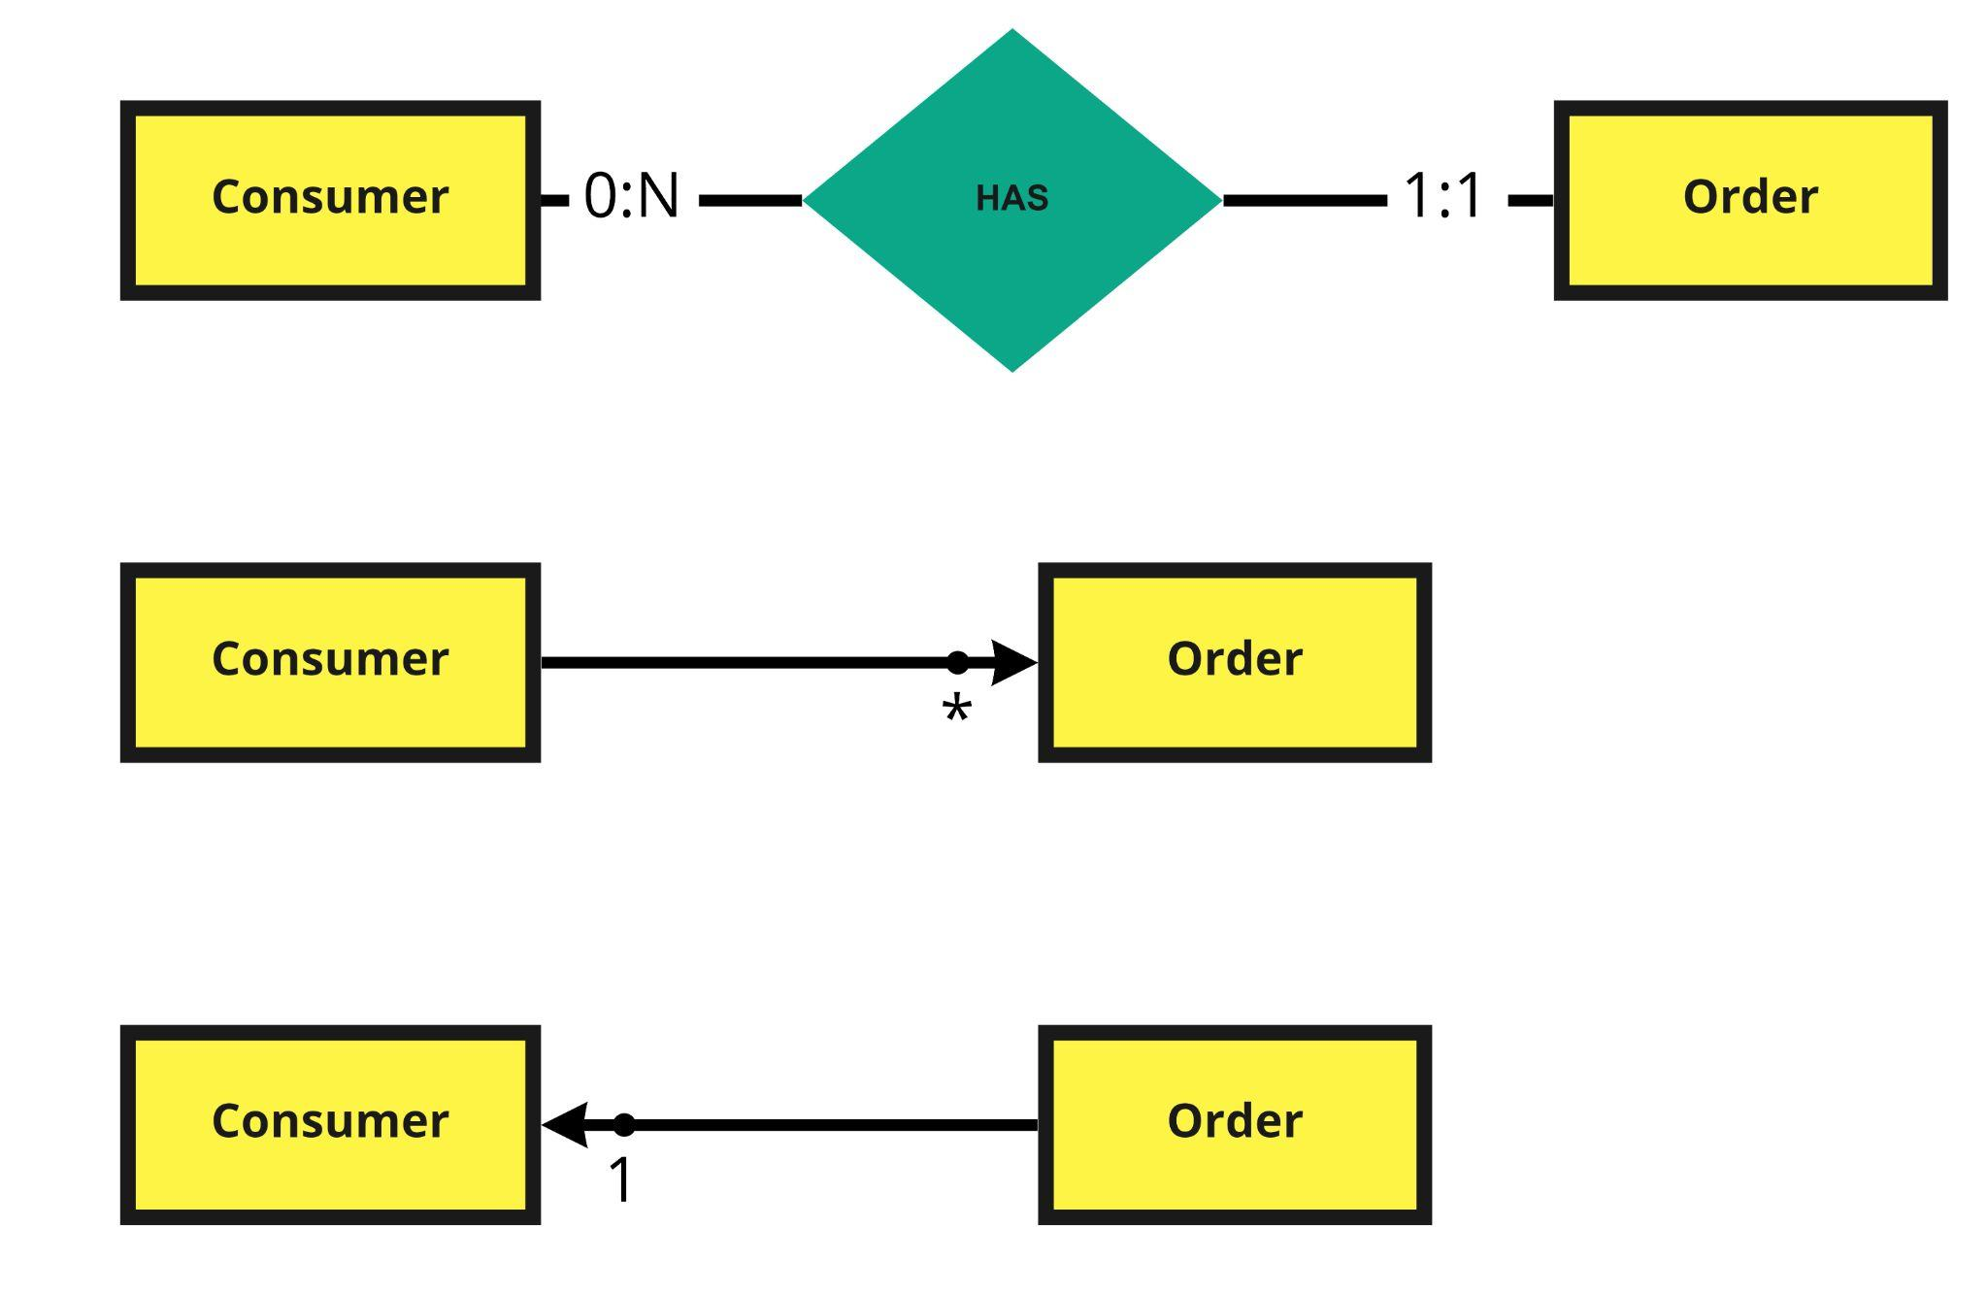
ORM relationship design
•Consumer → Order @OneToMany is necessary to list the order associated to the consumer.
•Order → Consumer @ManyToOne is necessary and it is used for persisting the entity.

Slide 43
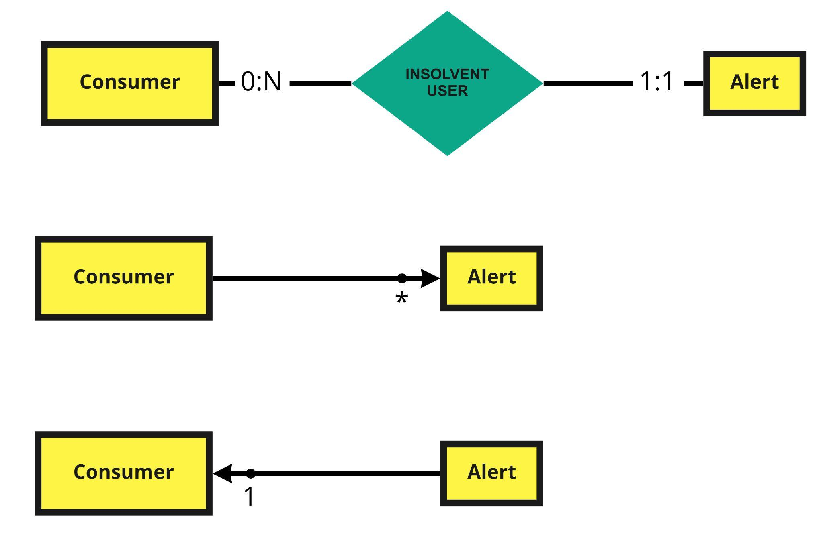
ORM relationship design
•Consumer → Alert @OneToMany is necessary to list the alerts generated in case of rejected transaction (#OfRejectedTransaction >= 3 ).
•Alert→ Consumer @ManyToOne is necessary to persist the alert including the details of the consumer (username and email) which is associated to the entity.

Slide 44
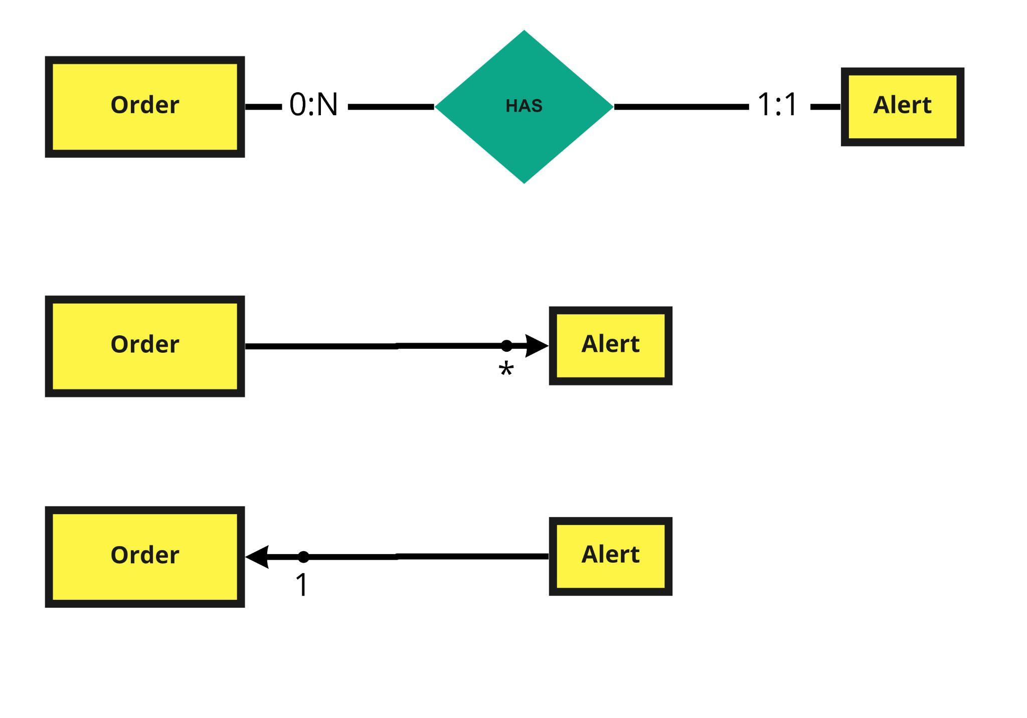
ORM relationship design
•Order → Alert @OneToMany is not necessary.
•Alert → Order @ManyToOne is necessary to persist the alert including the order associated to the entity.

Slide 45
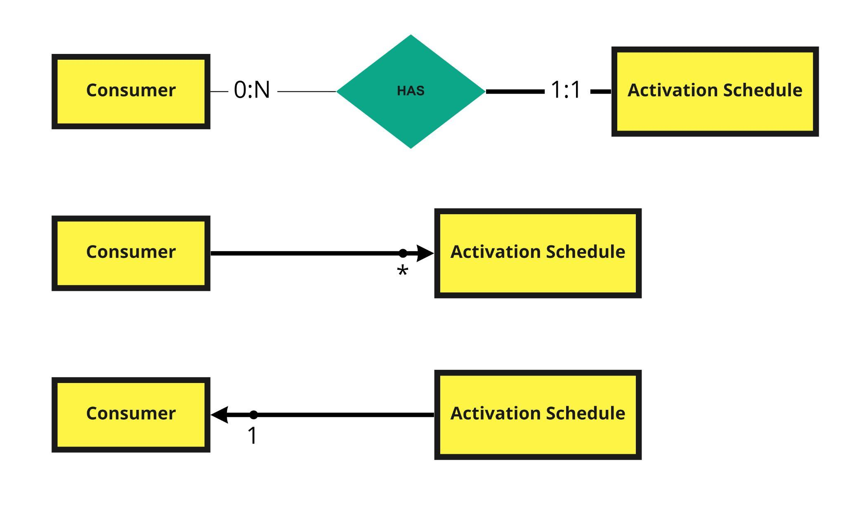
ORM relationship design
•Consumer → Activation Schedule @OneToMany is necessary to persist the activation schedules of the consumer.
•Activation Schedule → Consumer @ManyToOne is necessary to update the inverse relations for persisting the entity.

Slide 46
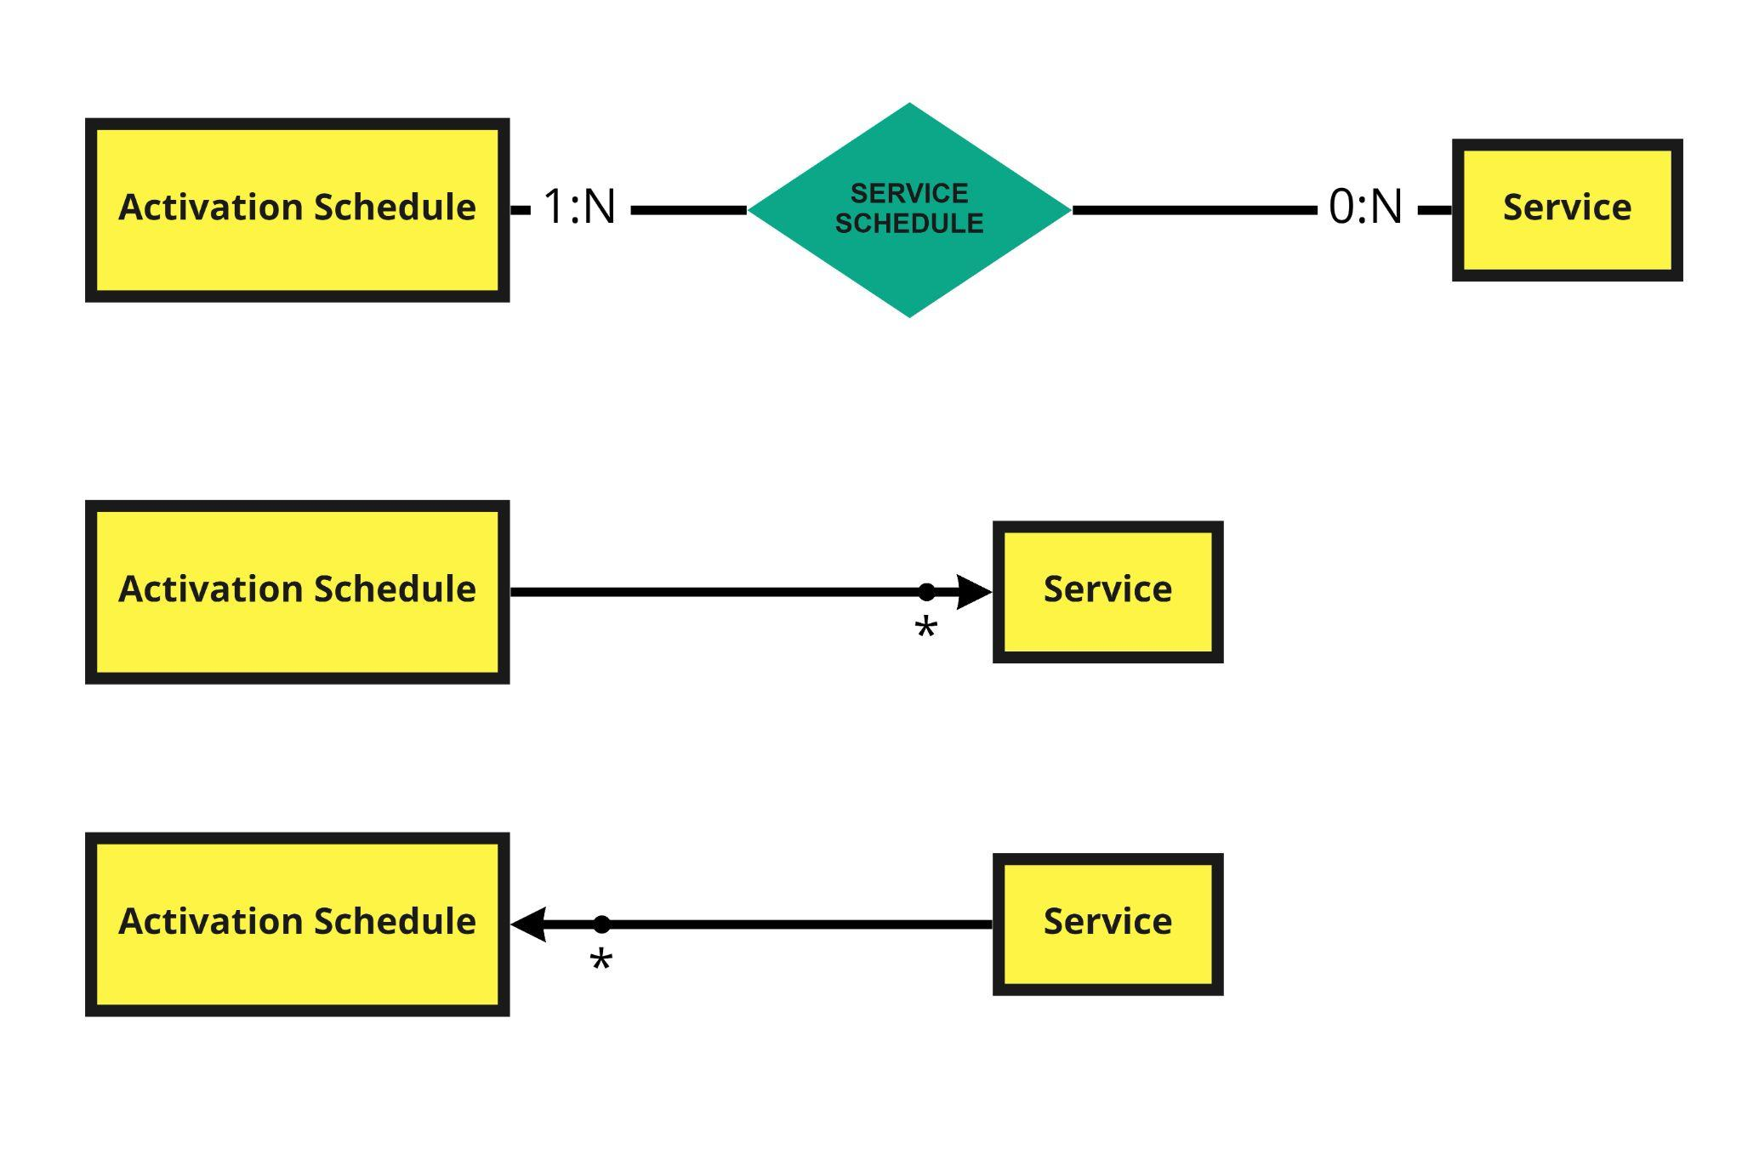
ORM relationship design
•Activation Schedule → Service @ManyToMany is necessary for persisting the services associated to the activation schedule.
FetchType = EAGER
•Service → Activation Schedule @ManyToMany is not necessary.

Slide 47
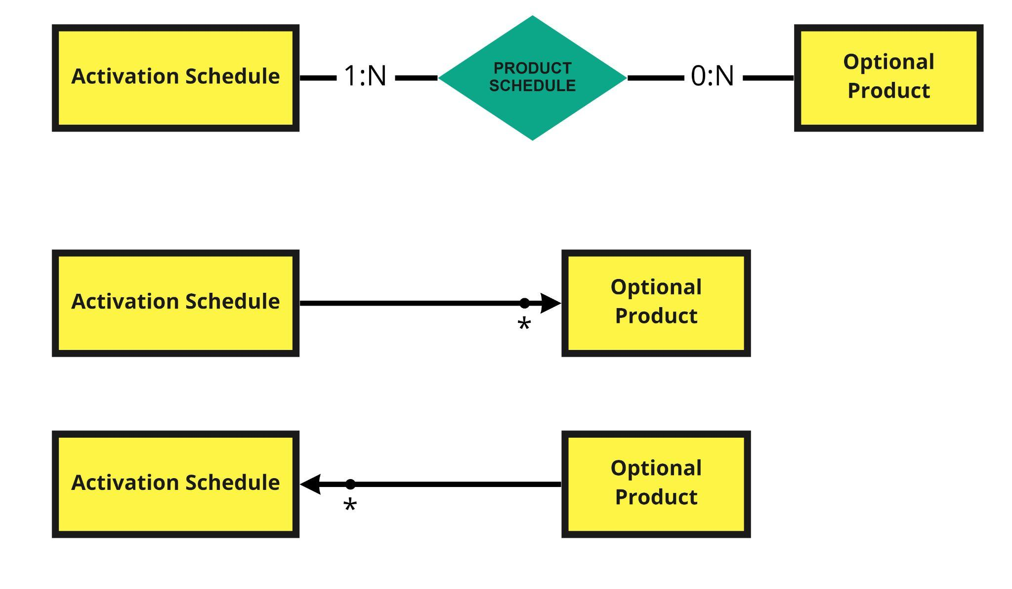
ORM relationship design
•Activation Schedule → Optional Product @ManyToMany is necessary for persisting the optional products associated to the activation schedule.
FetchType = EAGER
•Optional Product → Activation Schedule @ManyToOne is not necessary.

Slide 48
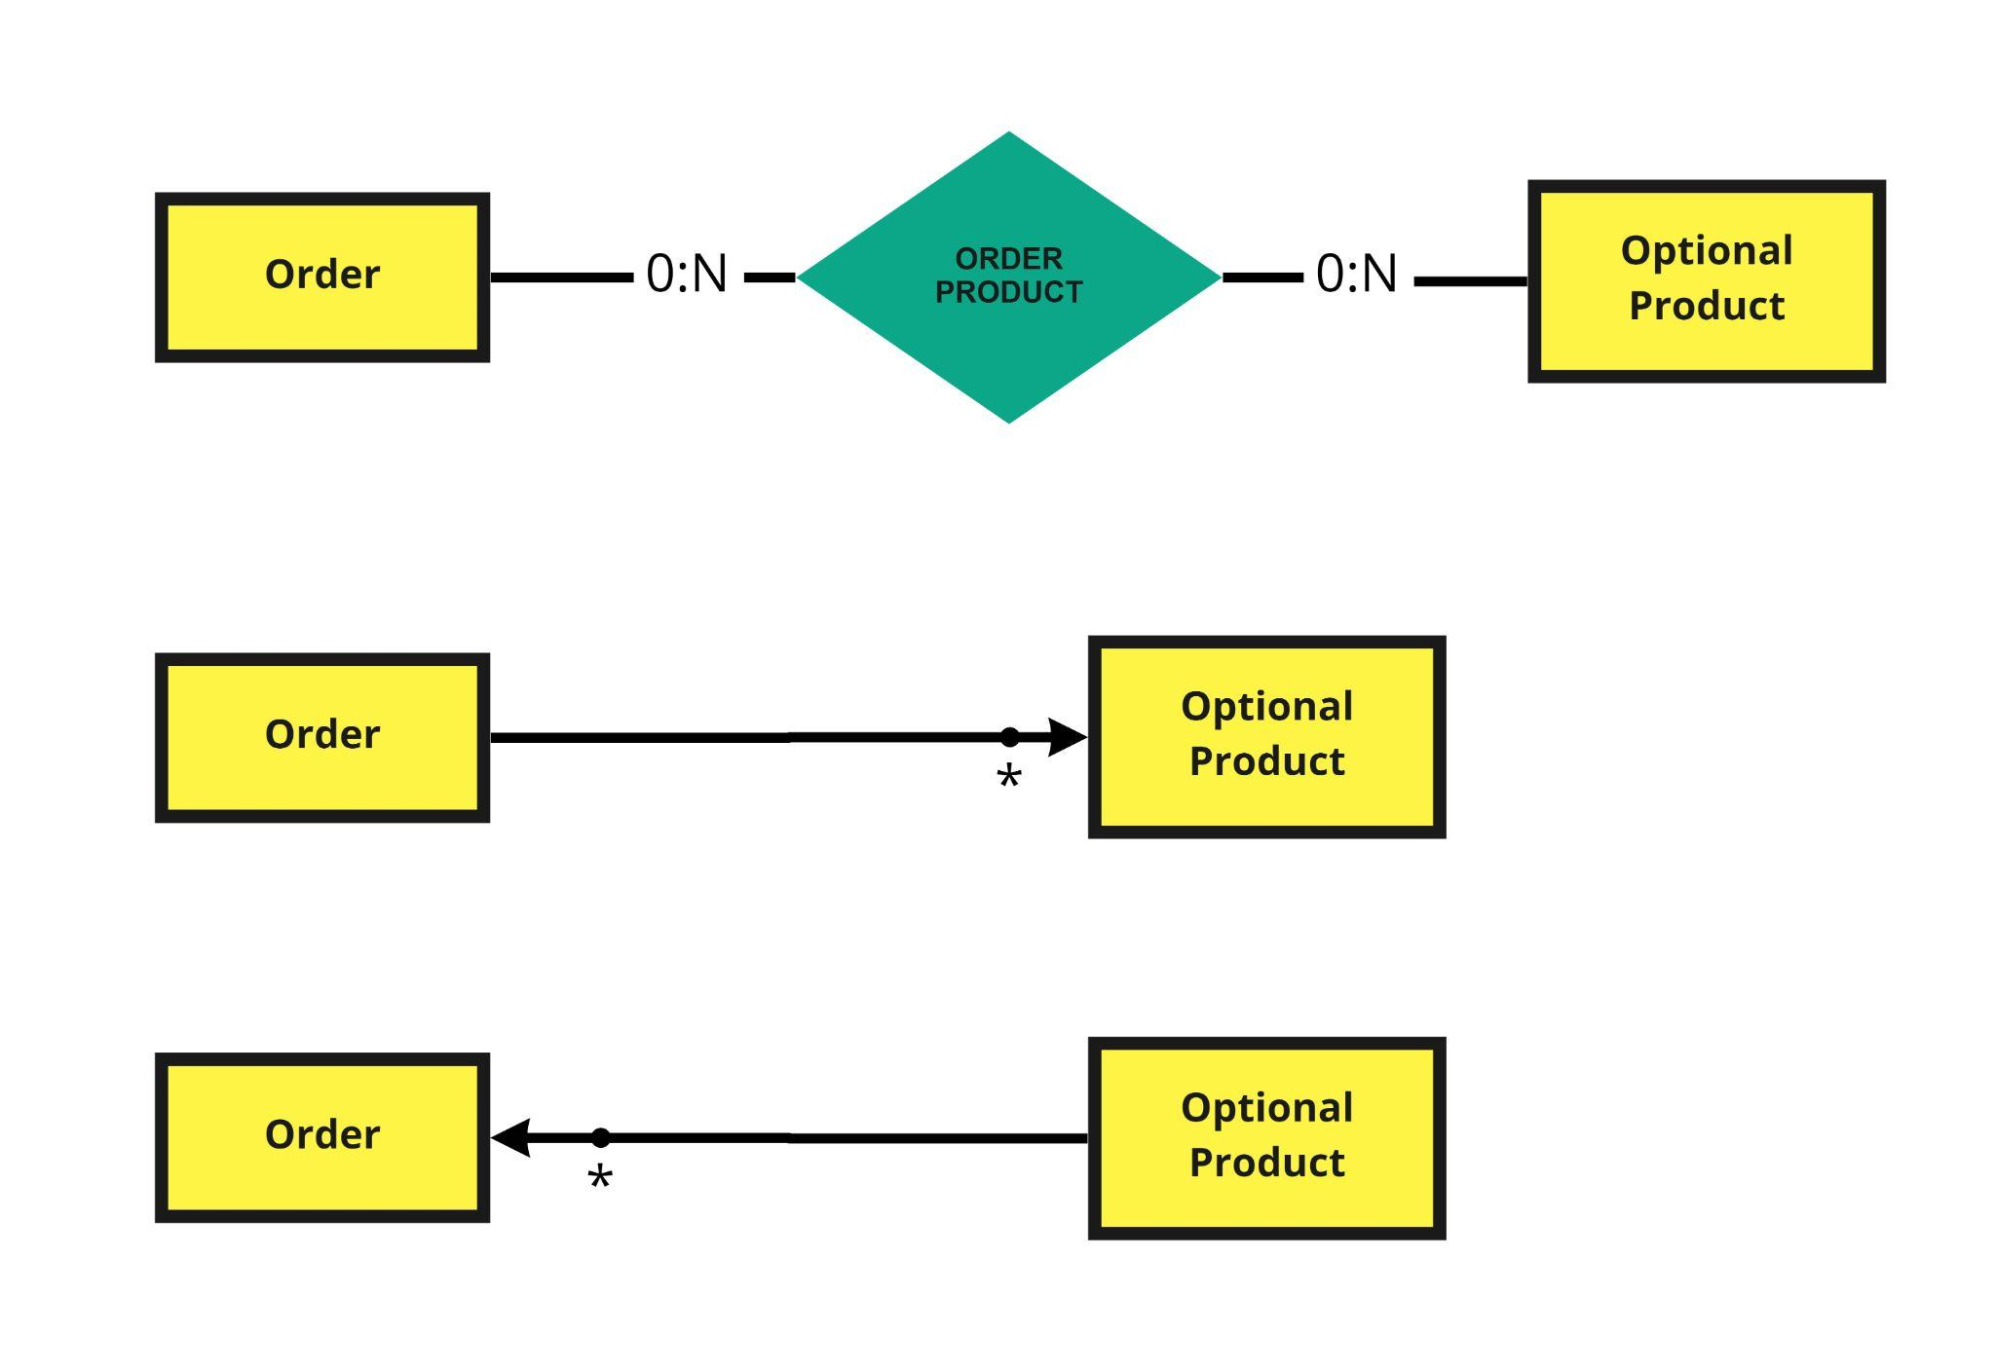
ORM relationship design
•Order → Optional Product @ManyToMany is necessary to list the optional product/s associated to the order (and for persisting them).
FetchType = EAGER
•Optional Product → Order @ManyToMany is not necessary.

Slide 49
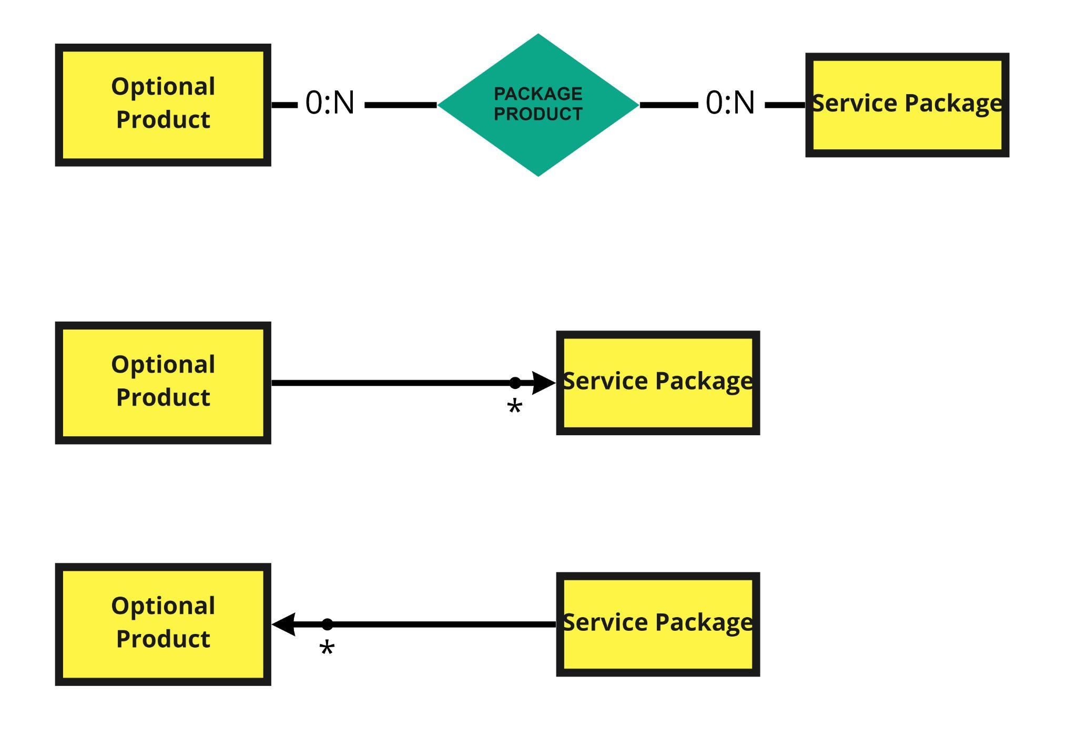
ORM relationship design
•Optional Product → Service Package @ManyToMany is not necessary.
•Service Package → Optional Product @ManyToMany is necessary to list the optional products associated to the service package (and for persisting them).
FetchType = EAGER

Slide 50
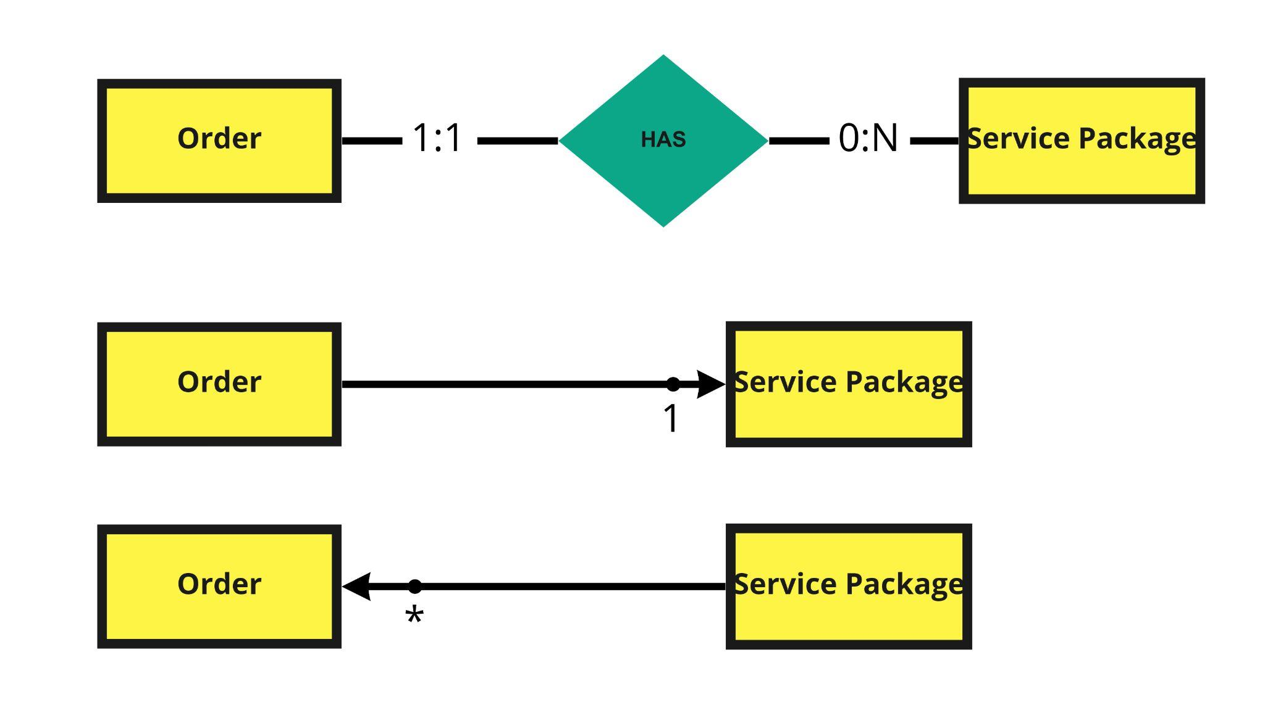
ORM relationship design
•Order → Service Package @ManyToOne is necessary to list the service package associated to the order (and for persisting it).
•Service Package → Order @OneToMany is not necessary.

Slide 51
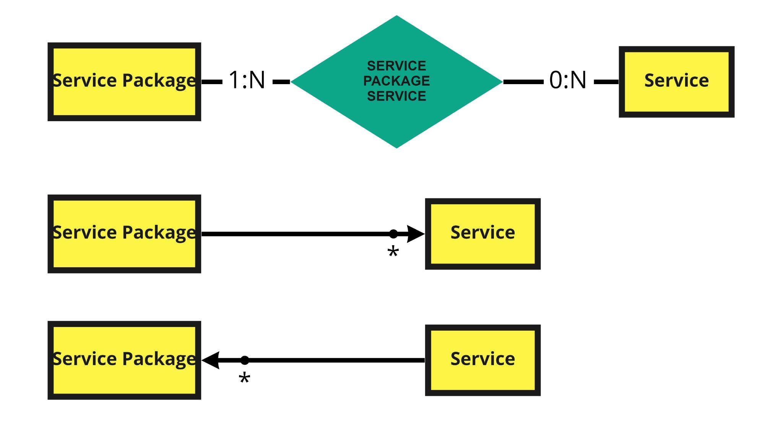
ORM relationship design
•Service Package → Service @ManyToMany is necessary to list the service associated to the service package (and for persisting them).
FetchType = EAGER
•Service → Service Package @ManyToMany is not necessary.

Slide 52
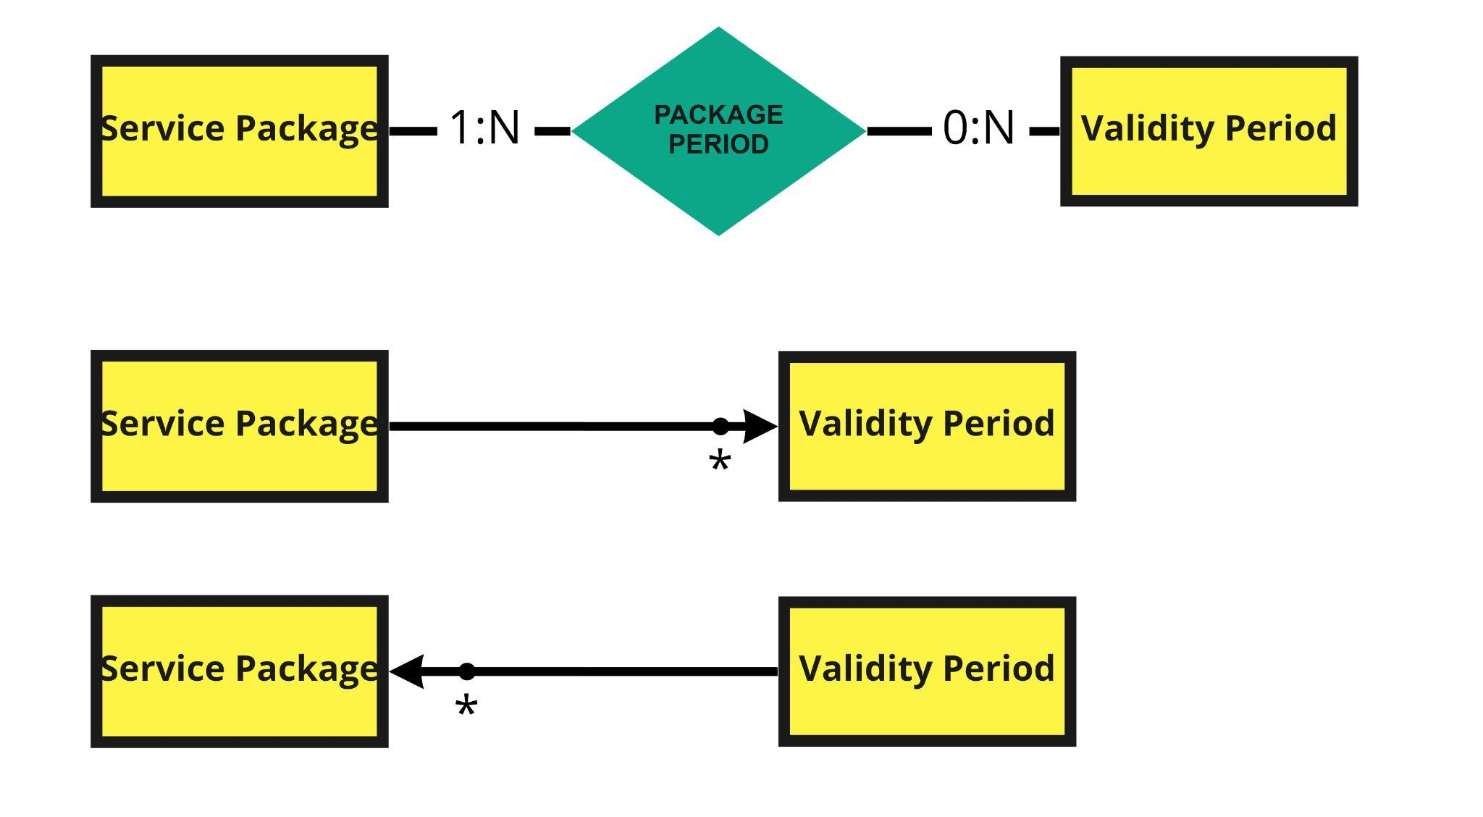
ORM relationship design
•Service Package → Validity Period needed to show all the validity periods of a service package:
Owner = validity period;
FetchType = EAGER;
It must support the retrieval of the monthly cost of each validity period.
•Validity Period → Service Package @ManyToMany is not necessary.
monthly cost
monthly cost
monthly cost

Slide 53
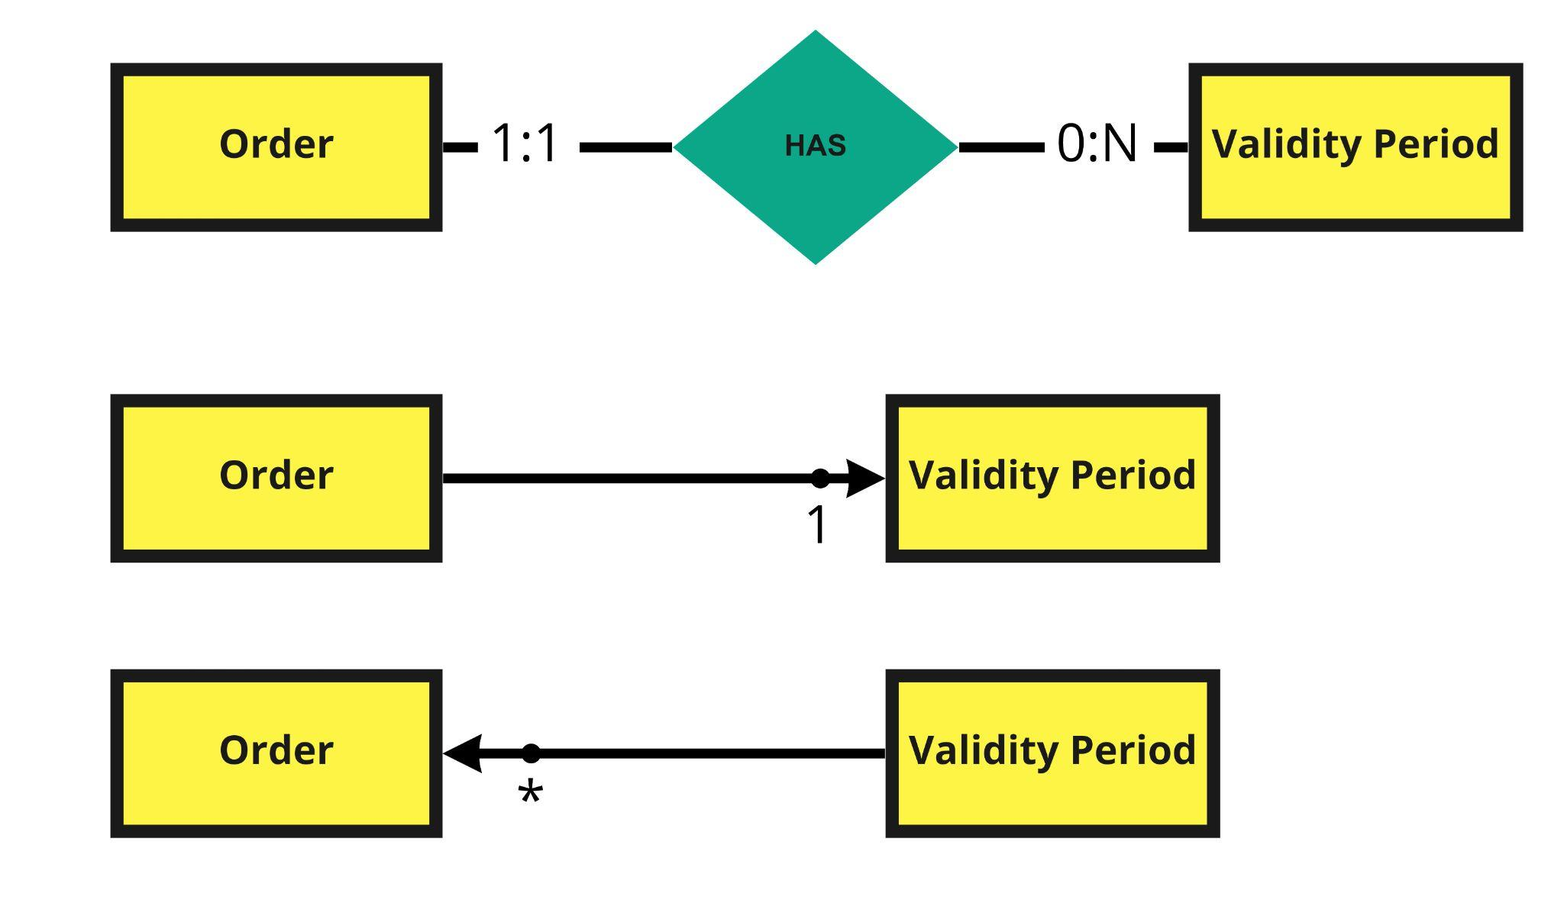
ORM relationship design
•Order → Validity Period @ManyToOne is necessary for showing the validity period associated to the order (and for persisting it).
•Validity Period → Order @OneToMany is not necessary.

Slide 54
Entities 1 (Activation Schedule)
@Entity
@Table(name = "activationschedule", schema="db2_savino_vinati")
@NamedQuery(name="Activationschedule.findAll", query="SELECT acsc FROM Activationschedule acsc")
public class Activationschedule implements Serializable {
private static final long serialVersionUID = 1L;
@Id
@GeneratedValue(strategy = GenerationType.IDENTITY)
private int id;
@Temporal(TemporalType.DATE)
private Date activationdate;
@Temporal(TemporalType.DATE)
private Date deactivationdate;
@ManyToOne
@JoinColumn(name="iduser")
private User user;
@ManyToMany(fetch=FetchType.EAGER)
@JoinTable(
name="serviceschedule",
joinColumns= { @JoinColumn(name="idactivation")},
inverseJoinColumns= { @JoinColumn(name="idservice")}
)
private List<Service> services;
@ManyToMany(fetch=FetchType.EAGER)
@JoinTable(
name="productschedule",
joinColumns= { @JoinColumn(name="idactivation")},
inverseJoinColumns= { @JoinColumn(name="idoptionalproduct")}
)
private List<Optionalproduct> optionalproducts;

Slide 55
Entities 2 (Alert)
@Entity
@Table(name = "alert", schema="db2_savino_vinati")
@NamedQuery(name="Alert.findAll", query="SELECT a FROM Alert a")
public class Alert implements Serializable {
private static final long serialVersionUID = 1L;
@Id
@GeneratedValue(strategy = GenerationType.IDENTITY)
private int id;
@ManyToOne
@JoinColumn(name="idinsolventuser")
private Insolventuser insolventUser;
@OneToOne
@JoinColumn(name="idorder")
private Order order;
private float amount;
@Column(name="active", insertable = false)
private Boolean active;
@Column(name="lastrejection", insertable = false, updatable = false)
@Temporal(TemporalType.TIMESTAMP)
private Date lastrejection;

Slide 56
Entities 3 (InsolventUser)
@Entity
@Table(name = "insolventuser", schema="db2_savino_vinati")
@NamedQuery(name="Insolventuser.findAll", query="SELECT iu FROM Insolventuser iu")
public class Insolventuser implements Serializable {
private static final long serialVersionUID = 1L;
@Id
private int id;
private int failedpaymentcount;
private boolean insolvent;
@OneToOne
@JoinColumn(name = "id")
@MapsId
private User user;
@OneToMany(mappedBy="insolventUser", cascade = CascadeType.ALL, orphanRemoval = true)
private List<Alert> alerts;

Slide 57
Entities 4 (MvAlert)
@Entity
@Table(name="mv_alerts")
@NamedQuery(name="MvAlert.findAll", query="SELECT m FROM MvAlert m")
public class MvAlert implements Serializable {
private static final long serialVersionUID = 1L;
@Id
@GeneratedValue(strategy = GenerationType.IDENTITY)
private int id;
@OneToOne
@JoinColumn(name = "idalert")
private Alert alert;

Slide 58
Entities 5 (MvBestProduct)
@Entity
@Table(name="mv_bestproduct")
@NamedQuery(name="MvBestproduct.findAll", query="SELECT m FROM MvBestproduct m")
public class MvBestproduct implements Serializable {
private static final long serialVersionUID = 1L;
@Id
@GeneratedValue(strategy = GenerationType.IDENTITY)
private int id;
@OneToOne
@JoinColumn(name = "idoptionalproduct")
private Optionalproduct optionalproduct;
private float value;
private int sales;

Slide 59
Entities 6 (MvInsolventUser)
@Entity
@Table(name="mv_insolventuser")
@NamedQuery(name="MvInsolventUser.findAll", query="SELECT miu FROM MvInsolventUser miu")
public class MvInsolventUser implements Serializable {
private static final long serialVersionUID = 1L;
@Id
@GeneratedValue(strategy = GenerationType.IDENTITY)
private int id;
@OneToOne
@JoinColumn(name = "idinsolventuser")
private Insolventuser insolventuser;

Slide 60
Entities 7 (MvPackage)
@Entity
@Table(name="mv_package")
@NamedQuery(name="MvPackage.findAll", query="SELECT m FROM MvPackage m")
public class MvPackage implements Serializable {
private static final long serialVersionUID = 1L;
@Id
@GeneratedValue(strategy = GenerationType.IDENTITY)
private int id;
private float avgoptionalproducts;
@OneToOne
@JoinColumn(name = "idpackage")
private Servicepackage servicepackage;
private int sales;
private float value;
private float valuewithproducts;

Slide 61
Entities 8 (MvPackageperiod)
@Entity
@Table(name="mv_packageperiod")
@NamedQuery(name="MvPackageperiod.findAll", query="SELECT m FROM MvPackageperiod m")
public class MvPackageperiod implements Serializable {
private static final long serialVersionUID = 1L;
@Id
@GeneratedValue(strategy = GenerationType.IDENTITY)
private int id;
@ManyToOne
@JoinColumn(name = "idpackage")
private Servicepackage servicepackage;
@ManyToOne
@JoinColumn(name = "idperiod")
private Validityperiod validityperiod;
private int sales;

Slide 62
Entities 9 (MvSuspendedorder)
@Entity
@Table(name="mv_suspendedorders")
@NamedQuery(name="MvSuspendedorder.findAll", query="SELECT m FROM MvSuspendedorder m")
public class MvSuspendedorder implements Serializable {
private static final long serialVersionUID = 1L;
@Id
@GeneratedValue(strategy = GenerationType.IDENTITY)
private int id;
@OneToOne
@JoinColumn(name = "idorder")
private Order suspendedorder;

Slide 63
Entities 10 (Optionalproduct)
@Entity
@Table(name = "optionalproduct", schema="db2_savino_vinati")
@NamedQuery(name="Optionalproduct.findAll", query="SELECT op FROM Optionalproduct op")
public class Optionalproduct implements Serializable {
private static final long serialVersionUID = 1L;
@Id
@GeneratedValue(strategy = GenerationType.IDENTITY)
private int id;
private float monthlyprice;
private String name;

Slide 64
Entities 11 (Order)
@Entity
@Table(name = "order", schema="db2_savino_vinati")
@NamedQueries({
@NamedQuery(name="Order.findAll", query="SELECT o FROM Order o"),
@NamedQuery(name="Order.findFromId", query="SELECT o FROM Order o WHERE o.id = ?1"),
@NamedQuery(name="Order.findRejectedOrders", query="SELECT o FROM Order o WHERE o.paid = false AND o.user = ?1")
})
public class Order implements Serializable {
private static final long serialVersionUID = 1L;
@Id
@GeneratedValue(strategy = GenerationType.IDENTITY)
private int id;
private float totalvalue;
@Column(name="datehour", insertable = false, updatable = false)
@Temporal(TemporalType.TIMESTAMP)
private Date datehour;
@Temporal(TemporalType.DATE)
private Date startdate;
private boolean paid;
@ManyToOne
@JoinColumn(name="iduser")
private User user;
@ManyToOne
@JoinColumn(name="idservicepackage")
private Servicepackage servicepackage;
@ManyToOne
@JoinColumn(name="idvalidityperiod")
private Validityperiod validityperiod;
@ManyToMany(fetch=FetchType.EAGER)
@JoinTable(
name="orderproduct",
joinColumns= { @JoinColumn(name="idorder")},
inverseJoinColumns= { @JoinColumn(name="idoptionalproduct")}
)
private List<Optionalproduct> optionalproducts;

Slide 65
Entities 12 (Service)
@Entity
@Table(name = "service", schema="db2_savino_vinati")
@NamedQuery(name="Service.findAll", query="SELECT s FROM Service s")
public class Service implements Serializable {
private static final long serialVersionUID = 1L;
@Id
@GeneratedValue(strategy = GenerationType.IDENTITY)
private int id;
private String name;
@ManyToOne
@JoinColumn(name="idtype")
private Servicetype type;
@OneToOne(mappedBy="service")
private Servicemobile servicemobile;
@OneToOne(mappedBy="service")
private Serviceinternet serviceinternet;

Slide 66
Entities 13 (Serviceinternet)
@Entity
@Table(name = "serviceinternet", schema="db2_savino_vinati")
@NamedQuery(name="Serviceinternet.findAll", query="SELECT si FROM Serviceinternet si")
public class Serviceinternet implements Serializable {
private static final long serialVersionUID = 1L;
@Id
private int id;
private float feeextragbs;
private int includedgbs;
@OneToOne
@JoinColumn(name = "id")
@MapsId
private Service service;

Slide 67
Entities 14 (Servicemobile)
@Entity
@Table(name = "servicemobile", schema="db2_savino_vinati")
@NamedQuery(name="Servicemobile.findAll", query="SELECT sm FROM Servicemobile sm")
public class Servicemobile implements Serializable {
private static final long serialVersionUID = 1L;
@Id
private int id;
private float feeextraminutes;
private float feeextrasms;
private int includedminutes;
private int includedsms;
@OneToOne
@JoinColumn(name = "id")
@MapsId
private Service service;

Slide 68
Entities 15 (Servicepackage)
@Entity
@Table(name = "servicepackage", schema="db2_savino_vinati")
@NamedQueries({
@NamedQuery(name="Servicepackage.findAll", query="SELECT sp FROM Servicepackage sp"),
@NamedQuery(name="Servicepackage.findFromName", query="SELECT sp FROM Servicepackage sp WHERE sp.name = ?1")
})
public class Servicepackage implements Serializable {
private static final long serialVersionUID = 1L;
@Id
@GeneratedValue(strategy = GenerationType.IDENTITY)
private int id;
private String name;
@ManyToMany(fetch=FetchType.EAGER)
@JoinTable(
name="packageproduct",
joinColumns= { @JoinColumn(name="idservicepackage")},
inverseJoinColumns= { @JoinColumn(name="idoptionalproduct")}
)
private List<Optionalproduct> optionalproducts;
@ElementCollection(fetch = FetchType.EAGER)
@CollectionTable(name = "packageperiod", schema = "db2_savino_vinati", joinColumns = @JoinColumn(name = "idservicepackage"))
@MapKeyJoinColumn(name = "idvalidityperiod")
@Column(name = "monthlycost")
private Map<Validityperiod, Float> validityperiods;
@ManyToMany(fetch=FetchType.EAGER)
@JoinTable(
name="servicepackageservice",
joinColumns= { @JoinColumn(name="idservicepackage")},
inverseJoinColumns= { @JoinColumn(name="idservice")}
)
private List<Service> services;

Slide 69
Entities 16 (Servicetype)
@Entity
@Table(name = "servicetype", schema="db2_savino_vinati")
@NamedQuery(name="Servicetype.findAll", query="SELECT st FROM Servicetype st")
public class Servicetype implements Serializable {
private static final long serialVersionUID = 1L;
@Id
@GeneratedValue(strategy = GenerationType.IDENTITY)
private int id;
private String type;

Slide 70
Entities 17 (User)
@Entity
@Table(name = "user", schema="db2_savino_vinati")
@NamedQueries({
@NamedQuery(name="User.findAll", query="SELECT u FROM User u"),
@NamedQuery(name = "User.checkCredentials", query = "SELECT r FROM User r WHERE r.username = ?1 and r.password = ?2"),
@NamedQuery(name = "User.findFromUsername", query = "SELECT u FROM User u WHERE u.username = ?1"),
@NamedQuery(name = "User.findFromMail", query = "SELECT u FROM User u WHERE u.mail = ?1")
})
public class User implements Serializable {
private static final long serialVersionUID = 1L;
@Id
@GeneratedValue(strategy = GenerationType.IDENTITY)
private int id;
private String username;
private String password;
private String mail;
@ManyToOne
@JoinColumn(name="idusertype")
private Usertype usertype;
@OneToOne(mappedBy="user", cascade = CascadeType.ALL, orphanRemoval = true)
private Insolventuser insolventuser;
@OneToMany(mappedBy="user", cascade = CascadeType.ALL, orphanRemoval = true)
private List<Activationschedule> activationschedules;
@OneToMany(fetch = FetchType.EAGER, mappedBy="user", cascade = CascadeType.ALL)
private List<Order> orders;

Slide 71
Entities 18 (Usertype)
@Entity
@Table(name = "usertype", schema="db2_savino_vinati")
@NamedQueries({
@NamedQuery(name="Usertype.findAll", query="SELECT ut FROM Usertype ut"),
@NamedQuery(name="Usertype.findFromType", query="SELECT ut FROM Usertype ut WHERE ut.usertype=?1")
})
public class Usertype implements Serializable {
private static final long serialVersionUID = 1L;
@Id
@GeneratedValue(strategy = GenerationType.IDENTITY)
private int id;
private String usertype;

Slide 72
Entities 19 (Validityperiod)
@Entity
@Table(name = "validityperiod", schema="db2_savino_vinati")
@NamedQuery(name="Validityperiod.findAll", query="SELECT v FROM Validityperiod v")
public class Validityperiod implements Serializable {
private static final long serialVersionUID = 1L;
@Id
@GeneratedValue(strategy = GenerationType.IDENTITY)
private int id;
private int validityperiod;

Slide 73
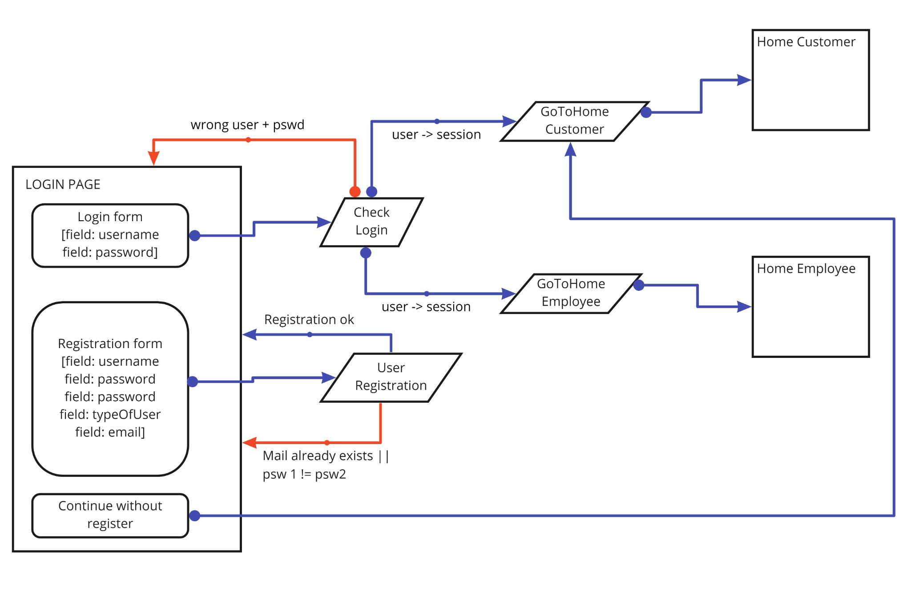
Interaction diagrams 1 (Login and Registration)

Slide 74
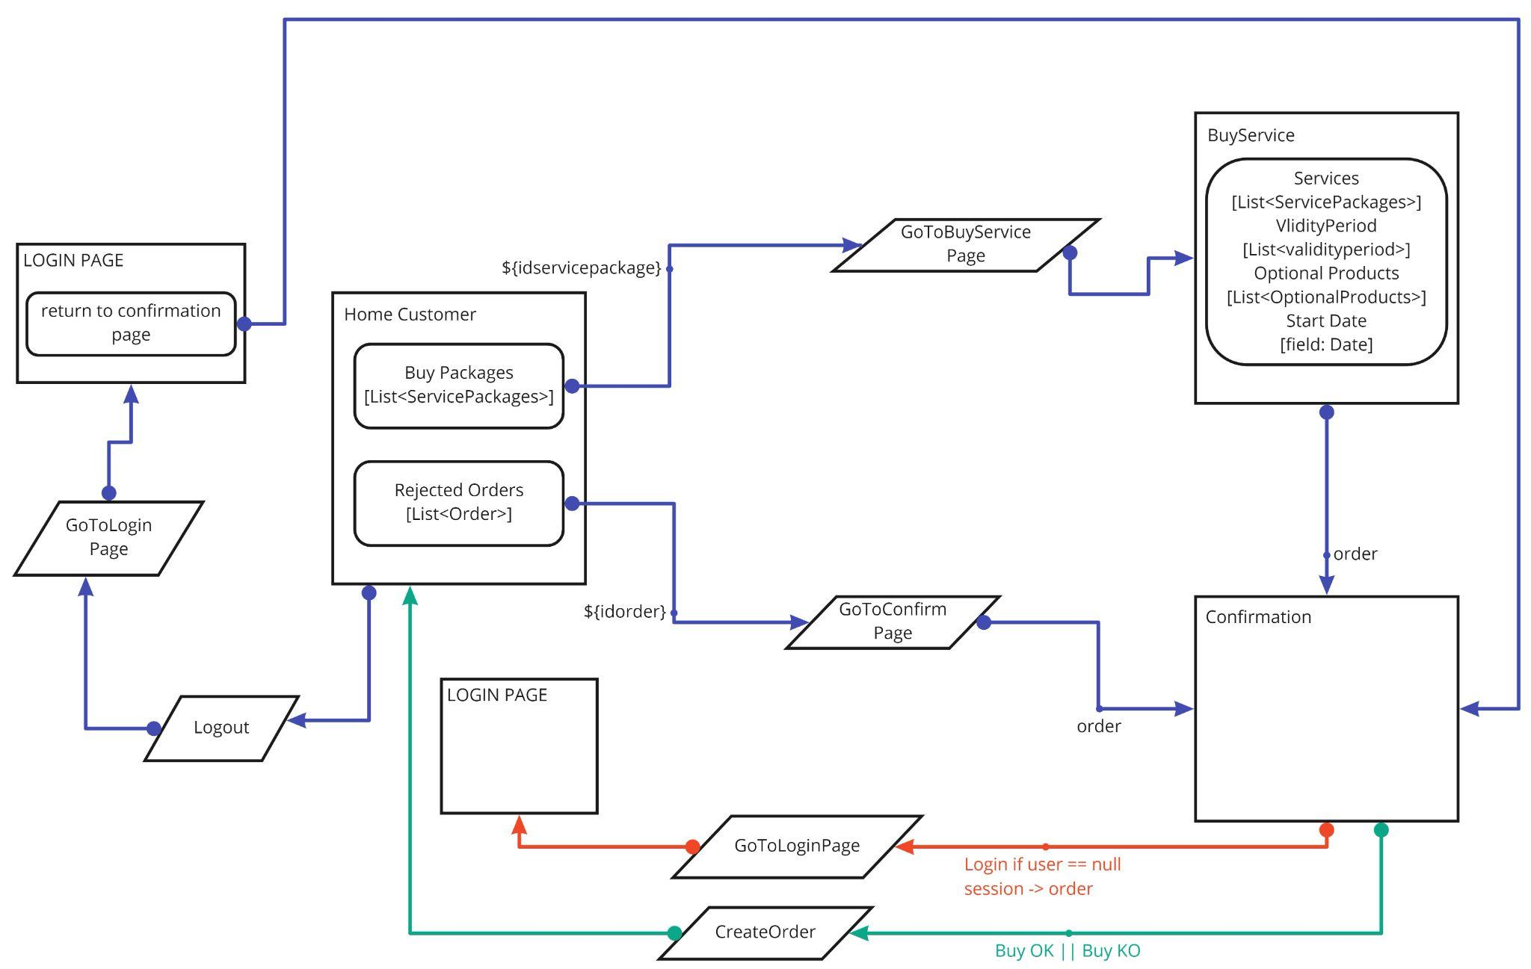
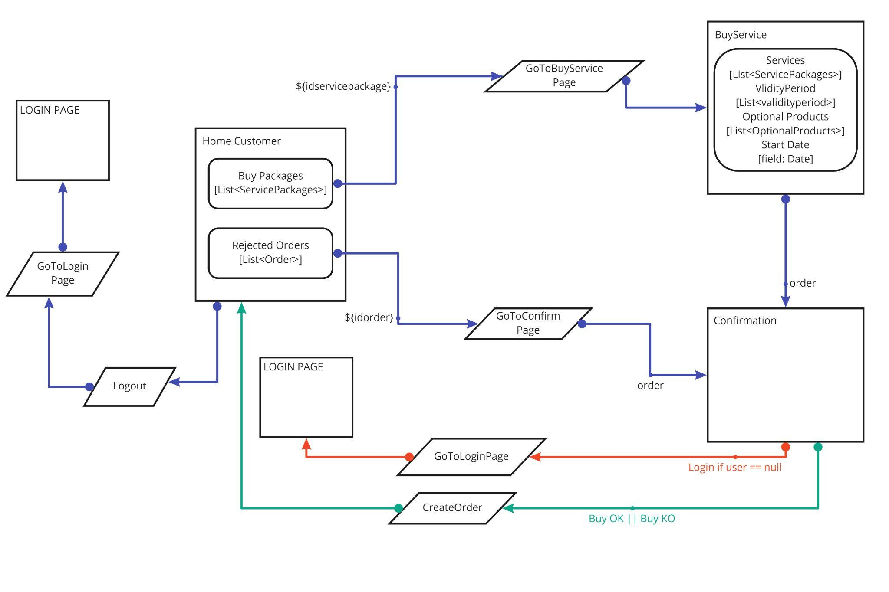
Interaction diagrams 2 (Buy service package)

Slide 75
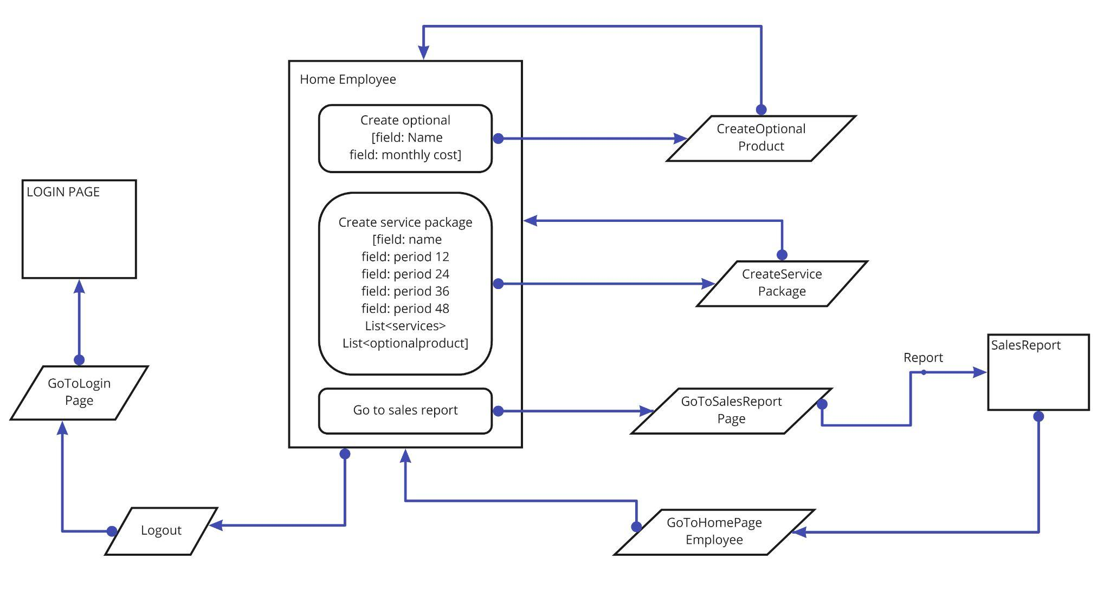
Interaction diagrams 3 (Opt. Product, Service package creation and Sales Report )

Slide 76
Interaction diagrams considerations
The logout buttons are presented only for homepage even if present also in other pages. They are omitted to enhance readability of graphs.

Slide 77
Components 1
Client tier
CheckLogin: verifies credentials and stores user info the web session
CreateOptionalProduct
CreateOrder
CreateServicePackage
GoToBuyServicePage
GoToConfirmPage
GoToHomePageCustomer
GoToHomePageEmployee
GoToLoginPage
GoToSalesReportPage
Logout
UserRegistration

Slide 78
Components 2
Business tier
@Stateless OptionalProductService
public void createOptionalProduct(String name, float monthlyprice)
@Stateless OrderService
public Order createOrderNoPersist(Integer idservicepackage, Integer idvalidityperiod, List<Integer> idoptionalproducts, Date date)
private Validityperiod checkValidityPeriod(Integer idvalidityperiod)
public Servicepackage checkServicePackage(Integer idservicepackage)
public float checkOptionalProducts(List<Integer> idoptionalproducts, Order order, float totalprice)
public void createOrder(Order order)
private void checkInsolventUserAndAlert(Order order)
private void createActivationSchedule(Order order, User user)
public Order findOrderById(Integer orderid)
public List<Order> findAllRejectedOrders(User user)

Slide 79
Components 3
Business tier (continue)
@Stateless SalesReportService
public List<MvBestproduct> findAllbestproducts ()
public List<MvAlert> findAllmvalerts()
public List<MvSuspendedorder> findAllmvsuspendedorders()
public List<MvInsolventUser> findAllmvinsolventusers()
public List<MvPackageperiod> findAllmvpackageperiods()
public List<MvPackage> findAllmvpackages()
@Stateless ServicePackageService
public List<Servicepackage> findAllServicePackages()
public Servicepackage findServicePackageById(int serviceId)
public List<Validityperiod> findAllValidityperiods ()
public List<Service> findAllServices()
public List<Optionalproduct> findAllOptionalproducts()
public void checkDuplicatedName(String name)
public void createNewServicePackage

Slide 80
Components 4
Business tier (continue)
@Stateless UserService
public User checkCredentials(String usrn, String pwd)
public Usertype getUsertype(String type)
public boolean checkDuplicatedMail(String username)
public boolean checkDuplicatedUsername(String username)
public void registerUser (String username, String password, String type, String mail)

Slide 81
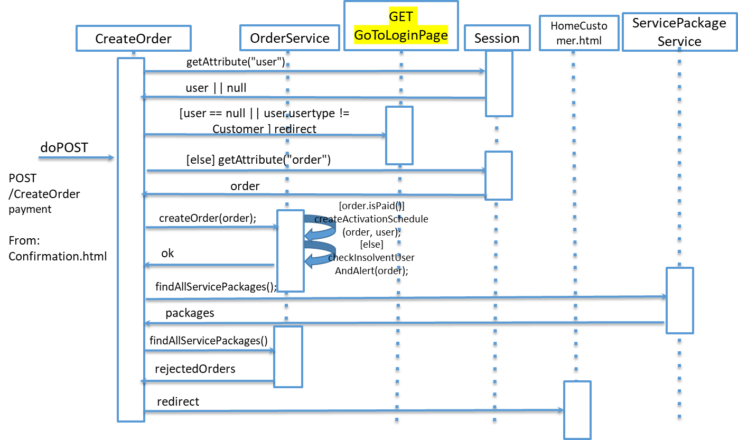
UML sequence diagrams (for salient events, CreateOrder)

