Slide 1

Weather forecasting and Quantum computing
Weather forecasting involves simulating highly dynamic, chaotic systems. Classical methods struggle due to the exponential complexity of variables involved.
Quantum computing, through superposition and entanglement, allows us to model and predict complex atmospheric behaviors more efficiently potentially revolutionizing meteorology.

Slide 2

Motivation
Why One Model Isn’t Enough
Weather variables behave differently in the atmosphere.
Temperature, precipitation, and wind are driven by different factors.
A single model may overlook key relationships.
Weather forecasting and Quantum computing
Weather forecasting and Quantum computing
Weather forecasting involves simulating highly dynamic, chaotic systems. Classical methods struggle due to the exponential complexity of variables involved.
Quantum computing, through superposition and entanglement, allows us to model and predict complex atmospheric behaviors more efficiently potentially revolutionizing meteorology.

Slide 3
Motivation
Why One Model Isn’t Enough
Weather variables behave differently in the atmosphere.
Temperature, precipitation, and wind are driven by different factors.
A single model may overlook key relationships.
Weather forecasting and Quantum computing
What We Do
Predict temperature, precipitation, and wind speed for Cairo.
Combine classical ML and quantum neural networks (QNNs).
Use Random Forests to select key features.
Train quantum models with Qiskit to explore quantum AI potential in weather forecasting.

Slide 4

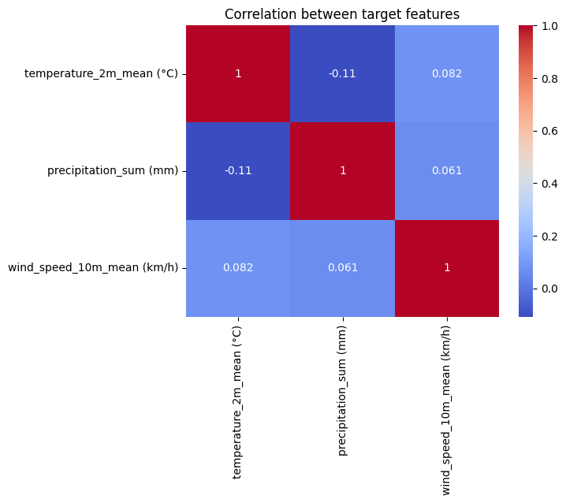
Weather forecasting and Quantum computing
Weather forecasting and Quantum computing
Motivation
Why One Model Isn’t Enough
Weather variables behave differently in the atmosphere.
Temperature, precipitation, and wind are driven by different factors.
A single model may overlook key relationships.
Weather forecasting involves simulating highly dynamic, chaotic systems. Classical methods struggle due to the exponential complexity of variables involved.
Quantum computing, through superposition and entanglement, allows us to model and predict complex atmospheric behaviors more efficiently potentially revolutionizing meteorology.
Correlation Insights
The target variables temperature_2m_mean, precipitation_sum, and wind_speed_10m_mean —show low correlation with each other.
These variables do not co-vary significantly, meaning:
1.High temperature does not imply high/low wind or rainfall.
2.Changes in one do not strongly predict changes in the others.

Slide 5
Motivation
Why One Model Isn’t Enough
Weather variables behave differently in the atmosphere.
Temperature, precipitation, and wind are driven by different factors.
A single model may overlook key relationships.
Weather forecasting and Quantum computing
Correlation Insights
Modeling Strategy
Weather forecasting and Quantum computing
Build three separate models, each specialized for one target.
Feature Selection with Classical ML
Quantum Neural Networks (QNNs) for prediction.
Improves prediction accuracy and interpretability.
Weather forecasting involves simulating highly dynamic, chaotic systems. Classical methods struggle due to the exponential complexity of variables involved.
Target Variable Correlation:
Temperature, precipitation, and wind speed show low correlation.
Changes in one do not reliably predict the others.
Quantum computing, through superposition and entanglement, allows us to model and predict complex atmospheric behaviors more efficiently potentially revolutionizing meteorology.

Slide 6

Motivation
Summary of Logic
Weather forecasting and Quantum computing
Preparing the Data
Correlation Insights
Weather forecasting and Quantum computing
The target variables temperature_2m_mean, precipitation_sum, and wind_speed_10m_mean —show low correlation with each other.
Low correlation among targets → separate models.
Custom feature selection → better model performance.
Enables more targeted forecasting insights.
Removed empty columns → All visibility columns were NaN
Dropped irrelevant features → e.g., snowfall_sum always 0
Kept only mean values → Removed min/max duplicates
Prevented data leakage :
Removed rain sum when predicting precipitation
Removed wind_gusts_10m_mean when predicting wind speed
Weather forecasting involves simulating highly dynamic, chaotic systems. Classical methods struggle due to the exponential complexity of variables involved.
These variables do not co-vary significantly, meaning:
1.High temperature does not imply high/low wind or rainfall.
2.Changes in one do not strongly predict changes in the others.
Quantum computing, through superposition and entanglement, allows us to model and predict complex atmospheric behaviors more efficiently potentially revolutionizing meteorology.

Slide 7
Motivation
Summary of Logic
Weather forecasting and Quantum computing
Weather forecasting and Quantum computing
Correlation Insights
Modeling Strategy
The target variables temperature_2m_mean, precipitation_sum, and wind_speed_10m_mean —show low correlation with each other.
Low correlation among targets → separate models.
Custom feature selection → better model performance.
Enables more targeted forecasting insights.
Build three separate models, each specialized for one target.
Feature Selection with Classical ML
Quantum Neural Networks (QNNs) for prediction.
Improves prediction accuracy and interpretability.
Weather forecasting involves simulating highly dynamic, chaotic systems. Classical methods struggle due to the exponential complexity of variables involved.
These variables do not co-vary significantly, meaning:
1.High temperature does not imply high/low wind or rainfall.
2.Changes in one do not strongly predict changes in the others.
Quantum computing, through superposition and entanglement, allows us to model and predict complex atmospheric behaviors more efficiently potentially revolutionizing meteorology.

Slide 8

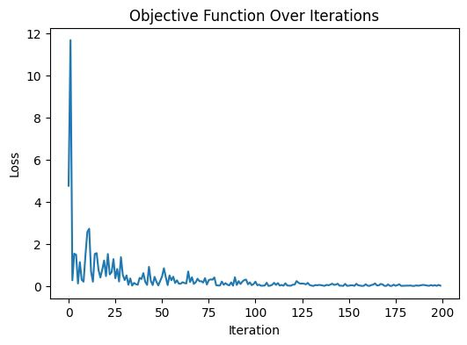
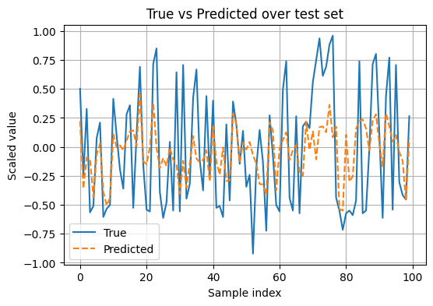
Motivation
Why One Model Isn’t Enough
Weather variables behave differently in the atmosphere.
Temperature, precipitation, and wind are driven by different factors.
A single model may overlook key relationships.
Weather forecasting and Quantum computing
Results
Correlation Insights
Modeling Strategy
Weather forecasting and Quantum computing
The target variables temperature_2m_mean, precipitation_sum, and wind_speed_10m_mean —show low correlation with each other.
Weather forecasting involves simulating highly dynamic, chaotic systems. Classical methods struggle due to the exponential complexity of variables involved.
Build three separate models, each specialized for one target.
Use feature selection tailored to each variable.
Improves prediction accuracy and interpretability.
These variables do not co-vary significantly, meaning:
1.High temperature does not imply high/low wind or rainfall.
2.Changes in one do not strongly predict changes in the others.
Quantum computing, through superposition and entanglement, allows us to model and predict complex atmospheric behaviors more efficiently potentially revolutionizing meteorology.
R² Train score: 0.2783
R² Test score: 0.3061

Slide 9
Motivation
Why One Model Isn’t Enough
Weather variables behave differently in the atmosphere.
Temperature, precipitation, and wind are driven by different factors.
A single model may overlook key relationships.
Weather forecasting and Quantum computing
Modeling Strategy
Summary of Logic
Correlation Insights
Weather forecasting and Quantum computing
The target variables temperature_2m_mean, precipitation_sum, and wind_speed_10m_mean —show low correlation with each other.
Weather forecasting involves simulating highly dynamic, chaotic systems. Classical methods struggle due to the exponential complexity of variables involved.
Low correlation among targets → separate models.
Custom feature selection → better model performance.
Enables more targeted forecasting insights.
Build three separate models, each specialized for one target.
Use feature selection tailored to each variable.
Improves prediction accuracy and interpretability.
These variables do not co-vary significantly, meaning:
1.High temperature does not imply high/low wind or rainfall.
2.Changes in one do not strongly predict changes in the others.
Quantum computing, through superposition and entanglement, allows us to model and predict complex atmospheric behaviors more efficiently potentially revolutionizing meteorology.

