Slide 1
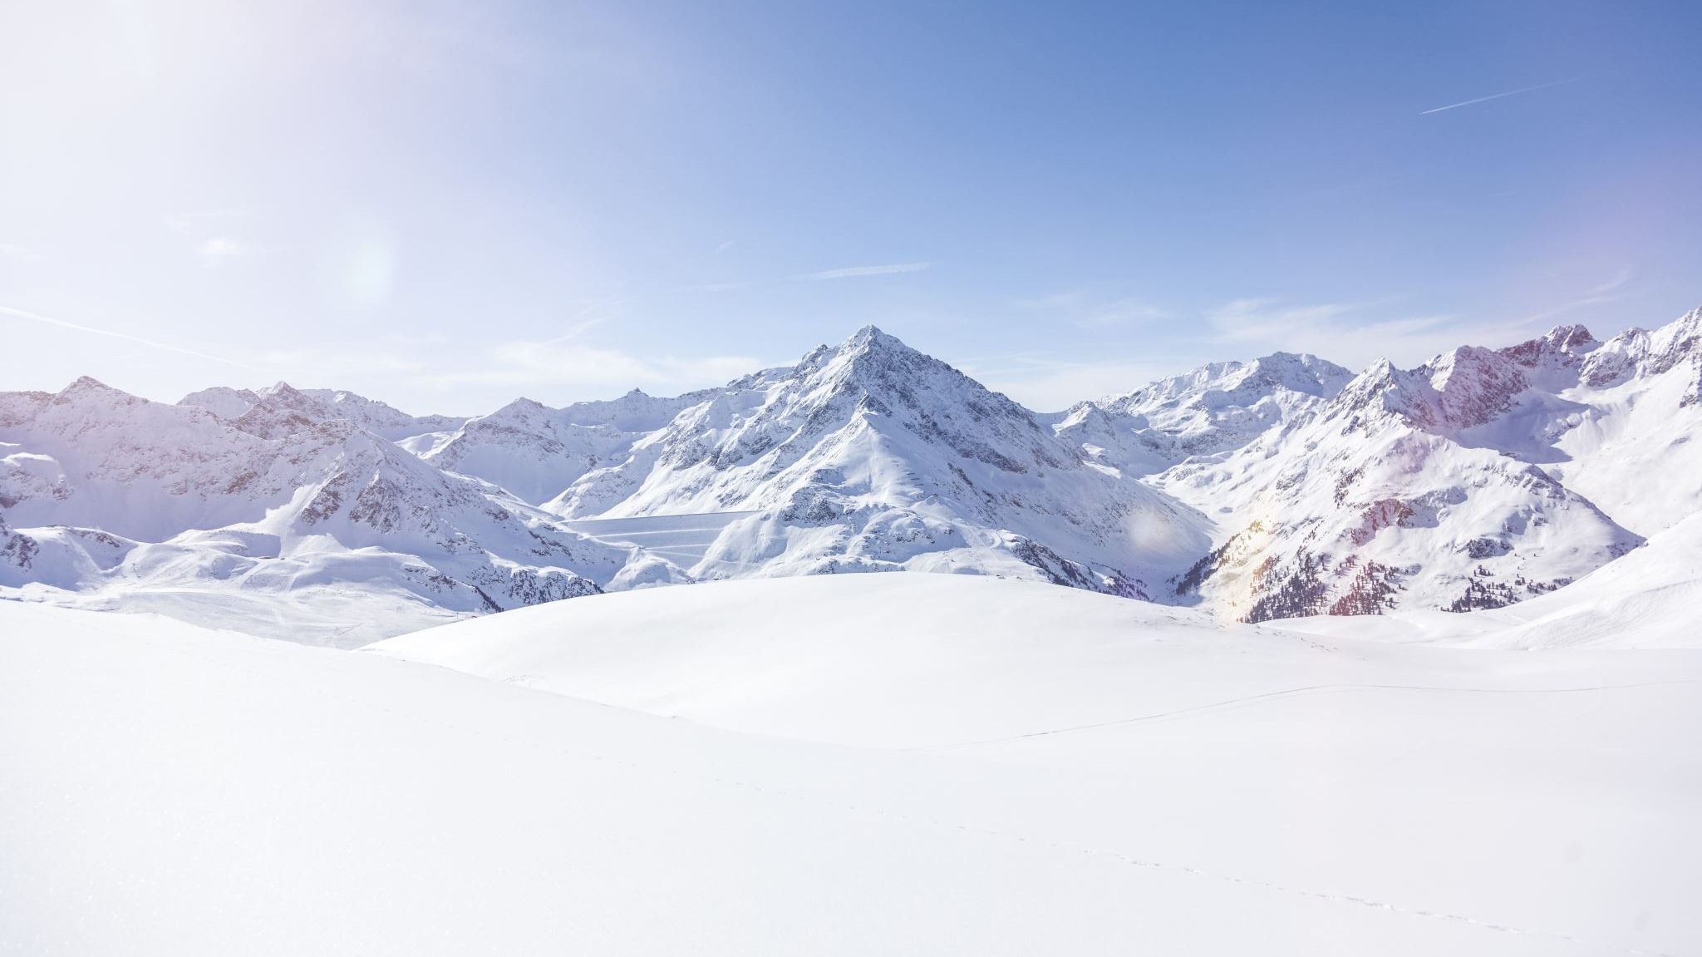
Big Mountain Ski Resort: An Additional Chair Lift
By: Jason Zhou

Slide 2
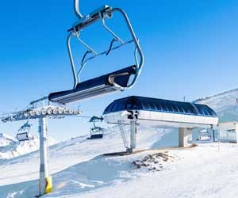
The Problem
Big Mountain Resort has installed an additional chair lift
Need to cut back on expenses or increase sources of revenue to make up for the cost

Slide 3
Recommendations
Add an additional ski run to the resort
Increase vertical drop (difference in elevation from base to summit) by 150 feet
Other Findings:
Increasing the length of a run doesn’t change anything
Closing down the least used ski runs doesn’t change anything

Slide 4
Modeling Foundation
We set up our model to analyze ticket pricing as a function of other data metrics of other competing ski resorts across the country
Used a 70-30 train-test split on our data
Notes:
Defining Problem As Stated
From that problem as defined, what we have done is to determine the price of ticket in the context of the ticket price of our competitors
Explain how we got our final ticket value with our analysis
Our model predicts ticket price of a function of other characteristics of the resort
We inputted characteristics of Big Mountain using our data to get results
We need to talk about the confidence of our results and why they should believe our analysis
For regression problems, we study the residual/error of the test set
Study the distribution of the error
We need to give them the worst case scenario of our predictions to let them know how accurate the modeling is

Slide 5
Model Type
Random Forest
MAE (Mean Absolute Error) of about 9.5, meaning ticket price predictions will at most be off by around $9.50

Slide 6
Model Analysis
Tested 4 scenarios
Closing least used runs
Add run + install new chairlift
Add run + install new chairlift + add 2 acres of snow making
Extend length of longest run + add 4 acres of snow making
Conclusions
Closing runs doesn’t increase revenue
Adding runs doesn’t increase revenue
Adding acres of snow making doesn’t increase revenue
Installing a new chairlift DOES increase revenue

Slide 7
Conclusion and Recommendation
Stick to just installing the additional chairlift and nothing else
Raise ticket price by $2.00 to make up for the cost of the chair lift

