Slide 1


Predicting the Price of Online Shopping Listings on Mercari
By: Jason Zhou

Slide 2

What is Mercari?
Online marketplace platform
Sellers are individuals, not corporations
Requires that sellers ship out items to the buyers

Slide 3

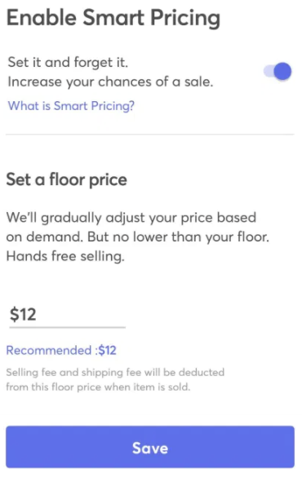
The Problem
Sellers often don’t know how much they should charge for their item
Mercari has an algorithm in place to suggest a price based on demand
Our job is to see if we can improve upon this

Slide 4

Stakeholders
Mercari
Sellers
Buyers

Slide 5
What determines the price/value of an item?
Item category
Condition
Brand
Availability

Slide 6
Working Data Set
1,000,000+ Item listings
Number of columns: 7
Over 4000 unique Brands, 1000+ unique categories
Found on Kaggle

Slide 7
Data Fields
Name
Condition
Category
Brand
Price
Shipping
Item Description

Slide 8


Data Cleaning Decisions
Dropped all rows with missing values
Dropped all rows with ‘Brand’s and ‘Category’s that occur in less than 50 instances in the data set
Dropped every row that has a value of 0 in the ’Price’ column
Took the log of the ‘Price’ column to account for skewing
Dropped the ’Name’ and ‘Item Description’ columns

Slide 9
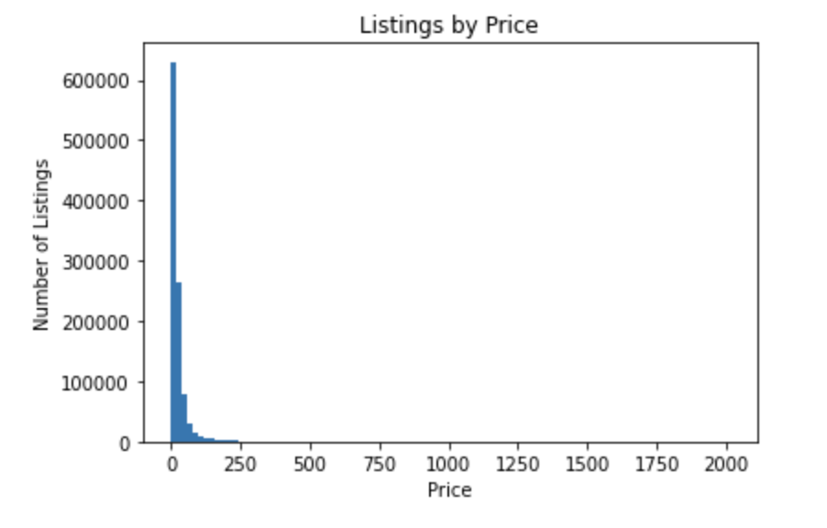
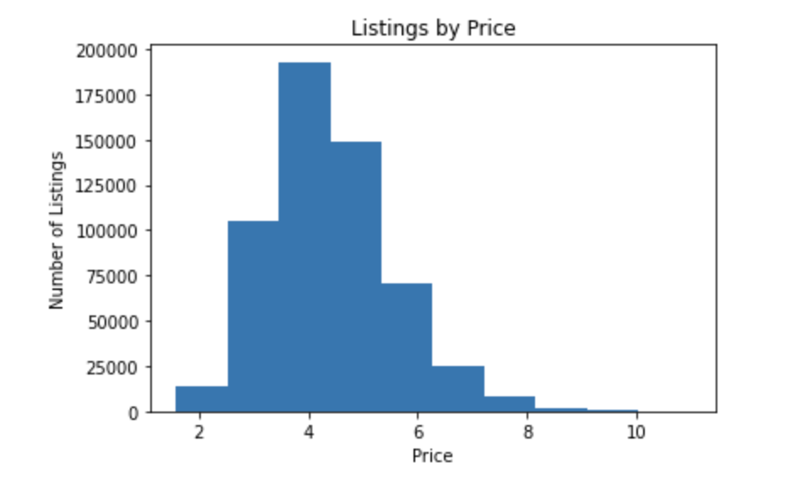
Price Distribution Before and After

Slide 10
Exploratory Data Analysis Findings
Target: Price
Features: Condition, Brand, Category, Shipping
Correlations with Price: Brand, Category, Shipping
No Correlations with Price: Condition

Slide 11
Preprocessing
Had to take a 20% sample of our working data set due to computational constraints
Target: Price
Features: Brand, Category, Shipping
70/30 train/test split

Slide 12
Model Selection
Linear Regression
Tuning:
Selecting K best neighbors
Random Forest
Tuning:
Increasing max_depth

Slide 13
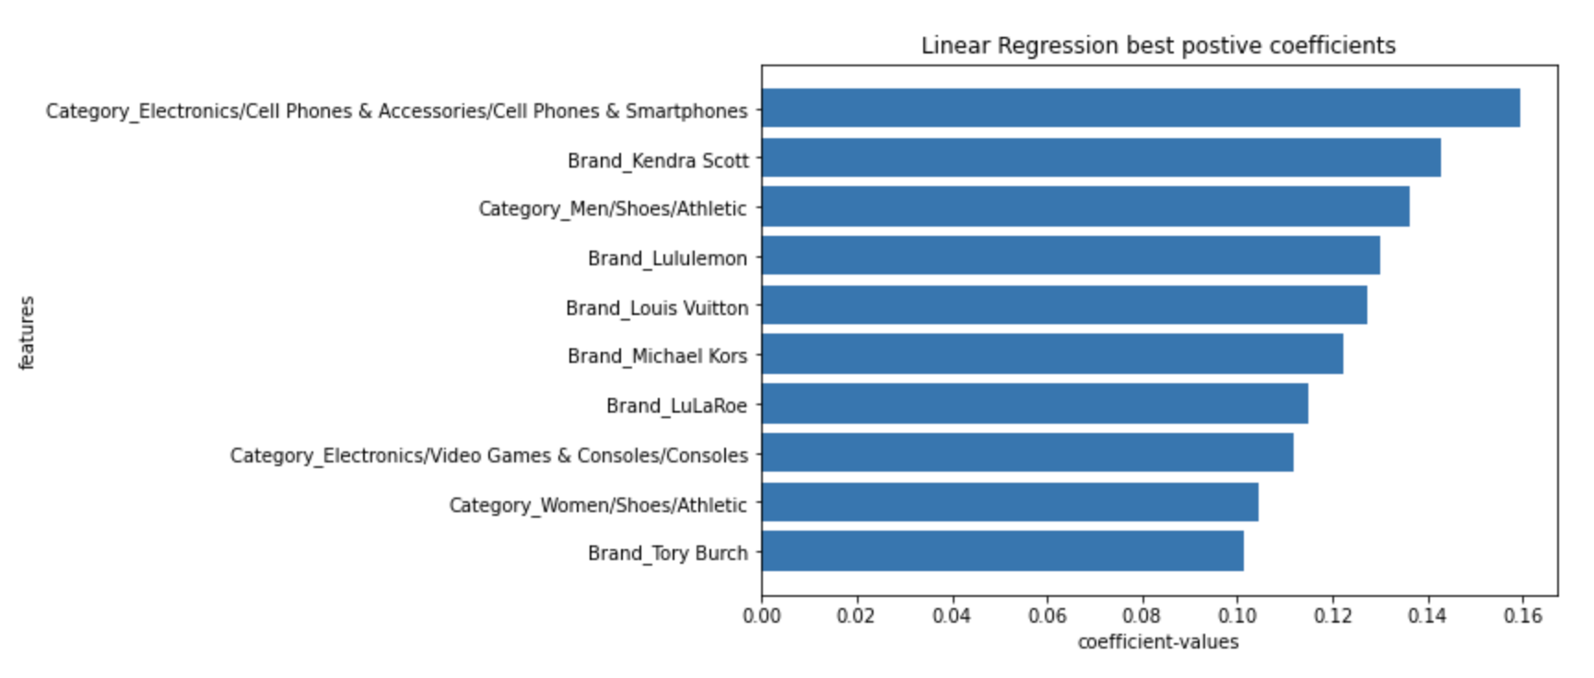
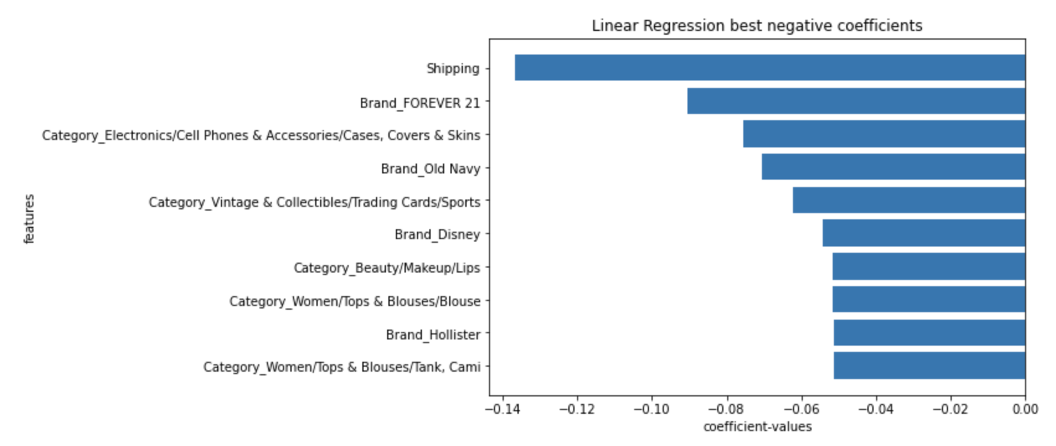
Feature Analysis – Linear Regression
Most positive coefficients
Most negative coefficients

Slide 14
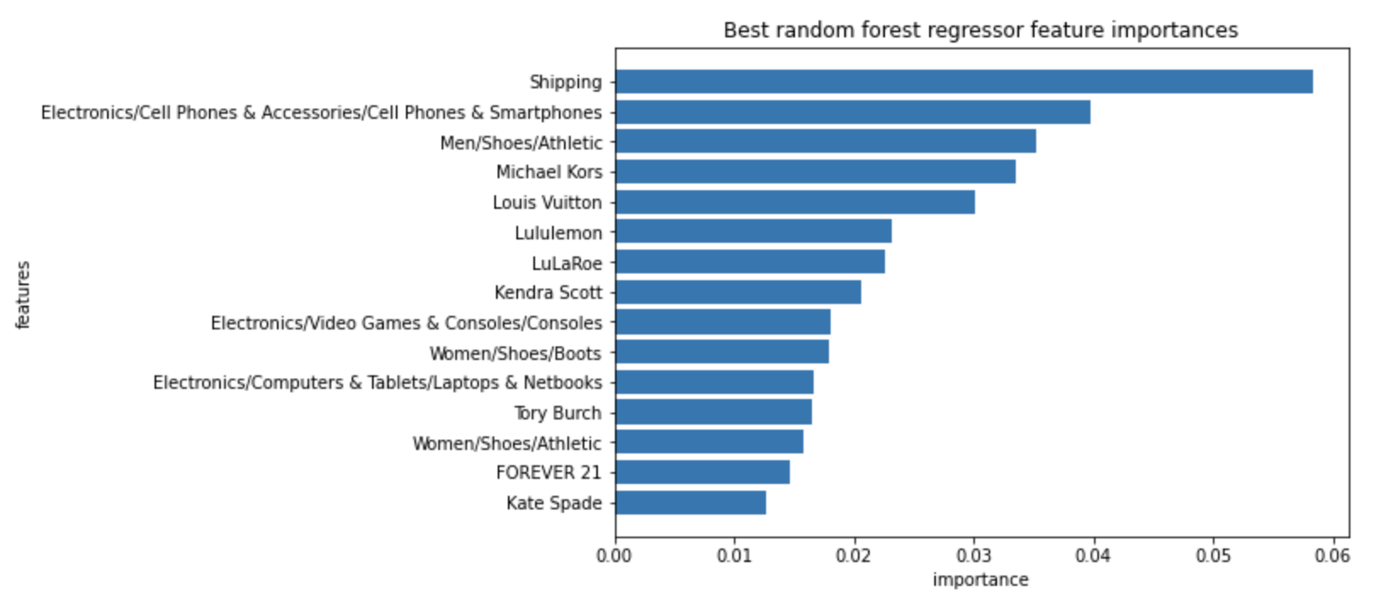
Feature Analysis – Random Forest

Slide 15
Final Model Evaluation
Model | Linear Regression | Random Forest
R score | 0.4109 | 0.4584
Mean Absolute Error | 0.6653 | 0.6333
Mean Absolute Percentage Error | 16.3564 | 15.4824

