Slide 1


Predicting the Price of Online Shopping Listings on Mercari
By: Jason Zhou

Slide 2

What is Mercari?
Online marketplace platform
Sellers are individuals, not corporations
Requires that sellers ship out items to the buyers

Slide 3


The Problem
Sellers often don’t know how much they should charge for their item
Mercari has an algorithm in place to suggest a price based on demand
The goal of this project is to study regression models that can suggest price based on other features of the listing
Notes:
What I did
How reliably my answer is (in terms of error), if they can trust the output of our model

Slide 4

Stakeholders
Mercari
Sellers
Buyers

Slide 5
Working Data Set
1,000,000+ Item listings
Number of columns: 7
Over 4000 unique Brands, 1000+ unique categories
Found on Kaggle (put URL)

Slide 6
Data Fields
Name
Condition (1-5, 1 being the best, 5 being the worst)
Category
Brand
Price
Shipping (whether the buyer or seller pays for shipping)
Item Description

Slide 7


Data Cleaning Decisions
Dropped all rows with missing values
Dropped all rows with ‘Brand’s and ‘Category’s that occur in less than 50 instances in the data set
Dropped every row that has a value of 0 in the ’Price’ column
Took the log of the ‘Price’ column to account for skewing
Dropped the ’Name’ and ‘Item Description’ columns

Slide 8
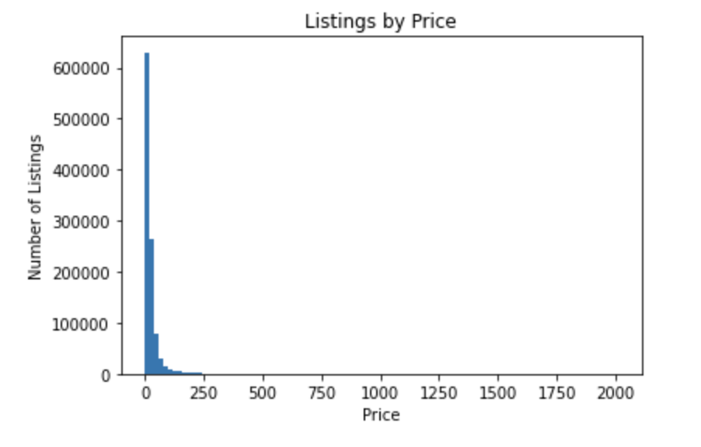
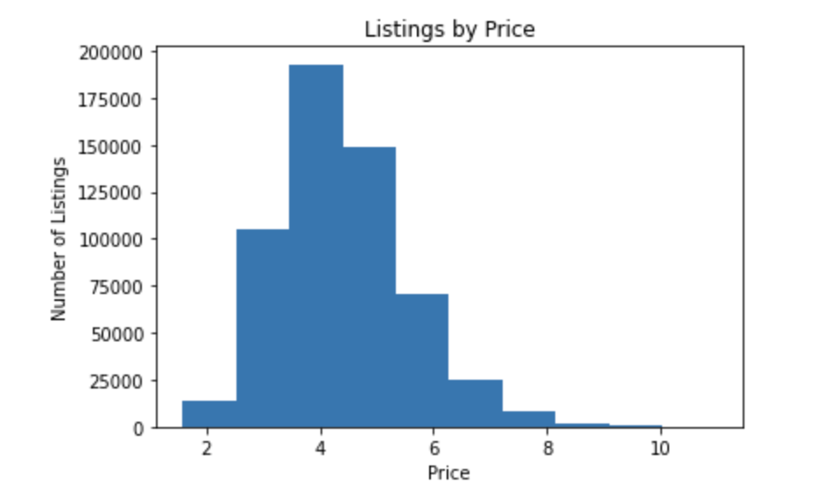
Price Distribution Before and After

Slide 9
Exploratory Data Analysis Findings
Target: Price
Features: Condition, Brand, Category, Shipping
Significant correlations with Price: Brand, Category, Shipping
Insignificant correlations with Price: Condition
Notes:
Change phrasing
Paste results to illustrate correlations
Data scientists shouldn’t have preconceptions
Next time for EDA: get pairwise connections for all features
Feature vs. Feature: to see if features are redundant with each other, you cannot use redundant features during training
Feature vs. Target: potential candidates to see which features could be affecting the target the most

Slide 10
Preprocessing
Had to take a 20% sample of our working data set due to computational constraints
Target: Price
Features: Brand, Category, Shipping
70/30 train/test split

Slide 11
Model Selection
Linear Regression
Tuning:
Selecting K best neighbors
Random Forest
Determining:
Increasing max_depth

Slide 12
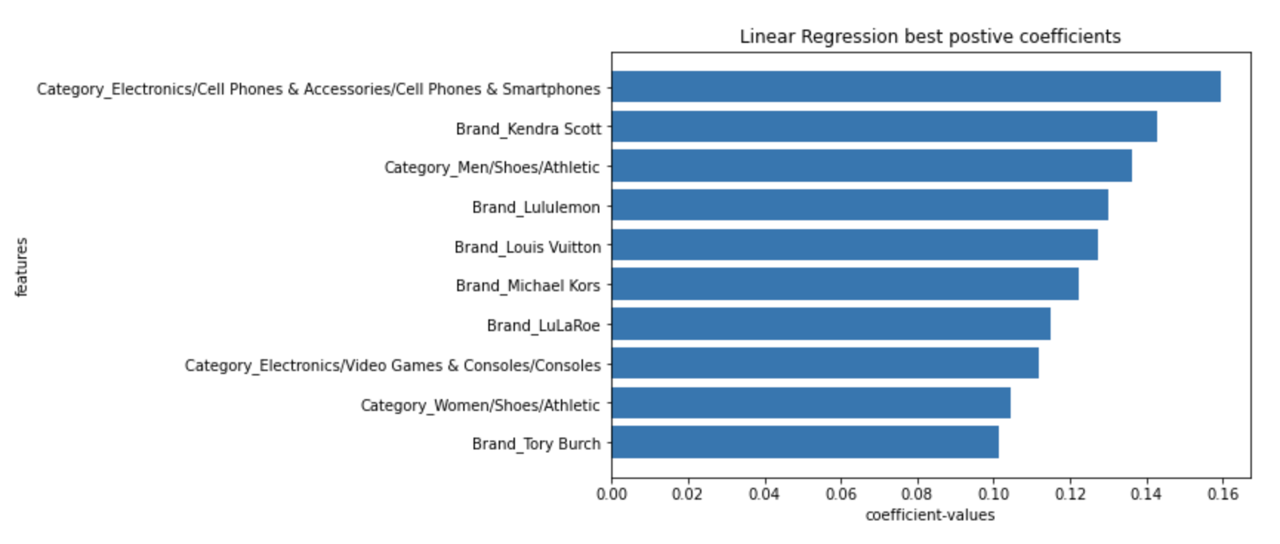
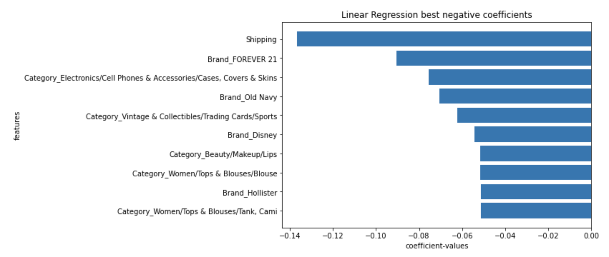
Coefficient Impact – Linear Regression
Most positive coefficients
Most negative coefficients

Slide 13
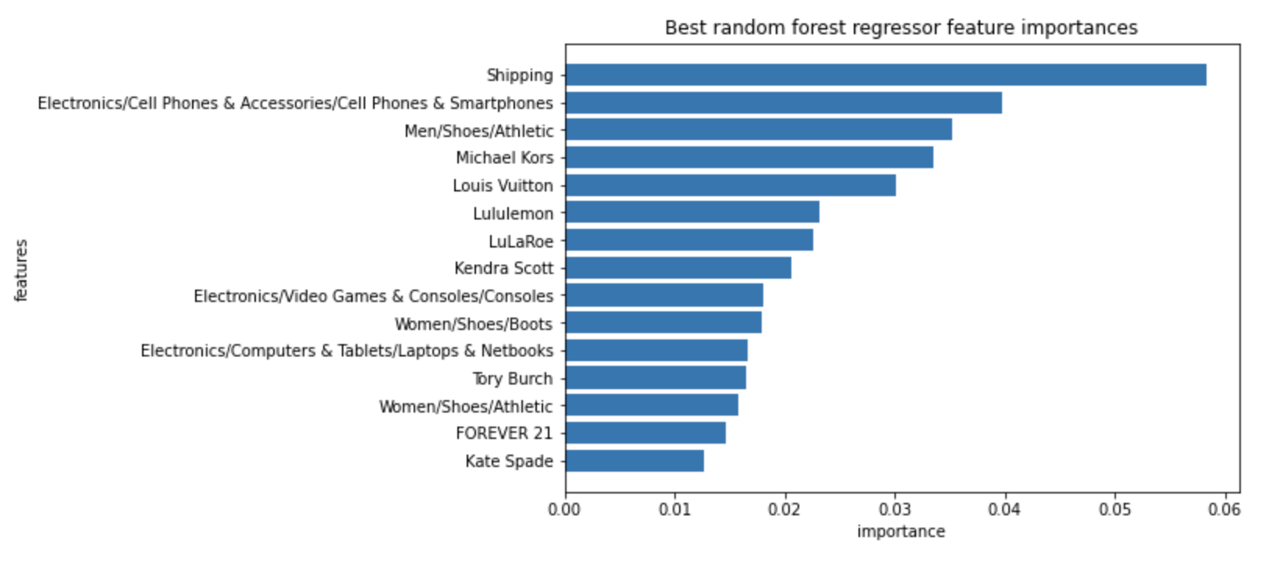
Coefficient Importance – Random Forest

Slide 14
Final Model Evaluation
Model | Linear Regression | Random Forest
R score | 0.4109 | 0.4584
Mean Absolute Error | 0.6653 | 0.6333
Mean Absolute Percentage Error | 16.3564 | 15.4824

Slide 15
Model Error – Adjusted for log scaling
MAE: %14.18
MAPE: 48%

Slide 16
Future Improvements
Store Dataframes more efficiently in memory so that slicing is no longer required
Testing more models, with more hyperparameter tuning
Get pairwise correlations of all features during EDA, including non-numeric features
Including and processing every column for correlation analysis

