Slide 1
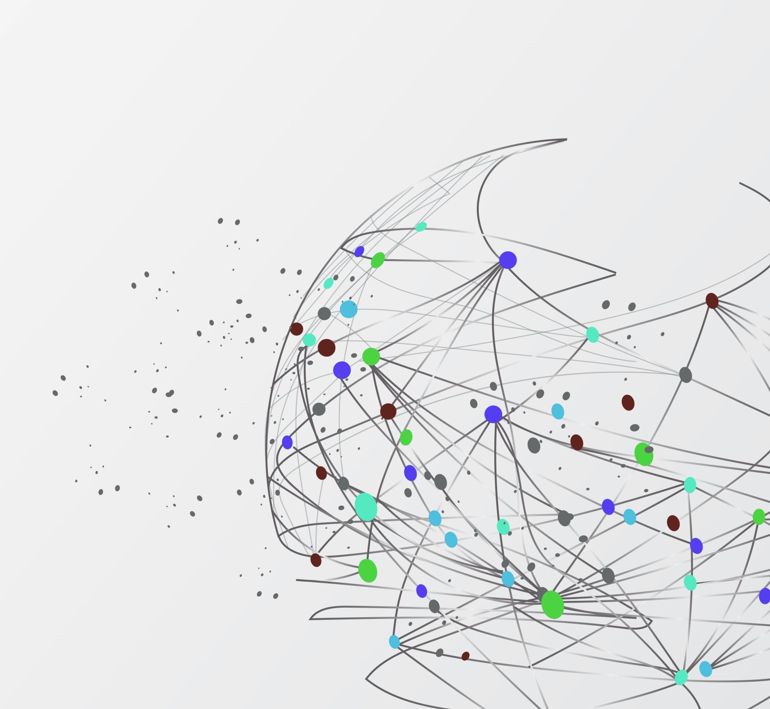
Twitter Sentiment Analysis: Nintendo E3 2018
By: Jason Zhou
With the help of: A J Sanchez

Slide 2
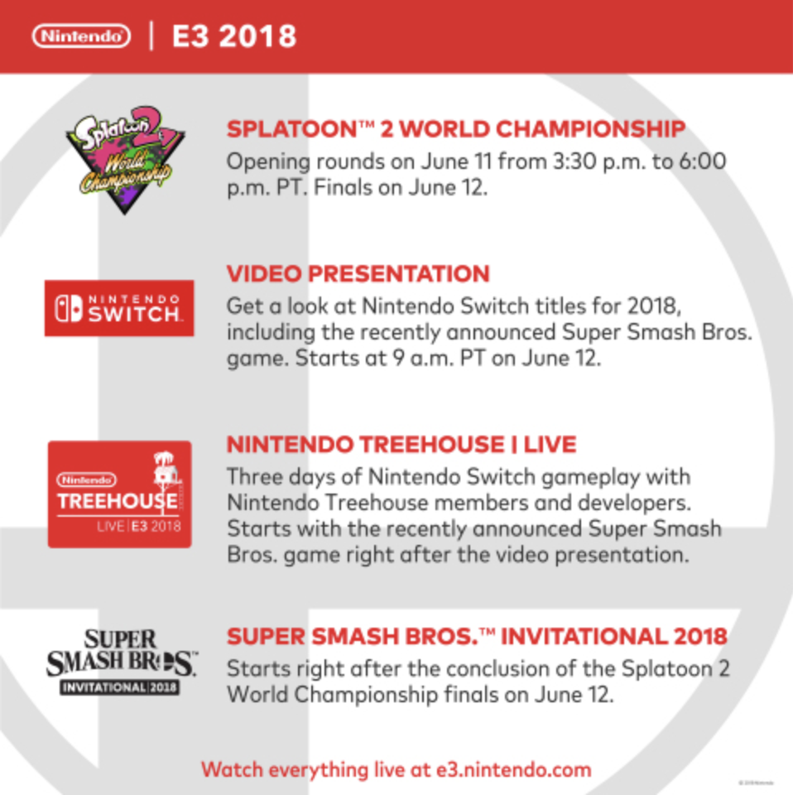
Introduction
E3 (Electronic Entertainment Expo) is a major annual event in the video game industry
Major companies in the industry attend the event to announce new releases, including Nintendo
Reactions to new titles get posted on Twitter
Major upcoming Nintendo titles: Super Smash Bros Ultimate, Fire Emblem: Three Houses, Super Mario Party

Slide 3
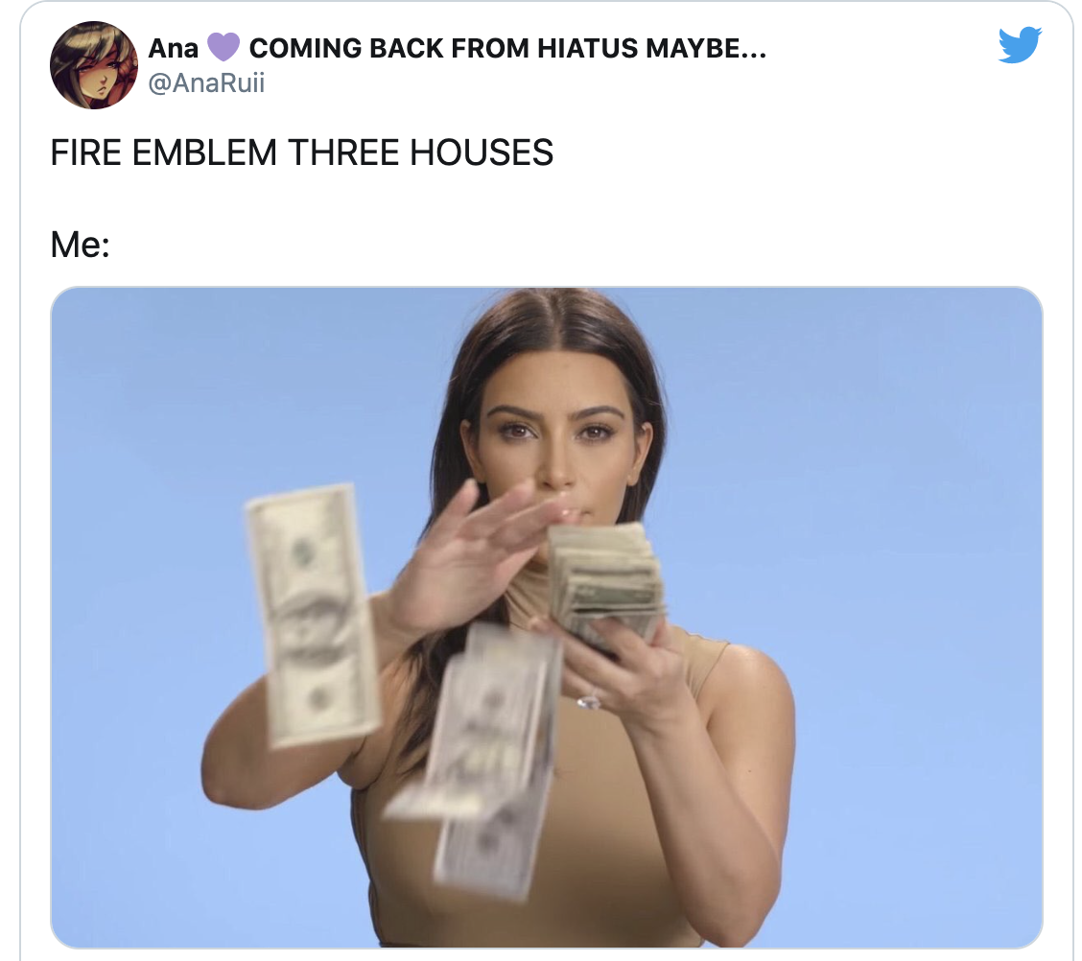
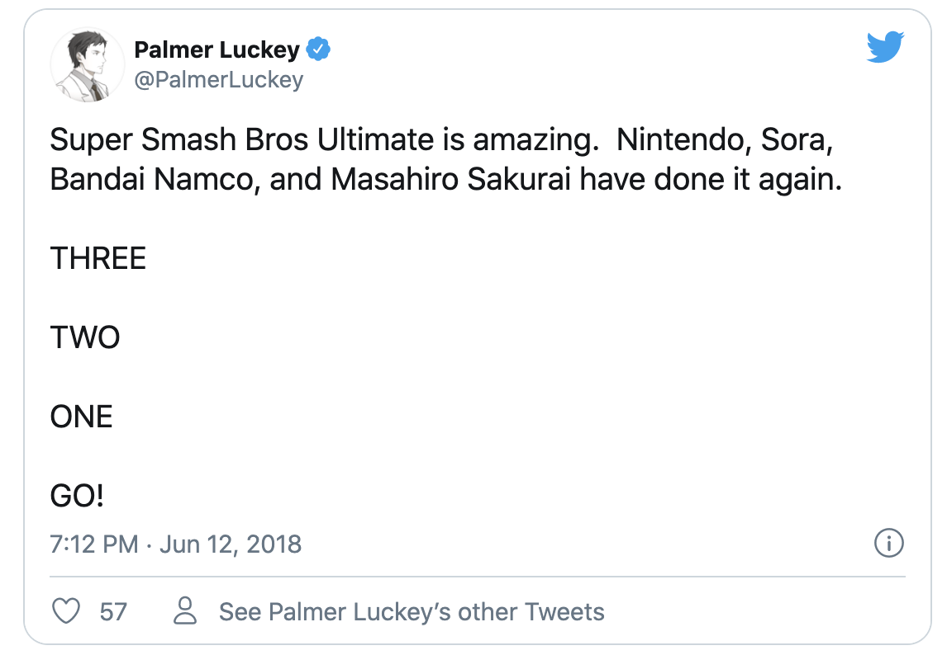
Business Problem
Sentiment analysis of tweets responding to the announcement of the major upcoming titles: Smash Ultimate, Fire Emblem, Mario Party
Build models that accurately label tweets as positive or negative reactions, one separate model for each game

Slide 4
Data Science Approach
Treat problem as binary classification problem, two classes “positive (0)” and “negative (1)”
1
Extract tweets corresponding to each game, based on hashtags. Separate into three distinct data sets
2
Label tweets using python package TextBlob, TextBlob takes a string and outputs polarity score between -1.0 and 1.0. Scores >= 0 categorized as positive, scores < 0 categorized as negative
3
Train classification models for each game, choose best performing model for each game
4
Set aside sample of data set to manually label using my own judgment, compare model labeling to mine, evaluate models based on classification report scores
5

Slide 5
Data Acquisition
Data set found on Kaggle, 100,000+ tweets captured during Nintendo’s presentation at E3 2018, using keywords #NintendoE3 and #NintendoDirect
Tweet data encoded in JSON format, with predefined attributes and values
Attributes of interest: ‘text’ and ‘entities’, which includes hashtags

Slide 6
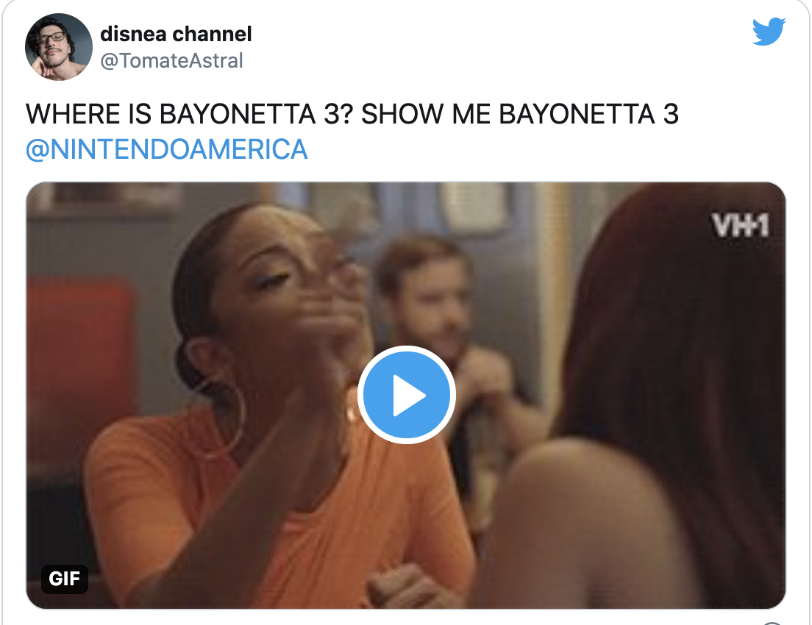
Data Wrangling
Processing text bodies of tweets
Removing URLs, punctuation, @s, hashtags, emojis, words not in the dictionary
Standardizing words/tokens, lemmatizing, lowercasing
Categorizing tweets by game using hashtags
Group similar hashtags together, eg: #supersmashbros, #smashbros, #smashultimate, #ssbu
Gather all tweets related to a game, based on the similar hashtags
Final columns used: ‘text’
Detecting and removing foreign tweets by checking words in English dictionary, and by using list of foreign language keywords, eg: (el, de, le, un)

Slide 7
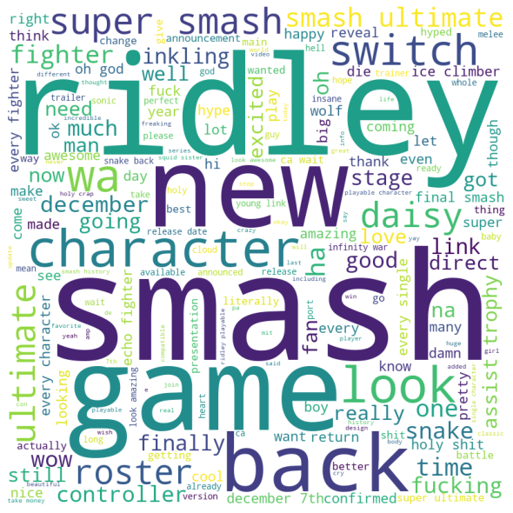
Exploratory Data Analysis
Initial data visualization using word clouds, looking for individual words that clearly indicate positive or negative sentiment
Feature Extraction with Vectorizers, examining correlations between token frequency vectors, identifying collinear vectors

Slide 8
Preprocessing
Setting aside sample of each collection of tweets to be manually labeled by myself, using train_test_split with stratification on the labels
Labeling the rest of the data using TextBlob, positive labeled as 0, negative labeled as 1
Checking for data imbalance
Labels by TextBlob | Smash Bros | Fire Emblem | Mario Party
Positive | 11861 | 1534 | 829
Negative | 674 | 29 | 53

Slide 9
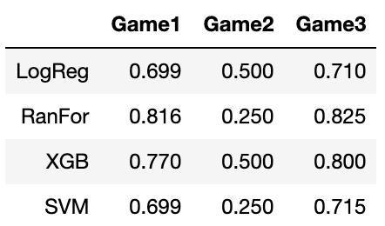
Baseline Modeling - Recall Scores
Models: LogisticRegression, RandomForestClassifier, XGBClassifier, SVC
Game1: Smash Bros Ultimate
Game2: Fire Emblem: Three Houses
Game3: Super Mario Party

Slide 10
Hyperparameter Tuning
LogisticRegression:
solvers, c_values
RandomForestClassifier:
n_estimators, max_features
XGBClassifier:
n_estimators, learning_rate
SVC:
kernel, C

Slide 11
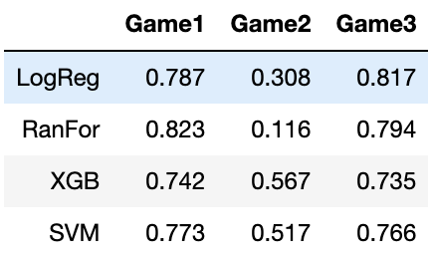
Extended Modeling – Recall Scores
Before Tuning
After Tuning

Slide 12
Final Models By Game
Super Smash Bros Ultimate: Random Forest
Fire Emblem: Three Houses: XGBClassifier
Super Mario Party: Random Forest

Slide 13

Comparing Model Predictions with Manually Labeled Data
 | Smash Bros | Fire Emblem | Mario Party
Accuracy | 0.960 | 0.970 | 0.925
Precision | 0.800 | 0.000 | 0.000
Recall | 0.222 | 0.000 | 0.000
F1 | 0.348 | 0.000 | 0.000

Slide 14
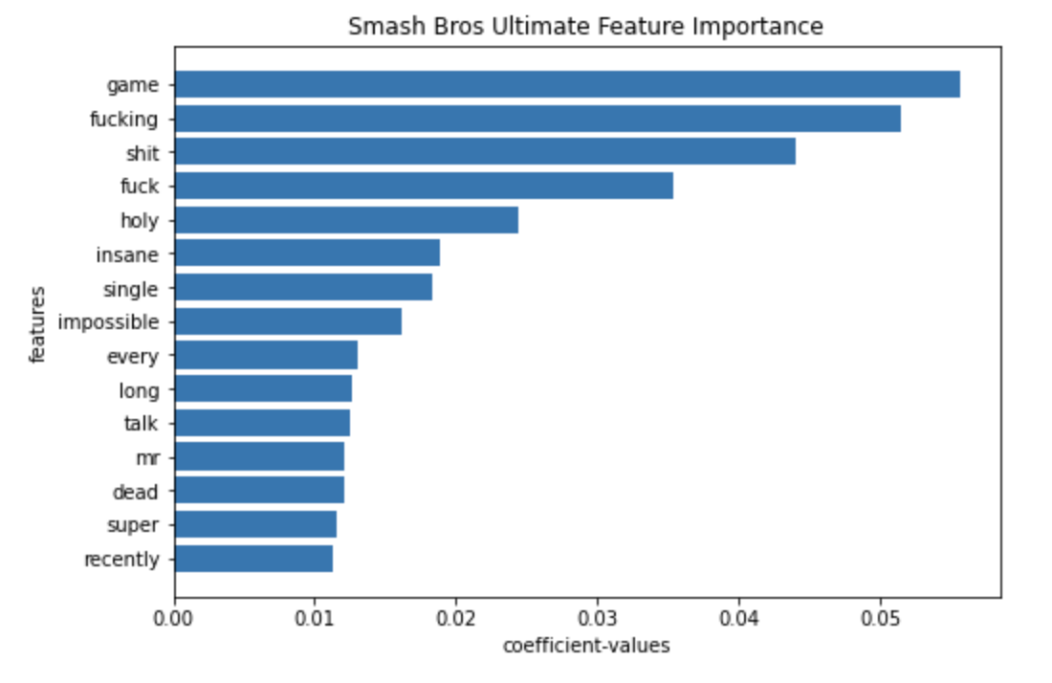
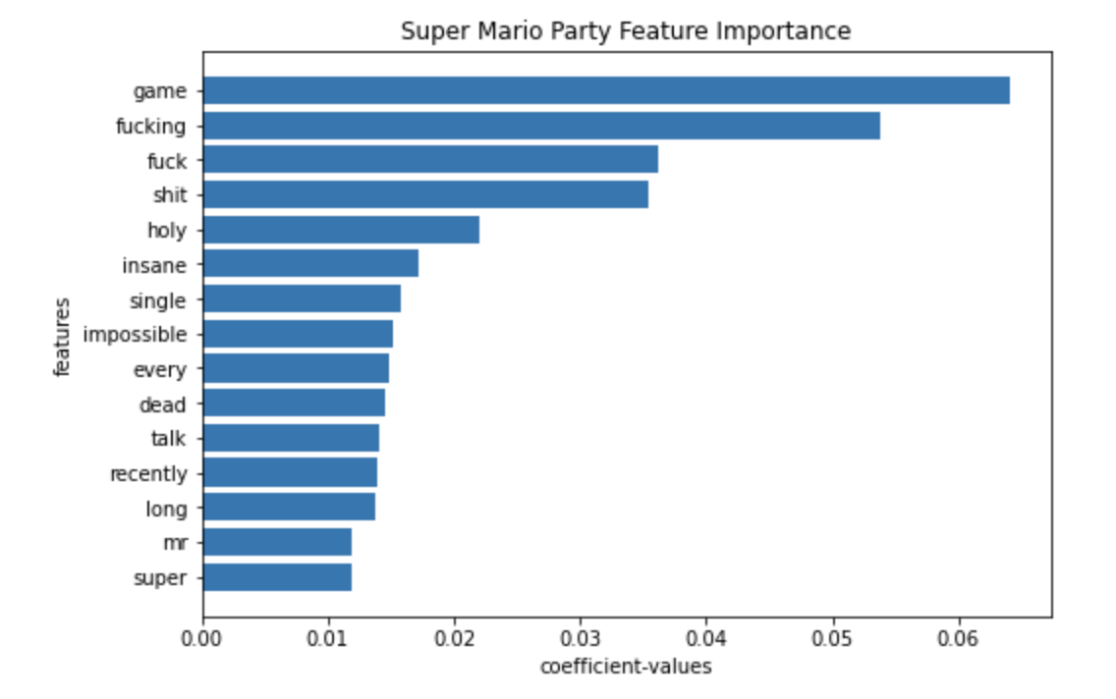
Feature Importance

Slide 15
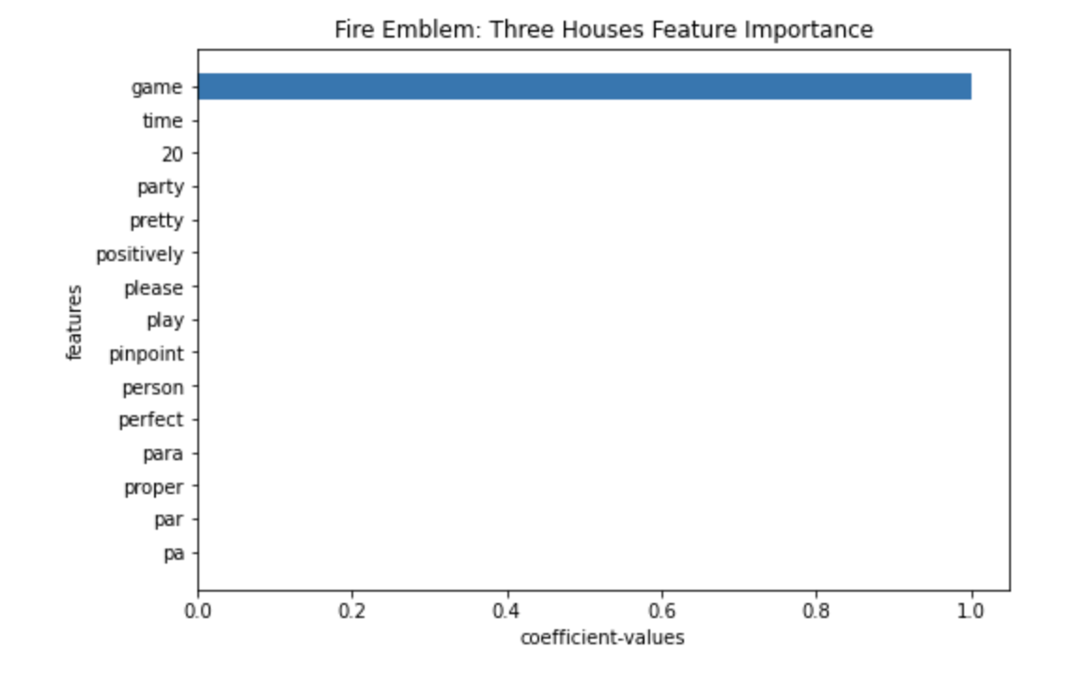
Feature Importance
Hmmm… why? How?
Most imbalanced data set: 53:1 positive: negative
Majority duplicate rows ,only 200 unique tweets out of 1563 total tweets
One tweet was retweeted 1178 times, in other words the data set has 1178 identical rows

Slide 16
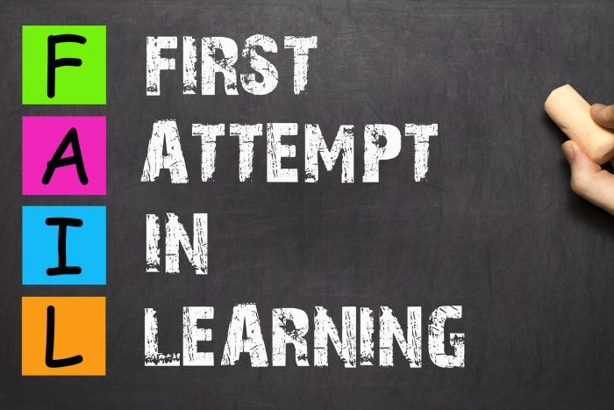
Reasons for Modeling Failure
The language and content of tweets is more unfocused and broad compared to for example, formal reviews
Harder for algorithms to work with documents that don’t adhere to more standard language
Bag-of-words representation of tweets is too simplistic and unnuanced

Slide 17
Future Improvements
Processing and evaluating images as well
More complex text representations than just bag-of-words representations, include phrases, sentence structure, grammar, punctuation
Better sampling methods suited for working with imbalanced data
Trying more models, tuning more hyperparameters

