Slide 1
IML_Group06
Sentiment Analysis Model
Group members-
IIT2021125: Radhika Gupta
IIT2021139: Naman Gupta
IIT2021140: Naysha Singh
IIT2021168: Kaushik Mullick
IIT2021170: Viraj Jagtap
IIT2021172: Shruti Bilolikar
Guided by- Prof. Shekhar Verma
Notes:
Entered text
Machine learning model for Sentiment Analysis:
In an era dominated by vast amounts of textual data generated across various online platforms, understanding and interpreting the sentiments expressed by individuals has become a crucial task. Sentiment analysis, also known as opinion mining, is a powerful natural language processing (NLP) technique that involves extracting and analyzing sentiments, opinions, and emotions from text data. This process enables us to gain valuable insights into the attitudes and feelings of users towards a particular subject, product, or event.
The aim of our sentiment analysis project is to harness the capabilities of machine learning and NLP to automatically categorize and understand the sentiment conveyed in textual content. By utilizing advanced algorithms and techniques, we can transform unstructured text into valuable information, providing businesses, researchers, and individuals with actionable insights.

Slide 2
Sentiment Analysis
Sentiment analysis is the process of classifying whether a block of text is positive, negative, or, neutral.
The goal which Sentiment analysis tries to gain is to be analyzed people’s opinions in a way that can help businesses expand.
It focuses not only on polarity (positive, negative & neutral) but also on emotions (happy, sad, angry, etc.).
It uses various Natural Language Processing algorithms such as Rule-based, Automatic, and Hybrid.

Slide 3
WHY Sentiment Analysis?
Sentiment analysis is the contextual meaning of words that indicates the social sentiment of a brand and also helps the business to determine whether the product they are manufacturing is going to make a demand in the market or not.
According to the survey,80% of the world’s data is unstructured. The data needs to be analyzed and be in a structured manner whether it is in the form of emails, texts, documents, articles, and many more.
Sentiment Analysis is required as it stores data in an efficient, cost-friendly.
Sentiment analysis solves real-time issues and can help you solve all real-time scenarios.

Slide 4
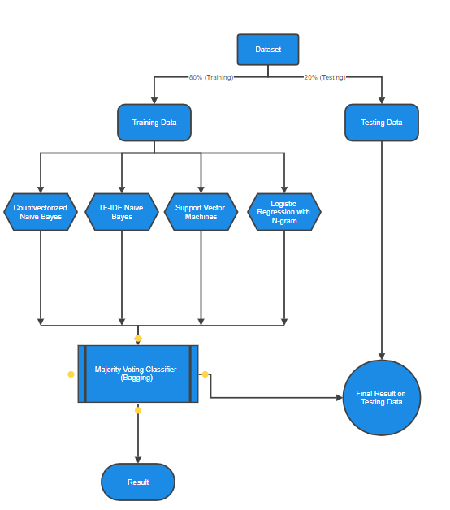
Flow
Chart:

Slide 5
Dataset
Dataset Overview:
1,600,000 tweets from Twitter API
Classified into 0 (negative) to 4 (positive)
6 fields: target, ids, date, flag, user, text
Data Cleaning:
Removal of tweets with 0 length
Resulting dataset: 1,592,328 × 2
Balanced Distribution:
Equal positive and negative samples
No skewness in dataset distribution

Slide 6
Preprocessing
Letter Frequency Analysis:
Frequency and relative frequency of letters in tweets
Chi-square test indicates a significant difference from English text distribution
High Pearson correlation (~96.7%) but p-value is 0
Character Analysis:
Counted characters per tweet
Max characters: 189, Min characters: 1, Mean: 42.78, Std Dev: 24.16
Skewed distribution observed in character length

Slide 7
Preprocessing
Word Analysis:
Counted words per tweet
Max words: 50, Min words: 1, Mean: 7.24, Std Dev: 4.03
Skewed distribution in word length similar to character length
GloVe Embedding:
Used GloVe for word representation
Transfer learning technique for efficiency
Downloaded GloVe, initialized embedding index with 400,000 word vectors, and embedding matrix

Slide 8
Naive-Bayes Classifier
Implemented using: Multinomial Naive Bayes Algorithm.
The CountVectorizer is employed to convert the text data into a matrix of token counts. Each row of this matrix corresponds to a tweet, and each column represents a unique word in the dataset. The fit_transform method is used on the training data (train_data['tweet']) to create a bag-of-words representation (vec).
The MultinomialNB classifier is then instantiated and trained using the bag-of-words matrix (vec) and corresponding labels from the training data (train_data['label']).

Slide 9
Naive-Bayes Classifier Results
Accuracy: 76.49262401637851%
precision recall f1-score support
Negative 0.76 0.77 0.77 159493
Positive 0.77 0.76 0.76 158973
Accuracy 0.76 318466

Slide 10
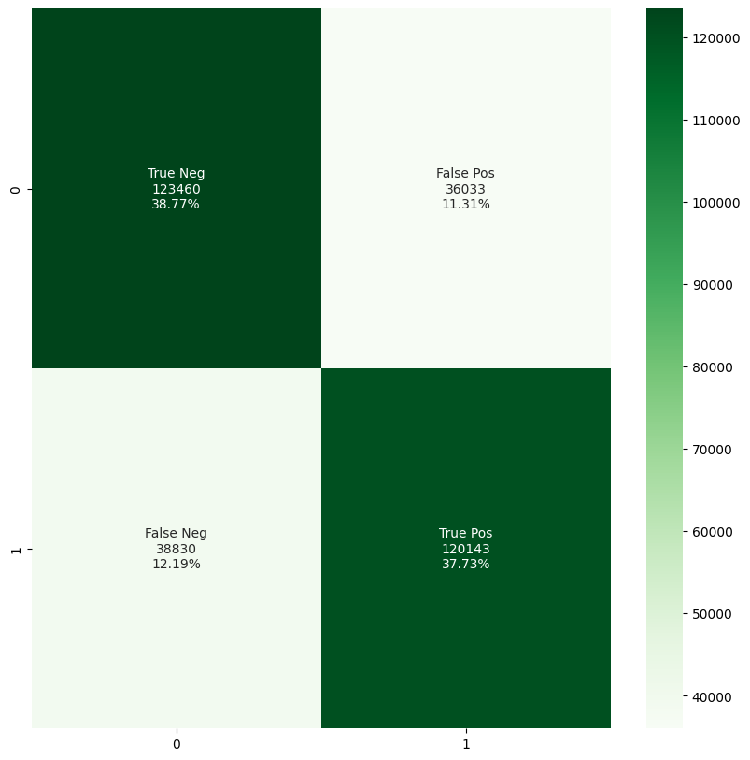
Naive Bayes Classifier Results

Slide 11
TF-IDF Naive-Bayes Classifier
TF-IDF (Term Frequency-Inverse Document Frequency)
Implemented using: Multinomial Naive Bayes Algorithm.
The difference between Naive Bayes and TF-IDF Naive Bayes classifier is the use of bag-of-words matrix (vec).
The TfidfVectorizer is employed to convert the text data into a TF-IDF matrix. TF-IDF represents the importance of each word in a document relative to the entire corpus. The fit_transform method is used on the training data (train_data['tweet']) to create a TF-IDF representation (tfidf_vec).
The MultinomialNB classifier is then instantiated and trained using the new bag-of-words matrix (tfidf_vec) and corresponding labels from the training data (train_data['label']).

Slide 12
TF-IDF Naive-Bayes Classifier Results
Accuracy: 75.89475799614401%
precision recall f1-score support
Negative 0.76 0.77 0.76 159493
Positive 0.76 0.75 0.76 158973
Accuracy 0.76 318466

Slide 13
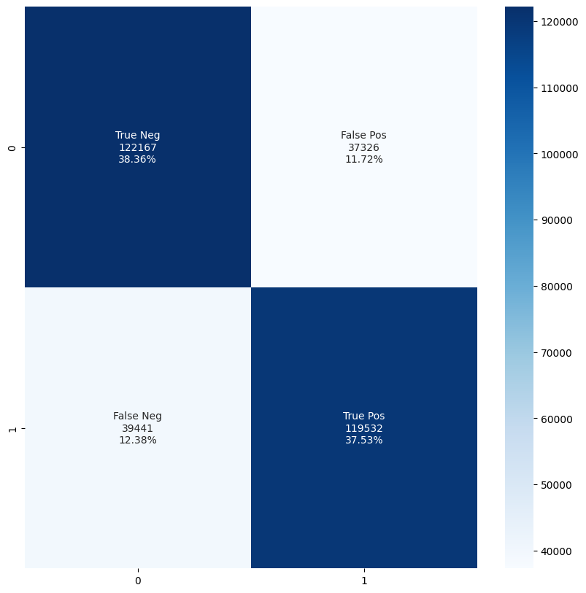
TF-IDF Naive Bayes Classifier Results

Slide 14
Support Vector Machine (SVM)
Implemented using: LinearSVC (Linear Support Vector Classification) model.
The bag-of-words matrix (vec) obtained from the Countvectorizer is reused here.
The LinearSVC classifier is instantiated and trained using the bag-of-words matrix (vec) and corresponding labels from the training data (train_data['label']).

Slide 15
SVM Results
Accuracy: 77.17118938913417%
precision recall f1-score support
Negative 0.76 0.79 0.78 159493
Positive 0.78 0.75 0.77 158973
Accuracy 0.77 318466

Slide 16
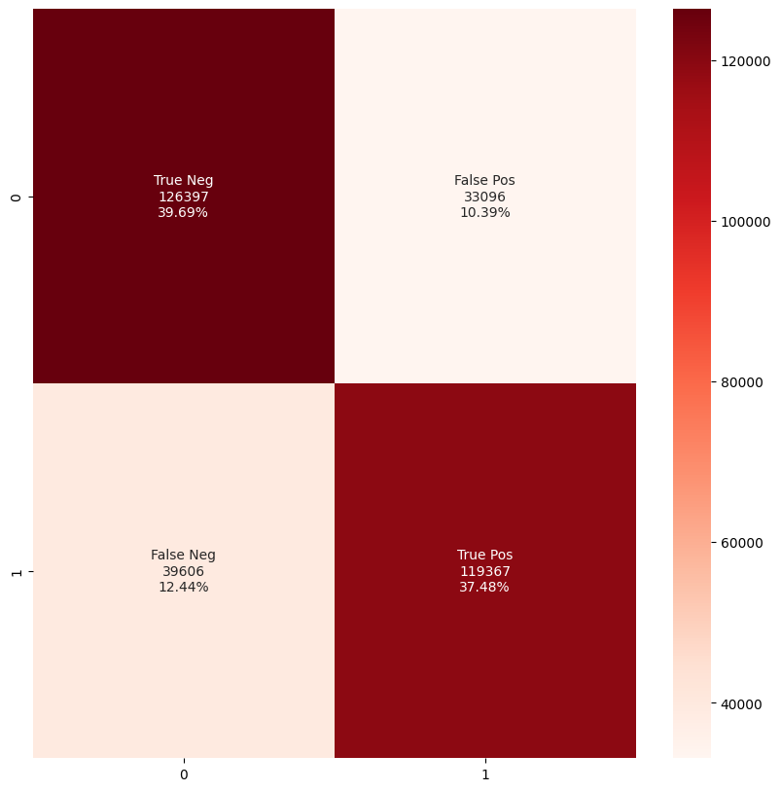
SVM Results

Slide 17
Logistic Regression with N-gram features
Implemented using: Logistic Regression model.
The CountVectorizer is used to create a bag-of-words representation with N-gram features (unigrams and bigrams).
(We have set min_df value as 5, as the min. number of documents a word must be present in to be included in vocabulary) (And ngram_range as (1,2) to include both unigrams and bigrams)
The Logistic Regression model is instantiated and trained using the vectorized training data (X_train_vectorized) and the corresponding labels from the training data (y_train).

Slide 18
Logistic Regression (N-gram) Results
Accuracy: 78.91643063937751%
precision recall f1-score support
Negative 0.81 0.76 0.78 159493
Positive 0.77 0.82 0.79 158973
Accuracy 0.79 318466

Slide 19
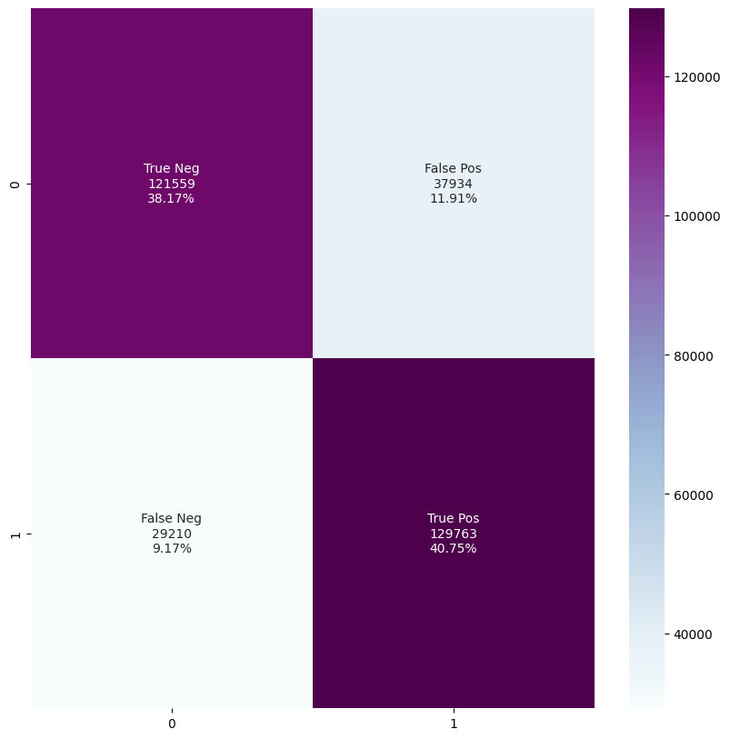
Logistic Regression (N-gram) Results

Slide 20
Final Step: Bagging
Bagging classifier combines multiple base models for sentiment analysis.
It uses an ensemble of base models, and the base models are combined using a hard-voting strategy (Mode of the predicted results).
Base models include-
Naive Bayes with CountVectorizer
Naive Bayes with TF-IDF features
Linear SVM
Logistic Regression with N-gram features
The Bagging Classifier is trained using the vectorized training data (X_train_vectorized) and the corresponding labels from the training data (y_train).
Notes:
0

Slide 21
Bagging Results
Accuracy: 77.72289663574762%
precision recall f1-score support
Negative 0.76 0.81 0.78 159493
Positive 0.80 0.74 0.77 158973
Accuracy 0.78 318466

Slide 22
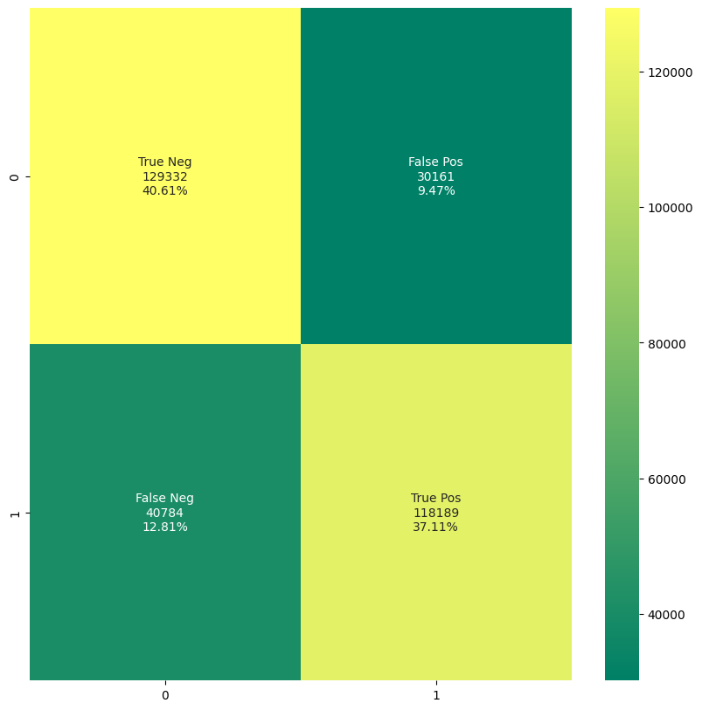
Bagging Results

Slide 23
Applications
Sentiment Analysis has a wide range of applications as:
Social Media: If for instance the comments on social media side as Instagram, over here all the reviews are analyzed and categorized as positive, negative, and neutral.
Customer Service: In the play store, all the comments in the form of 1 to 5 are done with the help of sentiment analysis approaches.
Marketing Sector: In the marketing area where a particular product needs to be reviewed as good or bad.
Reviewer side: All the reviewers will have a look at the comments and will check and give the overall review of the product.

Slide 24
Challenges of Sentiment Analysis
There are major challenges in the sentiment analysis approach:
If the data is in the form of a tone, then it becomes really difficult to detect whether the comment is pessimist or optimistic.
If the data is in the form of emoji, then you need to detect whether it is good or bad.
Even the ironic, sarcastic, comparing comments detection is really hard.
Comparing a neutral statement is a big task.

Slide 25
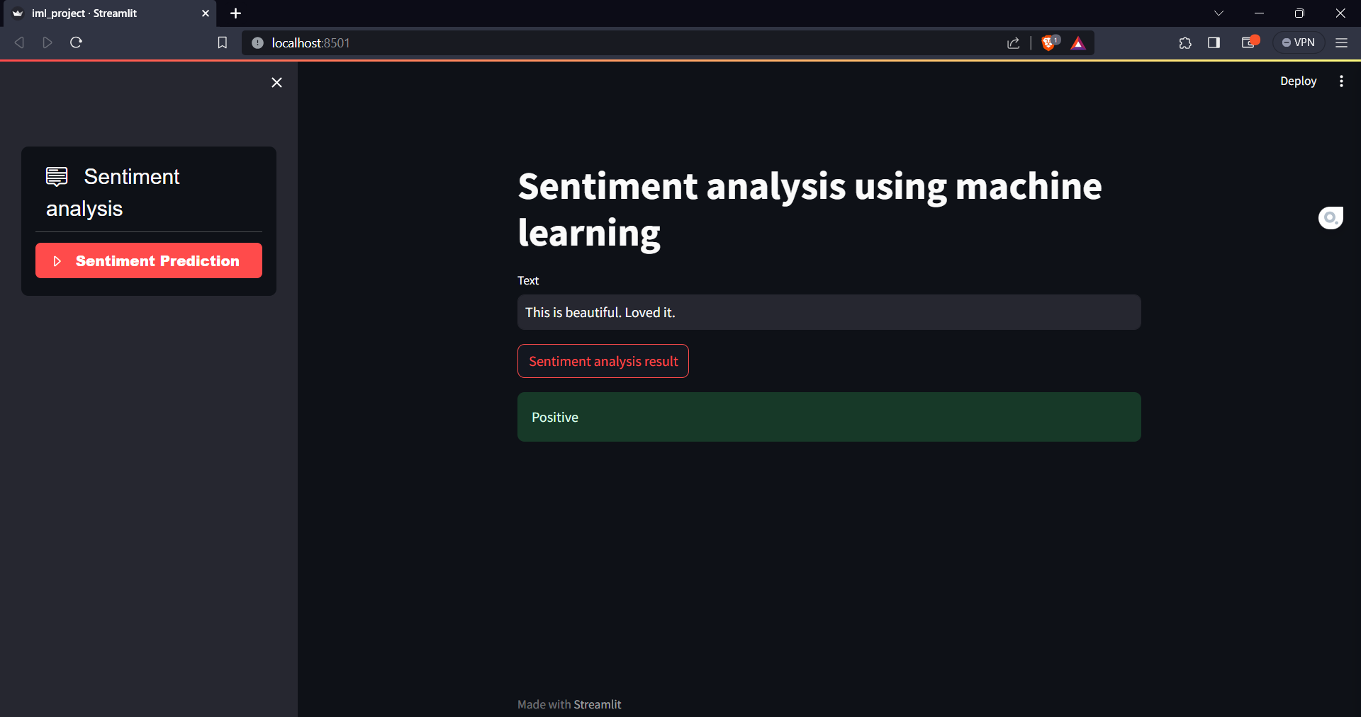
Interface

Slide 26
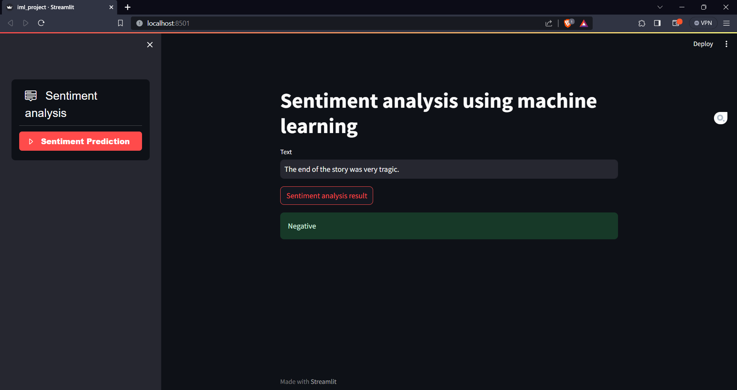
Interface

Slide 27
Thank you

