Slide 1




Project Overview
What was the task at hand?
1. Food
2. Activity
3. Loop
4. Sleep

Slide 2
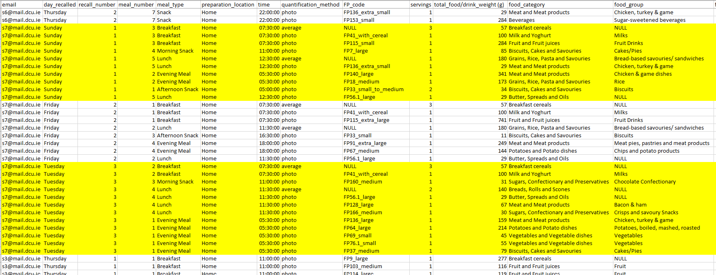
Data Cleaning – Food
How did I go about cleaning the food datasets?

Slide 3
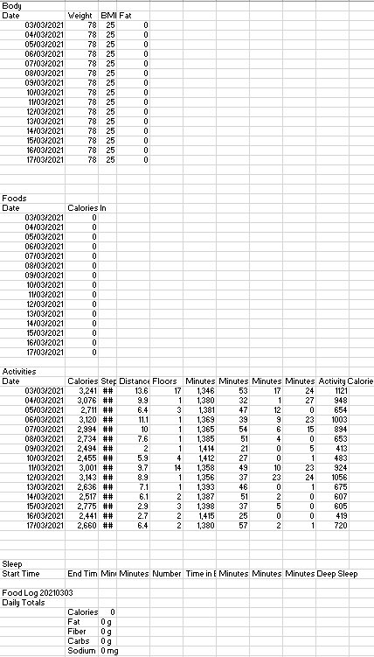
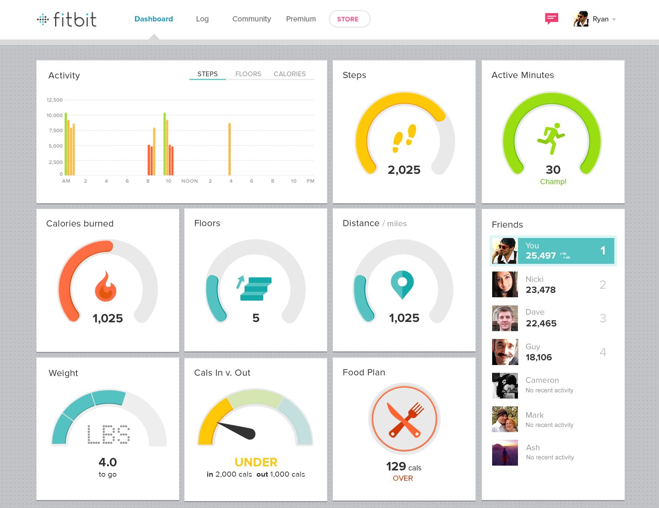
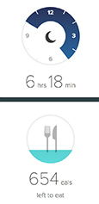
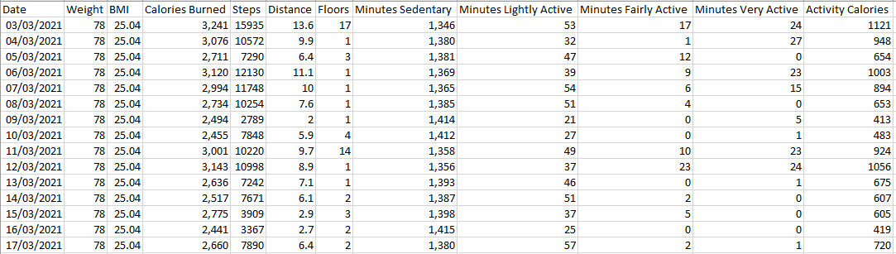
Data Cleaning – Activity
How did I go about cleaning the activity datasets?
1
2
3
4
5

Slide 4
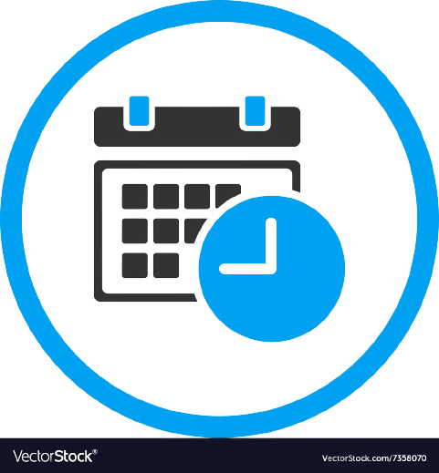




Data Cleaning – Loop
How did I go about cleaning the loop datasets?

Slide 5
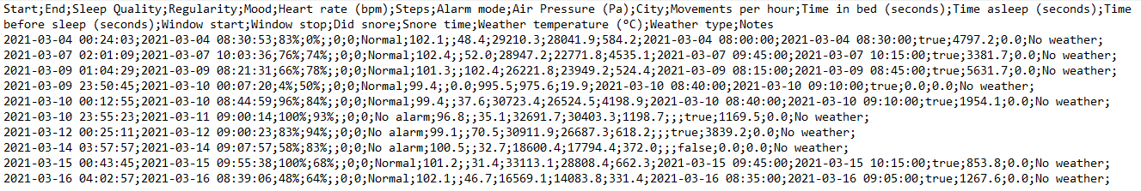
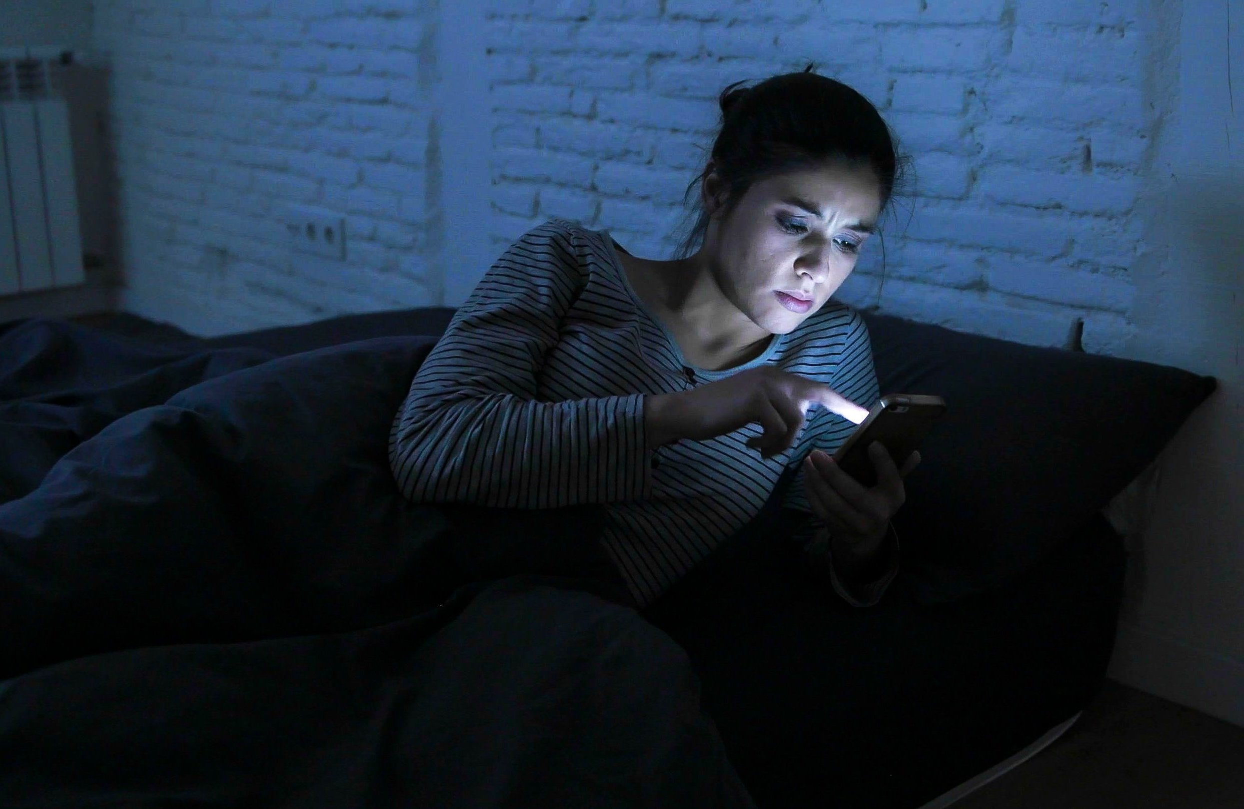
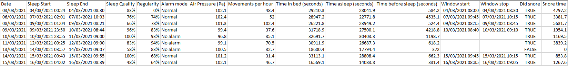

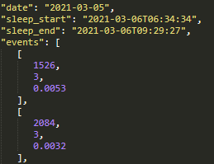
Data Cleaning – Sleep
How did I go about cleaning the sleep datasets?

Slide 6
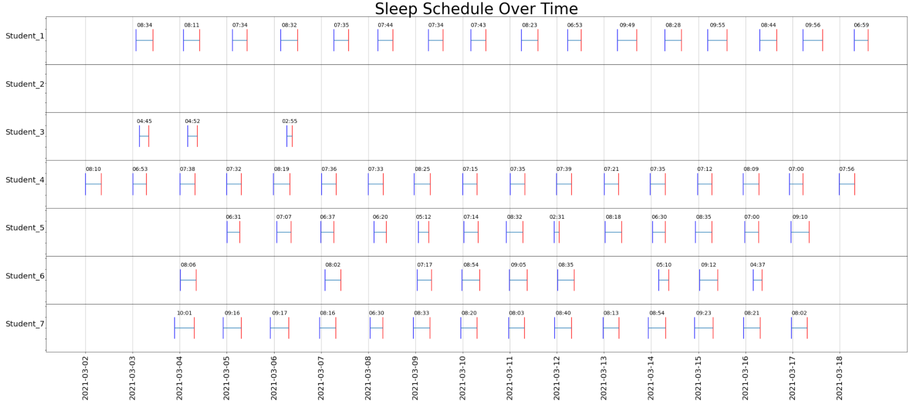
Sleep Data Analysis
What does the recorded data look like?

Slide 7
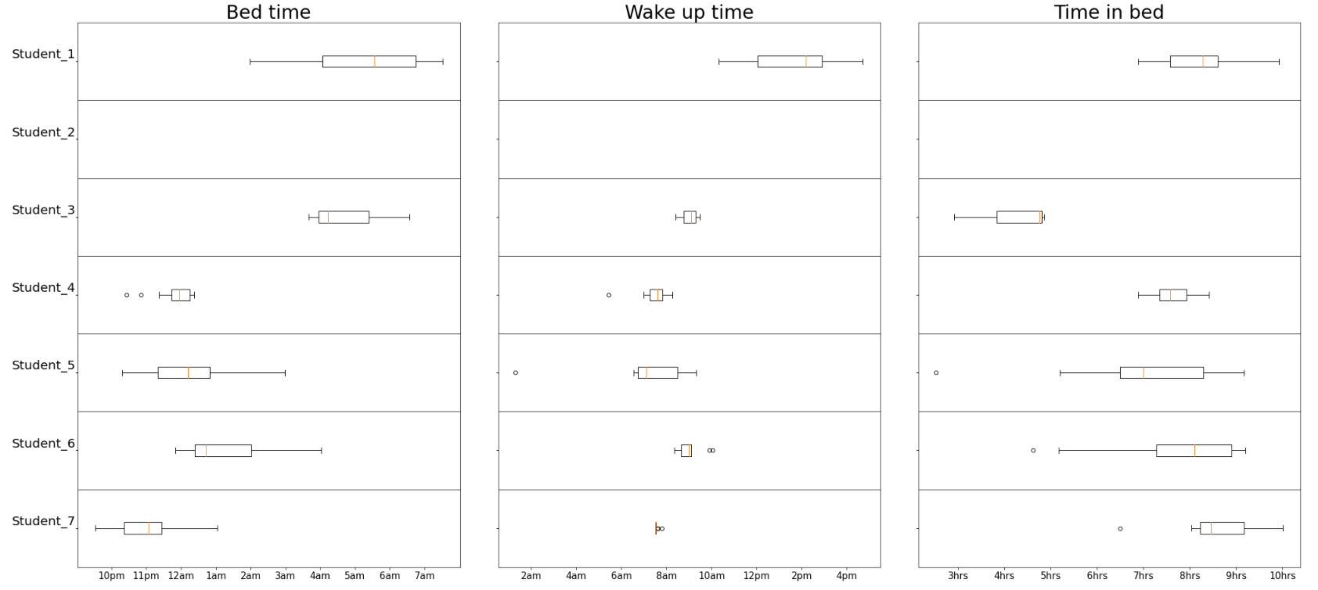
Sleep Data Analysis
What are the average times we go to sleep and wake up?

Slide 8
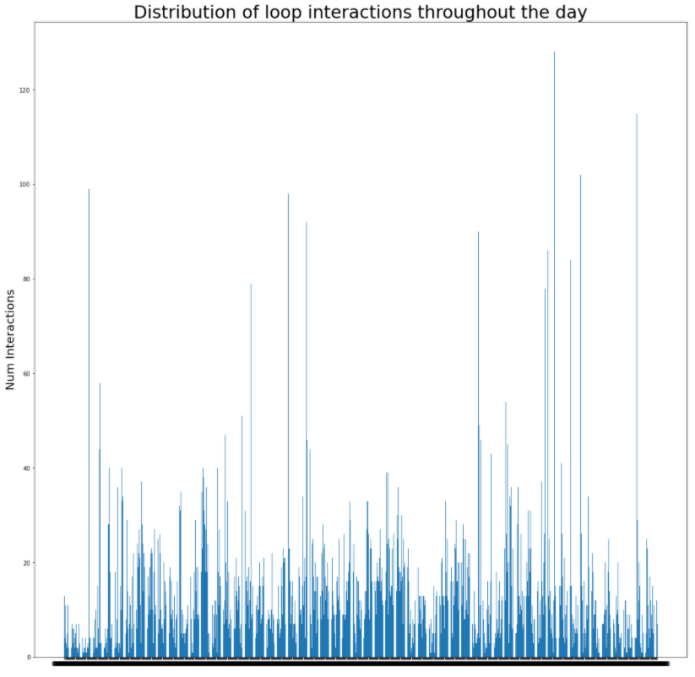
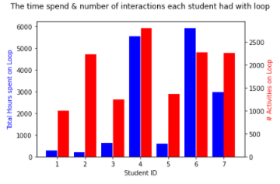
Loop Data Analysis
How & when do students interact with Loop?

Slide 9
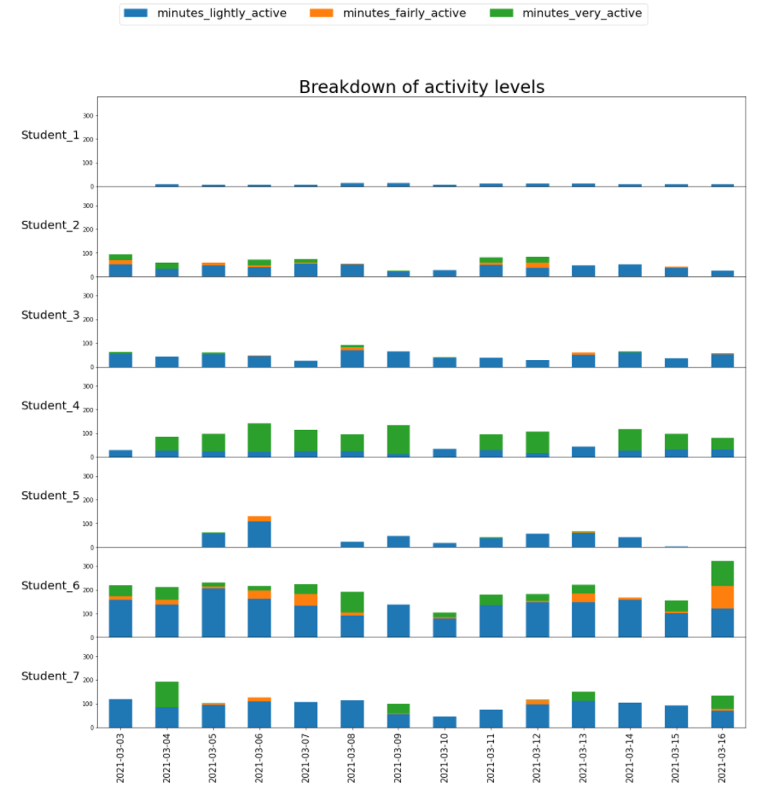
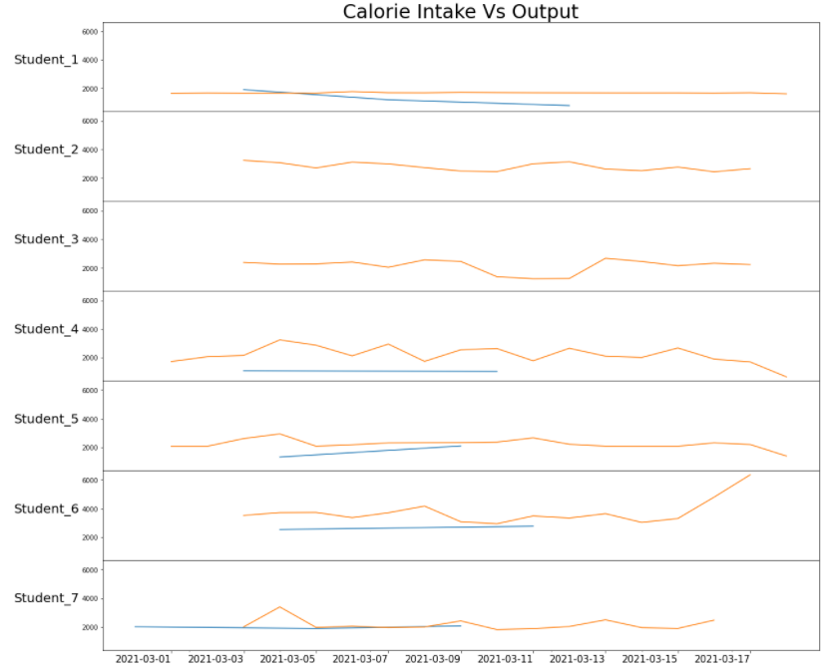
Activity & Food Data Analysis
How much do students exercise & is it in proportion to their calorie intake?

Slide 10


Conclusion
Any Questions?
Notes:
Any Questions?

