Slide 1





PRESENTED BY :
Anup Karki [363412]
Jit Bdr RanaMagar [363415]
Pratik Shrestha[363418]
Seazone Joshi [363420]
Date:9/7/2021
COLLEGE APP

Slide 2

OVERVIEW
INTRODUCTION
PROBLEM STATEMENT
OBJECTIVES
FEATURES
APPLICATION
FLOW CHART
ER DIAGRAM
DFD
GANTT CHART
SYSTEM REQUIREMENTS
CONCLUSION
SCREEN SHOTS

Slide 3
INTRODUCTION
This project is mainly concerned with the Information Management System named ‘COLLEGE APP’ built to streamline college administration.
1
Our system deals with the various activities related to the collage administration and also manage activities related to the students.
2
In the current time most of the activities are done manually and is very time consuming and costly as well.
3
This “COLLEGE APP” mainly focuses on the students, parents ,teachers and simplifies administration.
4

Slide 4

PROBLEM STATEMENT
Traditional college management process is inefficient as all the records are stored in paper.
Not only the records takes allot of physical space but also they are highly prone to environmental damages.
Retrieving particular record can take allot of time since we have to physically dig up the files.
Student have to physically visit the account section to get information about their fee status. To get any notice and news student have to pay a visit to notice boards.
The COLLEGE-APP eliminate the drawbackog tradition college management system and streamlines the process.

Slide 5
OBJECTIVES
To provide a digital platform for students to see exam result and notice board according to the faculties and semester.
01

Slide 6
FEATURES
Add Co-Admin / Moderator
1
Add Student & teachers, News and Announcement
2
View , Edit , Delete Academic calendar and Schedules.
3
Fees Structure, Fees Management and bill.
4
Gallery management
5

Slide 7
APPLICATION
College and Schools
01
Other Educational institutions.
02

Slide 8
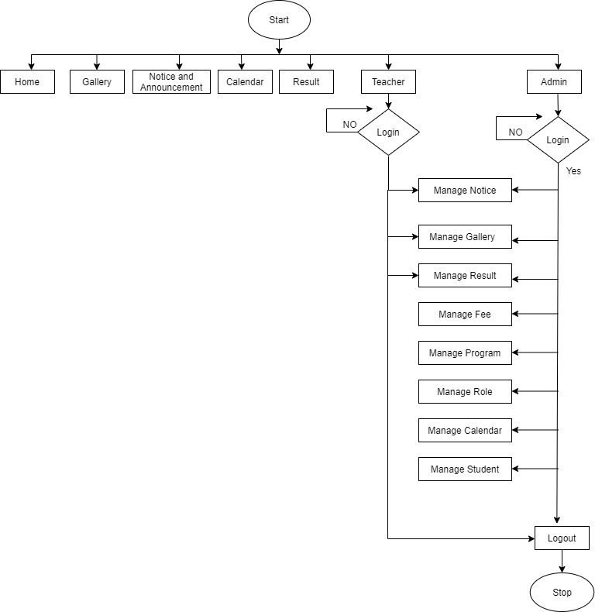
FLOW CHART
Figure 1.1: Flow Chart

Slide 9
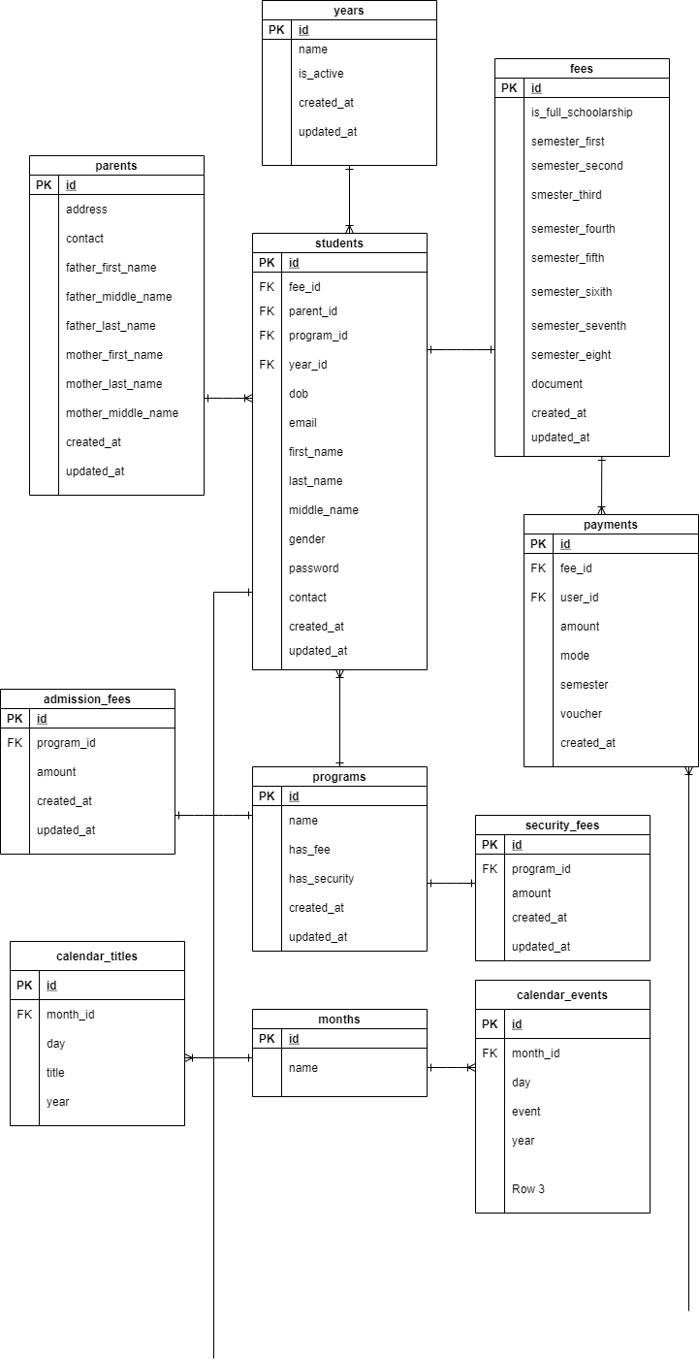
ER DIAGRAM
Figure 2.1: Entity Relationship Diagram

Slide 10
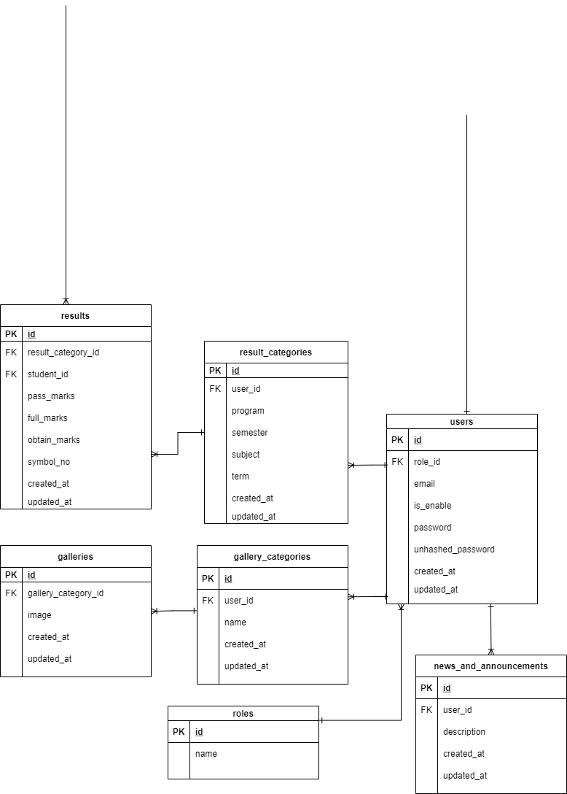
ER DIAGRAM
Figure 2.1: Entity Relationship Diagram

Slide 11
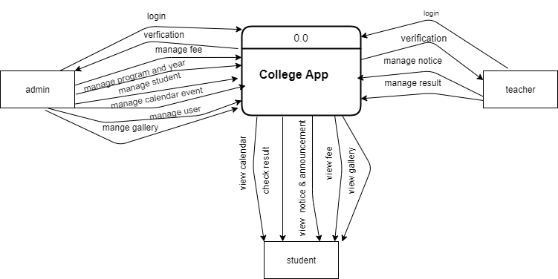
DFD LEVEL 0
Figure 2.1: Entity Relationship Diagram

Slide 12
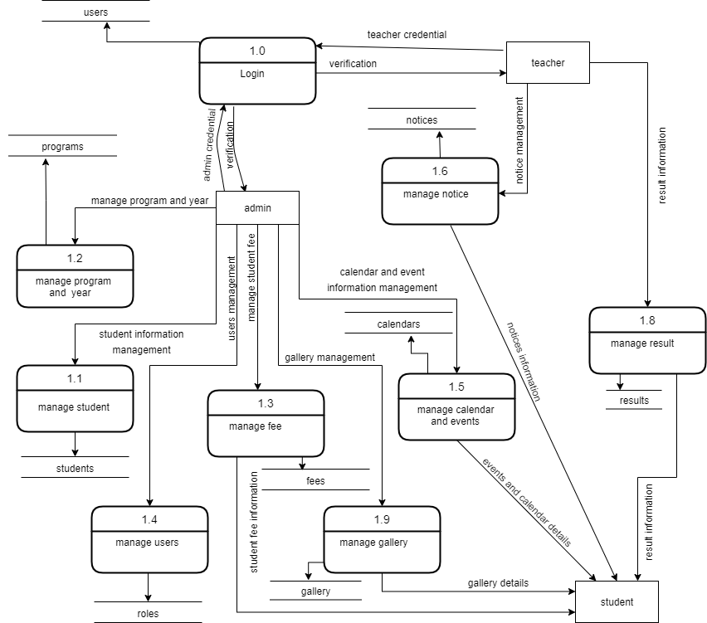
DFD LEVEL 1
Figure 2.1: Entity Relationship Diagram

Slide 13
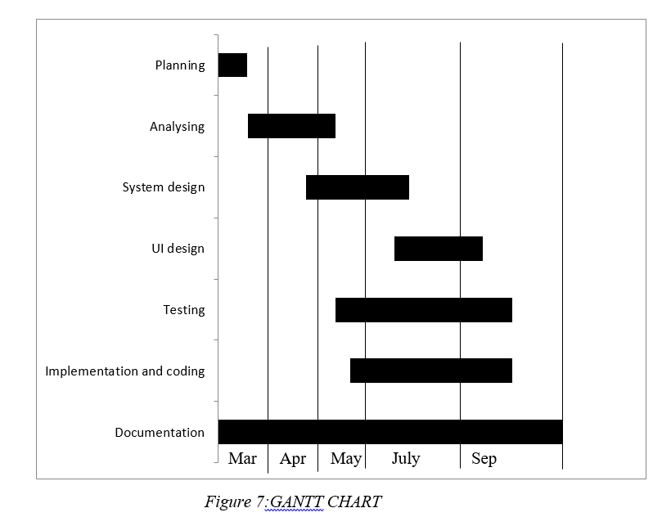
GANTT CHART
Figure 3.1: Gantt Chart

Slide 14
SYSTEM REQUIREMENTS
HTML,CSS,
Javascript
Java
Springboot
Windows 7,8,10
Or
Linux
Processor Pentium VI or higher
2 GB or more ram
50 GB or above space

Slide 15
CONCLUSION
We believe that we have achieved a system that will help streamline college administration.
We are positive that our system will help colleges that are still running on traditional methodology by integration our system into their administration to make it more efficient .
we have faith that it will provide trivial contribution in paving a digital path for college towards mainstream.
We want to summarize this presentation by saying that it was great pleasure working on this project , developing our skill set and collaborating with our team mates.

Slide 16

SCREENSHOTS

Slide 17
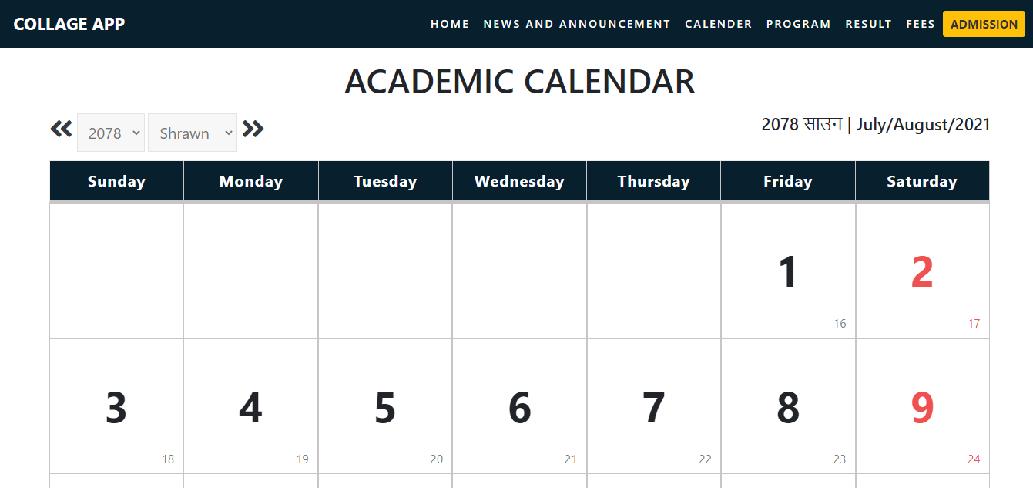
SCREENSHOTS

Slide 18
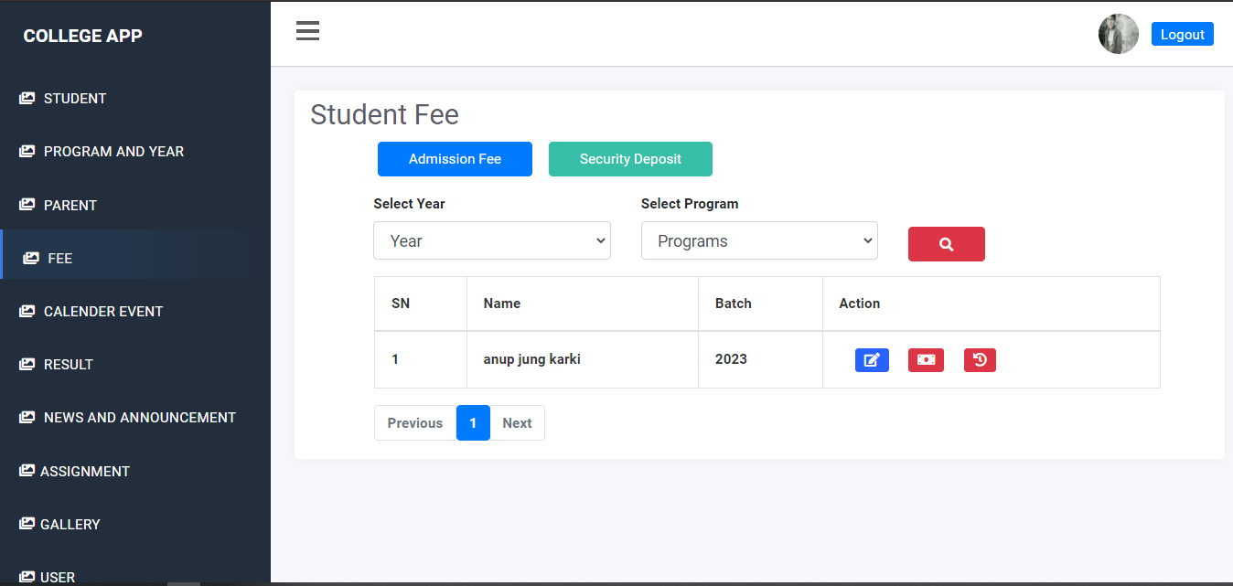
SCREENSHOTS

Slide 19
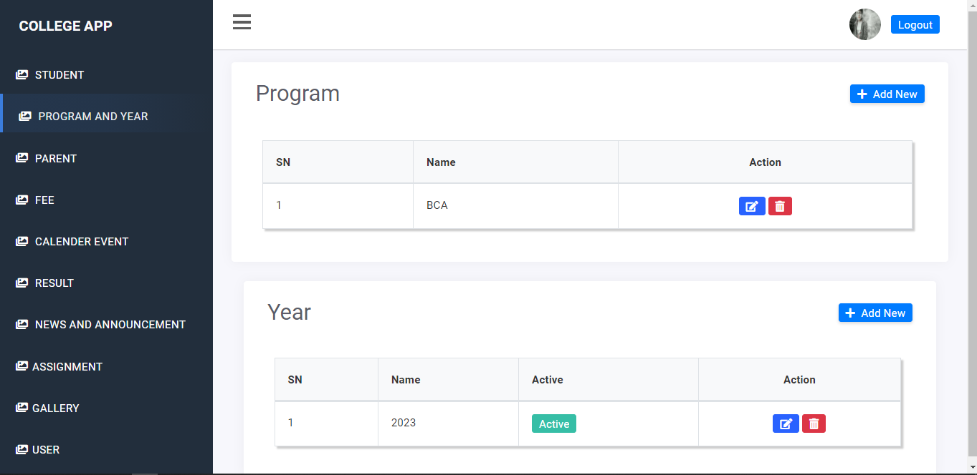
SCREENSHOTS

Slide 20
THANK YOU!!!

