Slide 1
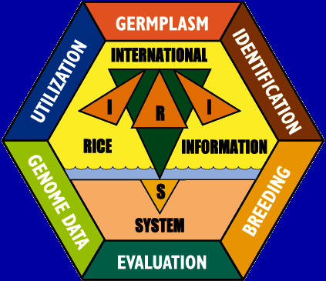
INTERNATIONAL RICE
INFORMATION SYSTEM
A PLATFORM FOR META-ANALYSIS OF RICE DATA

Slide 2
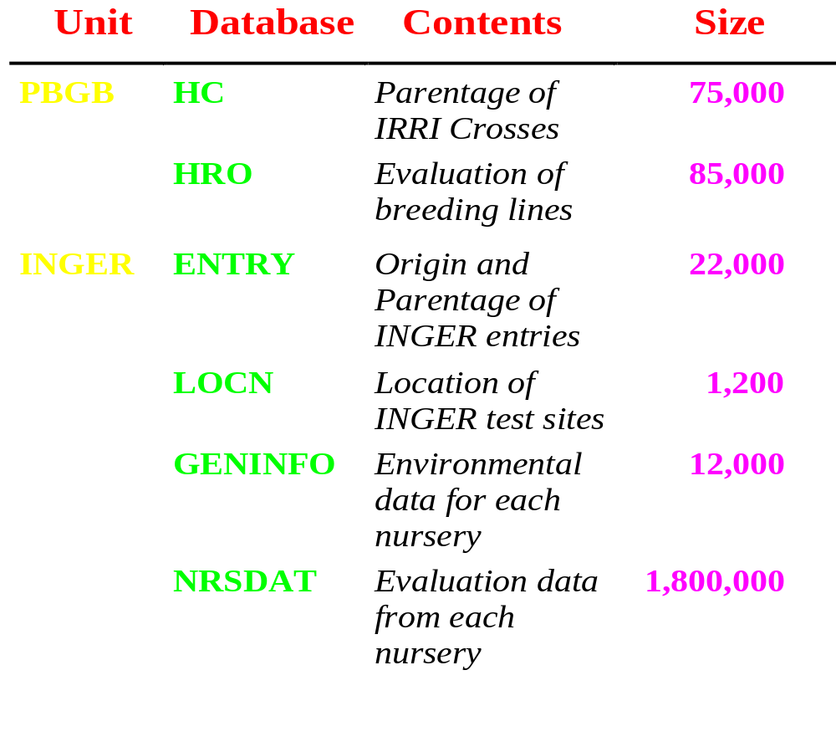
IRRIs Current GEU Databases

Slide 3
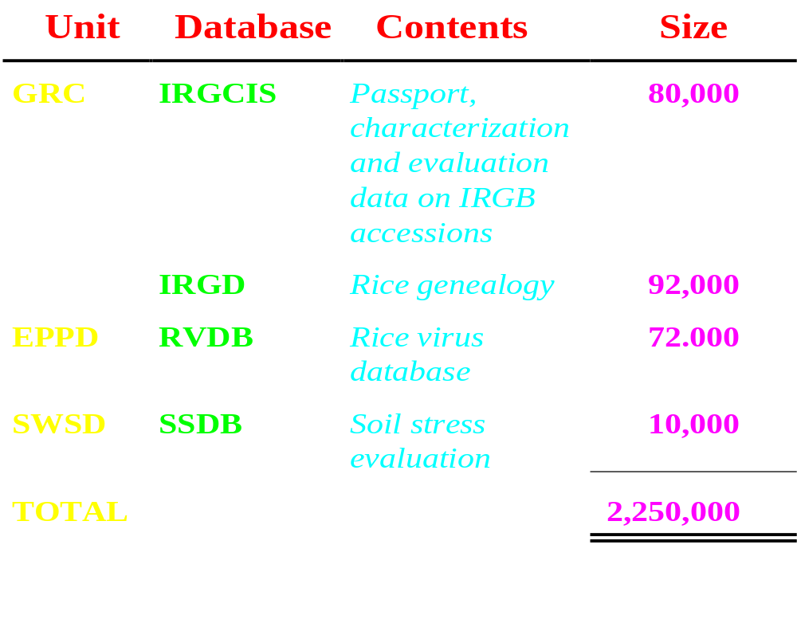
IRRIs Current GEU Databases

Slide 4
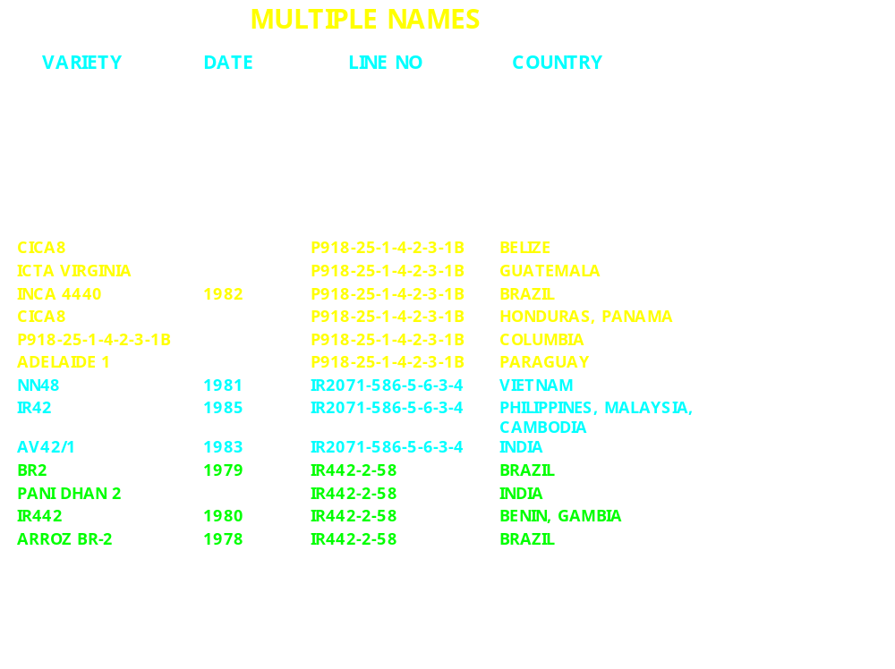

Slide 5
What is The International Crop Information System ?
ICIS is a computerized database system for management and utilization of genealogy, nomenclature, evaluation and characterization data for a wide range of crops
ICIS
IWIS
IRIS
ISIS
IMIS

Slide 6
WHAT DOES ICIS OFFER?
Unique identification of germplasm
General, integrated data management
Fully shareable with remote partners
Common structure across crops
Collaborative development

Slide 7
ICIS COMPONENTS
SET GENERATION
MODULE
GENETIC RESOURCES
INFORMATION
SYSTEM
FIELDBOOK
SYSTEM
GENEALOGY
MANAGEMENT
SYSTEM
PEDIGREE
ANALYSIS
SYSTEM
GENETIC
DATA
MANAGEMENT
SYSTEM
DATA
MANAGEMENT
SYSTEM
GIS APPLICATIONS
GxE ANALYSIS
APPLICATIONS

Slide 8
THE CORE OF ICIS ?
GENEALOGY MANAGEMENT SYSTEM
DATA MANAGEMENT SYSTEM
REMOTE ACCESS FACILITIES

Slide 9
Genealogy Management System
Function
Assign and maintain unique germplasm identification
Manage information on genealogy
Manage germplasm nomenclature
Record chronology of germplasm development and utilization

Slide 10
Genealogy Management System
Structural Assumptions
Accommodate all possible development methods
Three development classes
  Generative methods which increase genetic variability,
  Derivative methods which focus variability,
  Maintenance methods which reain genetic variability
Germplasm can be classified into groups of derivatives from a specific generative process,
I.e. all the lines from a cross

Slide 11
(Recursive
Links)
DATA MODEL FOR THE ICIS GENEALOGY MANAGEMENT SYSTEM
GERMPLASM
GENERATIVE GERMPLASM
has progentors
DERIVATIVE GERMPLASM
has group
has source
Developed by
METHODS
Called
NAMES
Named at
Developed at
LOCATIONS
Named by
Developed by
USERS
Assigned at
With value of
Assigned by
ATTRIBUTES
User-defined Fields
Defined property

Slide 12
GMS Applications
Genealogy Display Tools
Pedigree Input Tools
Breeder’s Tools (Set Generation)
Breeder’s Tools (Field Books)
Analysis Tools (Coefficients of Parentage)

Slide 13
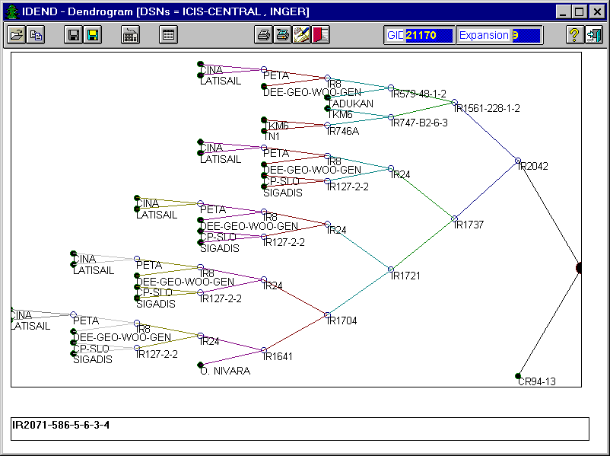
(IR42, NN48, AV42/1)

Slide 14
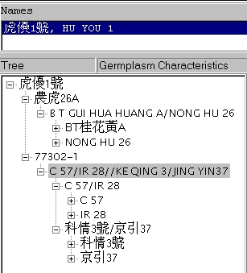
Historical Data from China

Slide 15
SETGEN
GMS application for managing crop information:
genealogy
nomenclature
characteristics

Slide 16
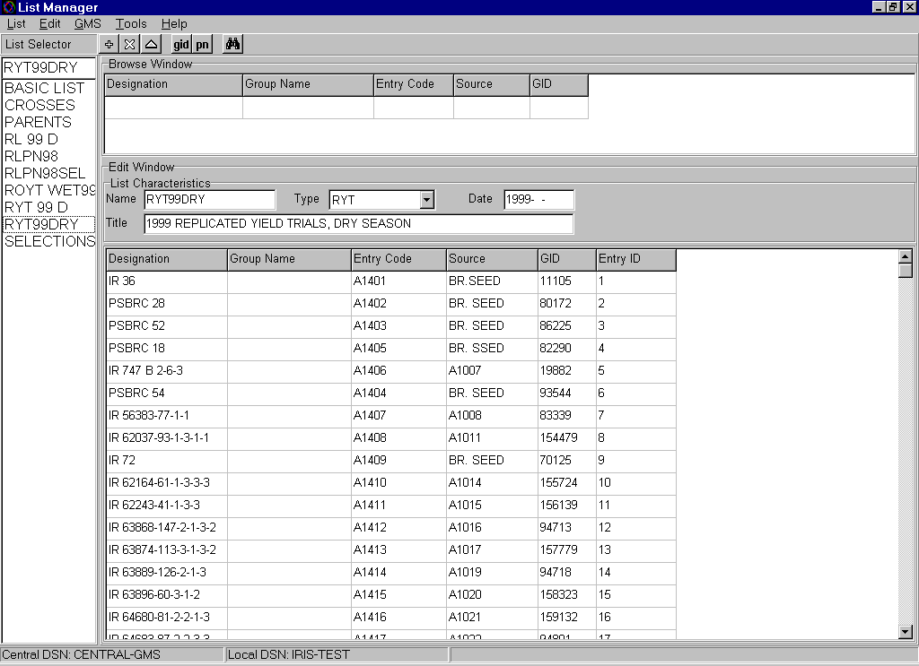
List Manager: germplasm list generator

Slide 17
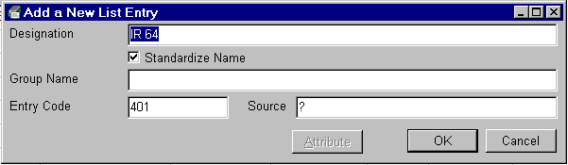
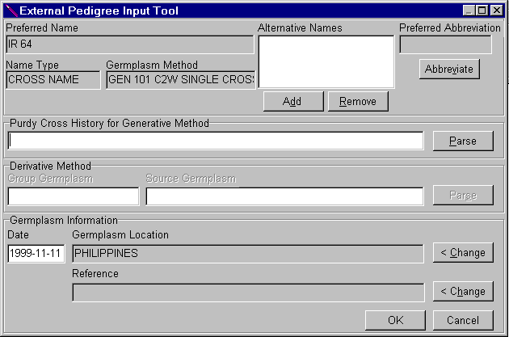
A. Generate basic lists

Slide 18
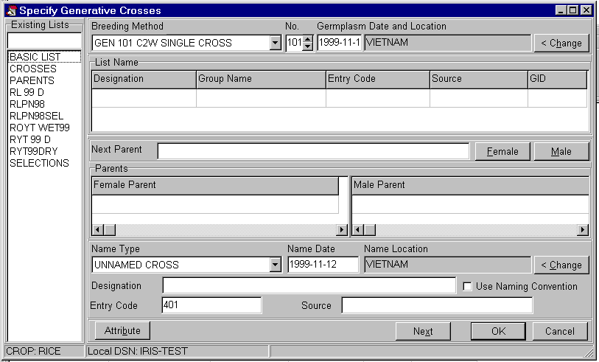
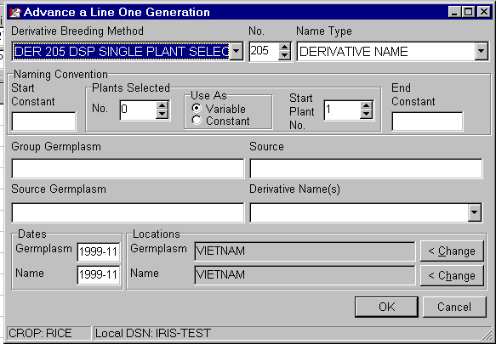
B. Generate cross or selections lists

Slide 19
FLDBK
GMS application for fieldbook
generation

Slide 20
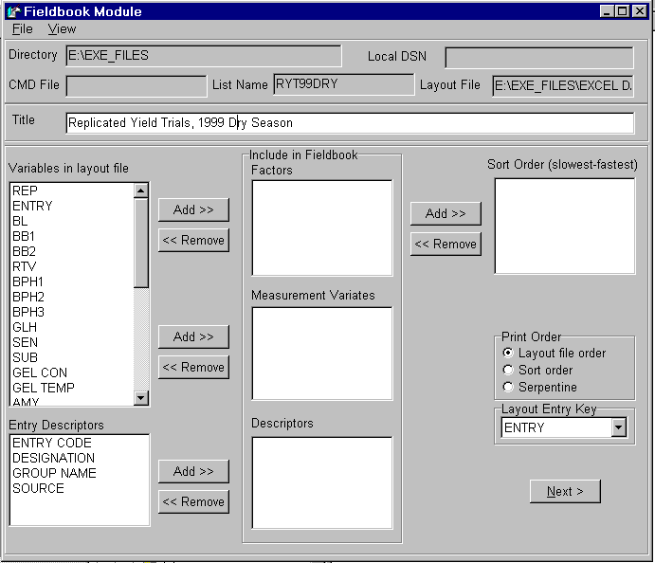
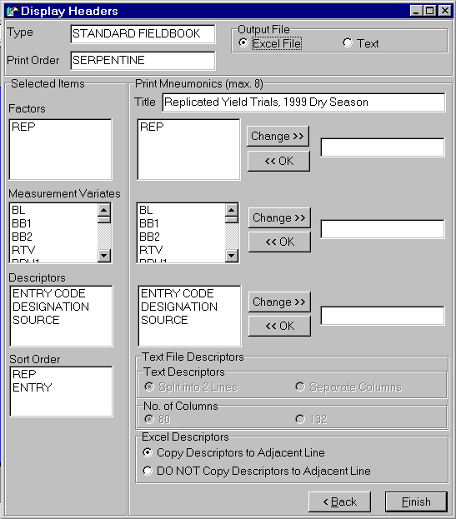
FLDBK specifications

Slide 21
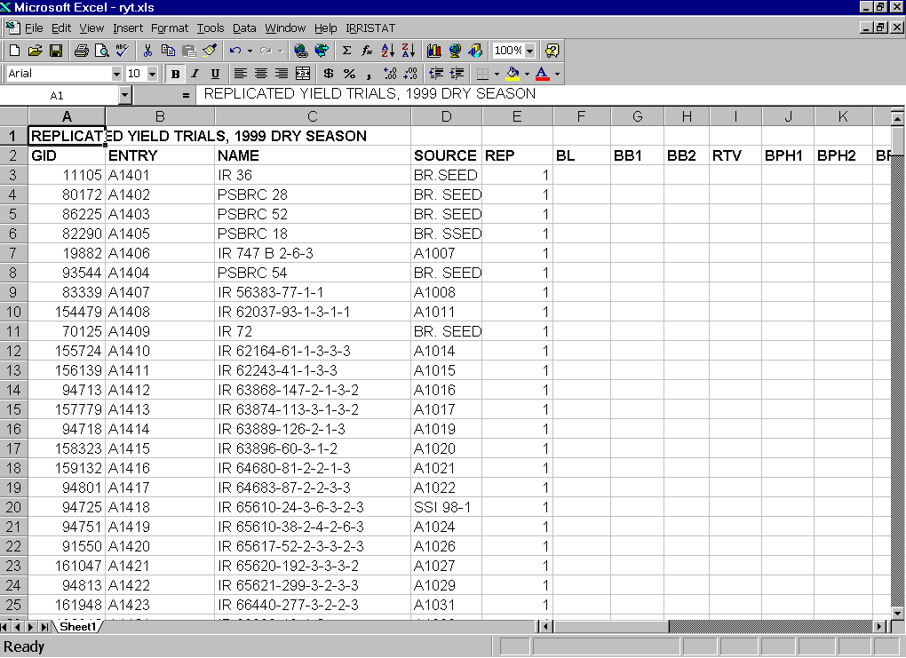
FLDBK output

Slide 22
Data Management System
Functions
Store structured germplasm evaluation and characterization data
Document Data
Link data to germplasm identifiers
Link data to other descriptors (Locations, treatments, etc.)
Facilitate structured searches

Slide 23
Data Management System
Structural Assumptions
The data is collected in studies
The data is in factorial structure
Any experiment or survey design can be accommodated
Multiple factorial hierarchies can be accommodated

Slide 24
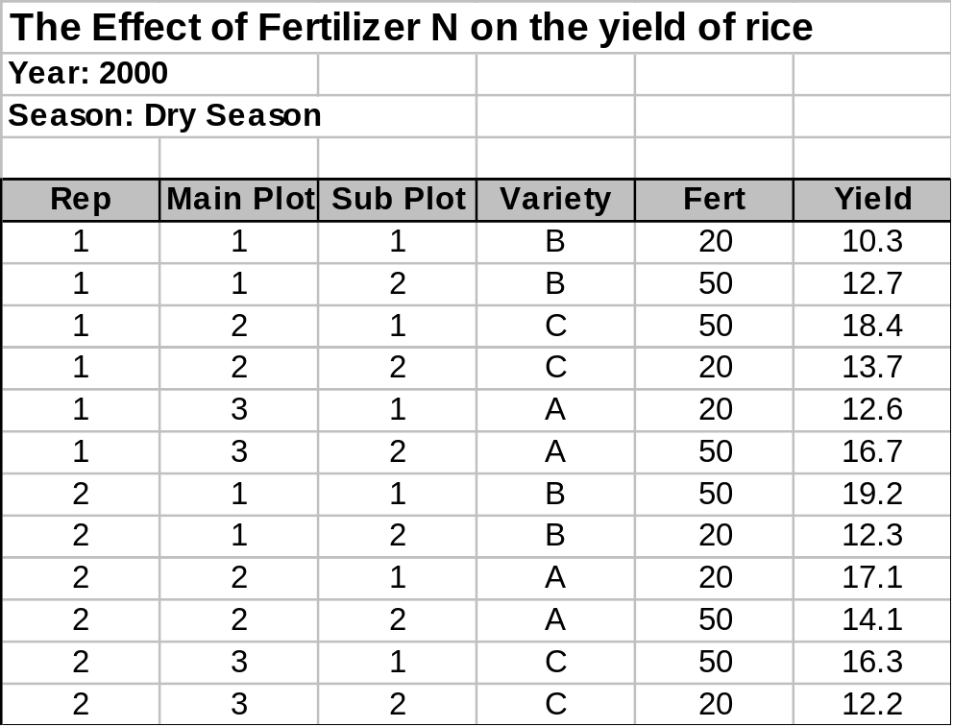
Data Model of DMS
Variate
Study
Filename: N2000DS.xls
Factor
Level
Observation
Unit
Datum

Slide 25
DATA MODEL FOR THE DATA MANAGEMENT SYSTEM
Applied in
STUDY
Observed in
Application of
PROPERTY
Measurement of
FACTOR
Expressed in
Expressed in
VARIATE
Applied by
SCALE
Measured by
Element
of
Index
METHOD
Measurement
of
Value
of
EFFECT
VECTOR
Representation of
LEVEL
OBSERVATION
UNIT
DATA
Indexed by
Observed by

Slide 26
DMS Applications
DATA QUERY TOOLS
DATA ANALYSIS TOOLS
GIS APLLICATIONS

Slide 27
DMS WORKBOOK
The DMS Workbook is a flexible tool for entering and retrieving evaluation, nursery trial, crop improvement data and even molecular data. It has a tool for querying the database across studies. It has a facility to retrieve entry list from GMS and associate it with a layout file.

Slide 28
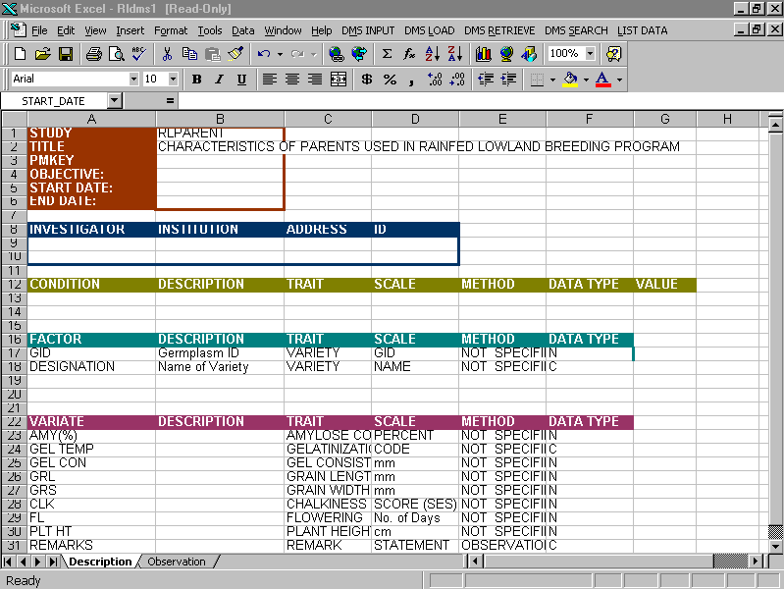
Entering a Data Set
A. Description Sheet of the Data Set

Slide 29
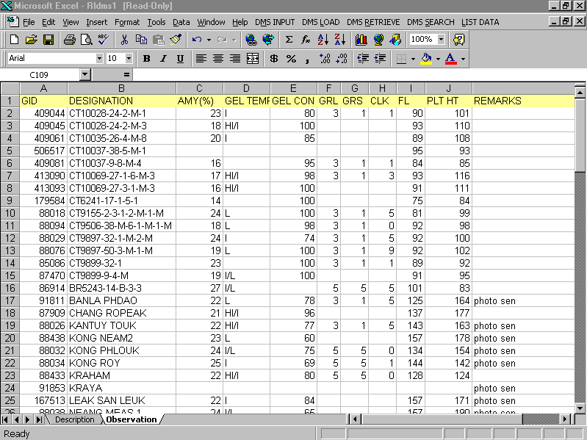
B. Observation Sheet of the Data Set

Slide 30
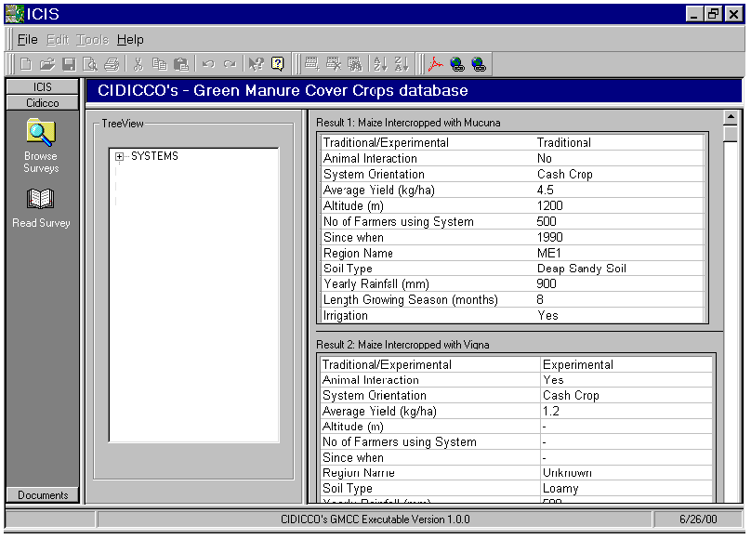

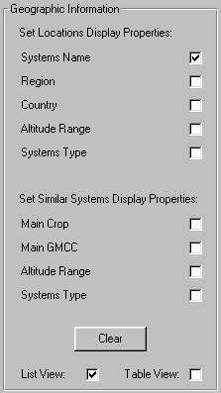
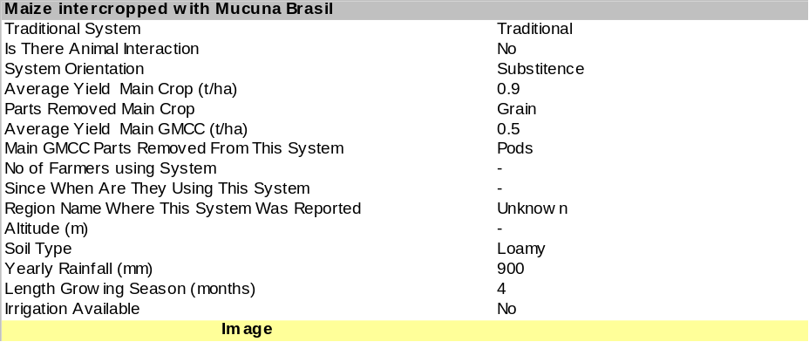
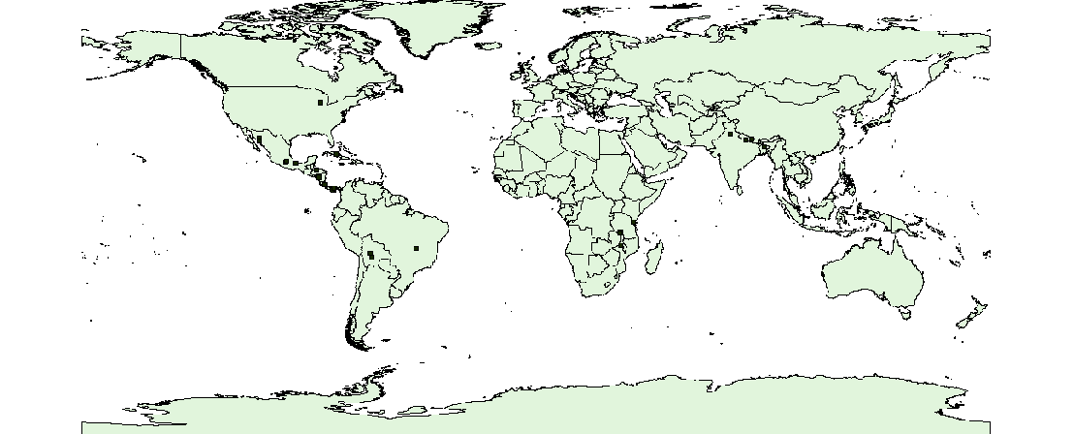
Geographic Queries
Map Tools
CIDICCO’s - Green Manure Cover Crops database
GIS
Maize Intercropped with Mucuna

Slide 31
REMOTE USERS
CENTRAL
DATABASE
LAN - OR - CD
USER1
USER2
USER3
USER4
LOCAL
DATABASE
on PC
1. User is unaware that there are two databases
Unique identification of germplasm is retained
by a combination of unique UserID+LocalGid
The user can retain most recent data for privacy
The user gets a new central database after update

Slide 32
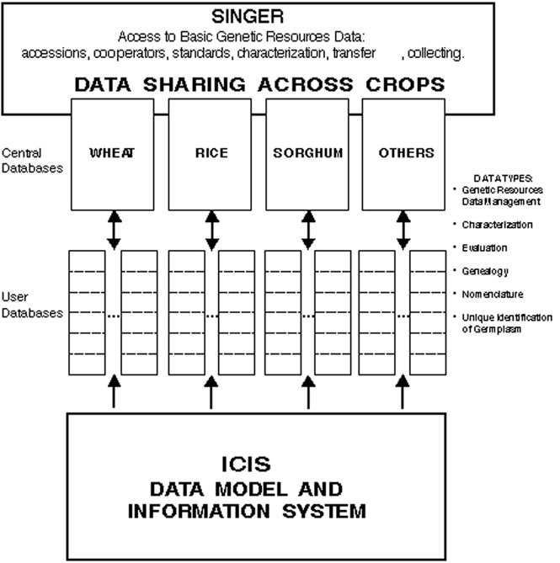

Slide 33
BENEFITS OF ICIS - Within Institutes
Unified data model for genetic resource data germplasm characterization and utilization data
Collaborative software development
Institutional memory
Powerful Research Tool
bringing information to germplasm
  Breeders
  Genetic Resource Specialists
  Pathologists
  Geneticists
  Physiologist

Slide 34
BENEFITS OF ICIS - International
Shared information
Distribution of information with seeds
Collaborative interaction

Slide 35
Examples of Meta-Analysis using IRIS
Tracing Germplasm flows
Analysis of Test-cross nurseries
Understanding GxE in Rainfed Lowland Rice
Evaluation of advanced breeding lines in drought-prone environments

Slide 36
Tracing Germplasm Flows
Where have Philippine Landraces been used?
  Marong Paroc, Sinawpagh and Tadukan occur in the pedigrees of almost all modern rice varieties all over the world
  15 other landraces appear in hundreds of varieties in 27 rice growing countries

Slide 37
Tracing Germplasm Flows
Where have the genes in modern Philippine rice varieties come from?
  82 Philippine released varieties contained 54 landraces from 13 foreign countries, 17 of unknown origin and 28 from the Philippines

Slide 38
Analyzing Testcross Nurseries
Promising lines are crossed to a panel of CMS lines and pollen sterility, spikelet fertility and heterosis are recorded to look for lines which maintain CMS sterility, or restore fertility and show heterosis.
Maintainers are converted into new CMS lines and restorers are tested as promising hybrids

Slide 39
Analyzing Testcross Nurseries
The frequency of maintainers varied considerably over the different CMS testers, but not according to origin of test lines
Frequency of restorers and heterotic combinations varied both with CMS tester and origin of test lines
Lines from Indonesia and the Philippines showed the most hererosis in the IRRI testcross nursery

Slide 40
a) IR 71590 +-IR 70413 (MS)/V 20 B | +-IR 70413 (MS) | | +-IR 58025 A | | +-IR 36 (MS)/IR 58025 B | +-V 20 B | +-ZHEN SHAN 97 | +-XI SHAN XUAN +-IR 70413 (MS)/IR 68897 B | +-IR 70413 (MS) | | +-IR 58025 A | | +-IR 36 (MS)/IR 58025 B | +-IR 68897 B | +-IR 46830 B | +-IR 58025 B +-IR 70413 (MS)/IR 64608 B | +-IR 70413 (MS) | | +-IR 58025 A | | +-IR 36 (MS)/IR 58025 B | +-IR 64608 B | +-NAVOLATO A 71 | +-SINALOA A 68 +-IR 70413 (MS)/IR 62829 B +-IR 70413 (MS) | +-IR 58025 A | +-IR 36 (MS)/IR 58025 B +-IR 62829 B +-TN 1/PTB 21 +-IR 13429-196-10 | b) IR 71591 +-IR 70413 (MS)/IR 68887 B | +-IR 70413 (MS) | | +-IR 58025 A | | +-IR 36 (MS)/IR 58025 B | +-IR 68887 B | +-IR 54752 B | +-IR 54752 B/IR 46830 B +-IR 70413 (MS)/IR 68891 B | +-IR 70413 (MS) | | +-IR 58025 A | | +-IR 36 (MS)/IR 58025 B | +-IR 68891 B | +-IR 46830 B | +-IR 35278-88-3-3/IR 54752 B +-IR 70413 (MS)/IR 68280 B | +-IR 70413 (MS) | | +-IR 58025 A | | +-IR 36 (MS)/IR 58025 B | +-IR 68280 B +-IR 70413 (MS)/PRAGATHI B | +-IR 70413 (MS) | | +-IR 58025 A | | +-IR 36 (MS)/IR 58025 B | +-PRAGATHI B +-IR 70413 (MS)/PMS 8 B | +-IR 70413 (MS) | | +-IR 58025 A | | +-IR 36 (MS)/IR 58025 B | +-PMS 8 B | +-IR 747-B2-6-3 | +-IR 665-40-6-3 +-IR 70413 (MS)/IR 70372 B +-IR 70413 (MS) | +-IR 58025 A | +-IR 36 (MS)/IR 58025 B +-IR 70372 B +-PUSA 150 +-KARNAL LOCAL
The viability of a Hybrid
Rice Program depends on
having a good supply of new CMS lines. Hence recurrent selection populations have been developed by random mating known maintainers
Figure 4. Pedigrees of recurrent selection populations developed to enhance the frequency of maintainer lines in testcross nurseries

Slide 41
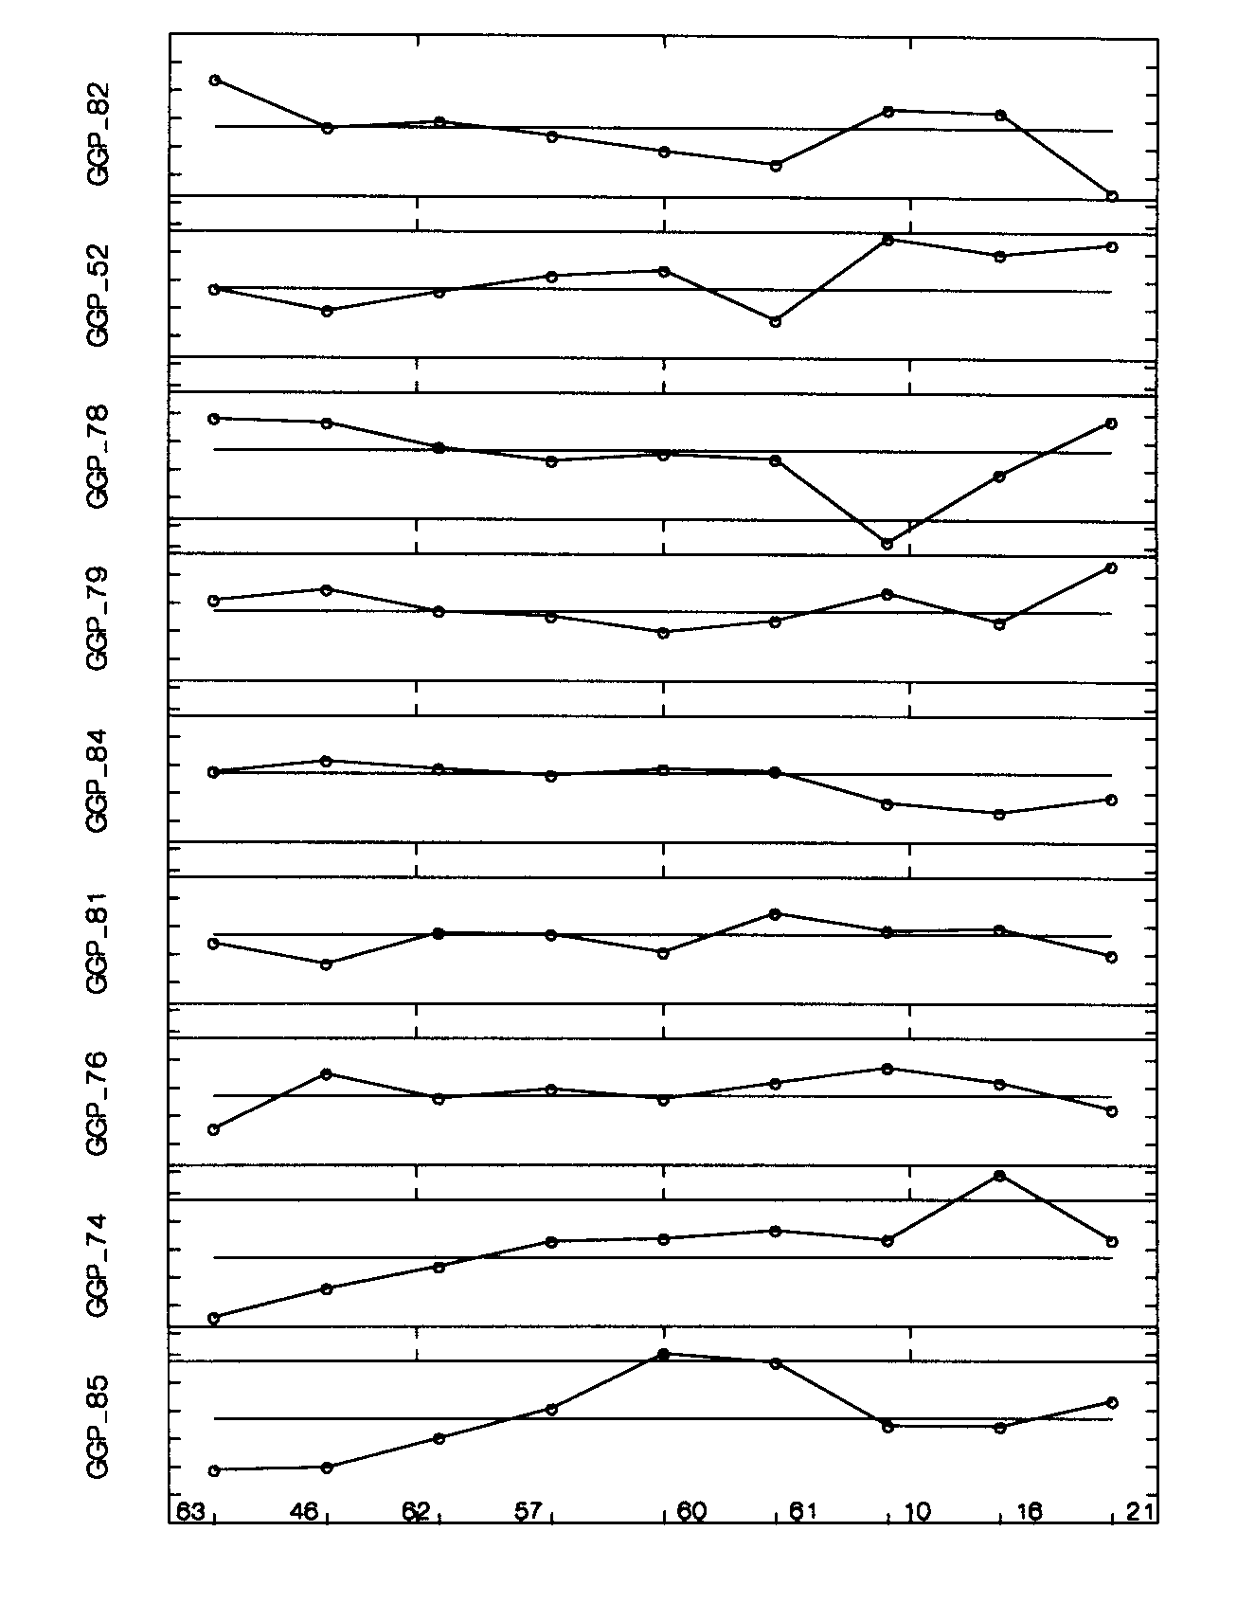
Response Patterns Genotypes*
Sabita
KDML 105
IR57546-PMI-1-B-2-2
NSG 19
IR58821-23-1-3-3
IR66469-17-5-B
IR66516
MAHSURI
IR66883
IR52561-UBN-1-1-2
IR54071-UBN-1-1-3-1
IR57515-PMI-8-1-1-S
IR66506-5-1-B
IR66879
IR66883
IR20
CT9993-5-10-1-M
IR66893-5-2-B
IR58307-210-1-2-3-3
IR54977-UBN-6-1-3-3
IR57514-PMI-5-B-1-2
IR62266-42-6-1
IR63429-23-1-3-3
IR66882-4-4-B
PSBRc14
IR64
IR36
CT9897-55-2-M-3-M
IR64615H
IR68877H
Genotype by Environment Interaction in Rainfed Lowland Environments
Interaction response patterns for grain yield for nine genotype groups over 9 environment groups. (Response values are averages, over group members, of mean polish interaction values with a range of –3 to +3 for each genotype group.)
General Stagnation
Hydrology Favourable
Stagnation
Favourable (long season)
Favourable (short season)
Late drought
Vegetative stage, drought
Rapid onset, late drought
Early Stress (flooding, rats)
* Reference line in bold

Slide 42
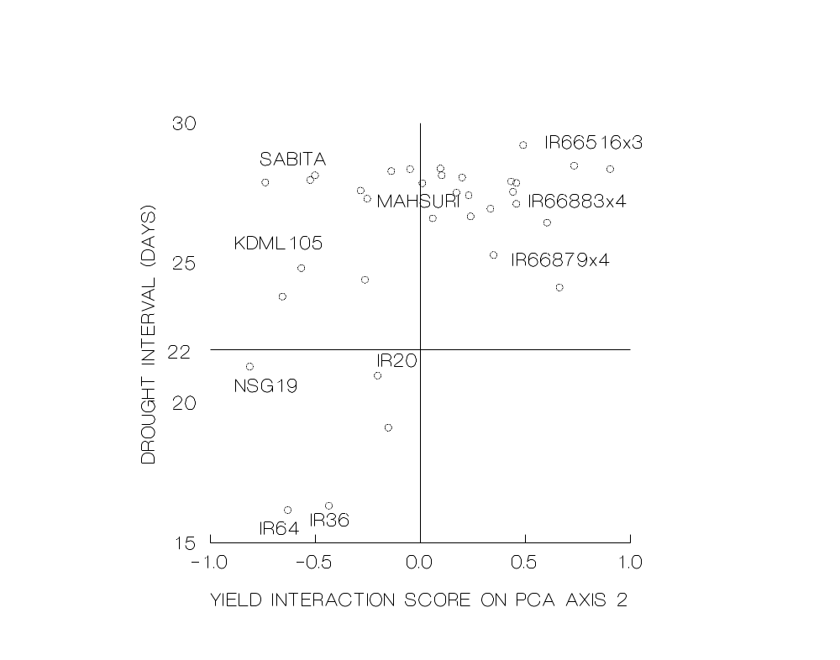
Number of days from onset of lethal, late season drought to physiological maturity against grain yield interaction scores for the second PCA interaction axis.

Slide 43
Evaluation of Advanced Breeding Lines
In multi-location and multi-year testing programs which lines perform consistently above average in all environments?

Slide 44
Biplot of First Two Ordination Axes for Combined 1998 & 1999 OFE
C8
K9
1.5
P8
P9
RD6
K8
MAHSURI
1
P9
HANG YI 71
R8
KHAO DAWK
U8
0.5
K9
U9
RD15
S9
P8
U8
C9
0
E9
AX2
R8
R9
K8
G41
-0.5
G42
S9
G61
IR68796-27-3-B-5-2-B
-1
G65
C9
U9
G66
C8
R9
G69
-1.5
E9
G70
IR 71505-22-B-1-B
IR 68796-27-3-B-6-1-B
G72
-2
G73
-1.5
-1
-0.5
0
0.5
1
1.5
2
G74
AX1
G75

Slide 45
A Model Breeding Project
Hybridization Block
U03WSHB
Plant 16 lines in plots with staggered planting to facilitate synchronization
Import 8 lines
Import 8 IR lines
Cross each imported lines as female parent to each IR lines.
F1 Nursery
U04DSF1
F1s planted in greenhouse
64 plots
F2 Nursery
U04WSF2
F2s space planted in field
64 plots. Planting list looks just like the F1 list since we will not number plants until we select them. Select four plants each cross
F3 Nursery
U05DSF3
F3 nursery rows
Plant seed from each selected F2 plant in rows
F4 Nursery
U05WSF4
F4 nursery plots
Bulk seeds from 70 selected F3 Rows
F5 Nursery
U06DSF5
F5 nursery rows
Select different numbers of desirable plants from the F4 plots. Number the plants 1…n when selected
U06WSRYT
RYT
Select 20 lines from the F5 nursery and bulk the seeds for replicated yield trial.

