Slide 1
ICIS RETRIEVER
Arllet M. Portugal
Associate Scientist
CRIL

Slide 2
ICIS Retriever
Data Retriever is an application in MS Access that extracts data from the local and central DMS databases based on the specified property, scale and method.
It has a tool for sub setting the retrieved data, determining aggregate values and linking queries.
Information from the Genealogy Management System (GMS) and Inventory Management system can also be retrieved and linked with the queries from the DMS

Slide 3
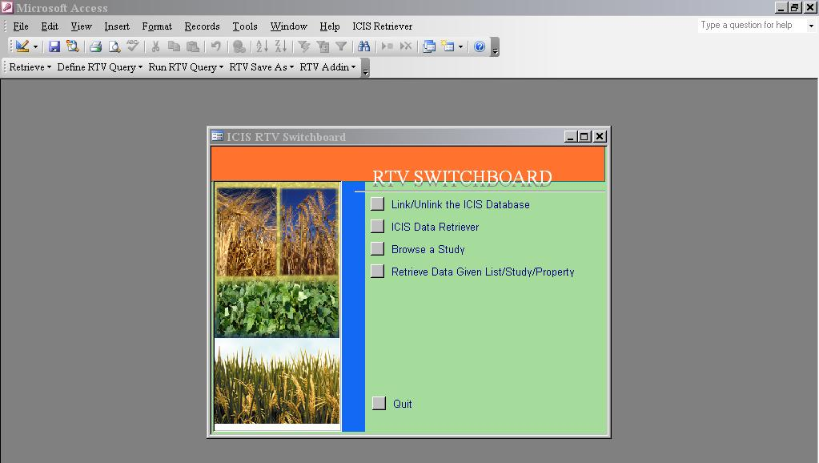
Menu and Default Switchboard

Slide 4
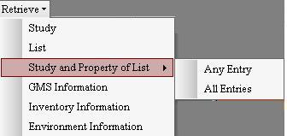
Retrieve Menu
Browses a study and gets its dataset
Retrieves a SetGen list into a RTV-LIST table that can be used for search.
Retrieves observed or measured data for any entries of SetGen list(s) based on the selected studies and properties
Gets information from GMS for a given query or list
Provides the stock balance of the entries in selected query or list
Retrieves observed or measured data from studies where all entries of selected SetGen list(s) are tested
Provides information about the specified location in a query based on the set environmental variable

Slide 5
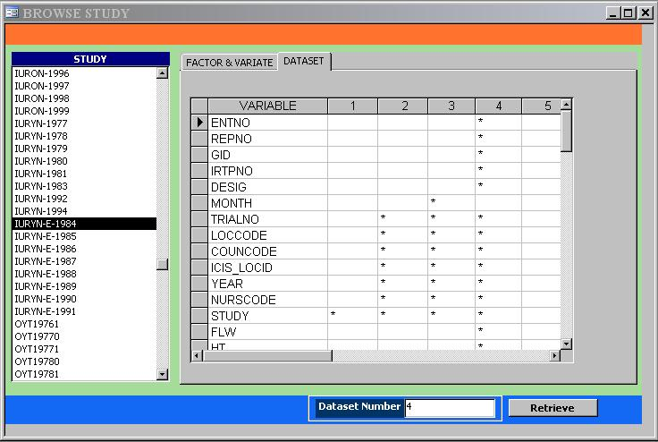
Browsing Study
Show the different data sets for a selected study
Show the variables in the study and their corresponding Trait, Scale and Method
Studies existing in the database
Enter the number of the data set you wish to retrieve
Retrieve and display the data of the entered data set

Slide 6
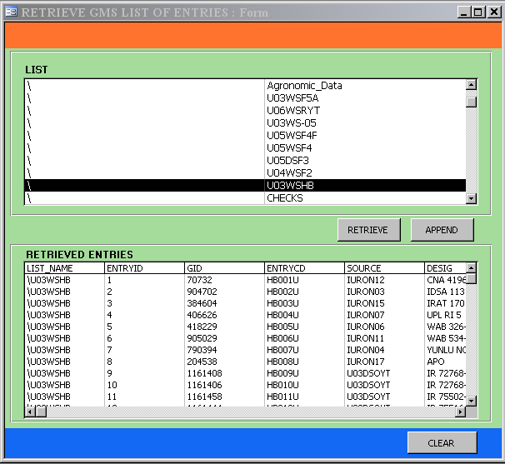
Retrieving a List
Select a germplasm list
Retrieve the entries of the selected list.
Append the entries of the selected list.
Clear the record of retrieved entries
The retrieved list is stored in a table named RTV-LIST and can be used as criteria of a search or query.

Slide 7
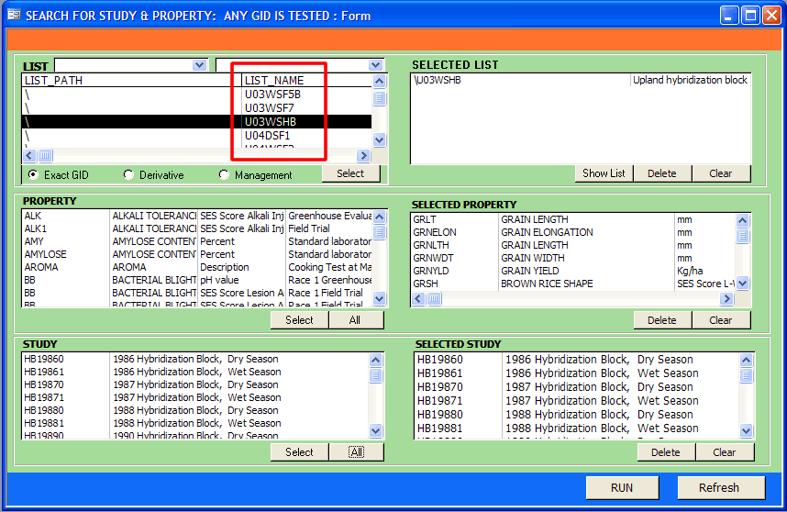
Retrieve Data From Studies where any entry in list is tested
SetGen 1st & 2nd Level List Folder
Names of Lists
Selected Lists
Properties of the studies
Selected Properties
Studies where any entry of the list is tested
Selected Studies
Retrieves the data
Clears the selections

Slide 8
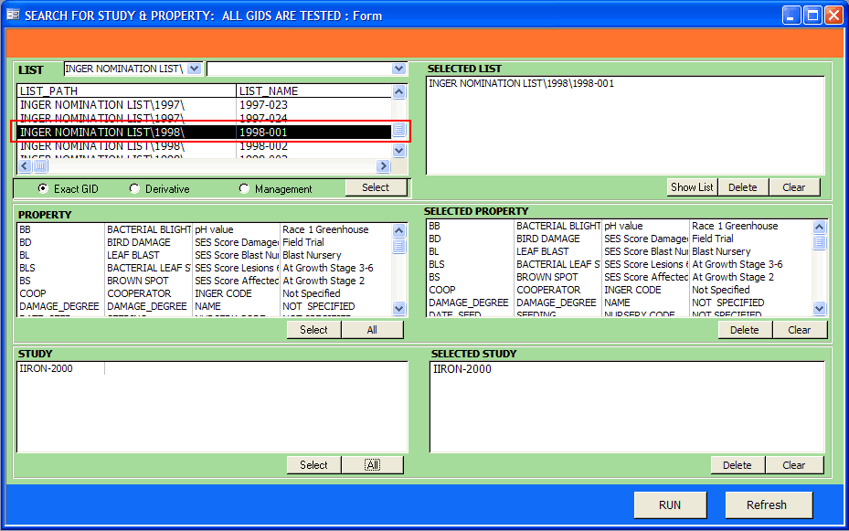
Retrieve Data From Studies where all entries in list are tested
SetGen 1st & 2nd Level List Folder
Selected Lists
Names of Lists
Properties, Scales and Methods of Studies
Selected Properties
Study where all entries of the selected list are tested
Selected Studies
Retrieve the data
Clear the selections

Slide 9

RTV Save As
Saves an open table query or table as SetGen List.
Saves an open table query or table as an Excel file that is readable by CropSTAT (formerly known as IRRISTAT)

Slide 10
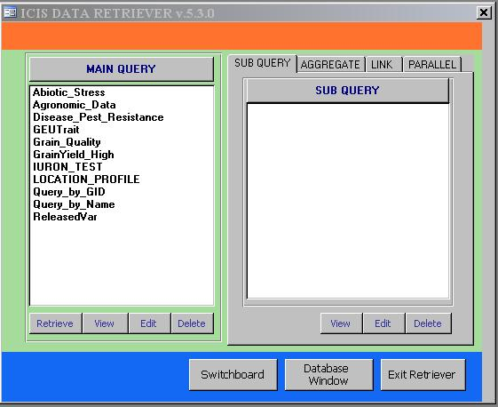
Query Builder of ICIS Retriever
Retrieves data from the DMS database based on a set of criteria defined by property, scale and method.
Combines two queries
Creates a subset of the data obtained from the main query
Computes averages, minimum values, maximum values and other aggregate values
Formats the data with the values of one variable as the column headers

Slide 11
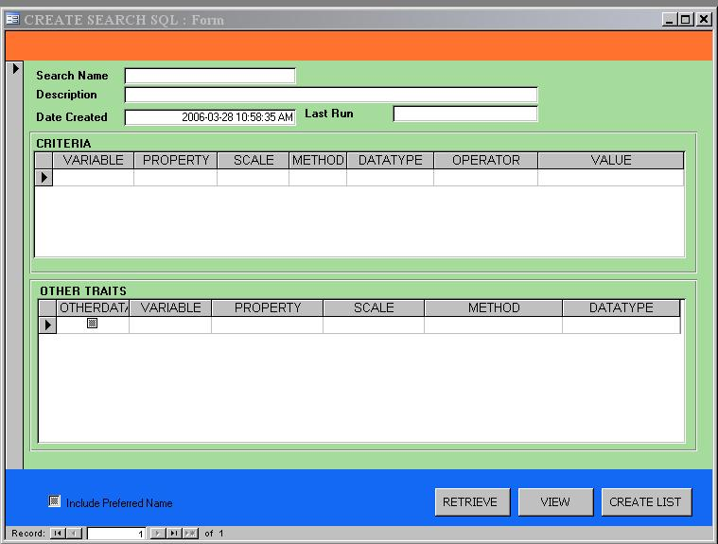












MAIN QUERY
Problem: Find the grain yield of varieties tested in the
study RYT19960
a meaningful name of a query
date the query is created
a useful description about the query
variables of the query with known values
restricting operator:
(N) =, >, <, >=, <=, LIST
(C) LIKE, LIST
value or table of values that limits the result of the query
GID | Variety | GID | Not Specified | N
YIELD | GRAIN YIELD | kg/ha | Paddy Rice | N
variables with unknown values
type of the data which is either (N)umber or (C)haracter
assigned variable name with no space in between
property of the variable
measurement unit of the variable
procedure on how the variable is measured or derived
run the query
Store the result as SetGen List
view a created query

Slide 12
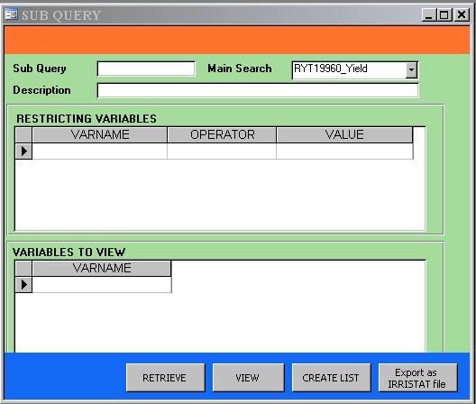





Sub query
Problem: Determine the varieties with grain yield greater
than 8000 in the study RYT19960
a meaningful name of the sub query
name of a main query
variables for sub setting the data of the main query
restricting operator:
(N) =, >, <, >=, <=, <>
(C) LIKE
(N or C) IS
value that limits the data
YIELD
variables you want to include in the sub query
run the query
view a created query

Slide 13
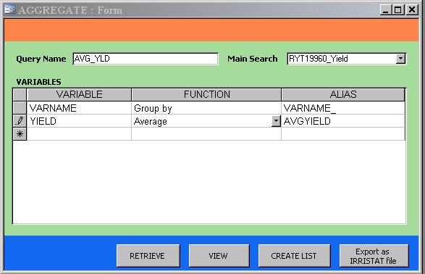
Aggregate Query
Problem: Get the average grain yield of each variety
tested in RYT19960
a meaningful name of the aggregate query
name of a main query
alias name of the variable
Function:
(N) AVG - average
SUM
(N or C) MIN - minimum
MAX - maximum
FIRST
LAST
COUNT
GROUP BY - the variable you
intend to group the
values
variables you intend to compute the aggregate values and variables to group the values

Slide 14
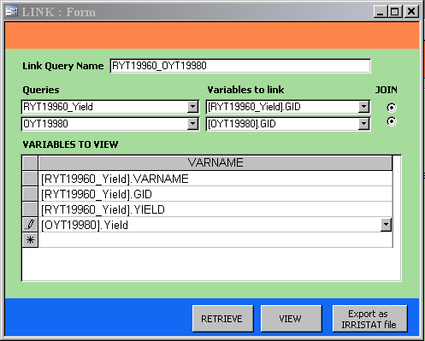
Link Query
Problem: Compare the grain yield of RYT19960 with
OYT19980.
a meaningful name of the link query
name of the first query to link
variable to link the first query; it must also exist in the other query
name of the other query to link
variable to link the second query with the first query
variables you want to include in the link query

