Slide 1
Tortoise CVS and GRIMS

Slide 2
Outline
Checking out of GRIMS from the repository
Task: Deleting binary files in the repository
Ignoring binary files when committing or adding data to the repository

Slide 3
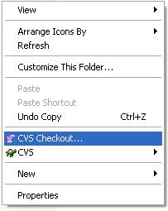
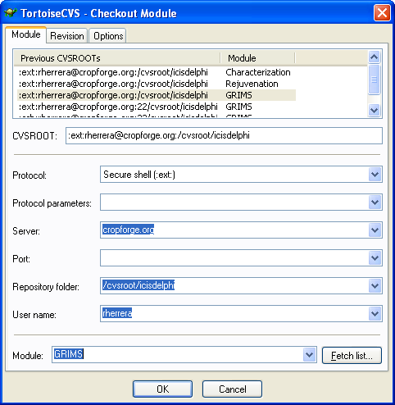
Checking out of GRIMS
To checkout a project
  Just right click your mouse on the desired working folder and follow the settings on the left.
  Note that when Ching and I specified the port number, the project won’t check out.
Assumptions:
  TortoiseCVS is already installed. Installer can be found from \\e351mc982v\temp\Rherrera\TortoiseCVS-1.8.24.exe courtesy of Jon
  The project is already in the CVS repository (i.e. GRIMS)

Slide 4
Task: Deleting binary files in the repository
When Ching and I imported the GRIMS in the CVS, we were not able to filter out the files with the following extensions:
  *.exe
  *.~*
  *.dpp
  *.dcu
  *.dof
  *.cfg
  *.res
  *.dll
  *.log
  So we need to delete them from the repository

Slide 5
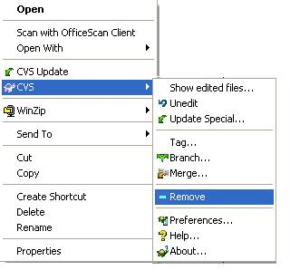
Task: Deleting binary files in the repository
Steps
  Highlight the files that needs to be removed, right click then click Remove
  Commit the whole project to reflect the changes in the CVS repository

Slide 6
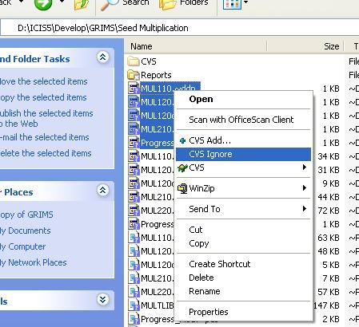
Ignoring binary files when committing or adding data to the repository
Steps
  Highlight the files that needs to be ignored, right click then click CVS Ignore. This will create a .cvsignore file. Edit this and add other file extensions that needs to be ignored when committing the project
  Or (from Dr. Metz)
  Create a file (in the directory) with notepad as cvsignore.txt then on command prompt:
  ren cvsignore.txt .cvsignore

