Slide 1
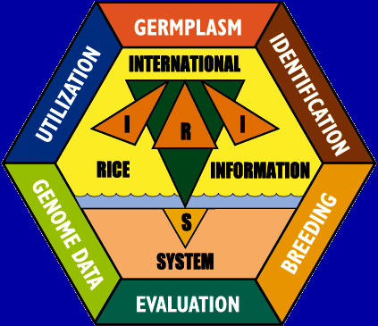
INTERNATIONAL RICE
INFORMATION SYSTEM
EXPERIENCES WITH ICIS AT IRRI

Slide 2
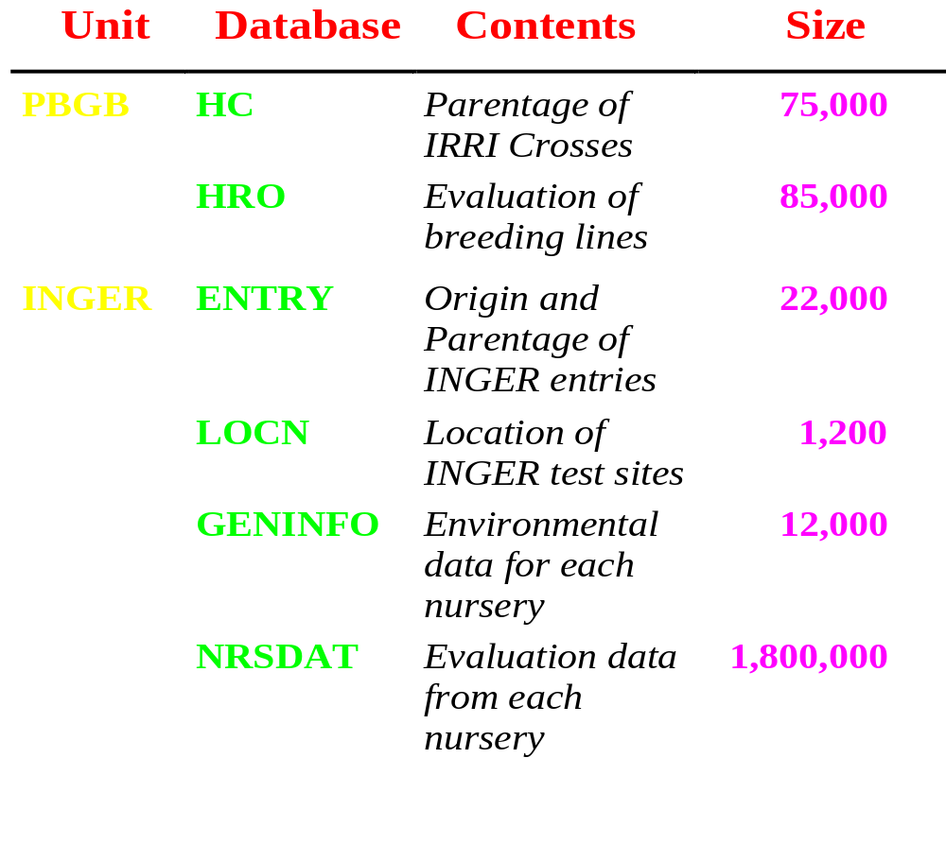
IRRIs Current GEU Databases

Slide 3
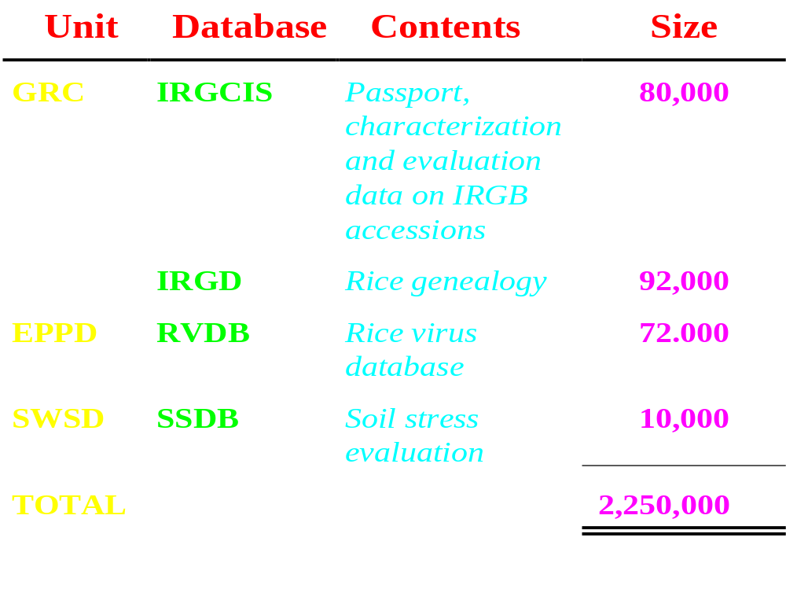
IRRIs Current GEU Databases

Slide 4
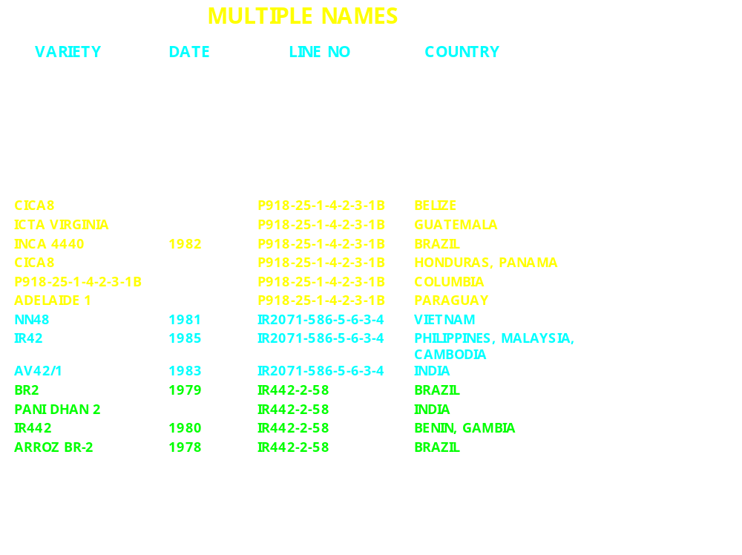

Slide 5
WHAT DOES ICIS OFFER?
Unique identification of germplasm
General, integrated data management
Fully shareable with remote partners
Common structure across crops
Collaborative development

Slide 6
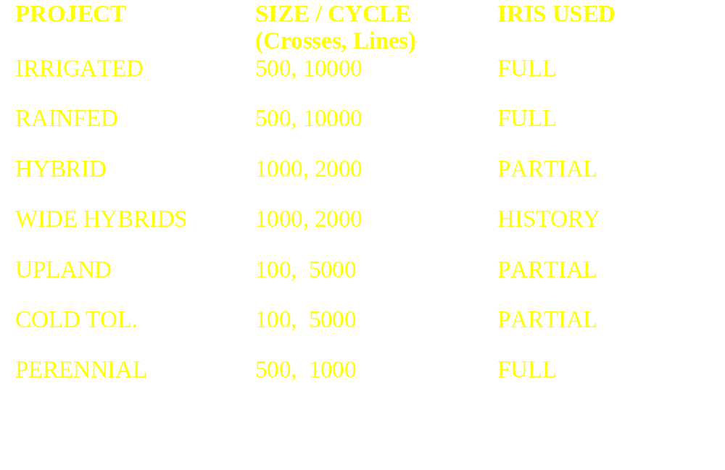
DEPLOYMENT OF IRIS IN IRRI’S BREEDING PROJECTS

Slide 7
IRRIGATED RICE BREEDING
CENTRAL IRIS
DATABASE
PBDG DATA
MANAGEMENT
Field Books for HB,
F2, PN, OYT, RYT
IRRIGATED RICE
BREEDERS
Evaluation Data and
Pedigree Processing
Cross Definition
IRB LOCAL
DATABASE
PLANT PATHOLOGY
AND ENTOMOLOGY
Screening
Data

Slide 8
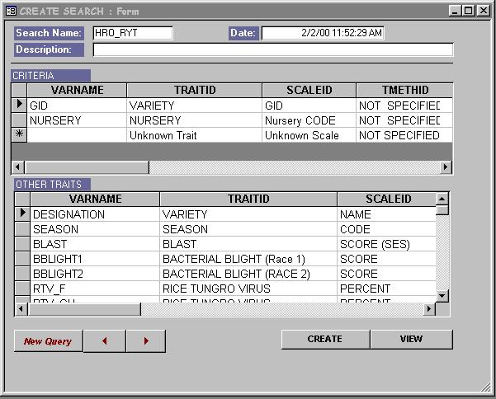
Step 1 - Search for historical data

Slide 9
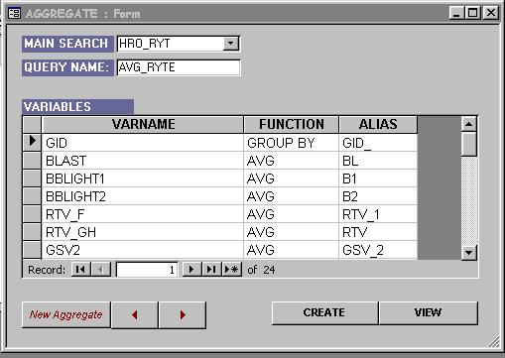
Step 2 -Average genotypic traits

Slide 10
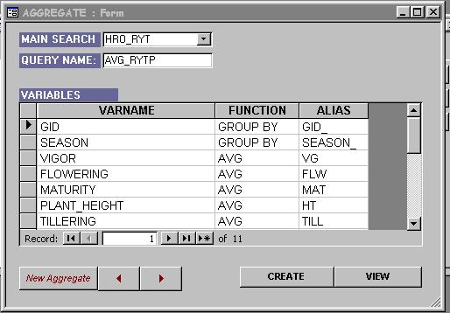
Step 3 - Average phenotypic traits

Slide 11
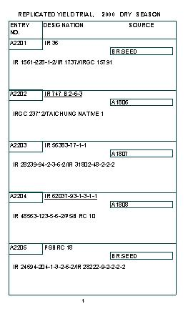
a
Step 4
Generate the
Field-book
Page 1:

Slide 12
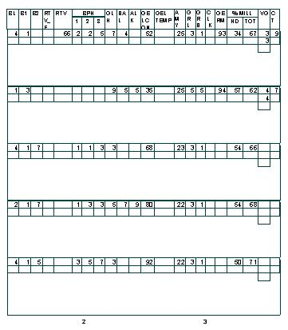
Page 2:

Slide 13
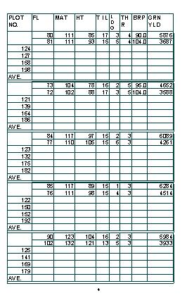
Page 3:

Slide 14
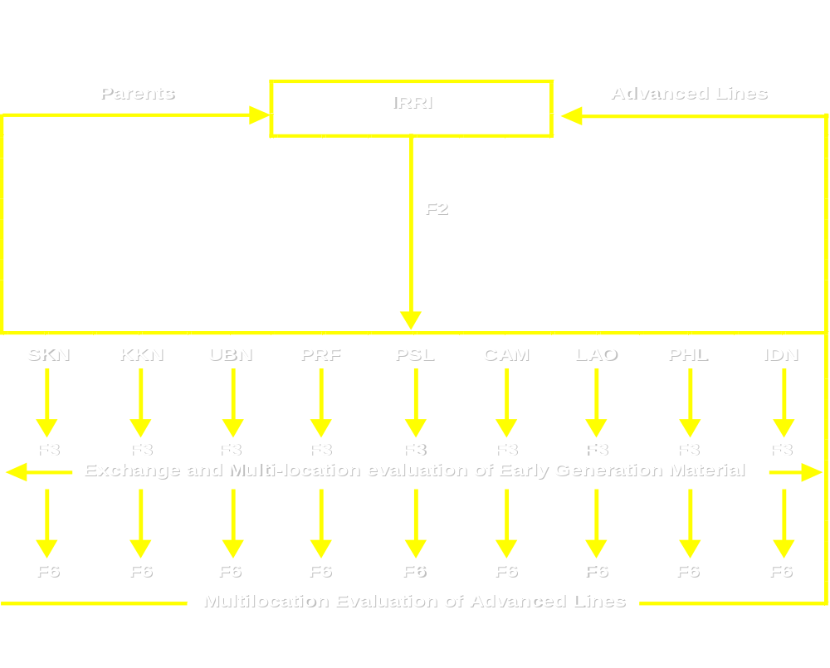
Rainfed Lowland Shuttle Breeding Networks

Slide 15
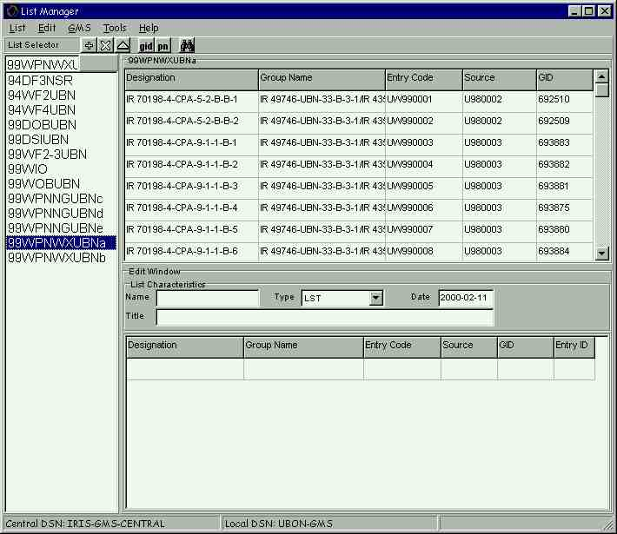
Step 1 - Capture historical lists

Slide 16
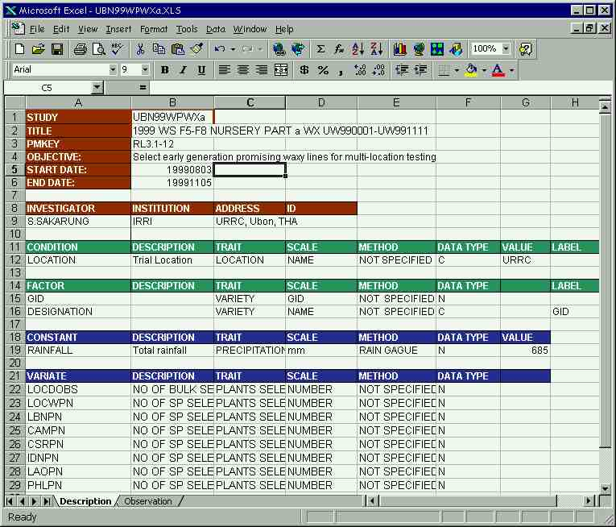
Step 2 - Document the PN data

Slide 17
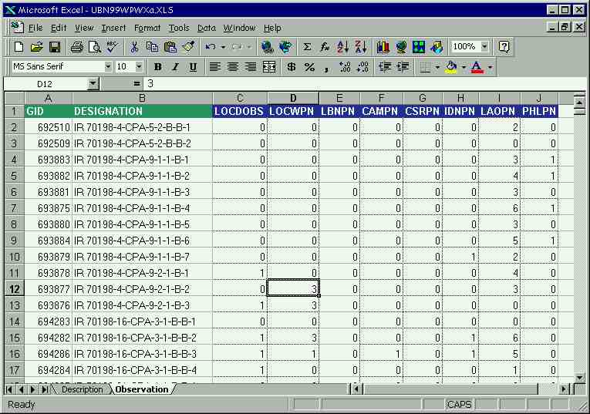
Step 3 - Record the PN data

Slide 18
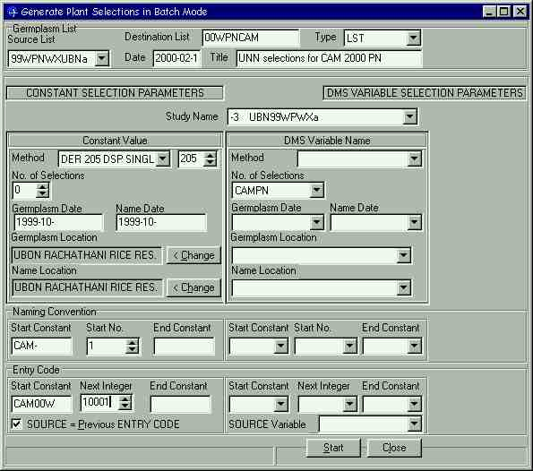
Step 4 - Process the PN data

Slide 19
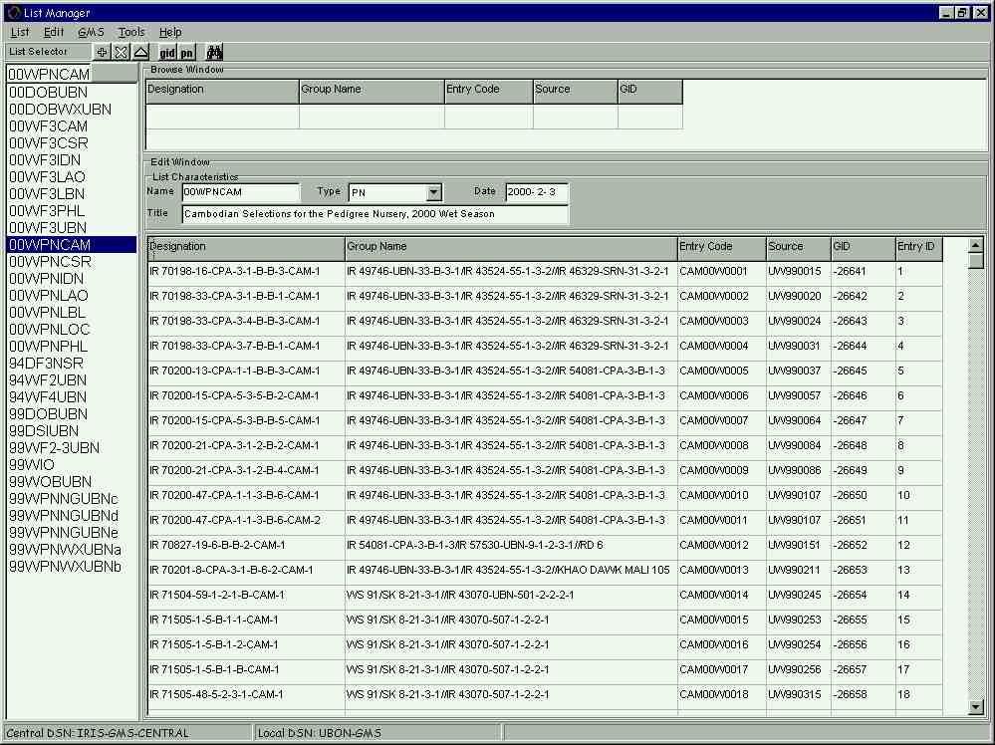
Step 5 - Export the New PNs

Slide 20
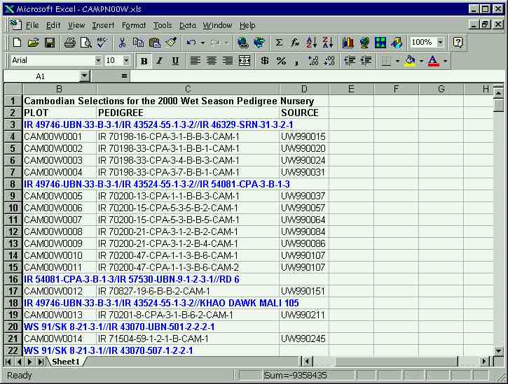
Step 6 - Generate new field-books

Slide 21
Upland perennial rice
Complex inter-specific crossing program to introduce rhizome regeneration in upland sativas
Staff changes required a new breeder to quickly follow the crossing structure

Slide 22
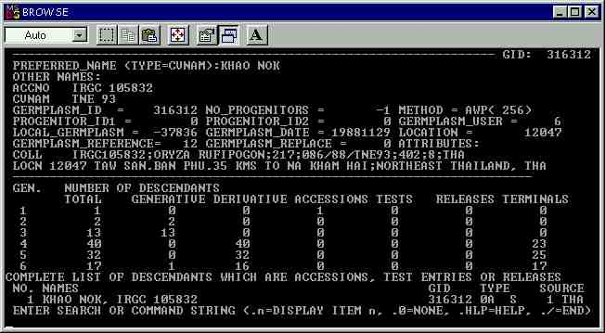
Tracing germplasm flows

Slide 23
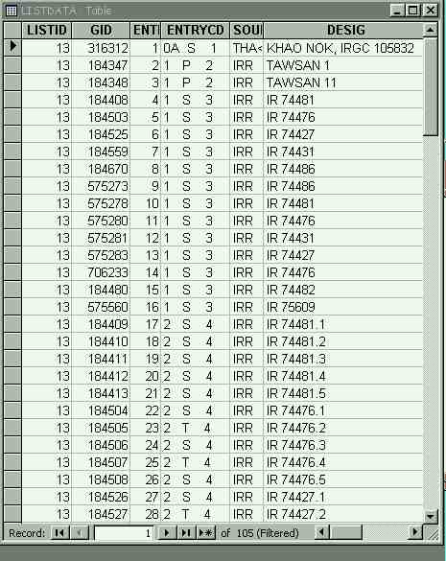
Analyzing the trace

Slide 24
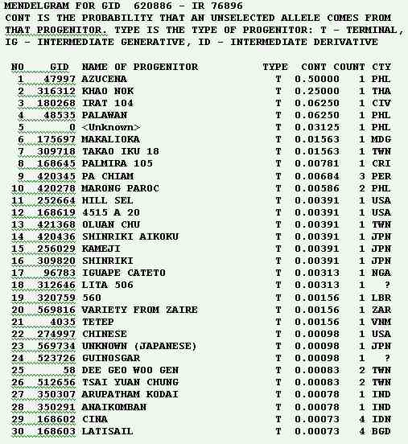
Computing genetic contributions

Slide 25
Pedigree Management for Hybrid Rice Breeding
Source Nursery
~200 Promising
Elite Lines
CMS Nursery
Maintenance of CMS and Maintainer lines
Test Cross Nursery
~600 hybrids/cycle
Backcross Nursery
Development of New
GMS & Maintainer Lines
~100
Identification of
Restorer Lines
~50
Observational Yield Trial
~350 F₁s /cycle
Preliminary Yield Trial
Combining ability
Test Nursery
~50
Advanced Yield
Trial ~25 entries
x 3 locations
Philippine National testing
NARS collaborators
INGER Hybrid Rice Nurseries

Slide 26
Conclusions
We have concentrated on IRIS deployment in breeding programs at IRRI
IRIS has proved stable and flexible in handling large breeding programs
IRIS is minimally intrusive for small breeding projects
IRIS is the key to managing shuttle breeding information between many partners

Slide 27
Conclusions - continued
IRIS has been successfully used to link breeding, genetic resources and international testing data
IRIS is being used for economic analysis of global efforts in germplasm improvement
IRIS is being deployed to manage molecular data and link to bioinformatic resources
Partners in Philippines, India, Cambodia, Laos, Thailand, Indonesia, China, and Korea are starting to use IRIS for management of genealogy and breeding data

