Slide 1
International Crop Information System
Arllet Portugal
Crop Research Informatics Laboratory

Slide 2
Outline
What is ICIS?
Why use ICIS?
Components of ICIS
Genealogy Management System (GMS)
Data Management System (DMS)
Inventory Management System (IMS)
Gene Management System (GEMS)
Standalone Tools

Slide 3
What is ICIS?
ICIS stands for International Crop Information System which is a computerized database system for general, integrated management and utilization of genealogy, nomenclature, evaluation and characterization data for a wide range of crops.
ICIS is a public open source collaboration involving a number of CGIAR centers and non-CG partners in Australia (U.Queensland), Canada (AAFC) and the Netherlands (Nunhems)
It is one of the Laboratory Management Systems (LIMS) being used in Generation Challenge Program (GCP)

Slide 4
What is ICIS? …
ICIS aside from rice crop is also successfully deployed for a number of non-rice crops: Wheat, Barley, Maize, Common Beans, Chick Pea, Cow Pea, Sugarcane, Potato, Sweet Potato
ICIS
IRIS
IWIS
IBIS
IMIS
ICHIS
IVIS
ISCIS
…

Slide 5
Why use ICIS?
Management of accurate and relevant germplasm information which is essential for knowledge based crop improvement programs can be achieved in ICIS.
Information in scattered islands has limited potential. In ICIS, those information can be linked and managed.
.

Slide 6
Components of ICIS
Crop Data Management
  Genealogy Management System (GMS)
  Data Management System (DMS)
  Inventory Management System (IMS)
  Genetic Resources Information Management System (GRIMS)
Genetics/Genomics (GEMS)
  Adapting diverse public domain open source schemas & software: GMOD, Ensembl, GO, BASE plus in-house Perl/Java code, …
Integrating with GIS and other data

Slide 7
REMOTE USERS
CENTRAL
DATABASE
LAN - OR - CD
USER1
USER2
USER3
USER4
LOCAL
DATABASE
on PC
1. User is unaware that there are two databases
Unique identification of germplasm is retained
by a combination of unique UserID+LocalGid
The user can retain most recent data for privacy
The user gets a new central database after update

Slide 8
Genealogy Management System (GMS)
GMS stores and manages information on genesis, genealogy, nomenclature and chronology of germplasm for a particular crop. It operates on the principle of unique identification of germplasm through system assigned Germplasm IDs

Slide 9
GMS …
Functions
Assign and maintain unique germplasm identification
Manage information on genealogy and nomenclature
Record chronology of germplasm development and utilization

Slide 10
GMS ….
Accommodate all possible development methods
Three development categories
  Generative methods which increase genetic variability, E.g. crosses
  Derivative methods which focus variability,
  e.g. selections
  Management methods which maintain variability
  e.g. seed increase
Germplasm can be classified into groups of derivatives from a specific generative process,
I.e. all the lines from a cross

Slide 11
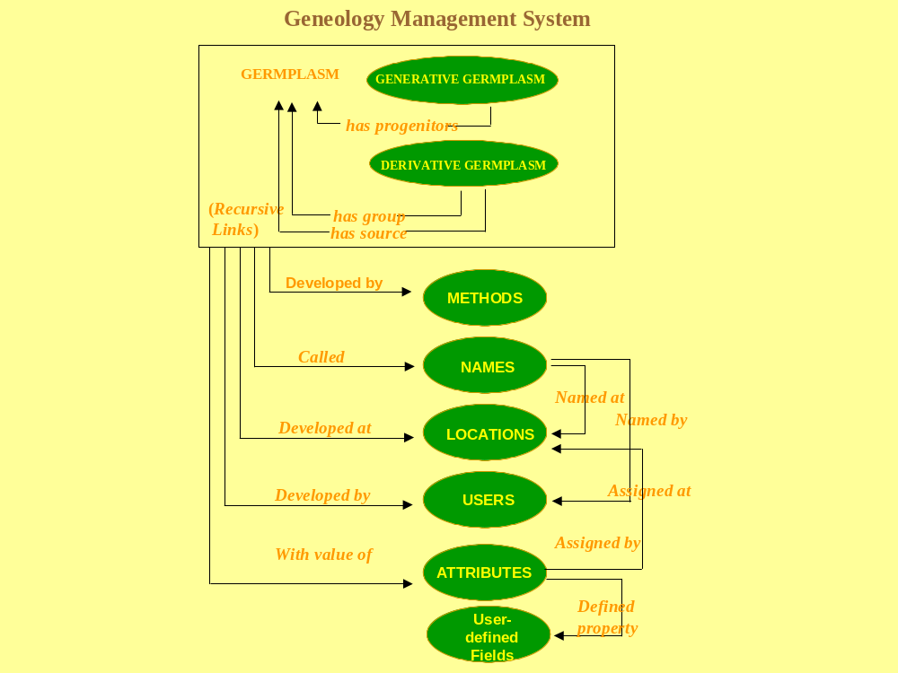
GMS Model

Slide 12
GMS Applications
SET GENERATION (SETGEN)
GMS Search
Browse
GMS Input

Slide 13
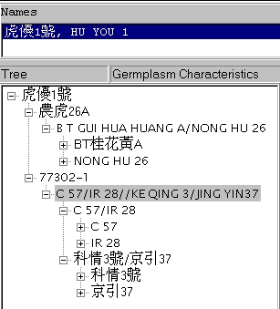
Historical Data from China

Slide 14
Data Management System (DMS)
DMS manages environmental data, germplasm characterization data and evaluation data for genetic resources and crop improvement projects. It is a data warehouse that accumulates and assembles data from a variety of sources and provides access to them.

Slide 15
DMS …
Store structured germplasm evaluation and characterization data
Document Data
Link data to germplasm identifiers
Link data to other descriptors (Locations, treatments, etc.)
Facilitate structured searches

Slide 16
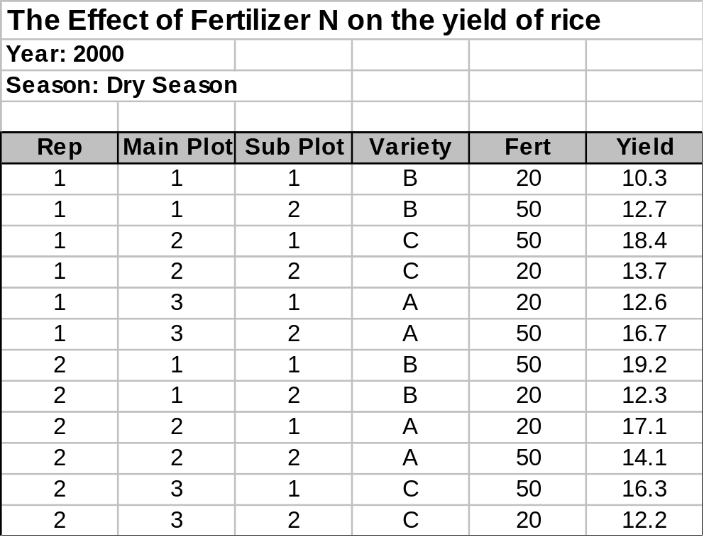
Data Model of DMS
Variate
Study
Filename: N2000DS.xls
Factor
Level
Observation
Unit
Datum

Slide 17
Data Model ...
Factor
Variate
Fert
Yield
PROPERTY
NITROGEN FERTILIZER
GRAIN YIELD
SCALE
kg/ha
t/ha
METHOD
Total Application
Paddy Rice

Slide 18
Property, Scale and Method
A property or trait is a measurable characteristic or feature of an experimental unit or experimental material (e.g., of a variety or environment), which is manipulated or measured in a study.
Scale is the measurement unit a trait is expressed.
A method is a technique of measuring or applying a trait.

Slide 19
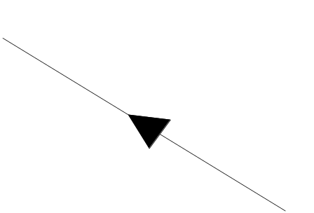



Data Model ....
STUDY
Applied in
Observed in
Identified by
FACTOR
PROPERTY
VARIATE
Expressed in
Measured/Applied by
Measurement of
Level of
SCALE
METHOD
LEVEL
DATUM
OBSERVATION
UNIT
Recorded from
Indexed by

Slide 20
DMS Applications
WORKBOOK (WRBK)
DATA RETRIEVER (RTV)

Slide 21
Inventory Management System
The ICIS Inventory Management System is a module designed to manage inventory information for any entities, including genetic resources and breeders’ seed stocks.
The Inventory Management System tracks individual entities, where they are stored, what quantities are in storage and what quantities are available for use.

Slide 22
IMS Application
Inventory Tracker

Slide 23
Genetic Resources Information Management System (GRIMS)
The ICIS-GRIMS is a set of modules designed to manage information on genetic resources for any crop and associated applications to facilitate gene bank activities. The following modules are required:
Acquisition and batch information
Passport information
Gene Bank Operations
Distribution

Slide 24
Gene Management System (GEMS)
GEMS will manage classical genetic information and molecular characterization.
The specific functions of GEMS are:
.
unique identification of genetic variants including molecular polymorphisms, sequences and traditional genes;
management of nomenclature of molecular variants;
identification of sources of different molecular variants;
identification of loci and alleles including molecular and physical mapping positions;
linkage of genes to traits and products

Slide 25
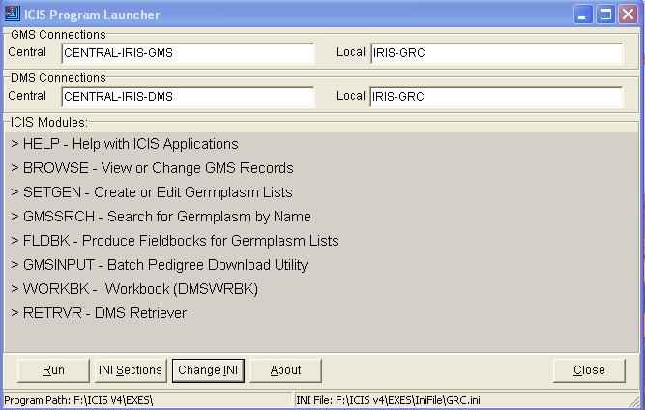
ICIS Standalone Launcher

Slide 26
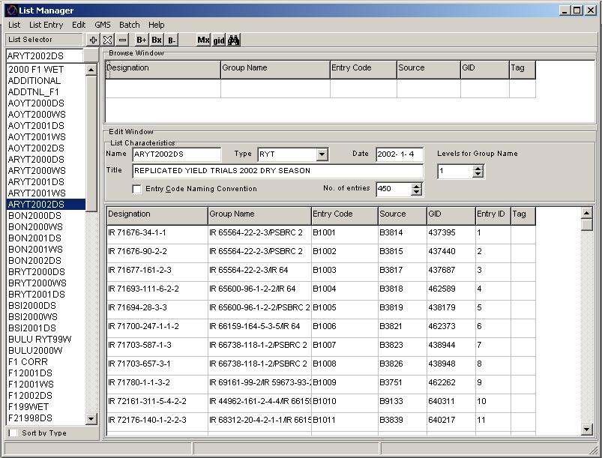
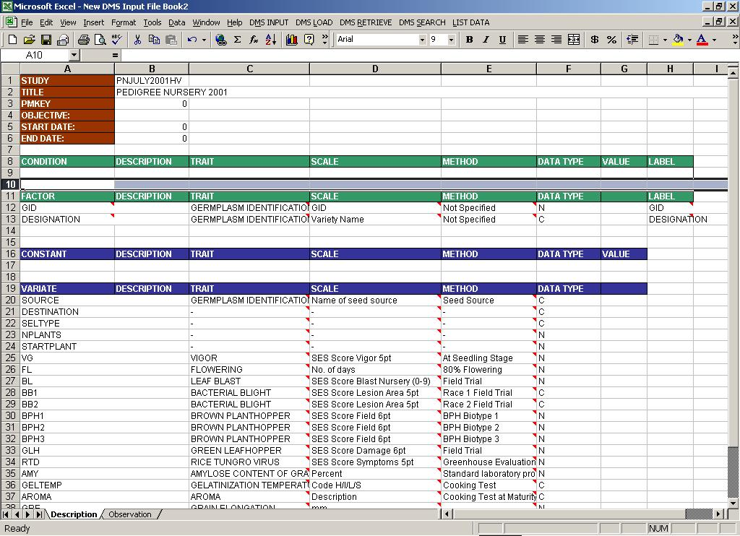
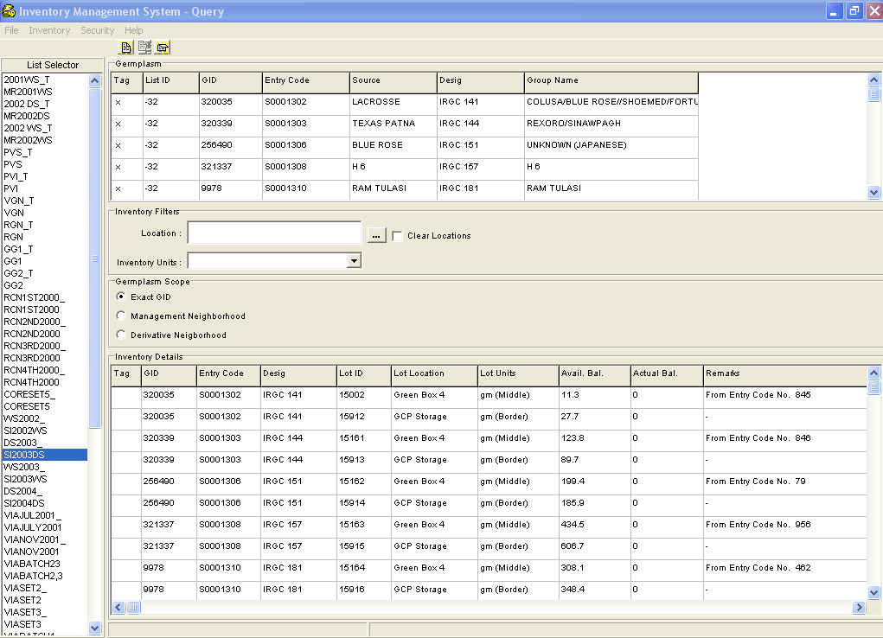
Standalone Tools
SetGen
ICIS Workbook
Inventory Tracker

Slide 27
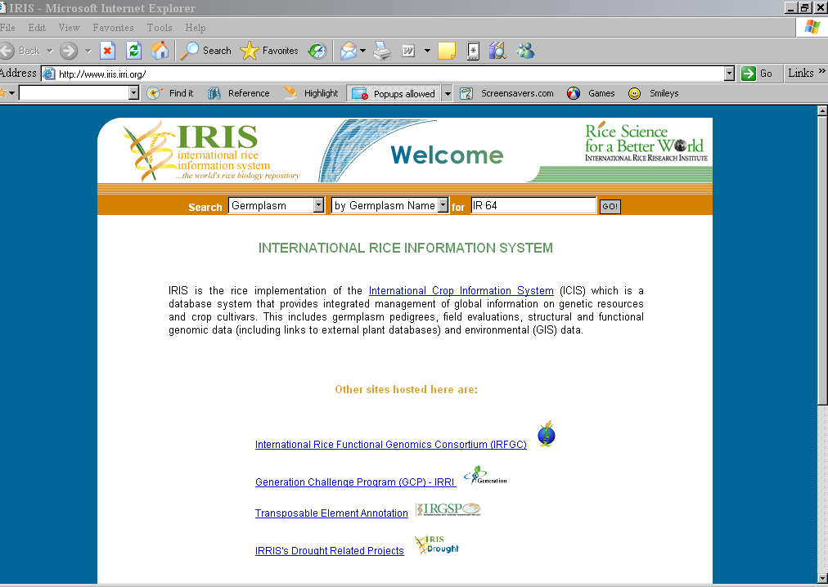

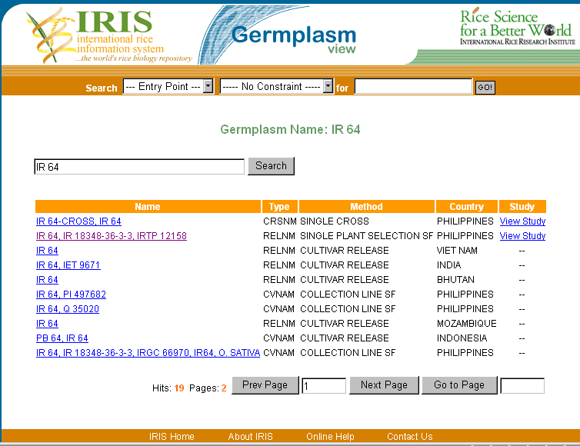
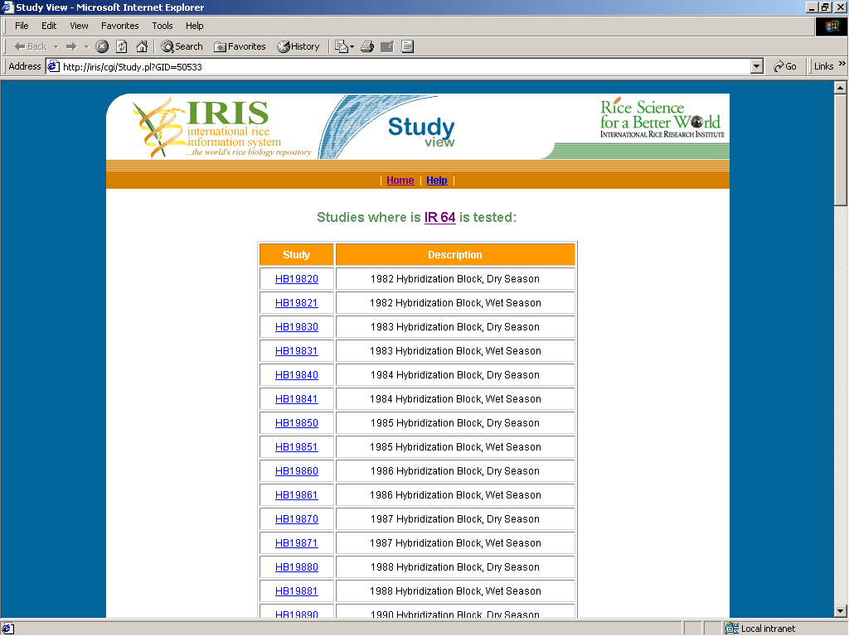
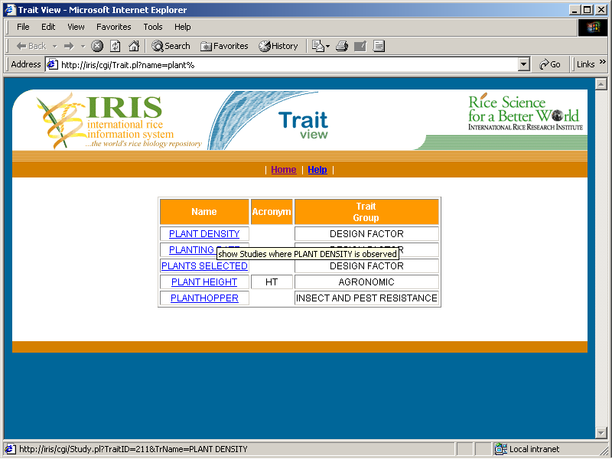
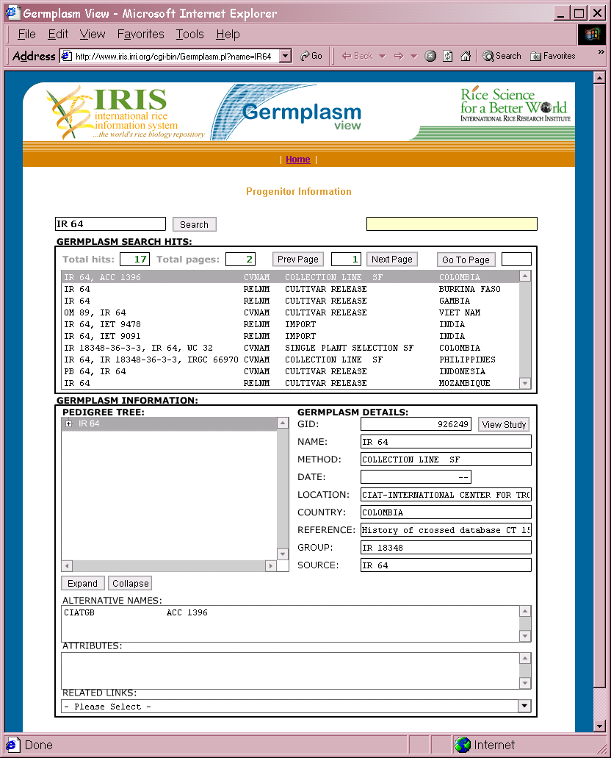
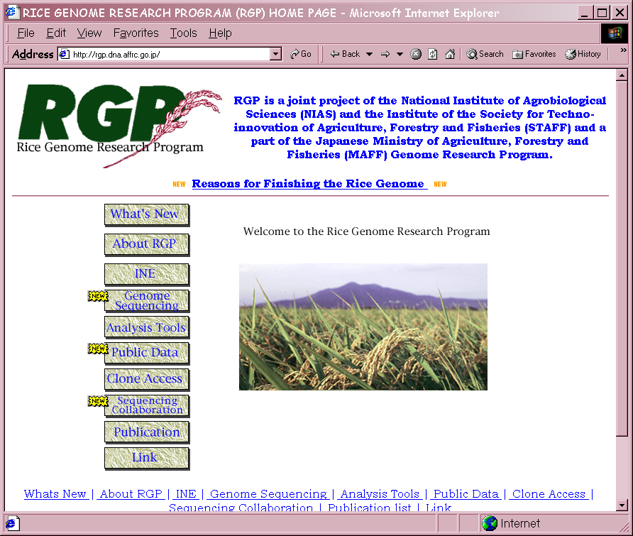
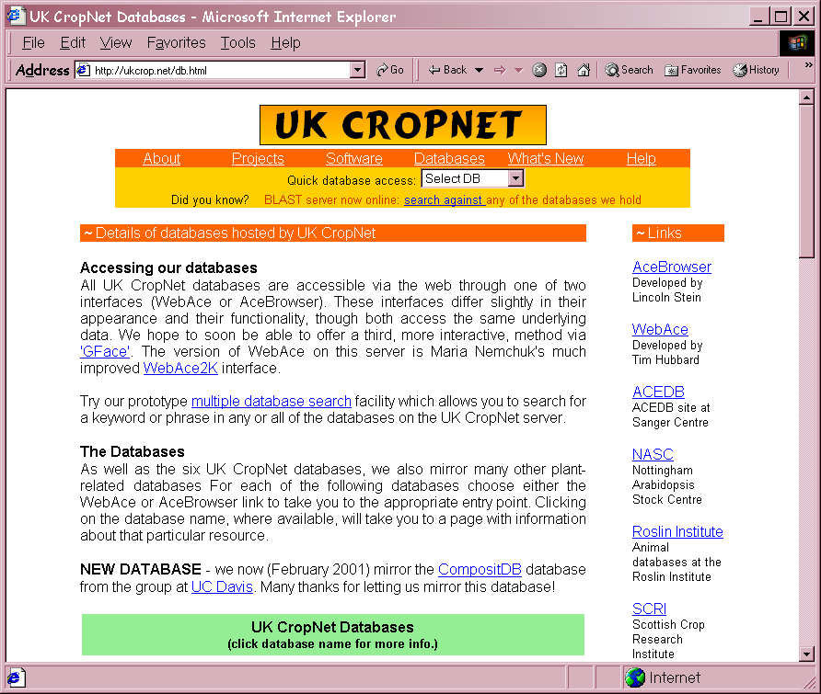
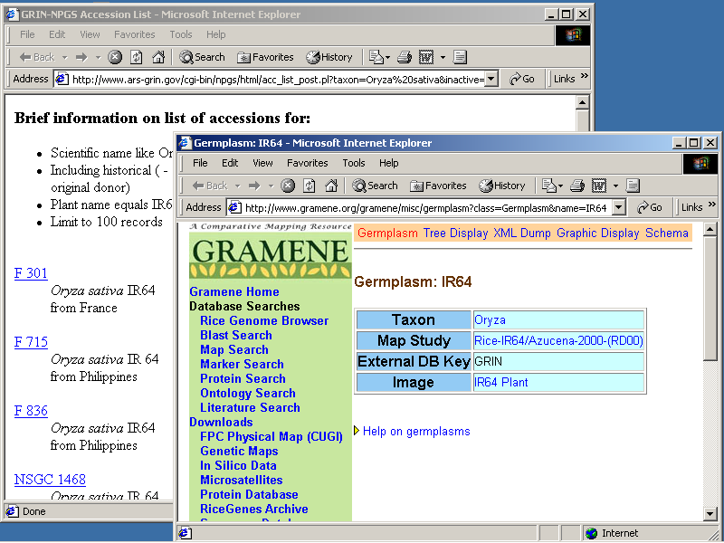
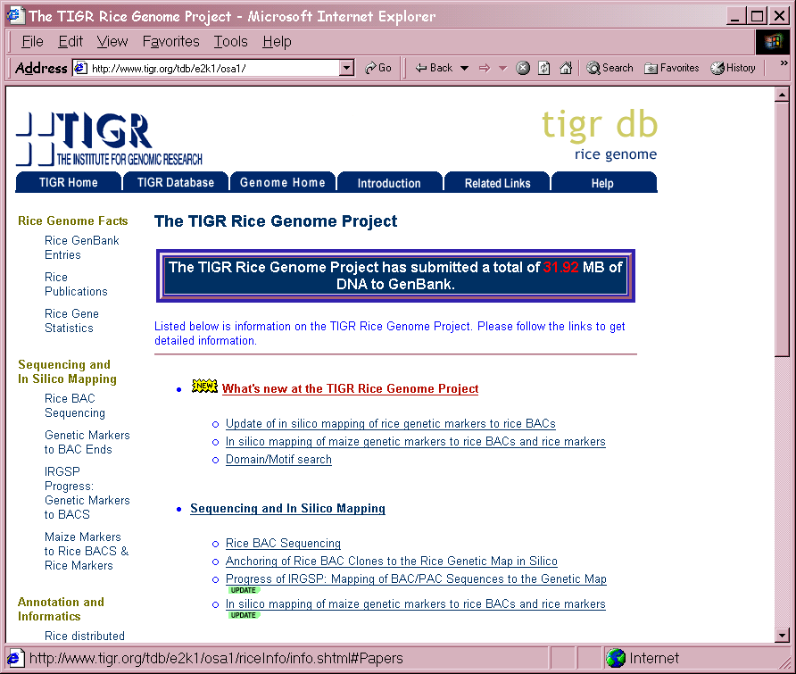
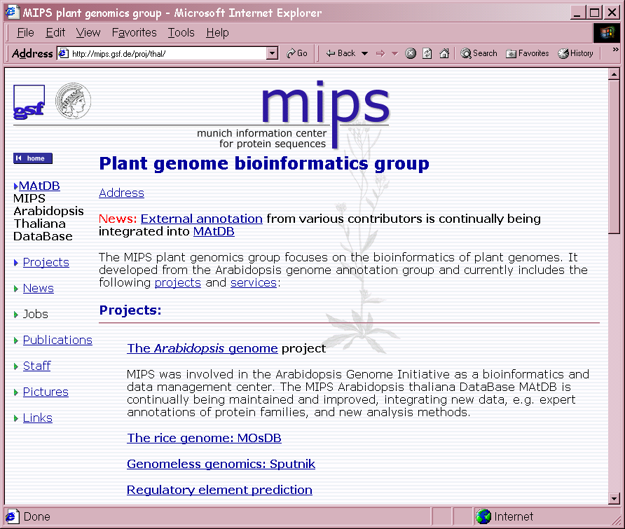
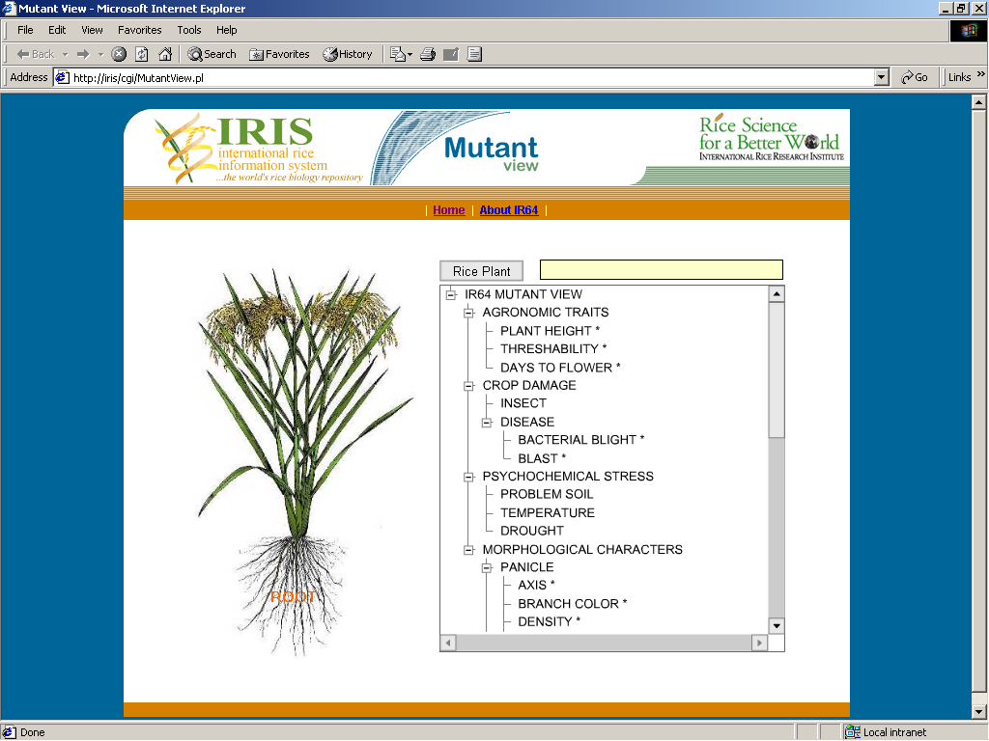
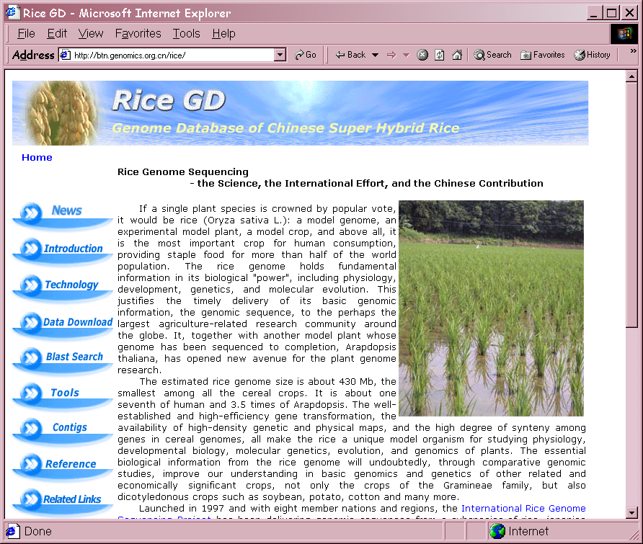
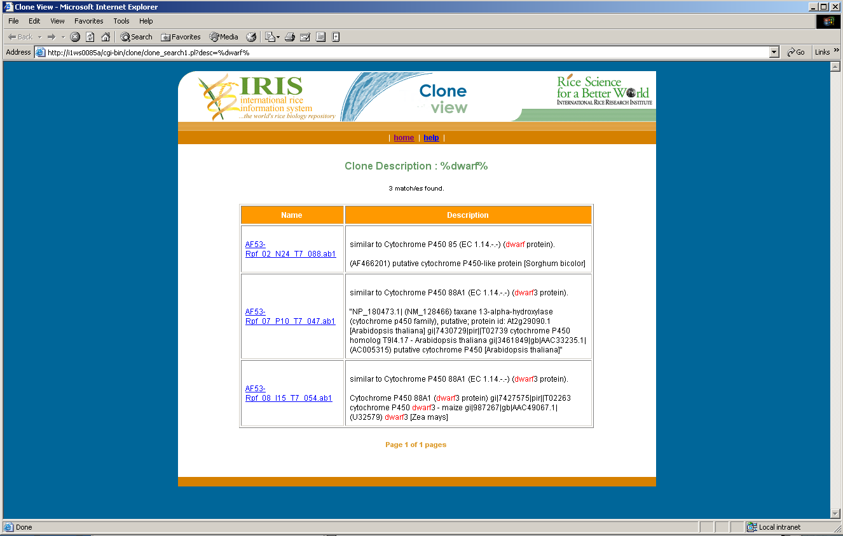
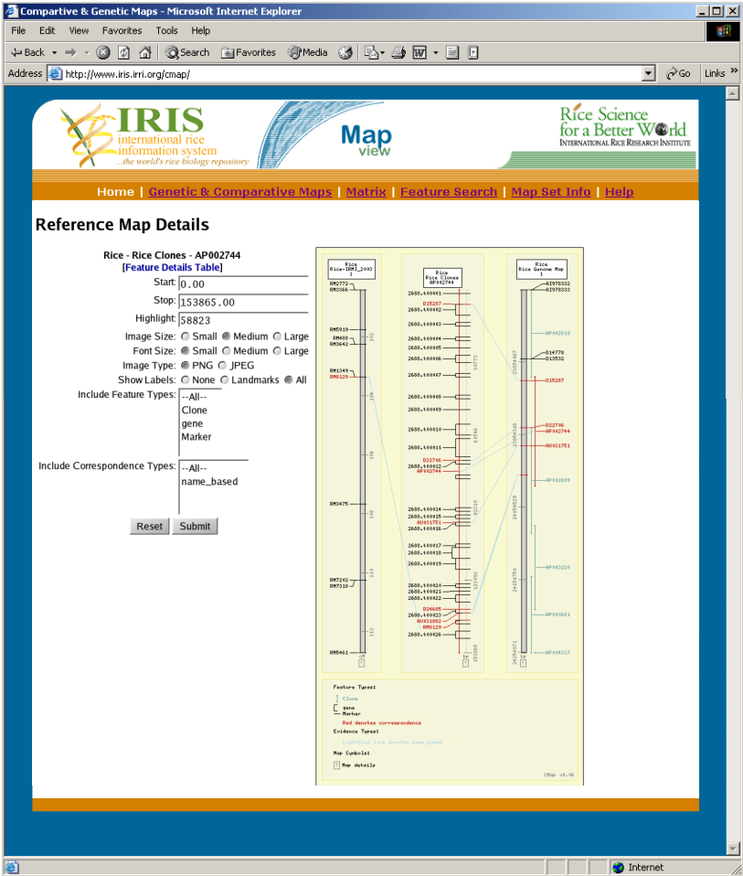
http://www.iris.irri.org
Germplasm Genealogies, Populations, Genetic Resources, Traits & Field Evaluation Data
Wildcard text queries from multiple entry points, with multiple constraints
Genetic Maps, Genome Annotation, Mutant Stocks, EST Clones, Gene Arrays, Proteomics, Metabolomics & Molecular Variation Data
Links with External Databases

