Slide 1
MANAGING DOCUMENTS/IMAGES
This presentation will probably involve audience discussion, which will create action items. Use PowerPoint to keep track of these action items during your presentation
In Slide Show, click on the right mouse button
Select “Meeting Minder”
Select the “Action Items” tab
Type in action items as they come up
Click OK to dismiss this box
This will automatically create an Action Item slide at the end of your presentation with your points entered.
Lilibeth M. Sison
T.T. Chang Genetic Resources Center
16 February 2009

Slide 2
Overview
The need to digitally preserve historical documents
The need to instantly retrieve, view, copy, fax or email necessary documents for cross-referencing against the data stored in the database
The need to display qualitative information through photographs

Slide 3
Objectives
To identify the necessary information to be stored in ICIS
To identify ICIS tables to be used
To suggest/get some feedback on how to store and retrieve this information

Slide 4
Information to be stored
GID
Image type – scanned collecting missions report, scanned acquisition documents from donor, scanned MTA, photograph of grain, photograph of seed focusing on a certain trait, etc.
Image filename

Slide 5
Storing data
Capturing images
  Create a list of accessions in an excel sheet
  Arrange accessions in the order that is listed in the excel sheet before each photo session
  Create a macro to store the timestamp (camera time when photo was taken) of each photo and its corresponding camera-generated filename
  Create a macro to rename filenames to the corresponding GID of each accession

Slide 6
Storing Data
Scanning documents
  Pages which have imperfections such as tears or holes are edited after scanning to erase these flaws
  Colored documents are converted to grayscale to limit the file size
  Higher resolution is required for documents with very small manuscripts, handwritten pages and ‘fragile’ papers
  In an excel sheet, specify keywords that would link to the document (used for searching purposes), which includes the accession number
  Saving of filename is done manually

Slide 7
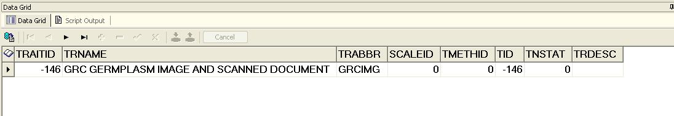
Storing data
The TRAIT table
  Define a trait to identify the property of the data to be stored

Slide 8
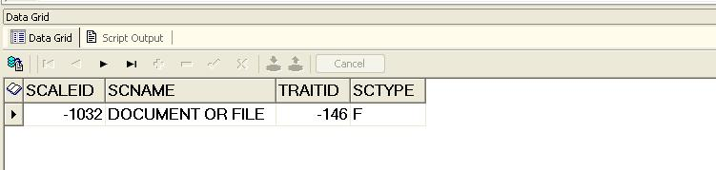
Storing data
The SCALE table
  Define a scale with FTYPE = ‘F’ to indicate the attribute of a germplasm of type F (file), using TRAITID = the TRAITID of the scanned document/image

Slide 9
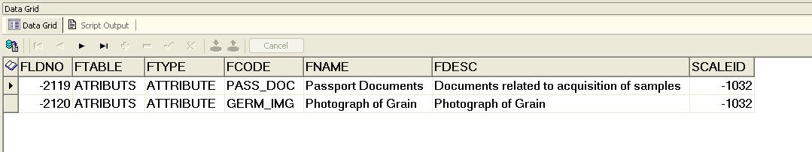
Storing data
The UDFLDS table
  Define the types of images in the UDFLDS using SCALEID = the SCALEID of the scanned document/image

Slide 10
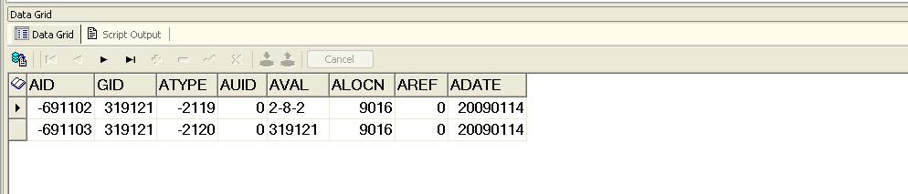
Storing data
The ATRIBUTS table
  Define the filenames of the images in the ATRIBUTS table using ATYPE = FLDNO in the UDFLDS table

Slide 11
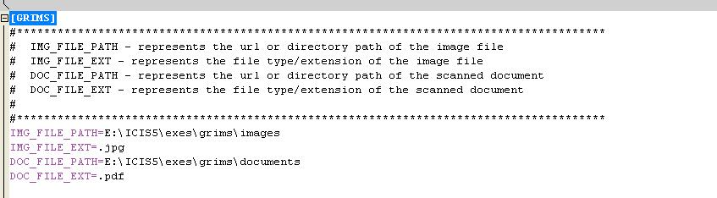
Implementation
INI file settings

Slide 12
Implementation
Filenames
  standard file name of passport documents would be the location of the original document in the cabinet
  e.g. 2-8-2.pdf → 2-8-2 means drawer-folder-file in folder
  standard file name of images would be the GID
  e.g. 31921.jpg → photo (grain) of GID 31921

Slide 13
Implementation
File location
  raw files can be stored in an external drive
  edited files can be stored in a photo-sharing website, e.g. Flicker

Slide 14
Thank you
This presentation will probably involve audience discussion, which will create action items. Use PowerPoint to keep track of these action items during your presentation
In Slide Show, click on the right mouse button
Select “Meeting Minder”
Select the “Action Items” tab
Type in action items as they come up
Click OK to dismiss this box
This will automatically create an Action Item slide at the end of your presentation with your points entered.

