Slide 1



ICIS Web Interface Progress
Pedigree Download Tool
Sandra Micallef – ICIS2006, CIMMYT

Slide 2
12 MONTHS AGO…….
At present
Perl Version of web interface
  Updated to JAVA version
Security/Access privileges issues
  Password protected site
Concurrent CITRIX version
  Too expensive to run - unjustified
Only few users
  Increased users of web site

Slide 3
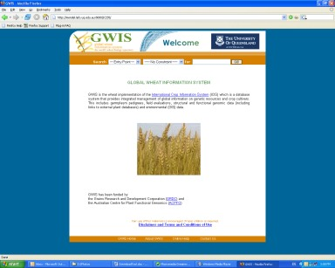
GWIS website
Comprehensive reference for Australian wheat pedigrees
Occasional feedback from breeders about pedigree accuracy
http://gwis.lafs.uq.edu.au

Slide 4
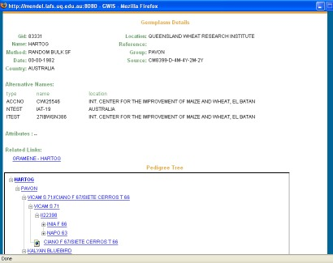
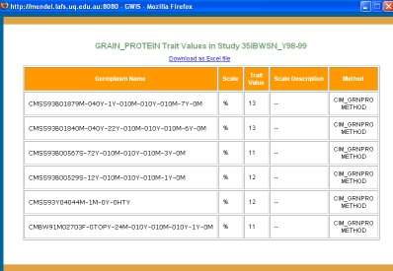
Data download from interface
Query DMS across studies
Only phenotypic/DMS data downloadable
Pedigree data cannot be downloaded

Slide 5
Required …..
Pedigree Download Tool
  Allows users to select a number of varieties
  Gives each variety’s pedigree
  Details of all parents in each pedigree (i.e. full ancestry tree)
  Ancestry tree can be defined to n generations

Slide 6
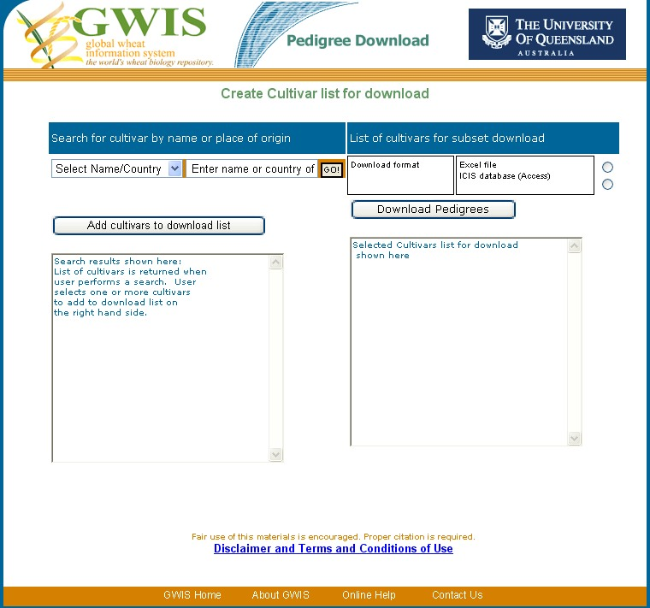
Search for variety by name or country of origin
List of search results
Add selected entries to list
Select output format (either or both)
Download pedigrees button

Slide 7
Advantages
Smaller database, hence faster
Pedigree relationship analysis (COP) is easier
More useful on web interface as a tool

Slide 8
Development
Currently:
  Prototype in VBA
  Uses lists from SETGEN
Web Enabled tool
  JAVA / ASP.NET
  Users create lists “on the spot”
  Output in spreadsheet or Access format
  To be included in standard ICIS web interface

Slide 9
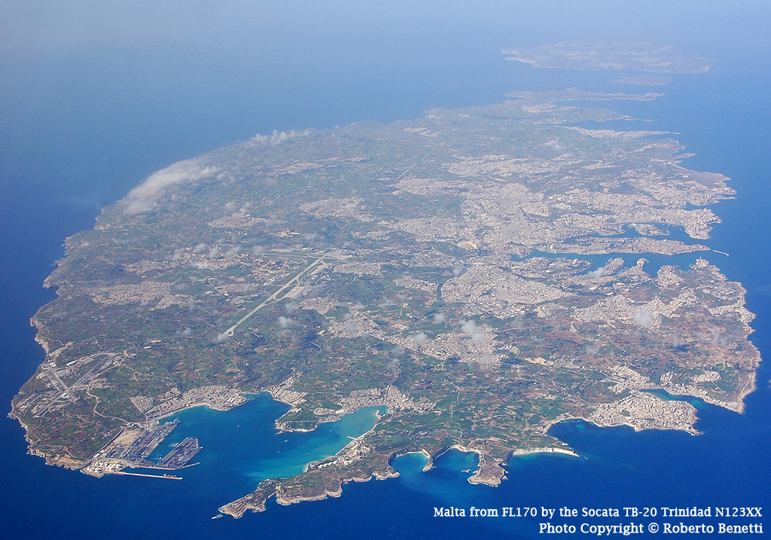
THANK YOU

