Slide 1
Inventory Tracker
International Crop Information System 5.4
Veritas Morena Salazar
CRIL

Slide 2
Inventory Management System
Setgen
Workbook
Inventory
Information Systems
Store
Withdraw
Commit
Barcode
+ General Users
Retrieve
Upload
Add Lot
Deposit
Reserve
Create Lot
Administrator
General User
Store
Withdraw
Deposit
Reserve
Other functionalities
Create Lot

Slide 3
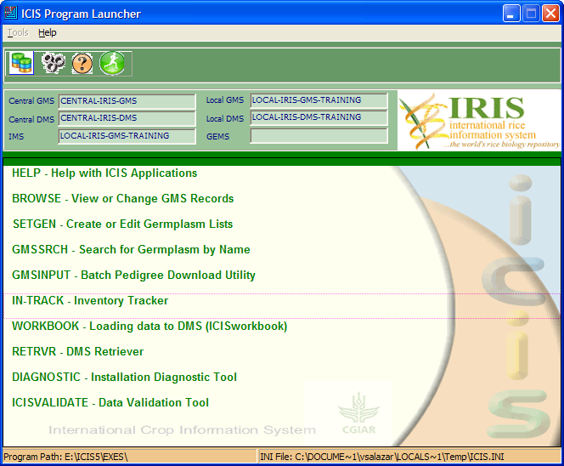
ICIS Launcher→ IN-TRACK

Slide 4
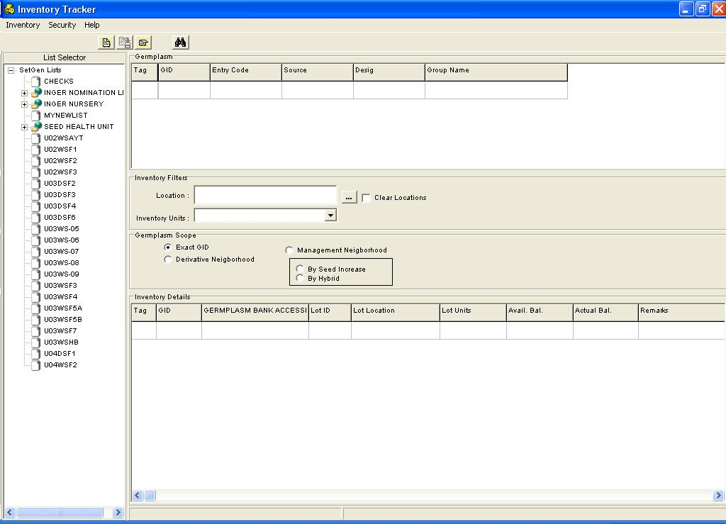
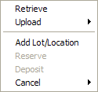
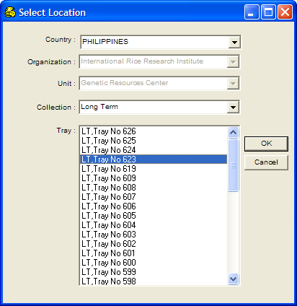

General User
Menu
Inventory
Security
Toolbars
Germplasm Section
Inventory Filters
Germplasm Scope
Inventory Details
List Selector

Slide 5
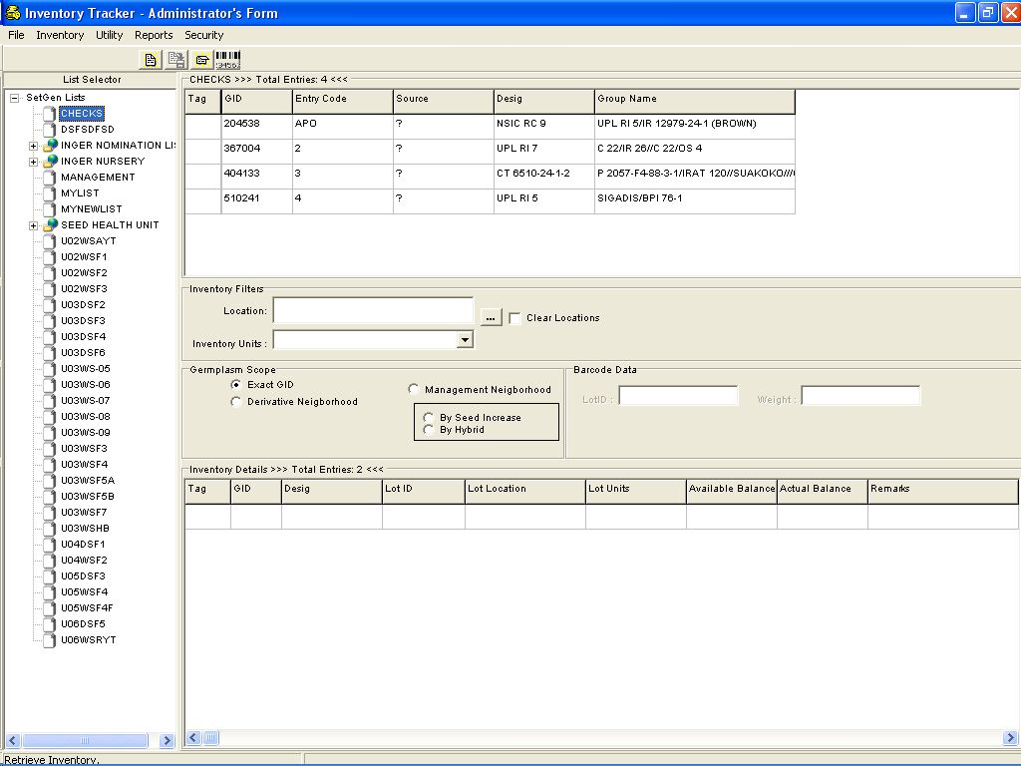

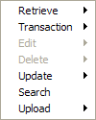


Administrator
Menu
Inventory
Reports
Toolbars
File
Utility
Germplasm Section
Inventory Filters
Germplasm Scope
Barcode Data
Inventory Details
List Selector

