Slide 1

Linking Genotype to Phenotype: the International Crop Information System
Notes:
BIOINFORMATICS SUPPORTING
RICE GENETIC ENHANCEMENT PROGRAMS
AT THE
INTERNATIONAL RICE RESEARCH INSTITUTE
Richard Bruskiewich (r.bruskiewich@cgiar.org),
Hei Leung, John Bennett, Kenneth McNally,
Alexander Cosico, Arllet Portugal, Teresa Reyes, Victor Ulat
and Graham McLaren
International Rice Research Institute
DAPO 7777, Metro Manila, Philippines (http://www.irri.org/)
The International Rice Research Institute (IRRI), a member institute of the Consultative Group for International Agricultural Research (CGIAR; http://www.cgiar.org), is augmenting its traditional research program in rice plant breeding and germplasm characterization with new projects in functional genomics and trait-driven gene discovery. These projects rely heavily upon bioinformatic approaches to cope with the large quantity of high-throughput data being generated within and outside the Institute.
My presentation will outline some of these bioinformatics-based approaches as they are being implemented at IRRI. The focal point of the talk will be upon the extension of the International Rice Information System (IRIS; http://www.iris.irri.org) – originally set up to manage germplasm pedigrees and field phenotyping data - to laboratory information management and online publication of genetic, genomic, mutational, DNA microarray, proteomic and genebank allele mining data.

Slide 2
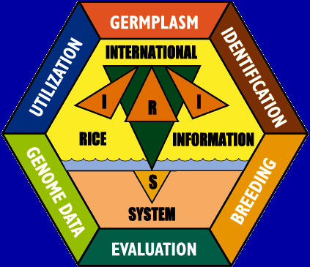

International Crop Information System (ICIS)
The Swiss Army Knife of Crop Research
http://www.icis.cgiar.org
ICIS is a computerized database system for general, integrated management and utilization of genealogy, nomenclature, evaluation and characterization data for a wide range of crops
ICIS is a public open source collaboration involving a number of CGIAR centers and non-CG partners in Australia (U.Queensland), Canada (AAFC) and the Netherlands (Nunhems)
ICIS is successfully deployed for a number of non-rice crops: Wheat, Barley, Maize, Common Beans, Chick Pea, Cow Pea, Sugarcane, Potato, Sweet Potato
Project resources (i.e. email lists, file downloads, etc) are now hosted at http://bioinformatics.org
The International Rice Information System (IRIS) is the rice version of ICIS and is being used as a vehicle to extend ICIS to genomic data

Slide 3
Components of ICIS
Crop Data Management
  Genealogy Management System (GMS)
  Data Management System (DMS)
  Windows, Perl and (soon) Java API
Genetics/Genomics
  Adapting diverse public domain open source schemas & software: GMOD, Ensembl, GO, BASE plus in-house Perl/Java code, …
Integrating with GIS and other data

Slide 4
DATA MODEL FOR THE ICIS GENEALOGY MANAGEMENT SYSTEM (GMS)
GERMPLASM
GENERATIVE GERMPLASM
has progenitors
DERIVATIVE GERMPLASM
has group
has source
Developed by
METHODS
Called
NAMES
Named at
Developed at
Named by
LOCATIONS
Developed by
USERS
Assigned at
With value of
ATTRIBUTES
Defined property of
User-defined Fields

Slide 5
DATA MODEL FOR THE DATA MANAGEMENT SYSTEM (DMS)
STUDY
Applied in
Ontology
Observed in
Application of
PROPERTY
Measurement of
Expressed in
Expressed in
FACTOR
VARIATE
SCALE
Measured by
Applied by
Defined by
METHOD
Value of
EFFECT
Partitioned by
Measurement of
LEVEL
OBSERVATION
UNIT
DATA
Indexed by
Observed by

Slide 6
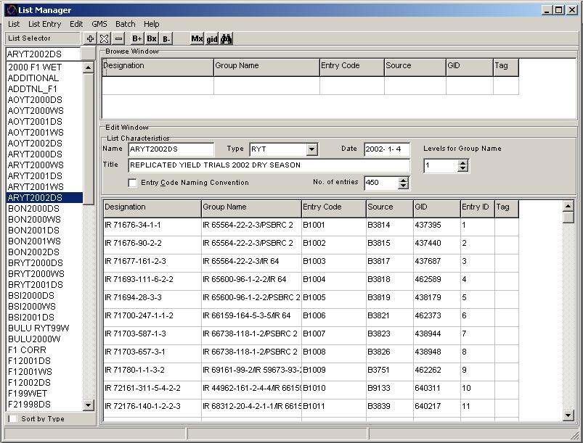
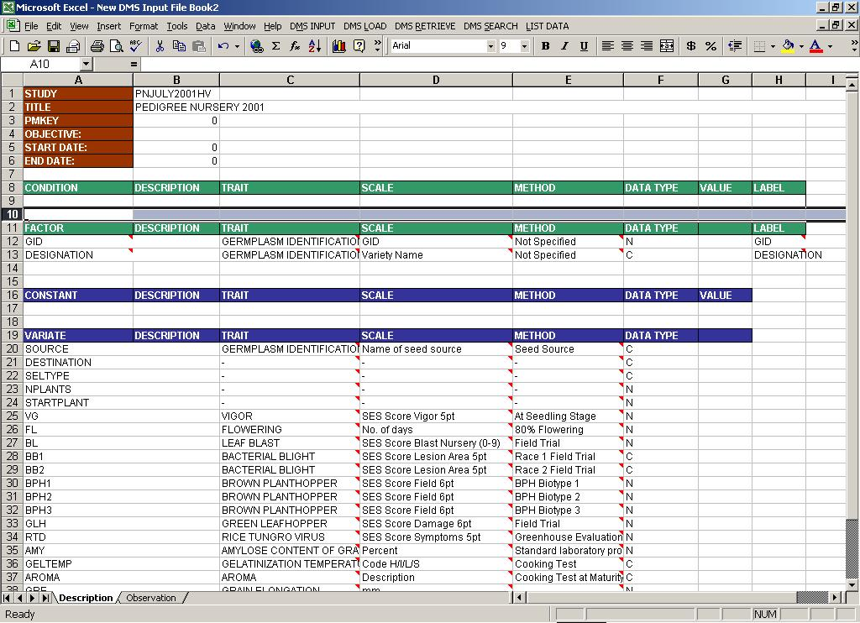
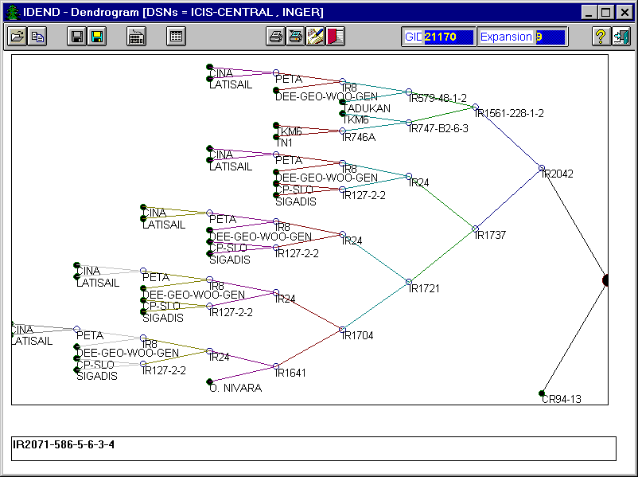
Standalone Tools for Breeders
List Manager
Field Workbook
Genealogy Diagrams

Slide 7
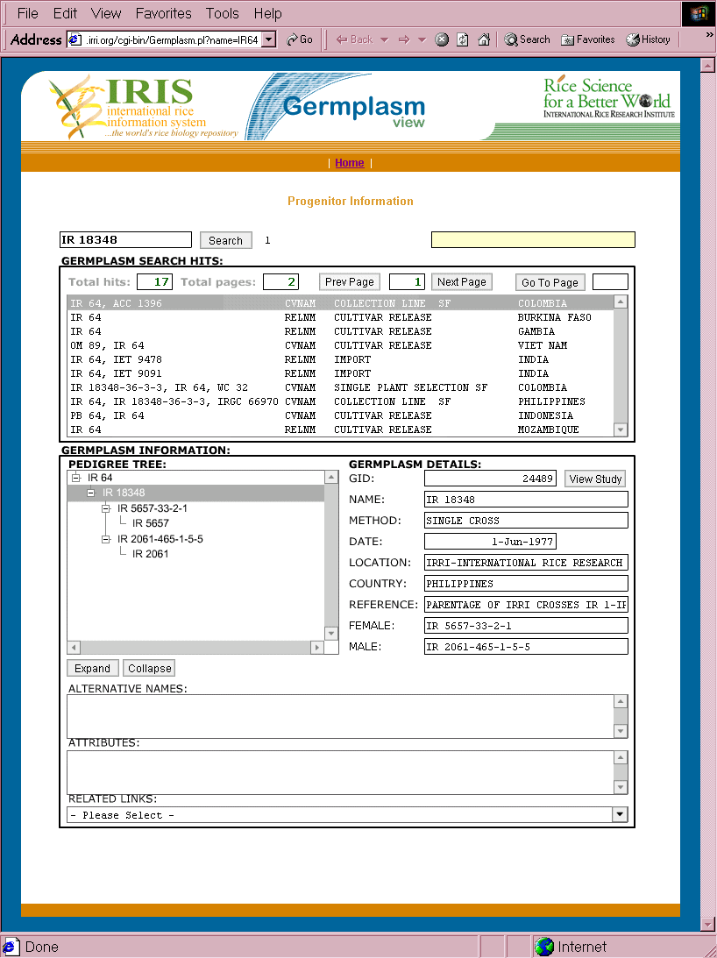
Pedigree Browsing in the Germplasm View

Slide 8
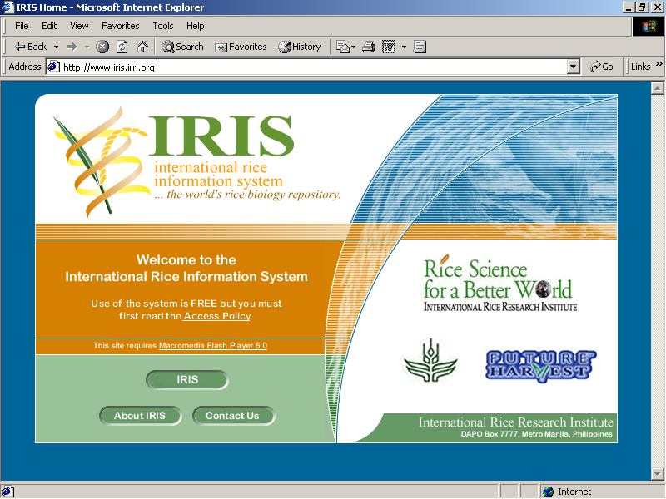

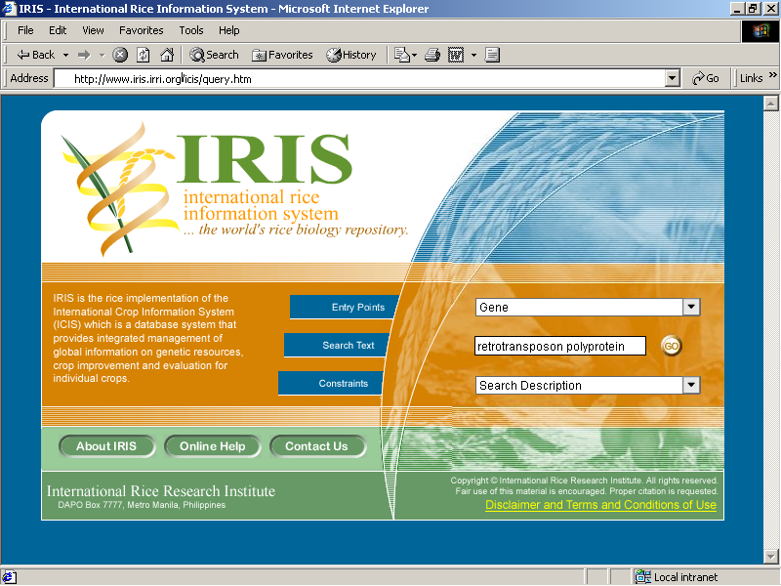
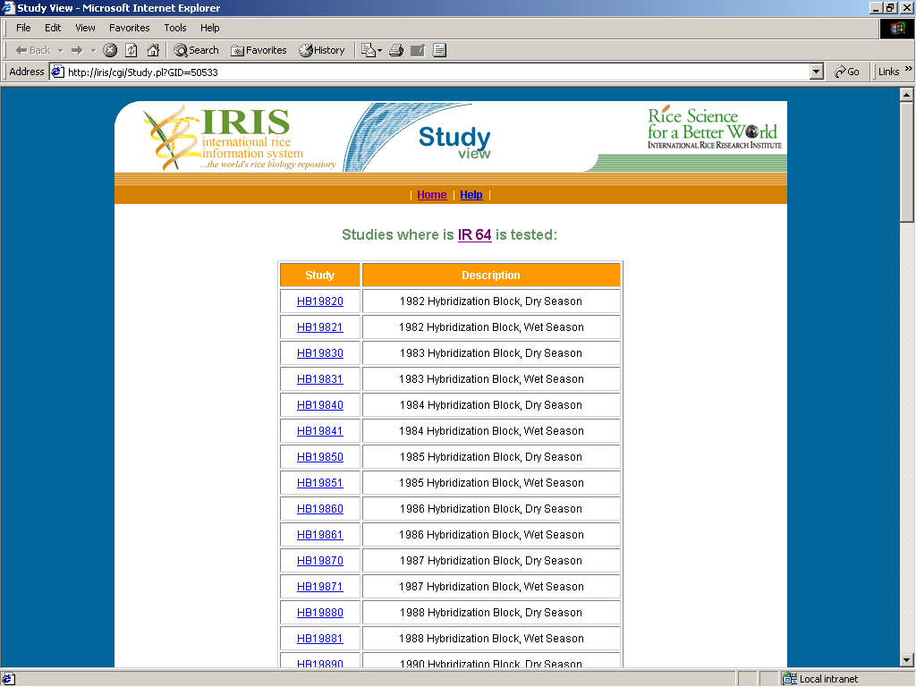
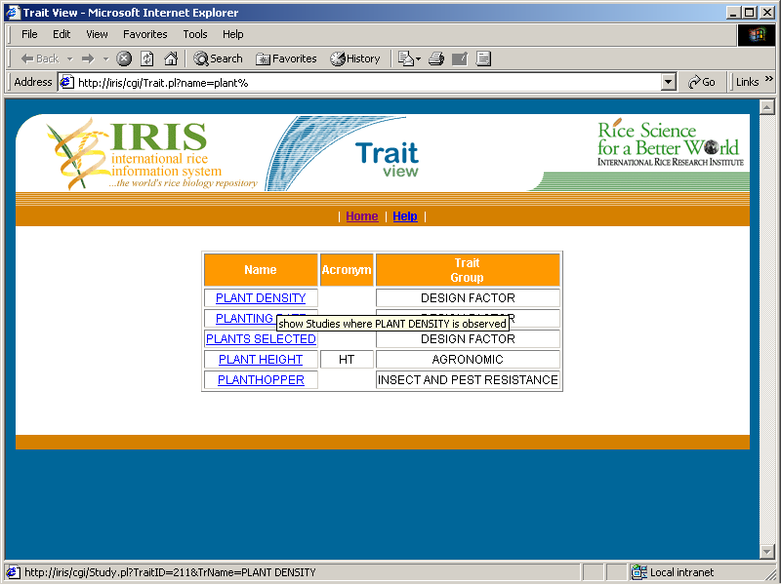
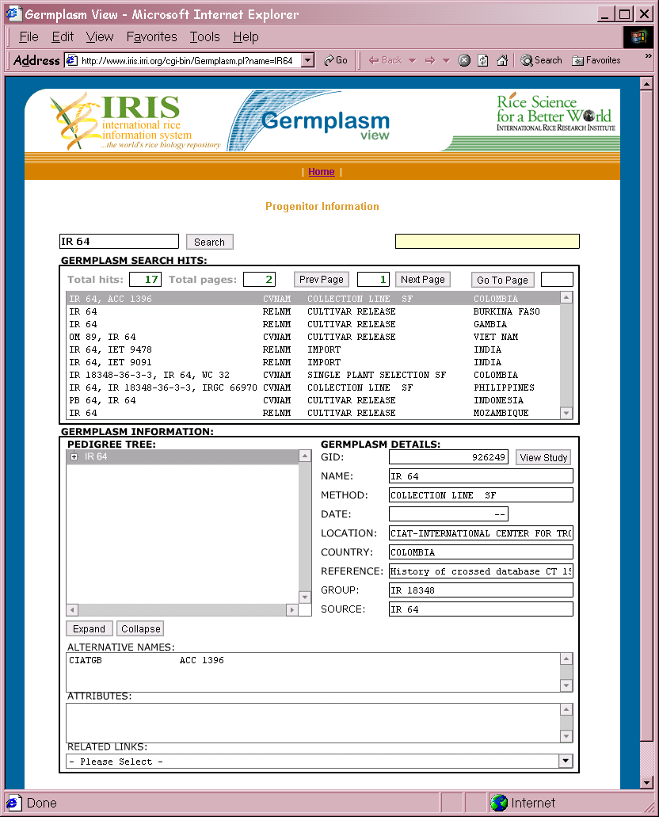
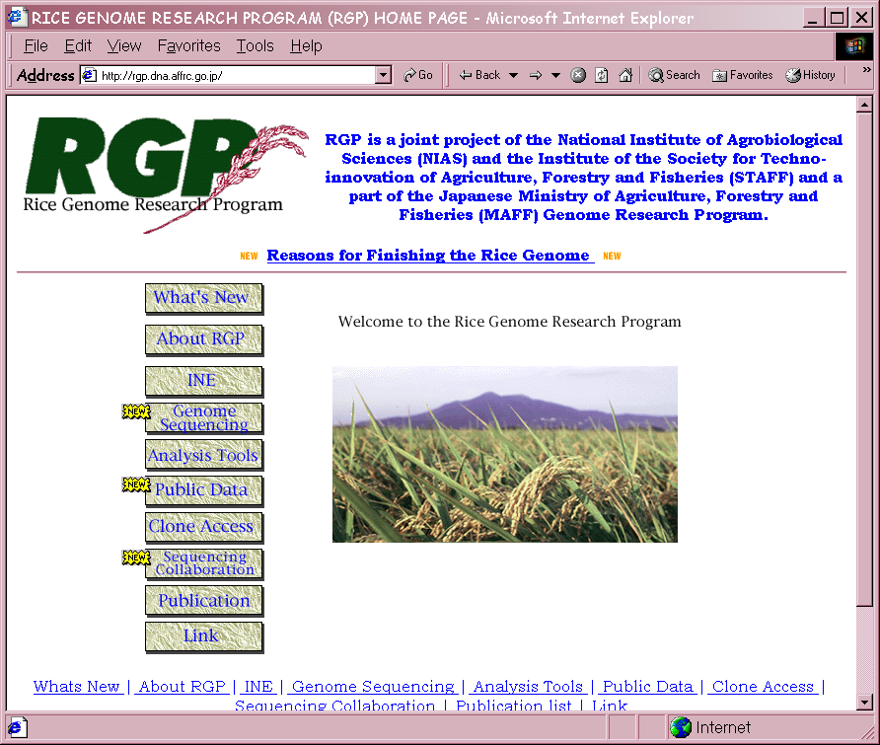
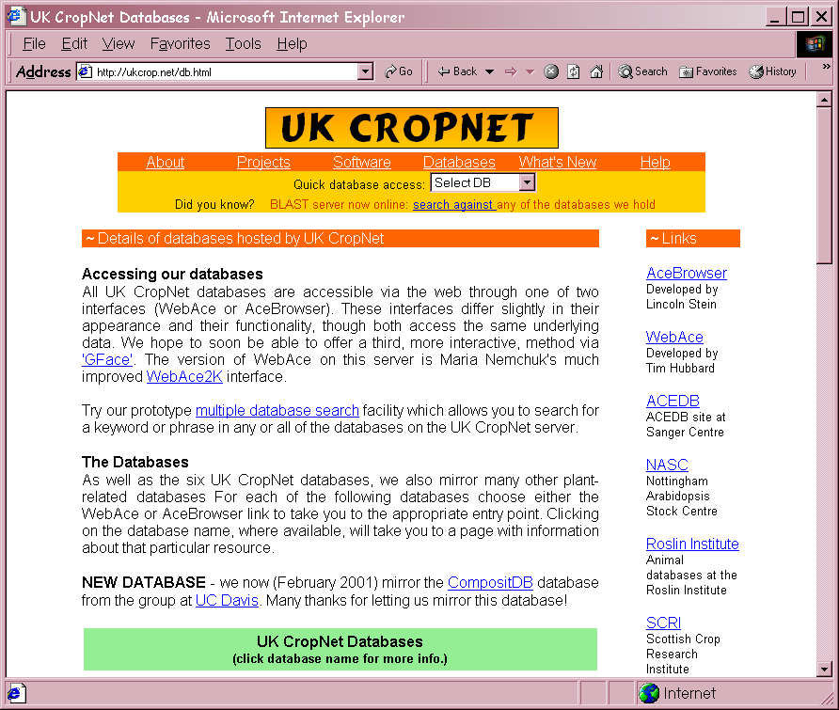
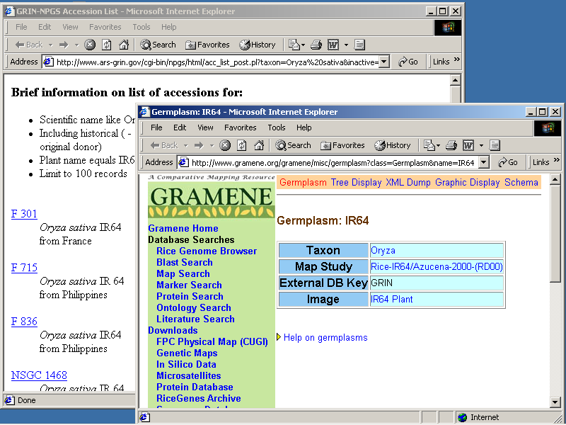
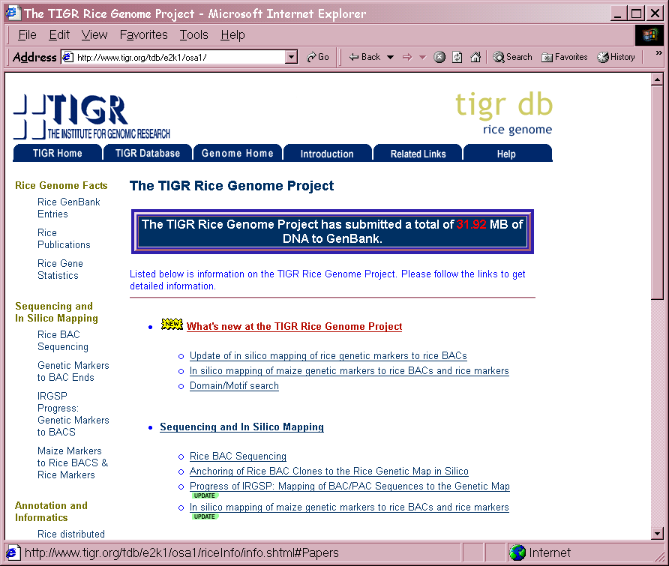
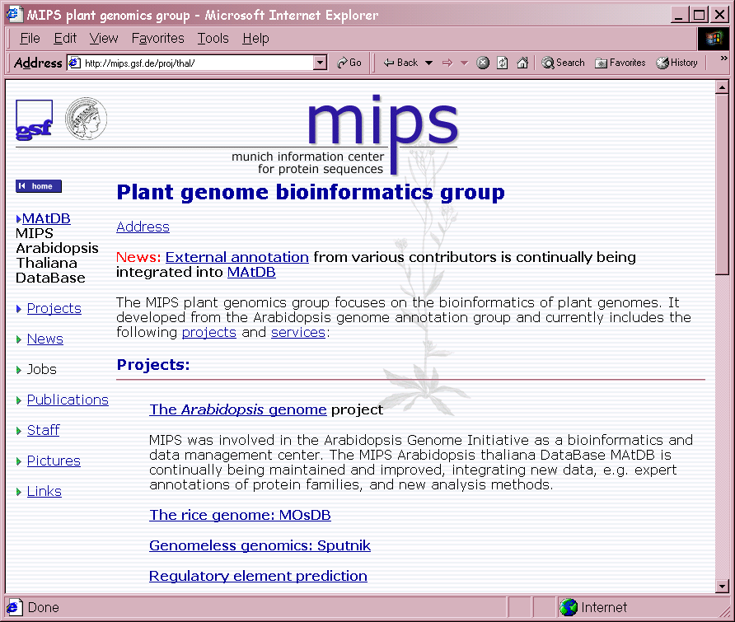
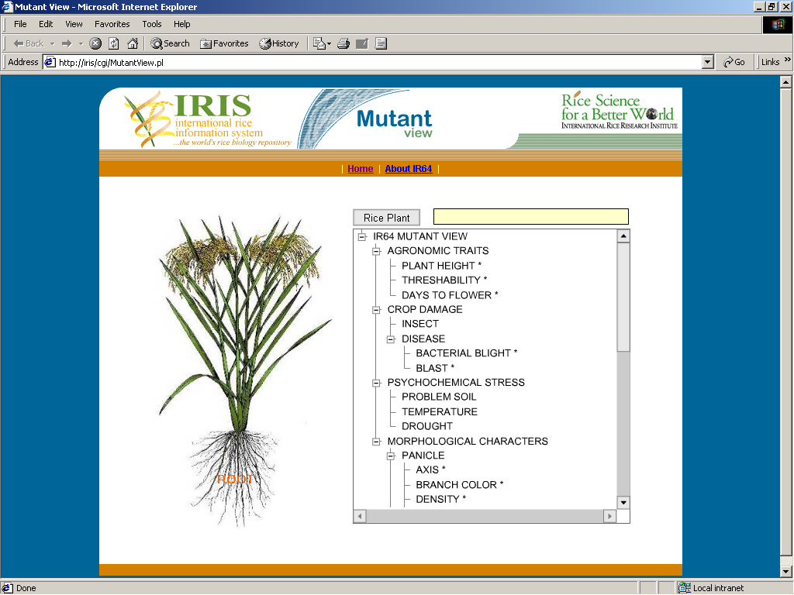
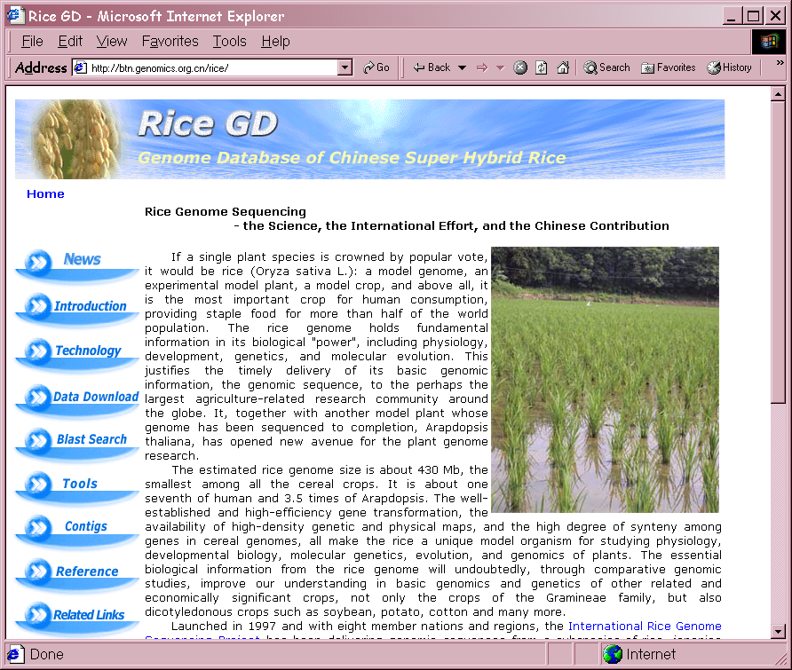
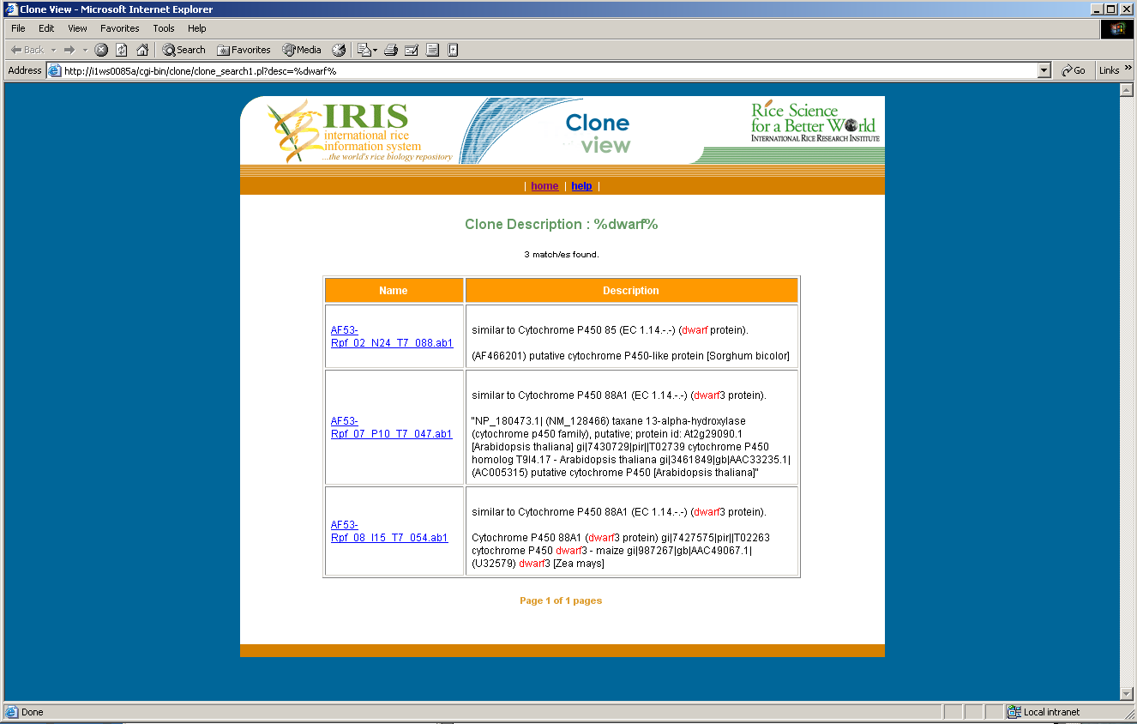
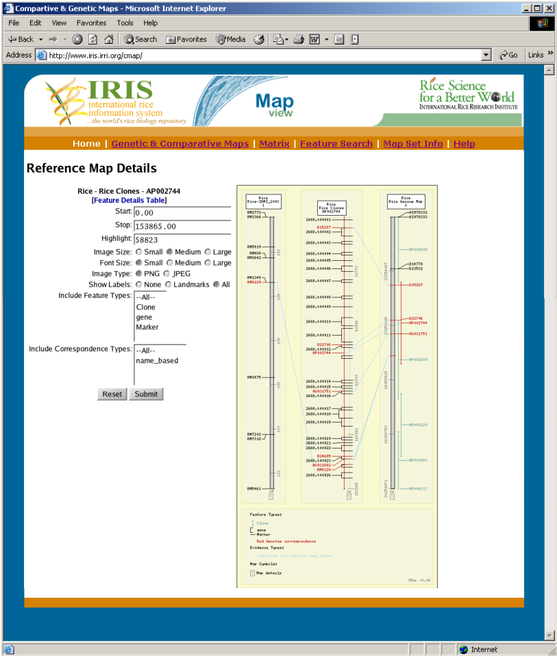
http://www.iris.irri.org
Germplasm Genealogies, Populations, Genetic Resources, Traits & Field Evaluation Data
Wildcard text queries from multiple entry points, with multiple constraints
Genetic Maps, Genome Annotation, Mutant Stocks, EST Clones, Gene Arrays, Proteomics, Metabolomics & Molecular Variation Data
Links with External Databases

Slide 9
Future Directions for ICIS/IRIS
Expanding set of genomic datasets cross integrated for gene discovery, with specialized integrated WWW and standalone application views
Ontology and associated data mining facilities developed further using semantic web technologies
Interoperability protocols such as BioMOBY incorporated into IRIS to facilitate data integration with international plant databases
Port ICIS to and, enhance system with, Java

