Slide 1
SCRIPTS FOR RETRIEVING DATASETS

Slide 2
SCRIPTS
ADVANTAGES
less client/server transactions
procedures/functions can be called with parameters by the client
stored procedures are compiled within database server, and therefore queries are executed faster
stored procedures also separates query logic from the code logic.
DISADVANTAGE
database specific

Slide 3
TEST ENVIRONMENTS
windows XP
1G RAM
Pentium4 3GHz
MYSQL
version 5.0
POSTGRESQL
version 8.2

Slide 4
JOINING GENOTYPE AND PHENOTYPE STUDIES
Get_dataset(phenotype study)
Get_dataset(genotype study)
Create_array_dataset(genotype table)
Join genotype and phenotype studies by GID

Slide 5
GET_DATASET
Description:
- Creates a new table in the database. The created table format is the same as the observation sheet.
Input Parameter/s:
newTableName – Name of the table to be created. Study name is used to properly identify the table
studyName – Name of the Study

Slide 6
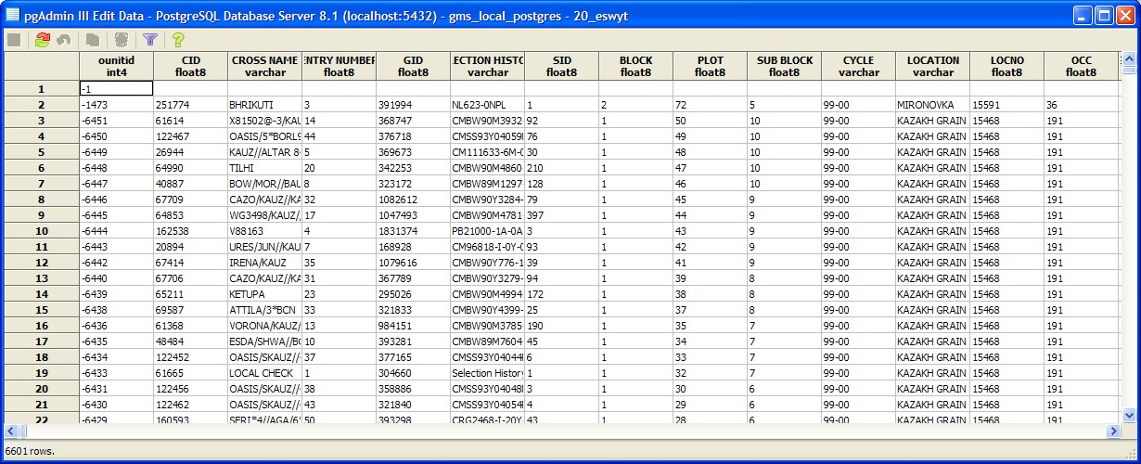
GET_DATASET
POSTGRESQL:
SELECT get_dataset('20_eswyt','20 ESWYT');
Total query runtime: 11157 ms.

Slide 7
GET_DATASET
POSTGRESQL:
SELECT get_dataset('dart','DArT_Genotype'); (33,667 rows)
Total query runtime: 6984 ms. ~ 7 secs
SELECT get_dataset('DW06_88_Genotyp','DW06_88_Genotyp');
Total query runtime: 14781 ms. ~ 15 secs

Slide 8
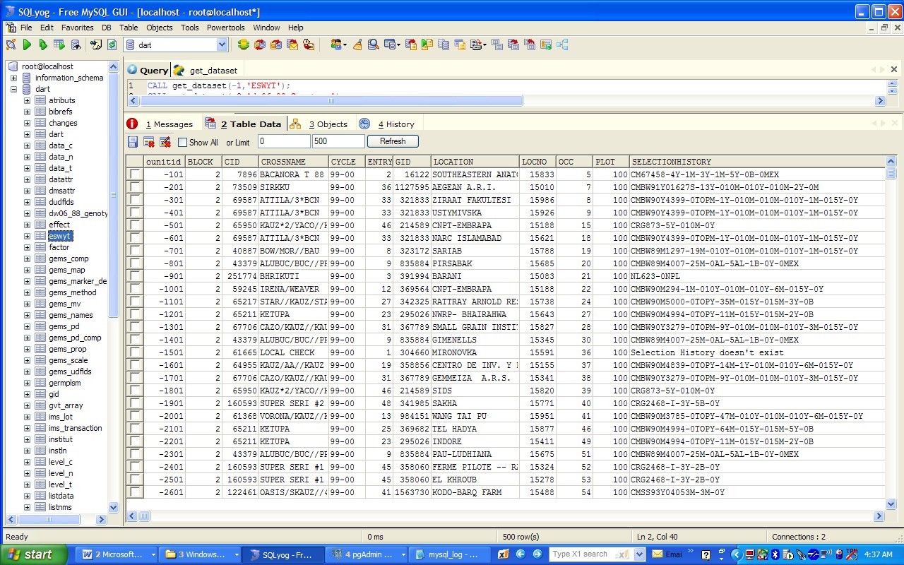
GET_DATASET
MySQL:
/*[4:28:25 AM][45828 ms]*/ CALL get_dataet(-1,'ESWYT')
~ 45 secs

Slide 9
GET_DATASET
MySQL:
Other Example :
Retrieval of a genotyping dataset with 33,667 rows
/*[2:08:10 PM][75984ms]*/ CALL get_dataset(-2,’dart’)
CALL create_array_dataset(‘dw06_88_Genotyp’)
/*[1:03:06 AM][78000 ms]*/ CALL get_dataset(-2, 'dw06_88_Genotyp')

Slide 10
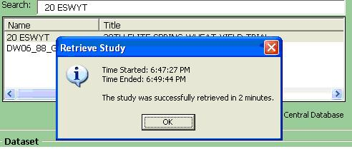
GET_DATASET
Workbook:
Another Example :
Retrieval of a genotyping dataset with 33,667 rows
(it takes 3mins in workbook)

Slide 11
CREATE_ARRAY_DATASET
DESCRIPTION:
creates a new table with two columns – GID and marker. The marker column is type text. It contains the concatenated allele values for each marker tested on the GID. Essentially, transforms the retrieved serial dataset into a parallel dataset.
INPUT PARAMETERS:
genotyping table with GID,MARKER, ALLELE as columns
- output from the get_dataset(genotype)

Slide 12
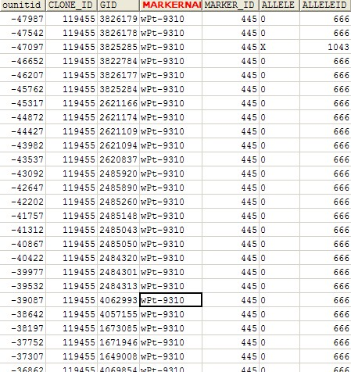
CREATE_ARRAY_DATASET

Slide 13
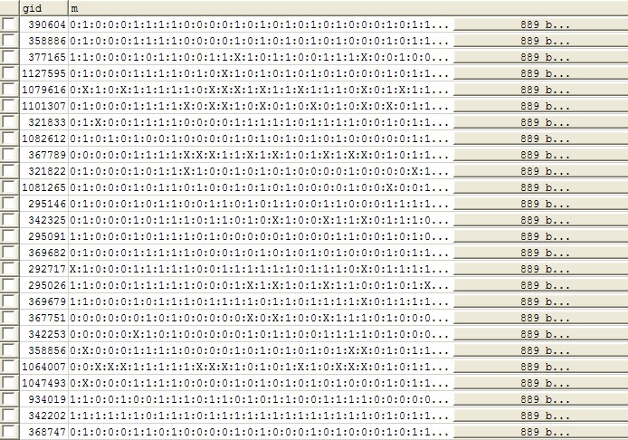
CREATE_ARRAY_DATASET
MYSQL:
68391 ms
POSTGRESQL:
2500ms

Slide 14
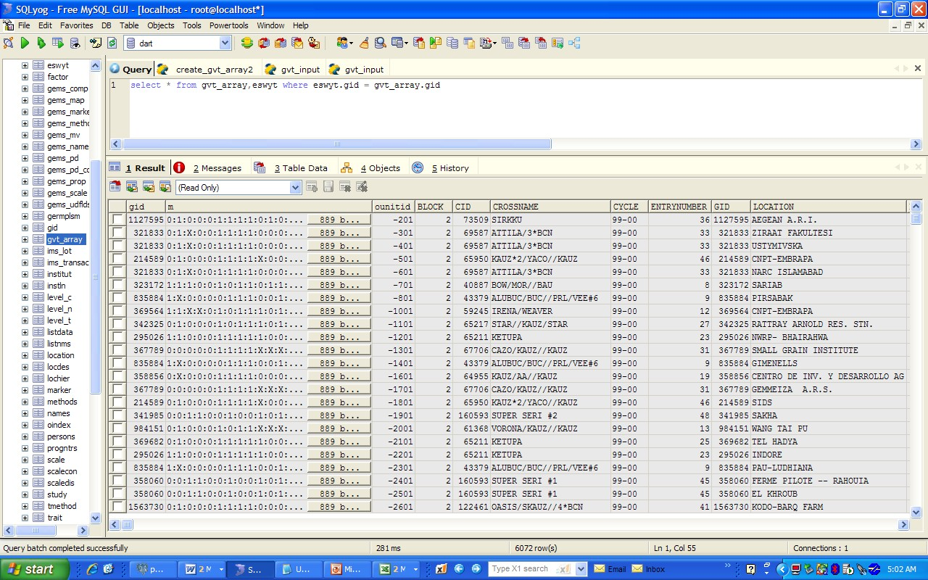
JOIN PHENOTYPE and GENOTYPE STUDIES

Slide 15
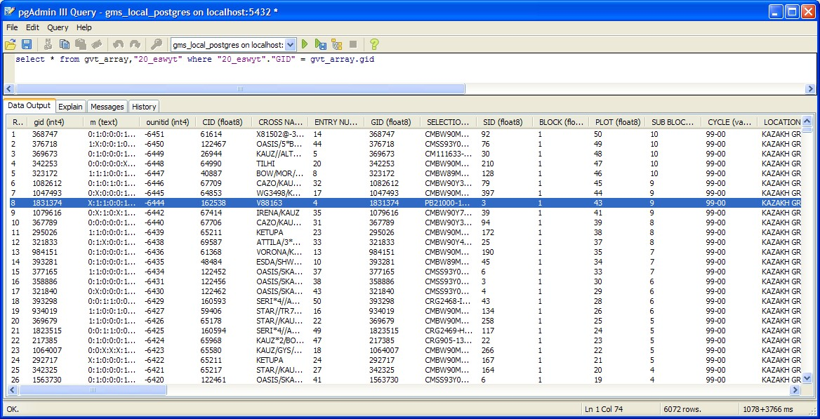
JOIN PHENOTYPE and GENOTYPE STUDIES

Slide 16
RUNNING TIME:
MYSQL :
get_dataset(phenotype) : 45828
get_dataset(genotype) : 78000 ms
create_array_dataset(genotype) : 68391 ms join tables:
/*[5:01:46 AM][ 15 ms]*/ select * from gvt_array,eswyt where eswyt.gid = gvt_array.gid

Slide 17
RUNNING TIME:
POSTGRESQL :
get_dataset(phenotype) : 11157 ms
get_dataset(genotype) : 14781 ms.
create_array_dataset(genotype) : 2500 ms join tables:
select * from gvt_array,"20_eswyt"
where "20_eswyt"."GID" = gvt_array.gid
Total query runtime: 1078 ms.
TOTAL TIME : 29156

Slide 18
CREATE_GEN_TABLE
DESCRIPTION:
INPUT PARAMETER/S:
Creates a new table with gid and marker column as columns from two genotyping studies. The marker column is a concatenation of all the alleles for each marker used in the two genotyping studies. Input genotype table is an output from create_table function
newTableName – name of the new table to be created
studyName1 – name of the first genotyping study
studyName2 – name of the second genotyping study

Slide 19
CREATE_GEN_TABLE
POSTGRESQL:
SELECT create_table ('gen', 'DArT_Genotype', 'DArT_Genotype2');
Total query runtime: 3327 ms.
Data retrieval runtime: 15 ms.
1 rows retrieved.
DArT_Genotype –
Number of rows : 33,666
Number of gids : 93
Number of markers : 362
DArT_Genotype2
Number of Rows : 8,185 rows
Number of gids : 88
Number of markers : 92
Roughly 41852 rows

Slide 20
RUNNING TIME:
POSTGRESQL :
get_dataset(phenotype) : 11157 ms
create_gen_table (2 genotypes) = 3327
create_array_dataset(genotype) : 2500 ms
join tables:
select * from gvt_array,"20_eswyt"
where "20_eswyt"."GID" = gvt_array.gid
1078 ms.
TOTAL TIME : 29156

Slide 21
RUNNING TIME:
POSTGRESQL :
get_dataset(phenotype) : 11157 ms
create_gen_table (2 genotypes) = 3327
create_array_dataset(genotype) : 2500 ms
join tables:
select * from gvt_array,"20_eswyt"
where "20_eswyt"."GID" = gvt_array.gid
Total query runtime: 1078 ms.
TOTAL TIME : 18062

Slide 22
CREATE_GEN_TABLE
MYSQL:
Optimized (indexes, no subselect, no automatic creation of tables)
set @p1 = 'dart3';
set @p2 = 'gid';
set @p3 = 'marker';
/*[8:13:32 AM][16047 ms]*/ call create_table_opt(@p1,@p2,@p3)
-- tables were all created before the script is executed

Slide 23
N Phenotype and M Genotype
Create a warehouse table with Genotype dataset
Studyid, gid, Marker, Allele
Create a warehouse table with phenotype dataset
studyid, gid, factor, value

