Slide 1
GENEALOGY MANAGEMENT SYSTEM
(GMS)
Database management system for germplasm information of a particular crop

Slide 2
SETGEN
GMS application for managing crop information:
genealogy
nomenclature
characteristics

Slide 3
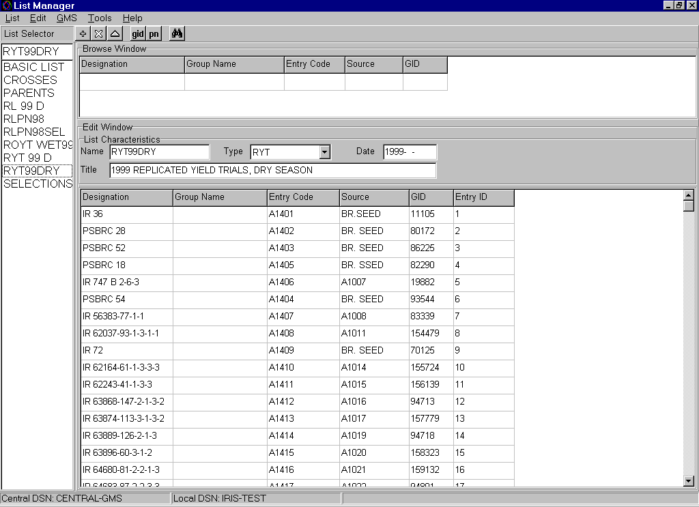
List Manager: germplasm list generator

Slide 4
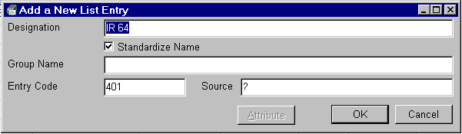
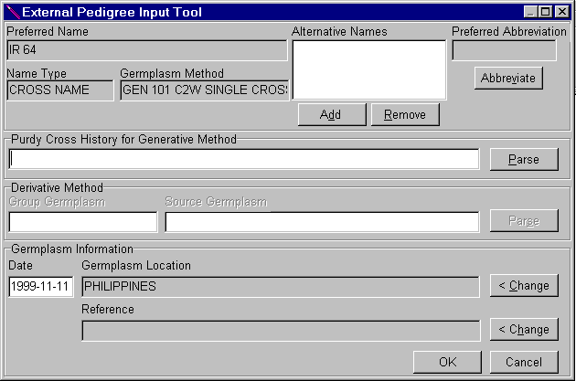
A. Generate basic lists

Slide 5
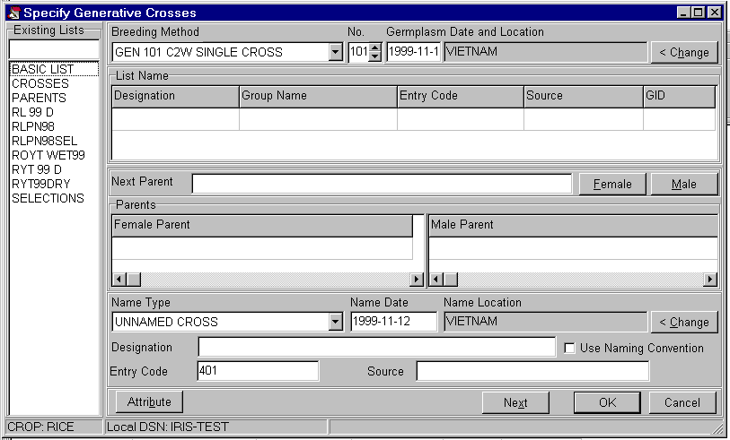
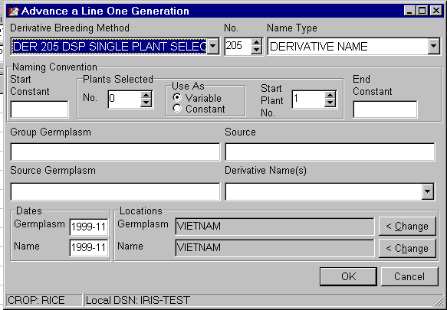
B. Generate cross or selections lists

Slide 6
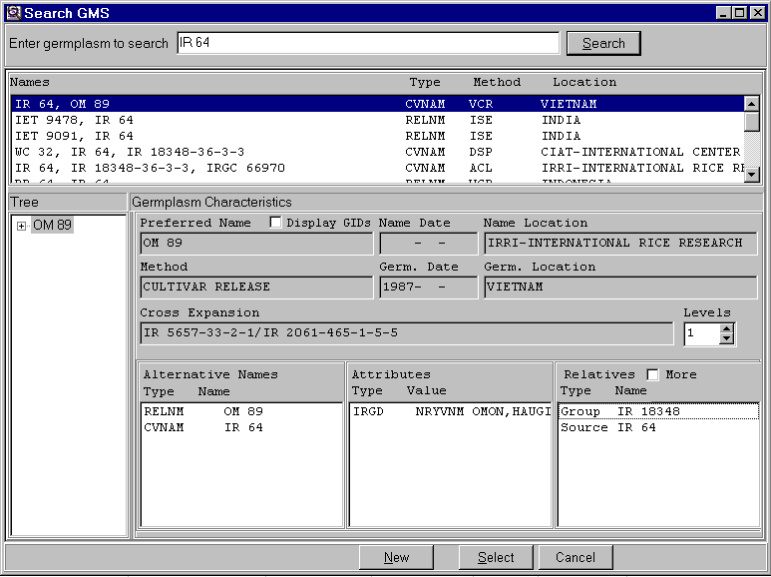
C. Perform name searches

Slide 7
FLDBK
GMS application for fieldbook
generation

Slide 8
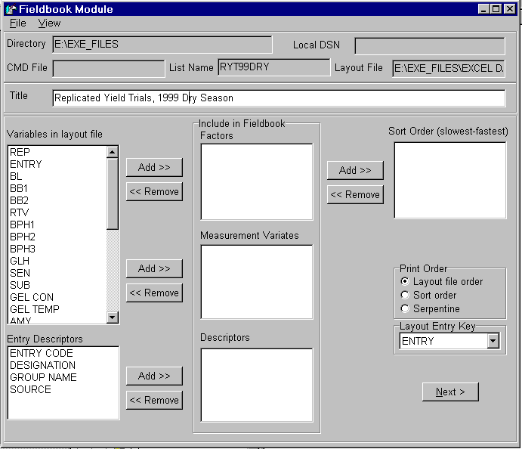
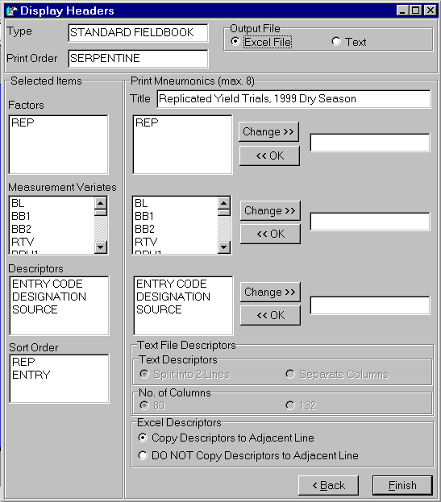
FLDBK specifications

Slide 9
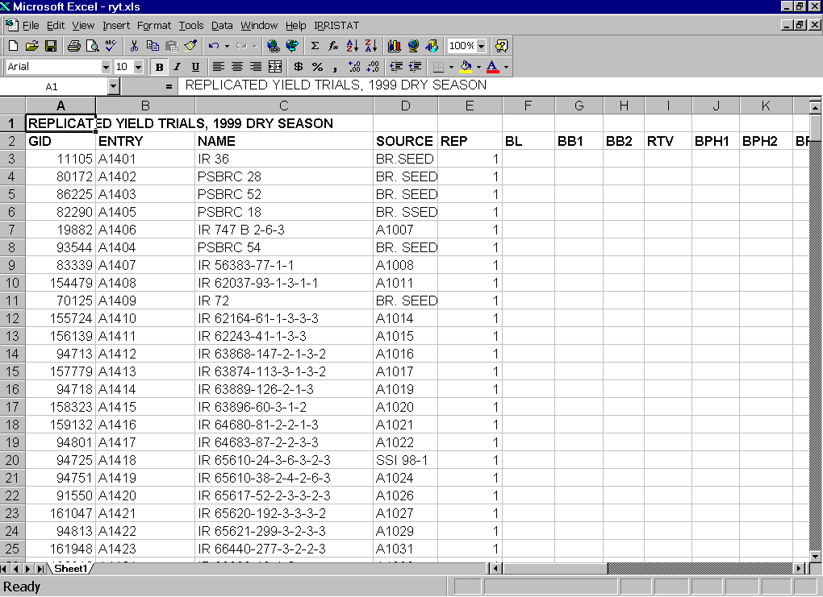
FLDBK output

Slide 10
DATA MANAGEMENT SYSTEM
(DMS)
Database management system for characterization and evaluation data for a particular crop

Slide 11
DMS WORKBOOK
The DMS Workbook is a flexible tool for entering and retrieving evaluation, nursery trial, crop improvement data and even molecular data. It has a tool for querying the database across studies. It has a facility to retrieve entry list from GMS and associate it with a layout file.

Slide 12
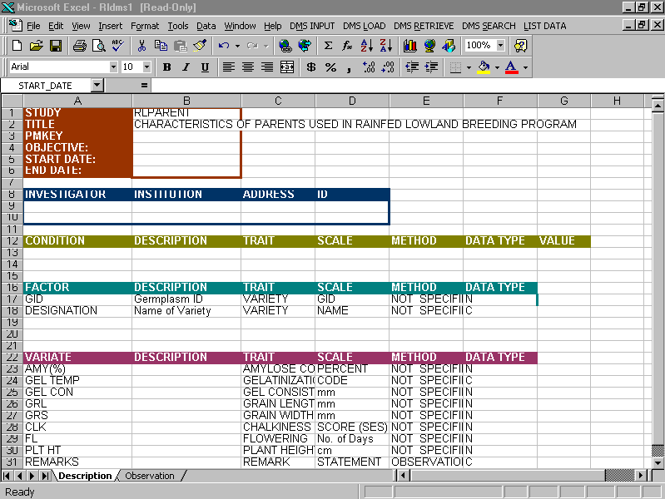
Entering a Data Set
A. Description Sheet of the Data Set

Slide 13
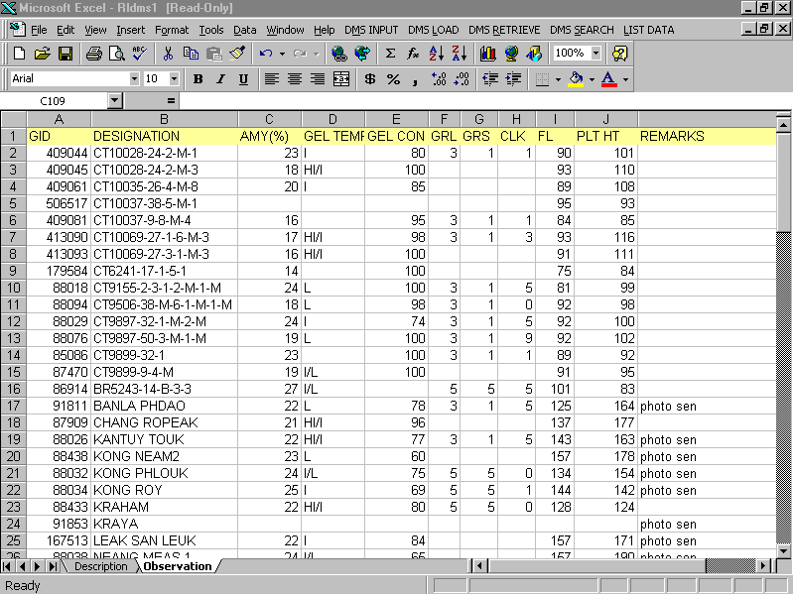
B. Observation Sheet of the Data Set

Slide 14
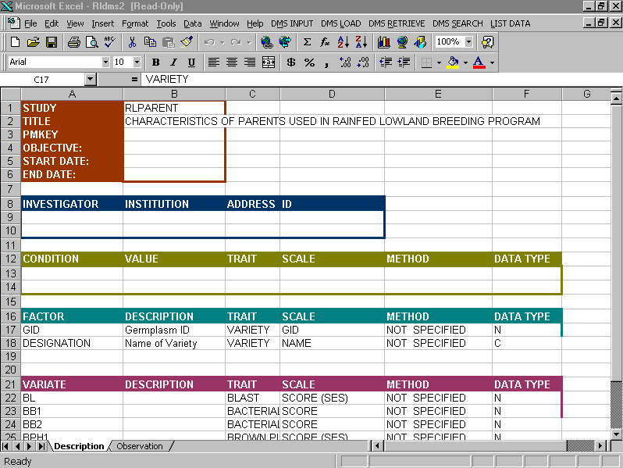
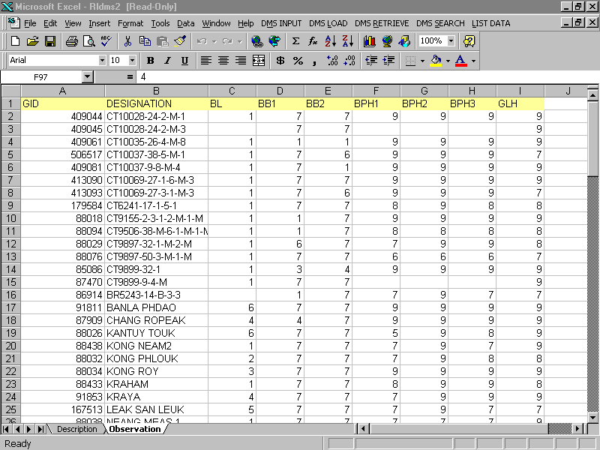
B. Another Data Set for the same Study

Slide 15
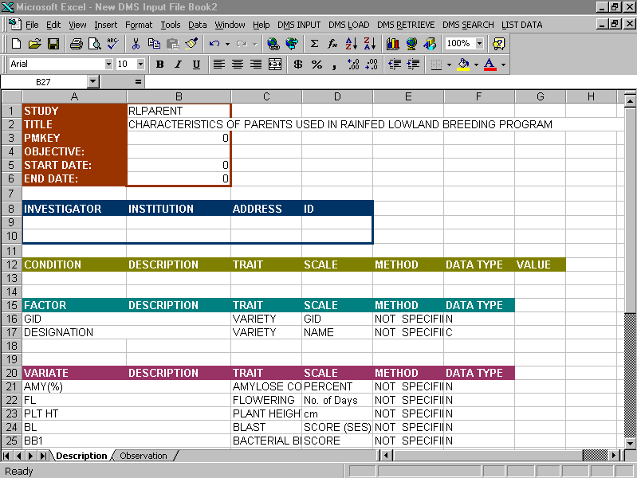
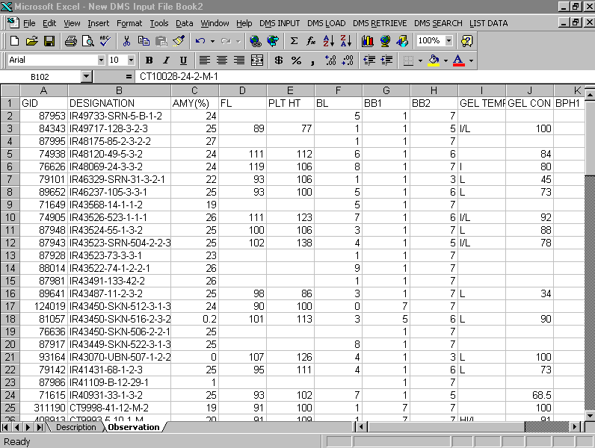
Retrieving Data Set of a Study
* The Workbook combines data of the same level combination

Slide 16
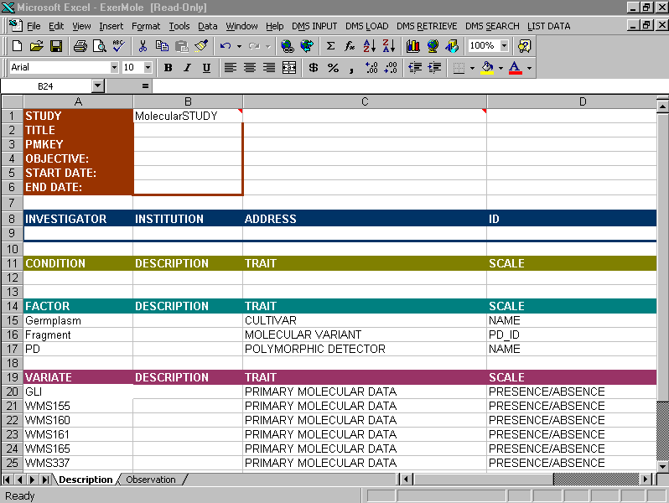
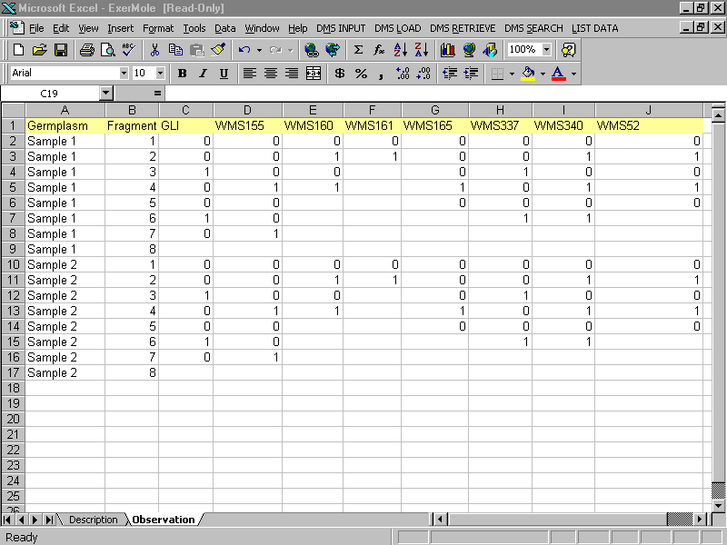
Entering Molecular Data

Slide 17
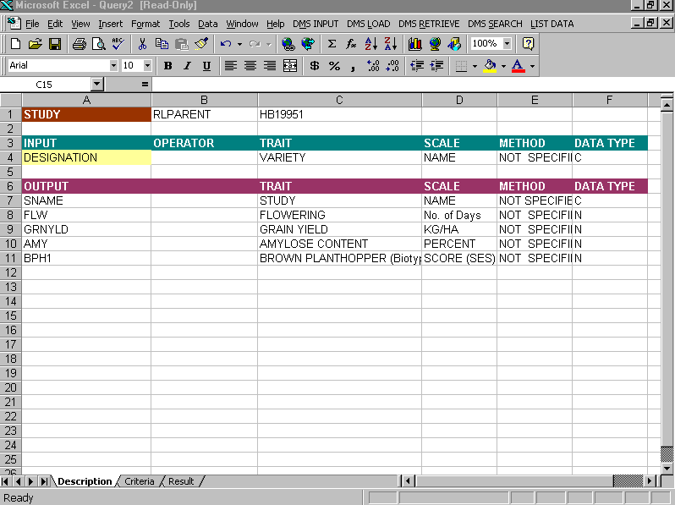
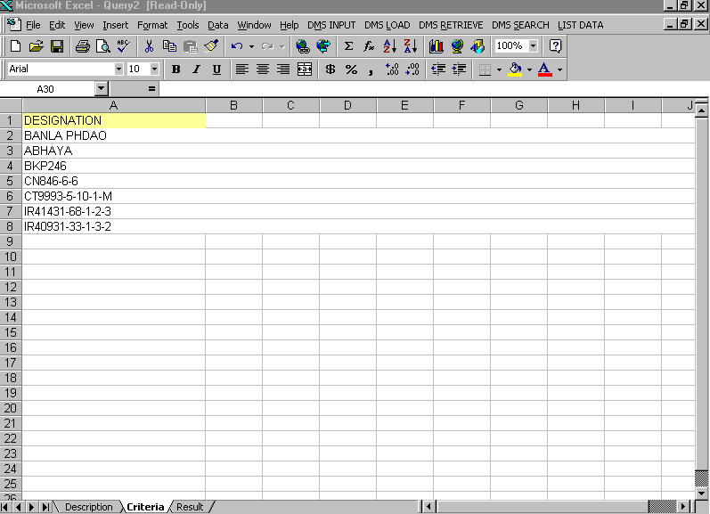
Querying the DMS Database
A. Description Sheet
B. Criteria Sheet

Slide 18
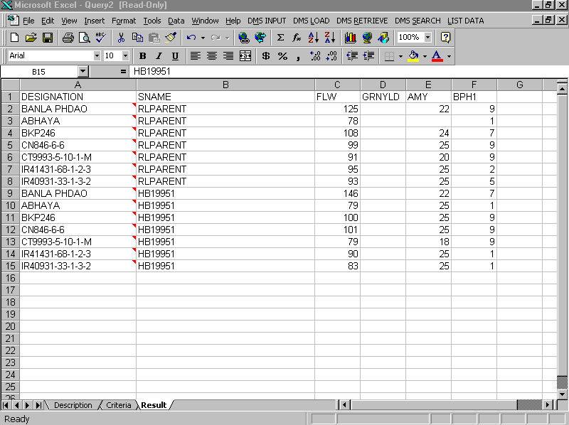
C. The Result of the Query

Slide 19
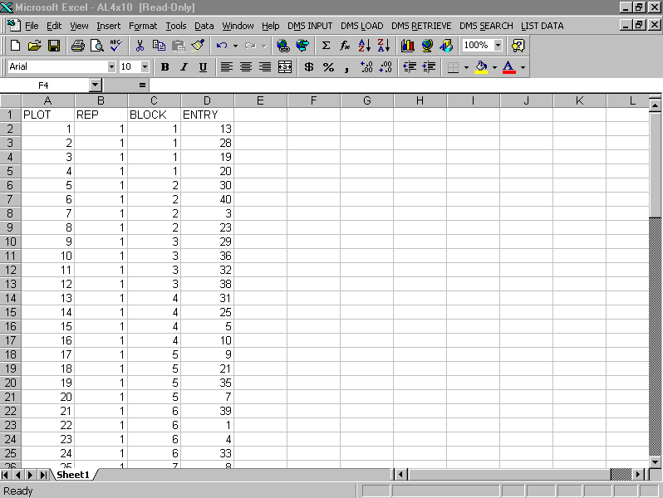
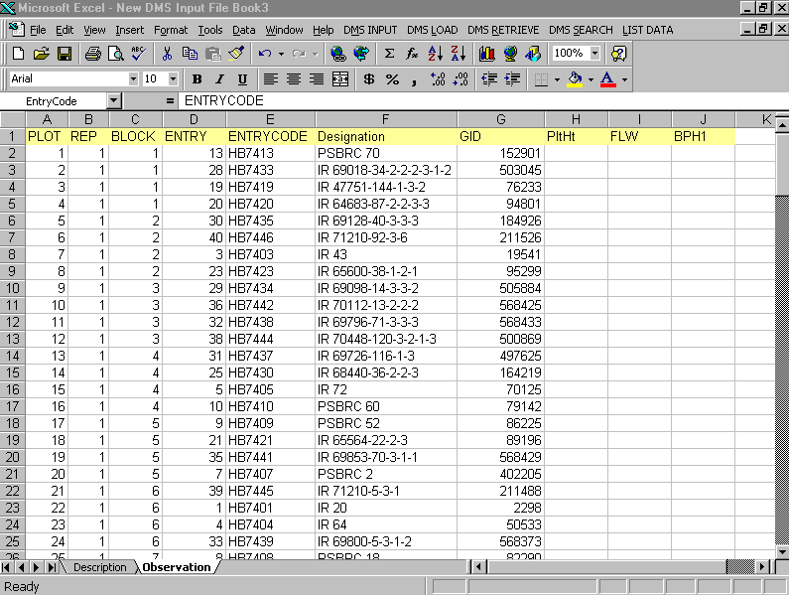
Retrieving Entry List from GMS
A. Layout file
B. The corresponding Workbook with associated
entries

