Slide 1
ICIS RETRIEVER
Arllet M. Portugal
CRIL

Slide 2
ICIS Data Retriever
Data Retriever is an application in MS Access that extracts data from the local and central DMS databases based on the specified property, scale and method.
It has a tool for sub setting the retrieved data, determining aggregate values and linking queries.

Slide 3
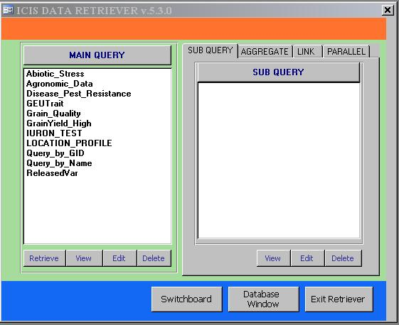
Main Screen of Data Retriever
Retrieves data from the DMS database based on a set of criteria defined by property, scale and method.
Combines two queries
Creates a subset of the data obtained from the main query
Computes averages, minimum values, maximum values and other aggregate values
Formats the data with the values of one variable as the column headers

Slide 4
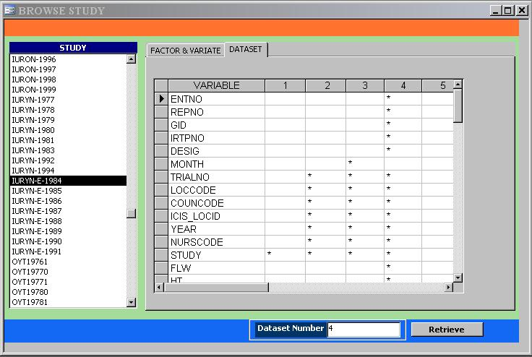
Browsing a Study
Show the different data sets for a selected study
Show the variables in the study and their corresponding Trait, Scale and Method
Studies existing in the database
Enter the number of the data set you wish to retrieve
Retrieve and display the data of the entered data set

Slide 5
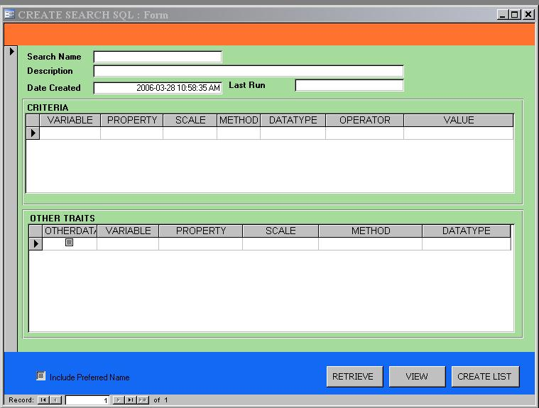












MAIN QUERY
Problem: Find the grain yield of varieties tested in the
study RYT19960
a meaningful name of a query
date the query is created
a useful description about the query
variables of the query with known values
restricting operator:
(N) =, >, <, >=, <=, LIST
(C) LIKE, LIST
value or table of values that limits the result of the query
GID | Variety | GID | Not Specified | N
YIELD | GRAIN YIELD | kg/ha | Paddy Rice | N
variables with unknown values
type of the data which is either (N)umber or (C)haracter
assigned variable name with no space in between
property of the variable
measurement unit of the variable
procedure on how the variable is measured or derived
run the query
Store the result as SetGen List
view a created query

Slide 6
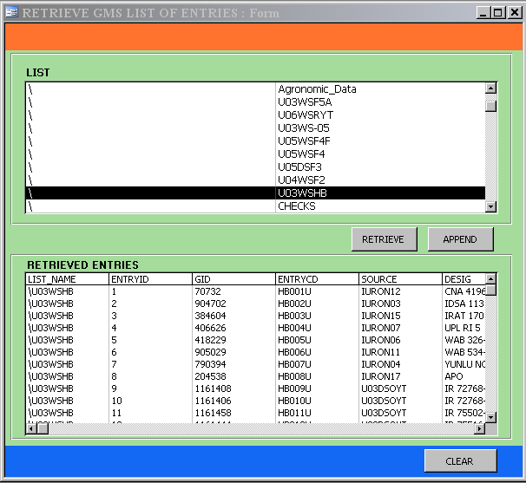
Retrieving a List
Select a germplasm list
Retrieve the entries of the selected list.
Append the entries of the selected list.
Clear the record of retrieved entries
The retrieved list is stored in a table named RTV-LIST and can be used as criteria of a search or query.

Slide 7
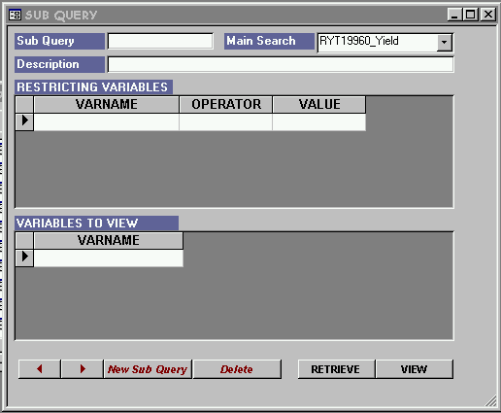





Sub query
Problem: Determine the varieties with grain yield greater
than 8000 in the study RYT19960
a meaningful name of the sub query
name of a main query
variables for sub setting the data of the main query
restricting operator:
(N) =, >, <, >=, <=, <>
(C) LIKE
(N or C) IS
value that limits the data
YIELD
variables you want to include in the sub query
run the query
view a created query

Slide 8
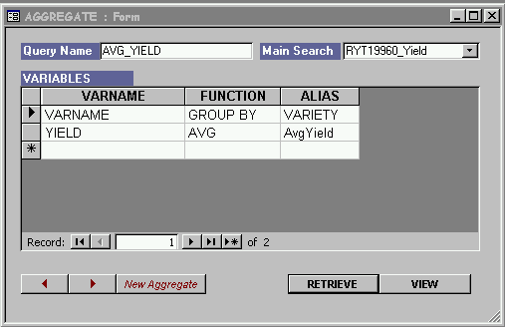
Aggregate Query
Problem: Get the average grain yield of each variety
tested in RYT19960
a meaningful name of the aggregate query
name of a main query
alias name of the variable
Function:
(N) AVG - average
SUM
(N or C) MIN - minimum
MAX - maximum
FIRST
LAST
COUNT
GROUP BY - the variable you
intend to group the
values
variables you intend to compute the aggregate values and variables to group the values

Slide 9
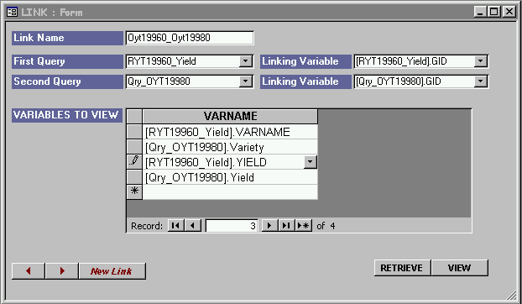
Link Query
Problem: Compare the grain yield of RYT19960 with
OYT19980.
a meaningful name of the link query
name of the first query to link
variable to link the first query; it must also exist in the other query
name of the other query to link
variable to link the second query with the first query
variables you want to include in the link query

