Slide 1
Tortoise CVS
A GUI CVS Client Program
Michael Jonathan M. Mendoza
m.mendoza@cgiar.org
Biometrics and Bioinformatics Unit
International Rice Research Institute

Slide 2
Objectives
At the end of the presentation, you should be able to:
Install and use TortoiseCVS
Learn how to put your source codes in CropForge under CVS management
Update/commit your CVS controlled file/s
Remove/ignore unwanted file/s from CVS control
Merge conflicts and revert back to previous file/s
Use Putty for SSH access to the CropForge CVS repository
Know where to get CVS ‘howto’ information when you need it

Slide 3
What is TortoiseCVS? How to install it?
TortoiseCVS is a free CVS client for Windows which can be downloaded from http://tortoisecvs.sourceforge.net/
Just double click the installer and follow the default settings. You will have to reboot your PC to complete the setup.
It doesn't function as a separate program but as an extension to the Windows Explorer that can be access via right-click.

Slide 4
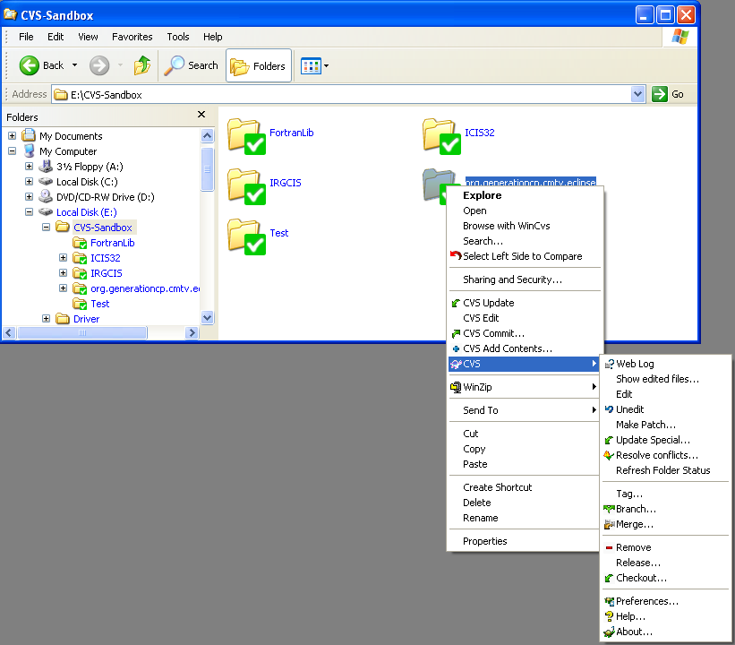
TortoiseCVS GUI

Slide 5
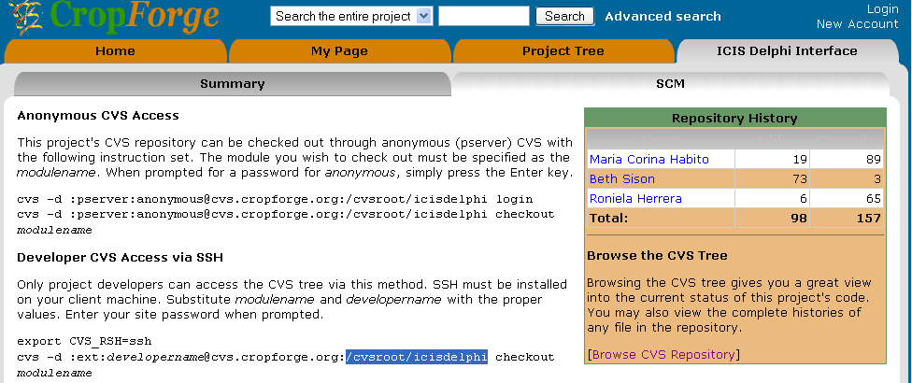
Creating a CVS Repository
Where is it?
Before you begin using CVS, you need to know where your repository is. CropForge already creates this for you.

Slide 6
Defining a New Module
How to put my codes to CVS ?
You have your files residing in a folder in your local hard drive. You want to import the files to CVS.
In CVS terms, the folder will be called a module.
Importing files involves three (3) steps:
  Make new module
  Adding files to your module
  Committing them
  Note: Importing a new module is a one time step only.

Slide 7
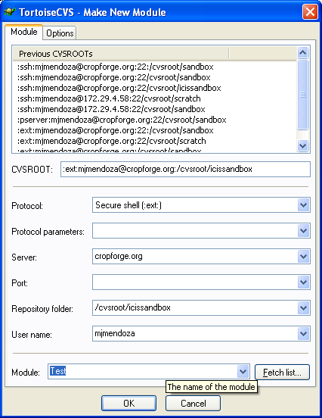
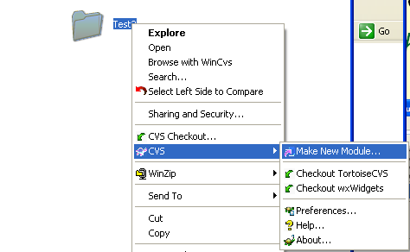
First step: Make New Module
  Right-click the folder where your codes are
  Under the CVS submenu, select Make New Module
  A dialog box will appear

Slide 8
Make New Module (cont.)
  Enter the necessary detailed information
    Protocol: select Secure shell (:ext:)
    Server: enter cropforge.org, or the appropriate address of the Linux server
    Repository folder: enter /cvsroot/icissandbox, or the appropriate full path to your repository.
    User name: enter your username for that server
    Module: enter a name for this module. Typically, this would be the name of your program. Generally, it is advisable to exclude spaces and punctuation marks in your module name.

Slide 9
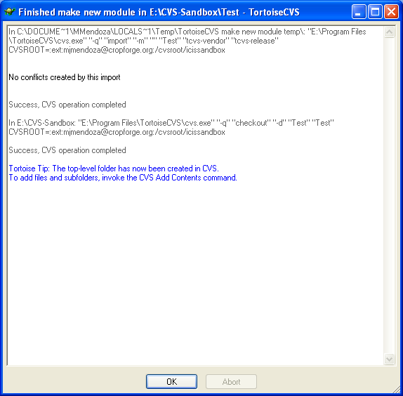
Make New Module (cont.)
  Click Ok. A Log windows will appear and a password dialog
  Enter your password (it may request it more than once)
  If everything is set correctly, you should see a success message and your module has been created. Click Ok.

Slide 10

Hands-on Demo

Slide 11
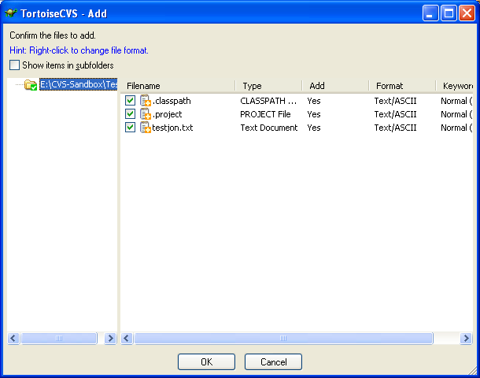
Second step: Adding files to your module
  Import all your files into the module. Right-click on the folder again and select CVS Add Content
  A dialog window will appear listing all the files. Go through this list carefully and uncheck any files that do not need to be revision controlled
Uncheck files you
don’t want to commit

Slide 12
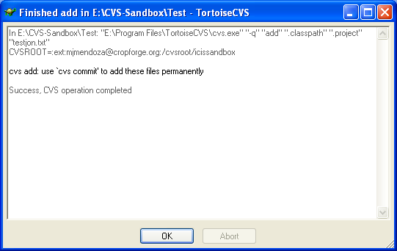
Adding files to your modules (cont.)
  Take care to do this during the importing step as removing files later is troublesome and will continue to take up space in your repository
  Once everything is good, click Ok. You will be prompted to enter your password, possibly more than once, one each for subdirectory added.

Slide 13
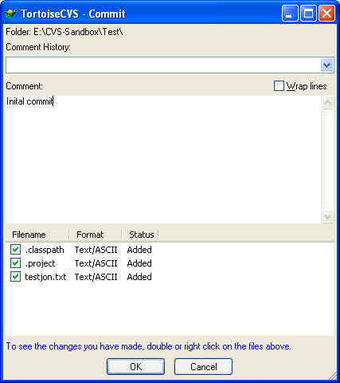
Third Step: Committing your first version
  Add all the files permanently. Again, right-click the folder where your files are. Select CVS Commit
Uncheck files you
don’t want to commit

Slide 14
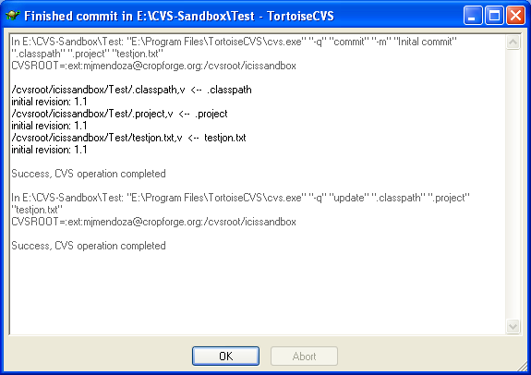
Committing your first version (cont.)
  Put appropriate comments, say “Initial commit” and click Ok
  You will be ask to enter your password (possibly more than once) and a success message will appear

Slide 15

Hands-on Demo

Slide 16
When using SSH, how do I make it so I don't need to enter the password every time I do anything?
During large updates and commits, you may find yourself having to enter your password quite often
To avoid this, you need to make a public/private key pair
  The public key goes on the server, and the private key sits on your hard drive
  When you connect, the server can verify who you are because only you have your private key

Slide 17
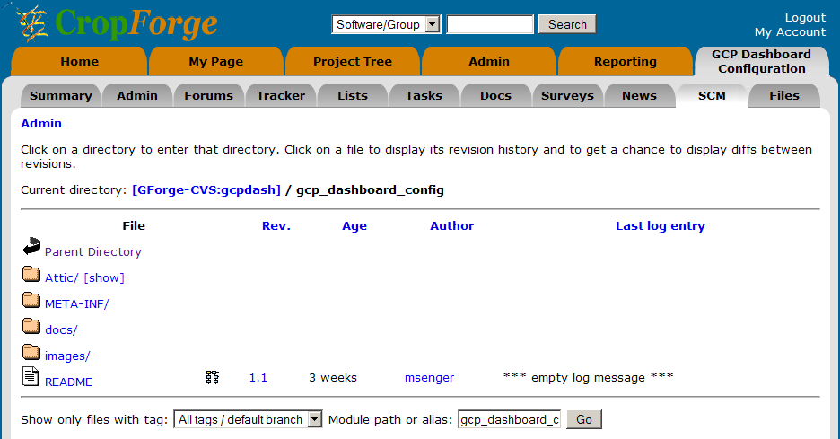


SSH access to CropForge
Secure Shell or SSH is both a
computer program and an
associated network protocol
designed for logging into and
executing commands on a
networked computer.
SSH
CVS
server
CVS
client
public
key
private
key

Slide 18
Secure Shell client for Windows OS
PuTTY (MIT, open source license)
PuTTY (Telnet and SSH client)
Plink (command-line interface to the PuTTY back ends)
Pageant (SSH authentication agent for PuTTY, PSCP and Plink)
PuTTYgen (RSA and DSA key generator)
http://www.chiark.greenend.org.uk/~sgtatham/putty/

Slide 19
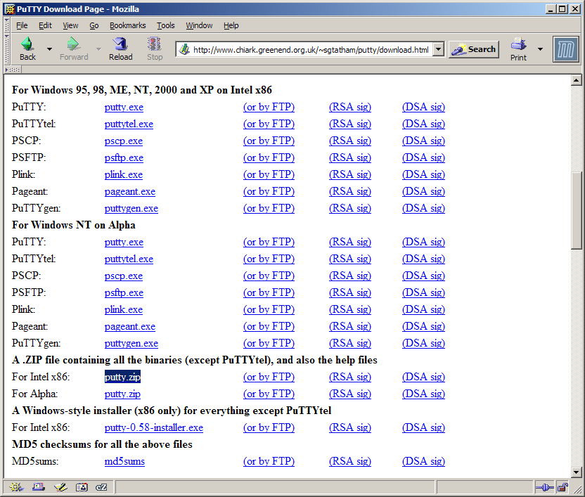
PuTTY download & install
extract to:
c:\putty

Slide 20
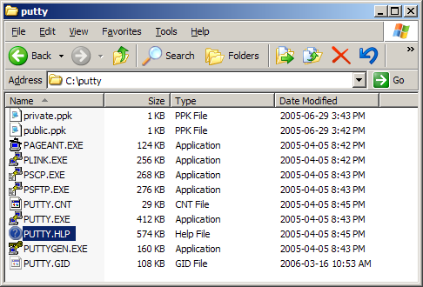
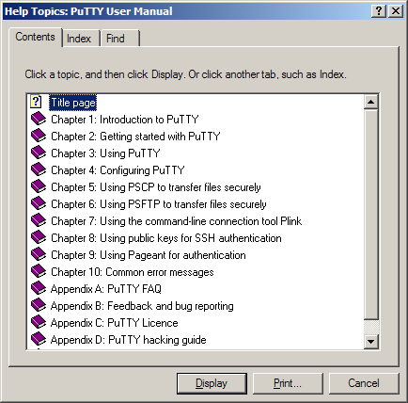
PuTTY help

Slide 21
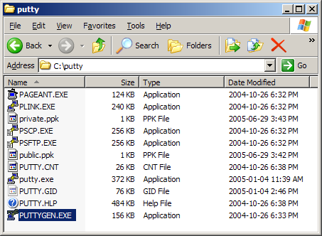
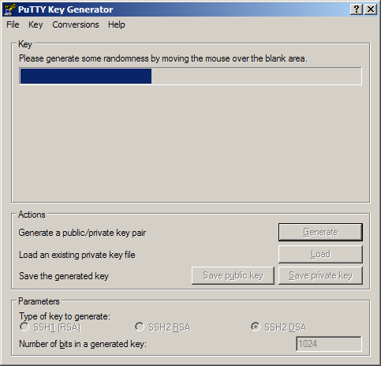
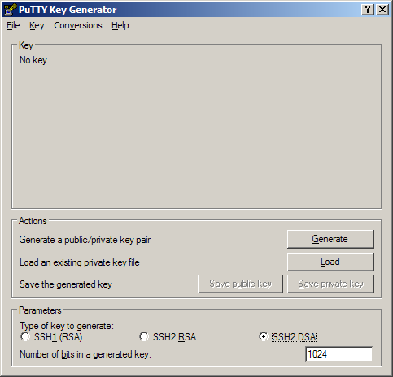
PUTTYGEN – Key Generator creating public/private keys
move
mouse
DSA

Slide 22
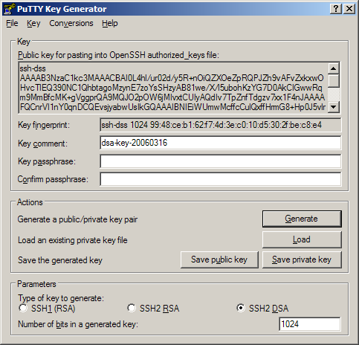
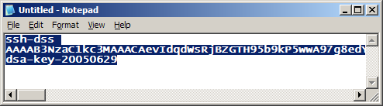
PUTTYGEN – Key Generator creating public/private keys
key must be
on single line
optional key
password

Slide 23
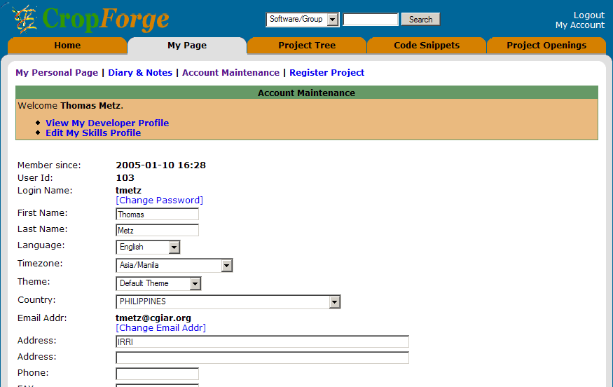
CropForge SSH access public key uploading

Slide 24
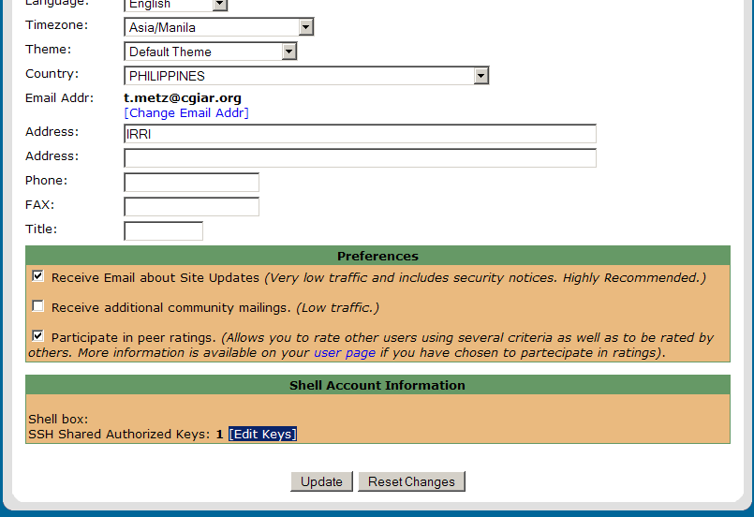
CropForge SSH access public key uploading

Slide 25
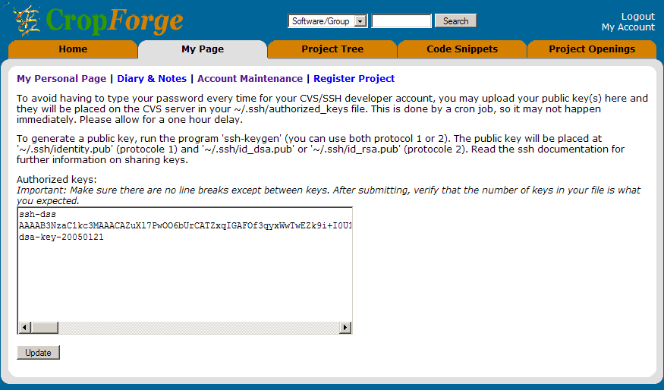
CropForge SSH access public key uploading

Slide 26
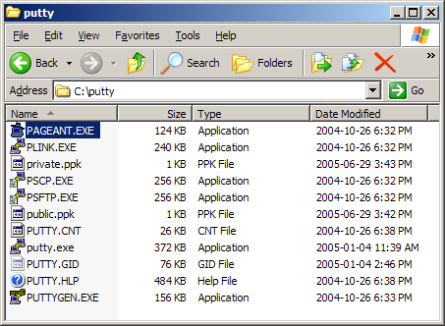
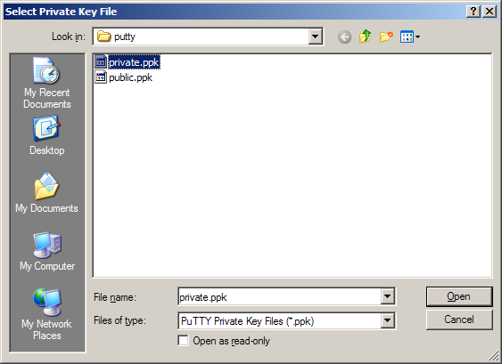
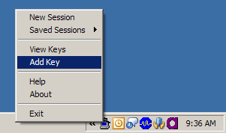
PAGEANT – PuTTY authentication agent private key loading
repeat after every
reboot/login

Slide 27
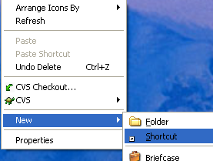
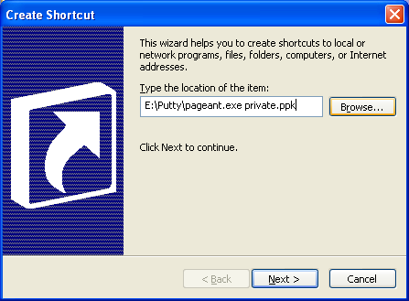
Private key Auto-Loading
How to auto-load my private key?
To avoid the hassle of loading your private key every time you login to your PC, just follow this steps:
    Create shortcut by right-clicking anywhere in the Desktop and enter the command E:\Putty\PAGEANT.EXE private.ppk for example

Slide 28
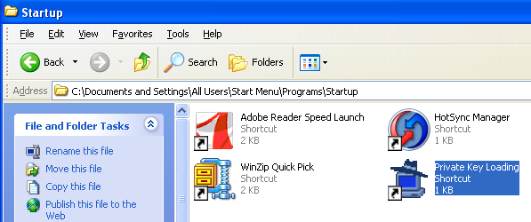
Private key Auto-Loading (cont.)
    Put this in your Startup folder usually located in C:\Documents and Settings\All Users\Start Menu\Programs\Startup in WindowsXP

Slide 29

Hands-on Demo

Slide 30
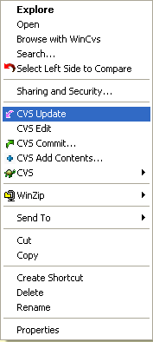
CVS Updates and Commits
How to keep my codes in CVS?
CVS update attempts to sync your local directory with that in the repository
CVS commit is the reverse, wherein your ‘saving’ the modified copy of your code/s from your local directory to the repository

Slide 31
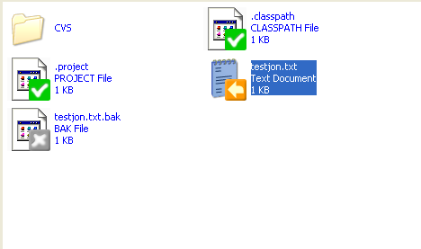
CVS Update Scenarios
What happens to my CVS files?
Typically, you will encounter these file scenarios when you do an update:
  Files that match between your local copy and the repository (ie., no changes have occurred)
  Files that you have changed but not yet committed - these will appear with a flag M and will not be uploaded to the repository until you do a commit (Right-click to do CVS Commit)
File was modified in the local copy
Notice the

Slide 32
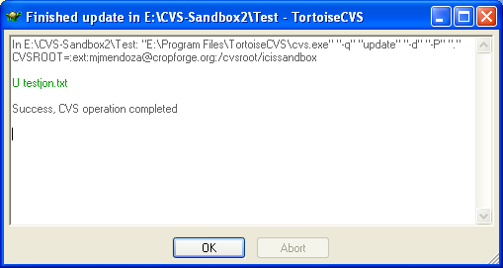
CVS Update Scenarios (cont.)
  Files that have changed in the repository but your local copy is out of date. This will occur, for example, if two or more developers are working with the same repository and another developer has committed some changes since the last time you did an update. In this case, these files (marked U) will be downloaded to your local copy of the module. This will also occur if you are missing a file from the repository (for example if you deleted one by mistake, or if another developer added one)

Slide 33
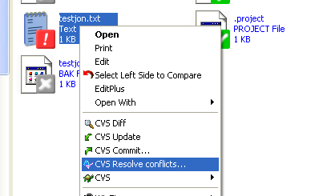
CVS Update Scenarios (cont.)
Merging conflicts
  Another scenario is, you have modified your local copy of a file and another developer has committed changes. CVS will try to reconcile both sets of differences automatically and will warn you of the circumstances. However, there are areas of the file in question where conflict arises and you must reconcile them manually. These are marked as C
    File/s with conflicts are marked by this icon
    Right-click the file and select CVS Resolve Conflicts…

Slide 34
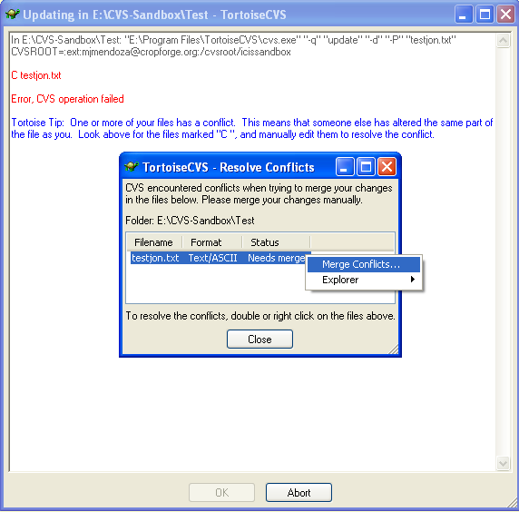
CVS Update Scenarios (cont.)
Merging conflicts
    The Resolve Conflicts dialog is shown
    Right-click on the conflicting file(s) and select Merge Conflicts…

Slide 35
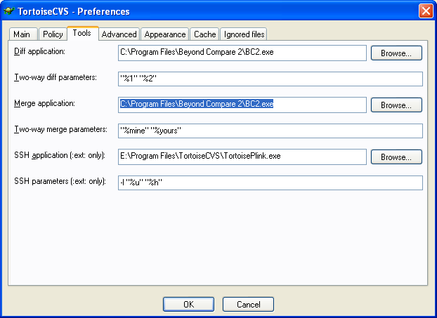
CVS Update Scenarios (cont.)
Merging conflicts
    TortoiseCVS will now invoke the merge application you have selected in Preferences/Tools/Merge application submenu such as Beyond Compare

Slide 36
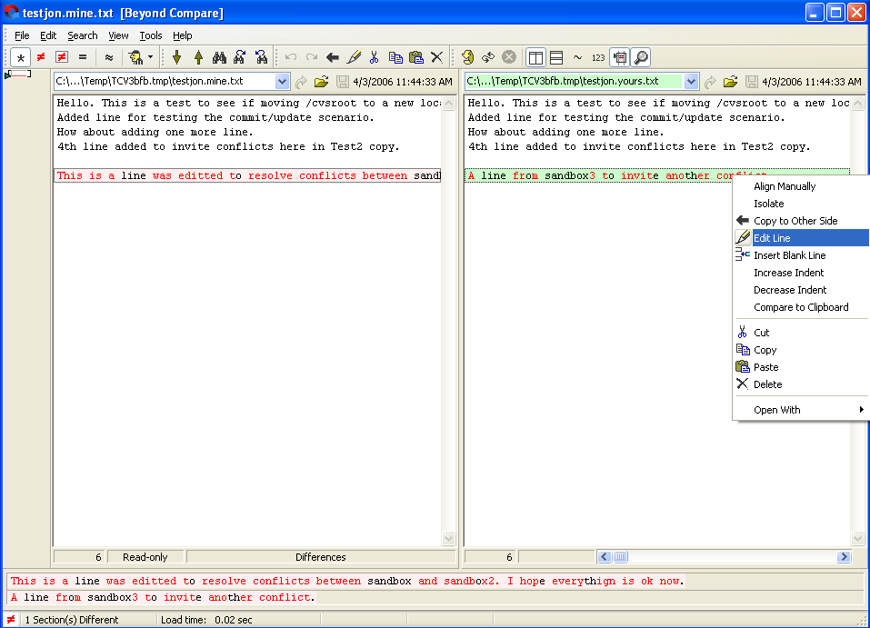
CVS Update Scenarios (cont.)
Merging conflicts
    Resolve each conflict, save the resulting file, and exit the merge application
    Confirm that you want to save the result of the merge

Slide 37

Hands-on Demo

Slide 38
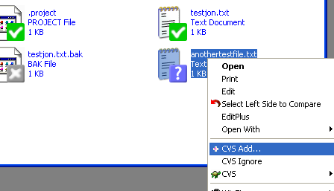
CVS Add
How to add new file to CVS?
In some instance, you might want to add new file (or folder). Simply creating a new file in your local copy of the module is not sufficient to make it part of CVS management
Right-click the file (or folder), select CVS Add and then CVS Commit it as usual
Notice the ? icon
File is not yet in CVS

Slide 39
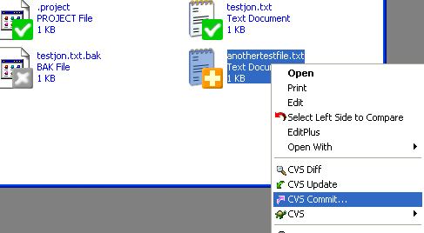
CVS Add (cont.)
Notice file icon after CVS Add signifying ready for CVS Commit

Slide 40
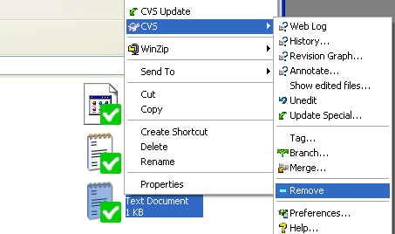
CVS Remove
How to remove unwanted file in CVS?
Don't just delete a file from your local copy to remove it since executing an CVS Update will make it re-appear
Right-click and select Remove from the CVS submenu
Then right-click the folder (or parent folder) and select CVS Commit
When another user now performs an Update, CVS will remove the file(s) from the sandbox

Slide 41
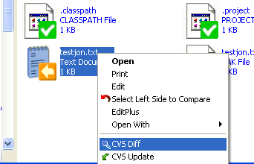
CVS Diff
How to compare my local copy vs. CVS copy?
In most cases, before you do a CVS Commit you may want to know what part of the file was modified from the CVS copy

Slide 42
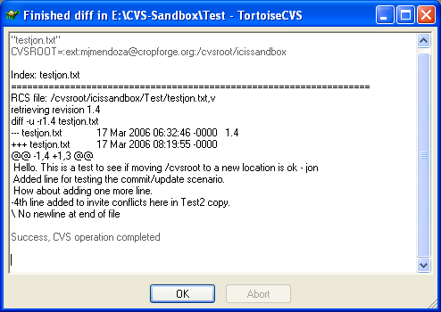
CVS Diff (cont.)
You can check the difference in a dialog window

Slide 43
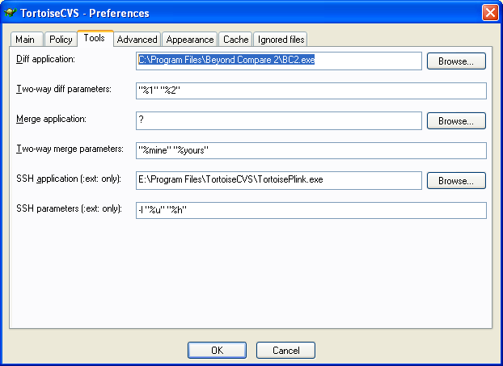
CVS Diff (cont.)
Or if you have a more user friendly external diff application such as Beyond Compare, you may use it by entering it in the CVS -> Preferences -> Tools -> Diff. application section

Slide 44
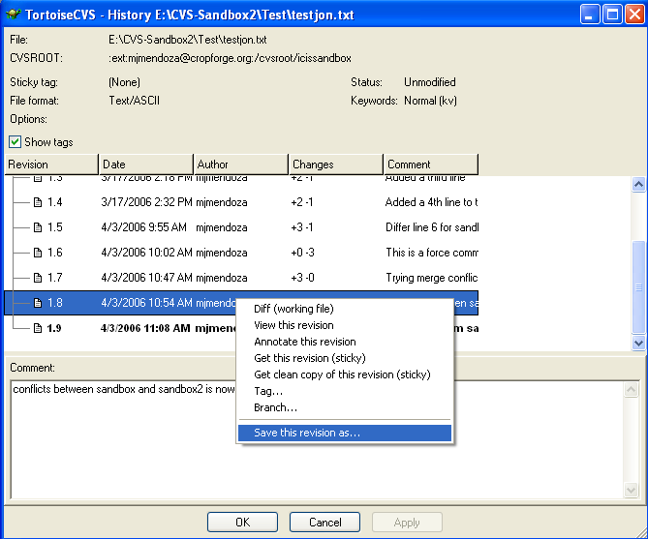
Reverting to Previous File Version
How to undo changes already checked-in?
How to go back to specific file revision
  Right-click on the file and select CVS → History to bring up the History Dialog
  Right-click on the revision you need and choose the "Save this revision as..." option

Slide 45
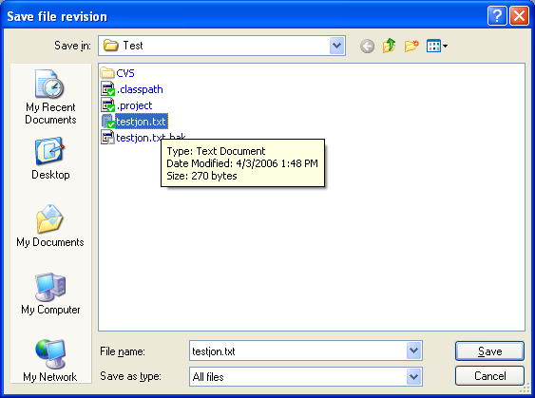
Reverting to Previous File Version (cont.)
  When the Save As dialog appears, do not click the "Save" button; instead, double-click on the file's name in the directory listing
  Answer "Yes" when prompted to overwrite the file
  You can commit the file if you want it to be the latest version again.

Slide 46
Hands-on Demo

Slide 47
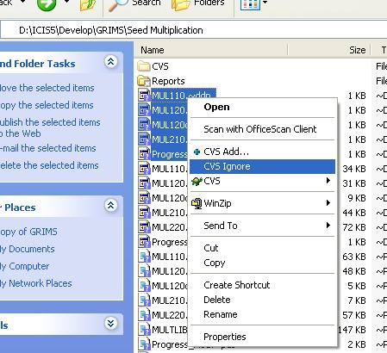
Ignoring binary files when committing or adding data to the repository
Steps
  Highlight the files that needs to be ignored, right click then click CVS Ignore. This will create a .cvsignore file. Edit this and add other file extensions that needs to be ignored when committing the project
  Or (from Dr. TMetz)
  Create a file (in the directory) with notepad as cvsignore.txt then on command prompt:
  ren cvsignore.txt .cvsignore

Slide 48
Reference Source
“Using Tortoise CVS for Revision Control”. http://helpdesk.biomath.ucla.edu/howtos/tortoise_cvs February 7, 2005.
“TortoiseCVs User’s Guide”. TortoiseCVS Help v1.8.24. January 9, 2006.
“Frequently Asked Questions”. TortoiseCVS Help v1.8.24. January 9, 2006.
“GenerationCP Software Engineering Collaboration Platform”. MS Powerpoint presentation by Thomas Metz. SP4 Commissioned Research Project 34, 2005/2006. March 2006.
“TortoiseCVS and GRIMS”. MS Powerpoint presentaion by Ella Herrera-Prantilla. March 2006.

