Slide 1
GENE MANAGEMENT SYSTEM
R. Valerio
CRIL

Slide 2
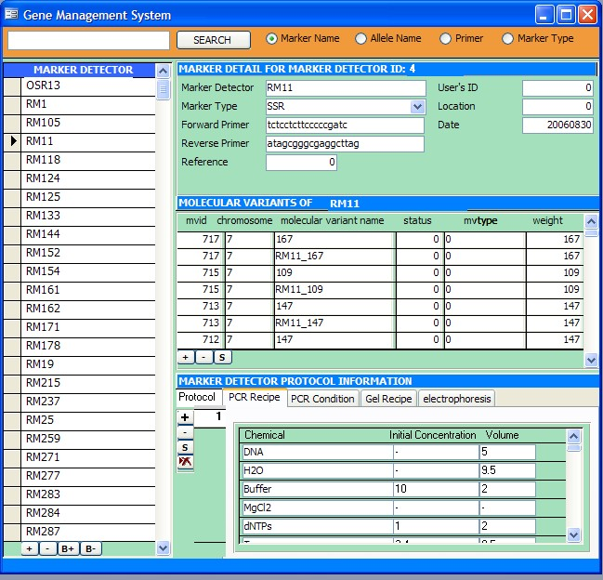
Gene Management System (GEMS)
GEMS stores and manages nomenclature of genetic and molecular variants by assigning Unique IDs for these variants

Slide 3
Loading of SSR Data
Sample SSR dataset
Workbook template
  Description Sheet
  Observation Sheet
  Marker Sheet
  Protocol Sheet
  Datasheet
GEMS interface

Slide 4
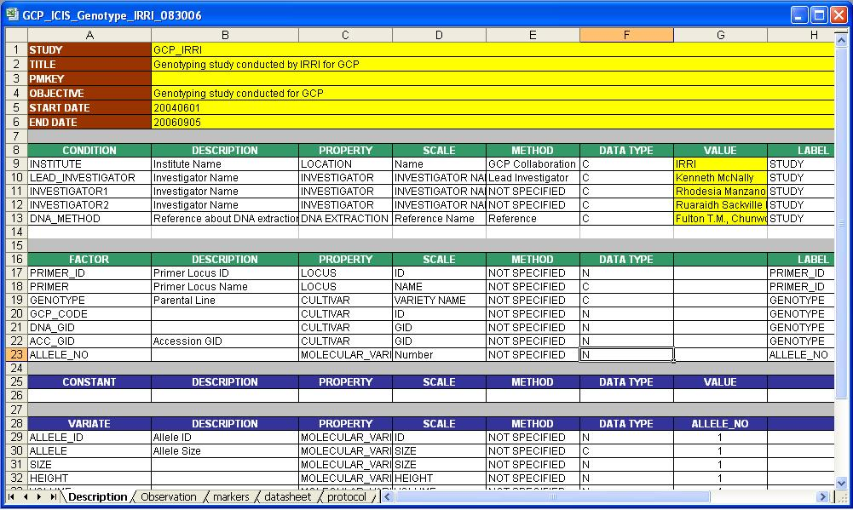
Workbook template
Description sheet

Slide 5
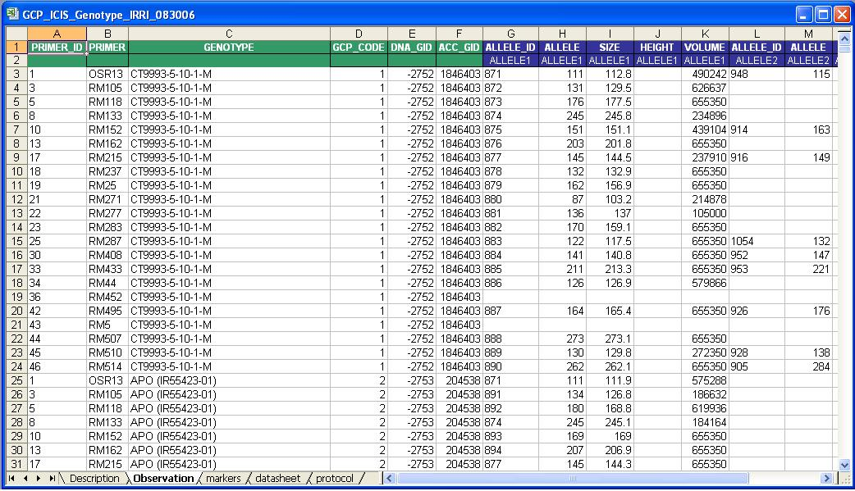
Workbook template
Observation Sheet

Slide 6
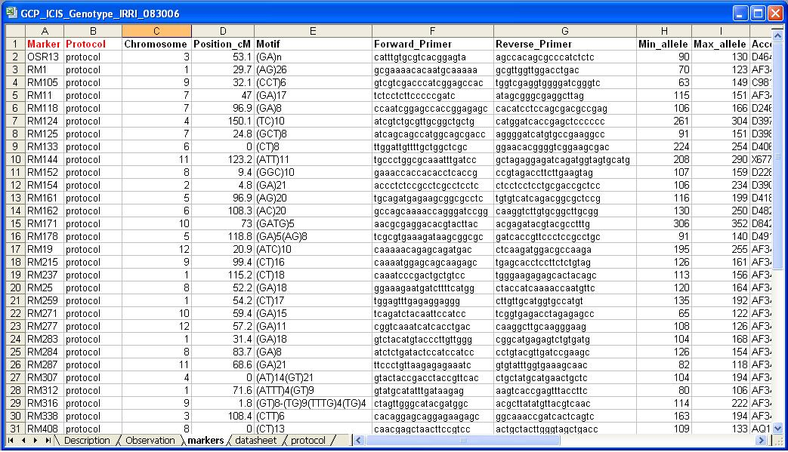
Workbook template
Markers sheet

Slide 7
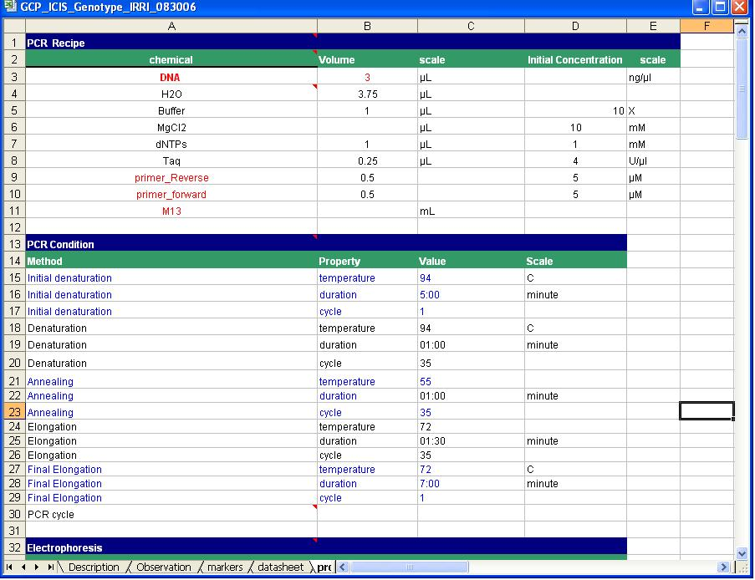
Workbook template
Protocol sheet

Slide 8
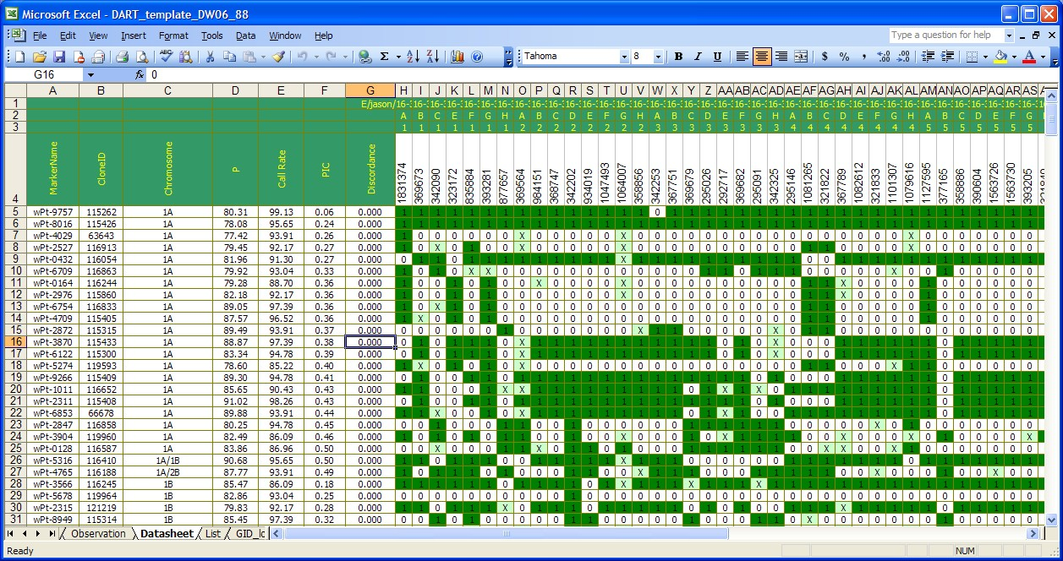
Workbook template
Datasheet (DArT dataset)

Slide 9
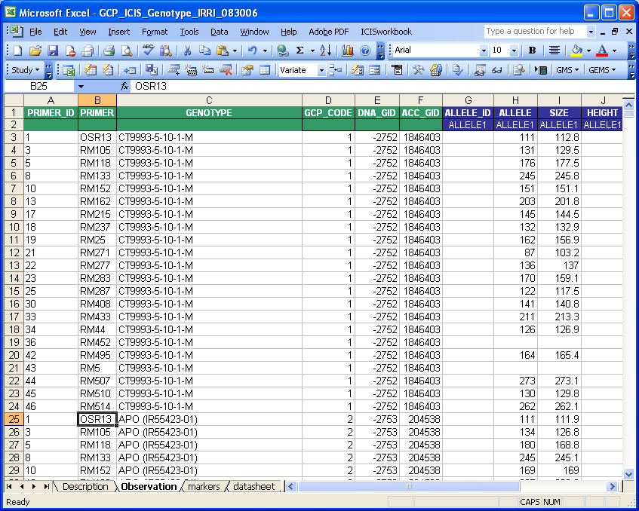
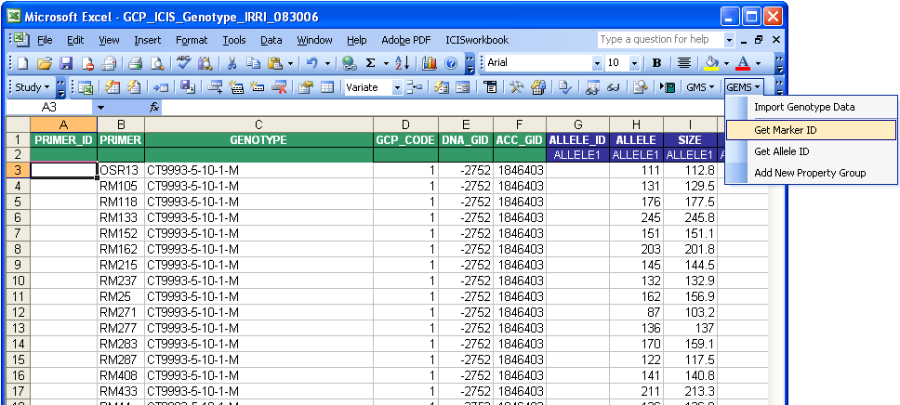
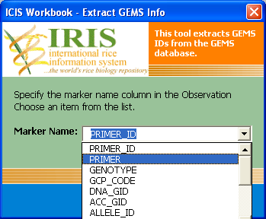
Loading of SSR Data
Retrieve Marker IDs

Slide 10
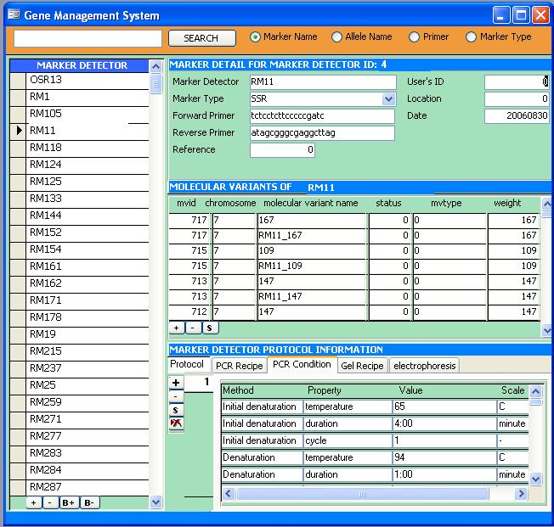
GEMS User Interface
Marker information
markers
Allele information
Protocol Information

