Slide 1
Data Management System
DMS is the component of ICIS that manages germplasm characterization and evaluation data, environmental data for genetic resources and crop improvement projects.

Slide 2
Functions of DMS
store structured data from genetic resource, variety evaluation & crop improvement studies;
document data
link data to germplasm identifiers;
link data to other descriptors (Location, treatments,molecular variant, etc.)
facilitate structured searches.

Slide 3
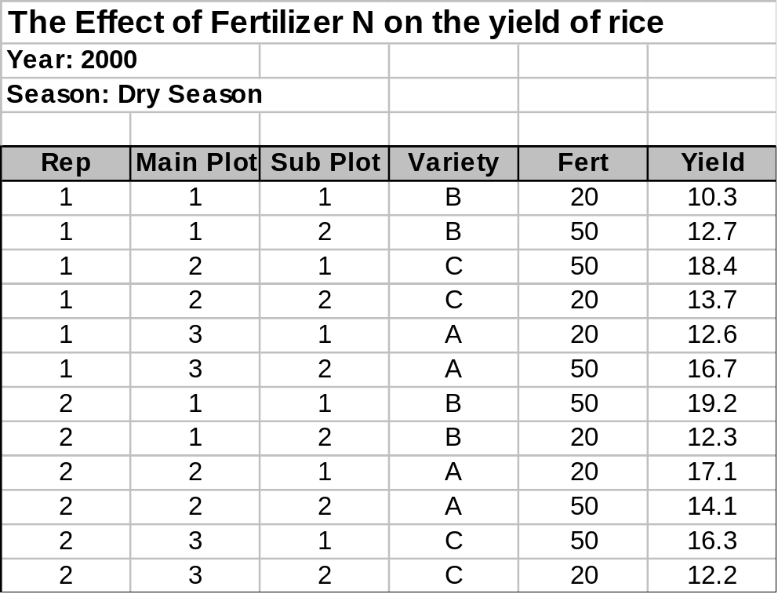
Data Model of DMS
Variate
Study
Filename: N2000DS.xls
Factor
Level
Observation
Unit
Datum

Slide 4
Data Model ...
Factor
Variate
Fert
Yield
PROPERTY
NITROGEN FERTILIZER
GRAIN YIELD
SCALE
kg/ha
t/ha
METHOD
Total Application
Paddy Rice

Slide 5




Data Model ....
STUDY
Applied in
Observed in
Identified by
FACTOR
PROPERTY
VARIATE
Expressed in
Measured/Applied by
Measurement of
Level of
SCALE
METHOD
LEVEL
DATUM
OBSERVATION
UNIT
Recorded from
Indexed by

Slide 6
DMS Workbook
Workbook is a DMS application that connects an Excel spreadsheet to the DMS database to facilitate loading and retrieving data from DMS.

Slide 7
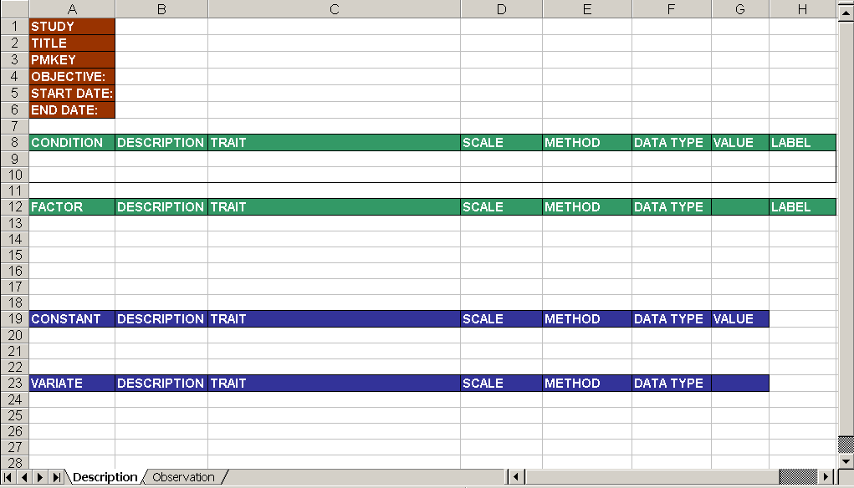


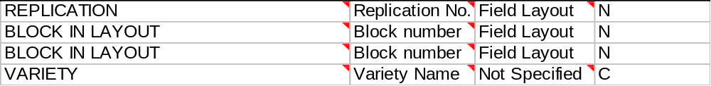






DMS Workbook File
N2000DS
Effect of Fertilizer N on the Yield of Rice
20000401
20000601
Year
Season
Rep
Main Plot
302
116
104
Sub Plot
N or C
Variety
Fert
1003
9
30
Yield
Description Sheet

Slide 8
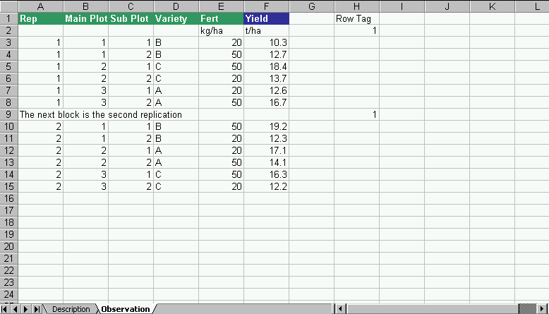
Workbook File . . .
columns of variate names
observation range
RowTag
column for marking rows that do not contain data to be loaded to DMS
the tag is any number except 0
Observation Sheet

Slide 9
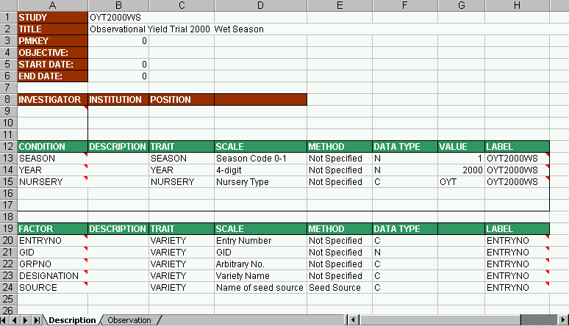
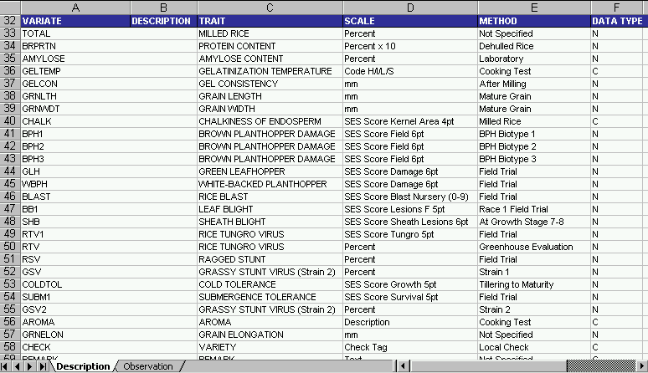
Sample Workbook Files
Observational Yield Trial of Irrigated Rice Program

Slide 10
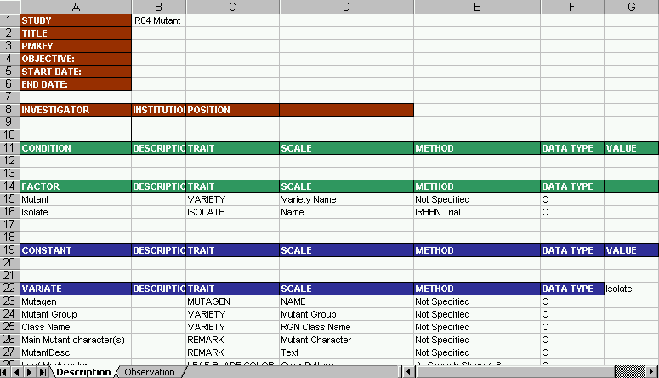
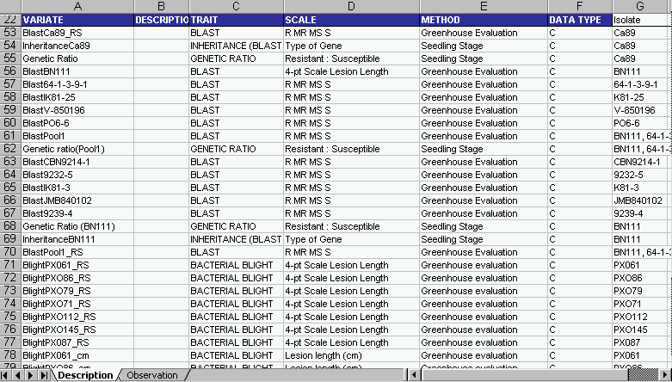
Sample Workbook Files . . .
IR64 Mutant Data

Slide 11
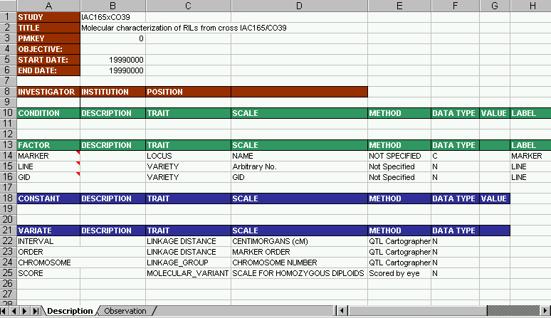
Sample Workbook Files . . .
Map Data

Slide 12
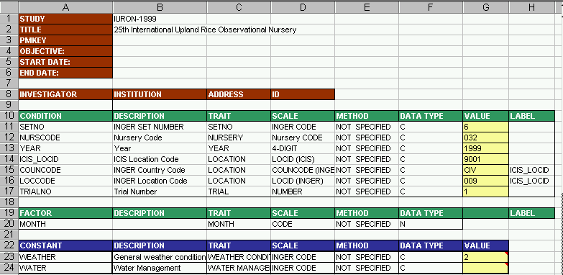
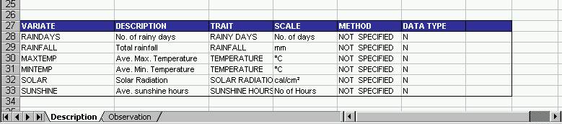
Sample Workbook Files . . .
INGER Weather Data

