Slide 1


CropSentry
Update
Presentation

Slide 2


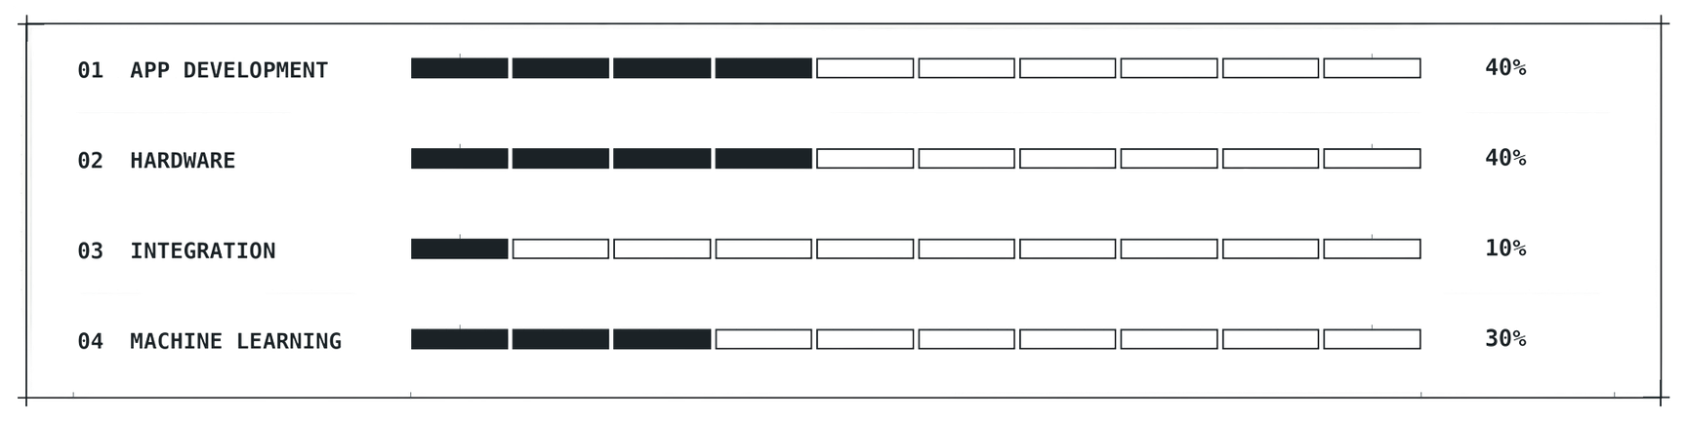
General Update
Where we are
What we’ve done
Where we plan to be
Currently, we are moving into the design phase of our project, pushing into physical manufacturing, finalizing code, and integrating the software/hardware.
So far, we’ve made progress on all sides of CropSentry. The most notable progress is seen in App Development and Hardware with heavy advancement into further stages of building the project.
These upcoming weeks for CropSentry will be heavy on design. We plan to build physical models/prototypes, add more integration to the app and its user interface, and build a working machine learning system.

Slide 3
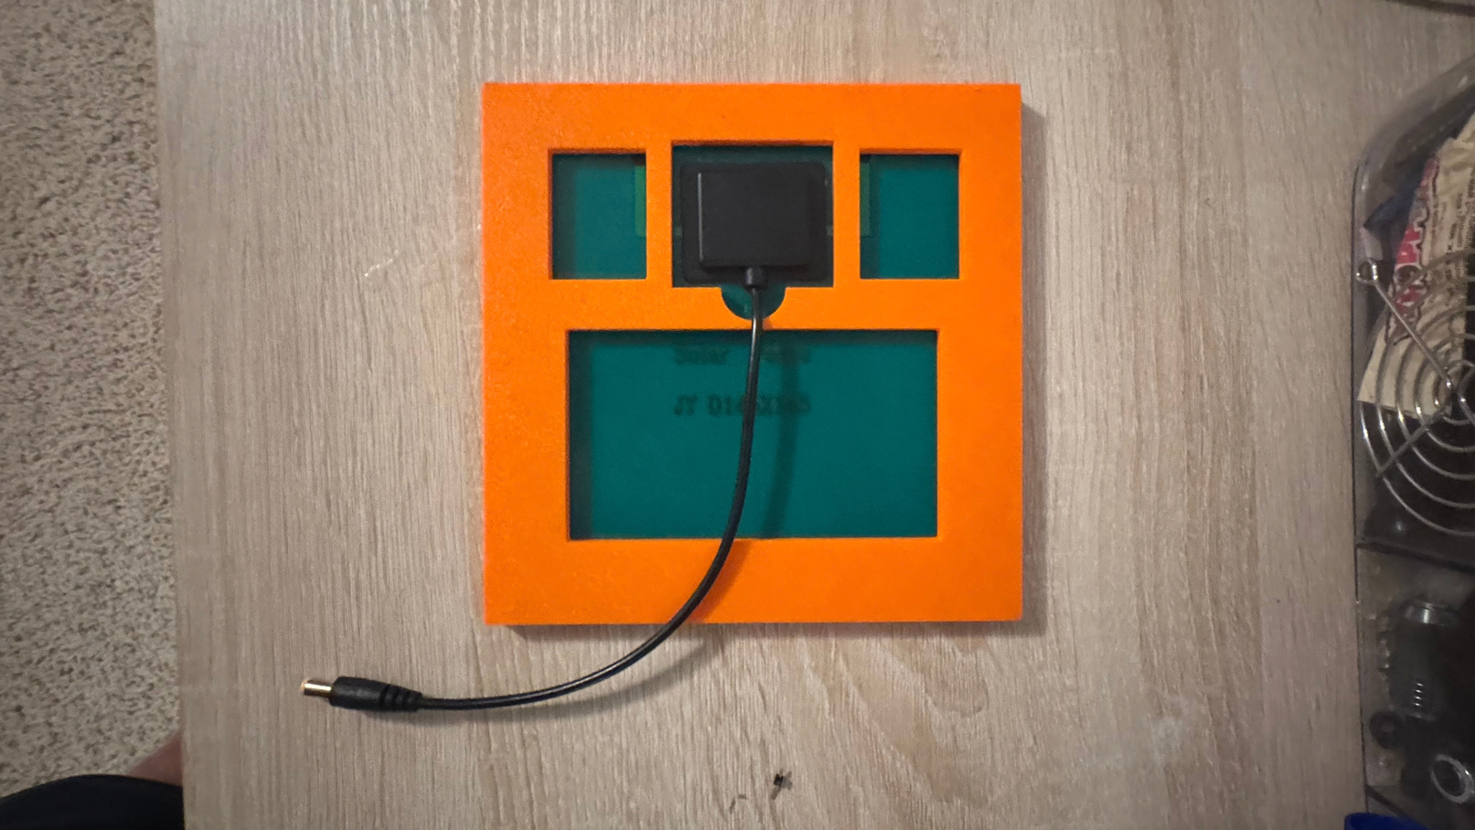
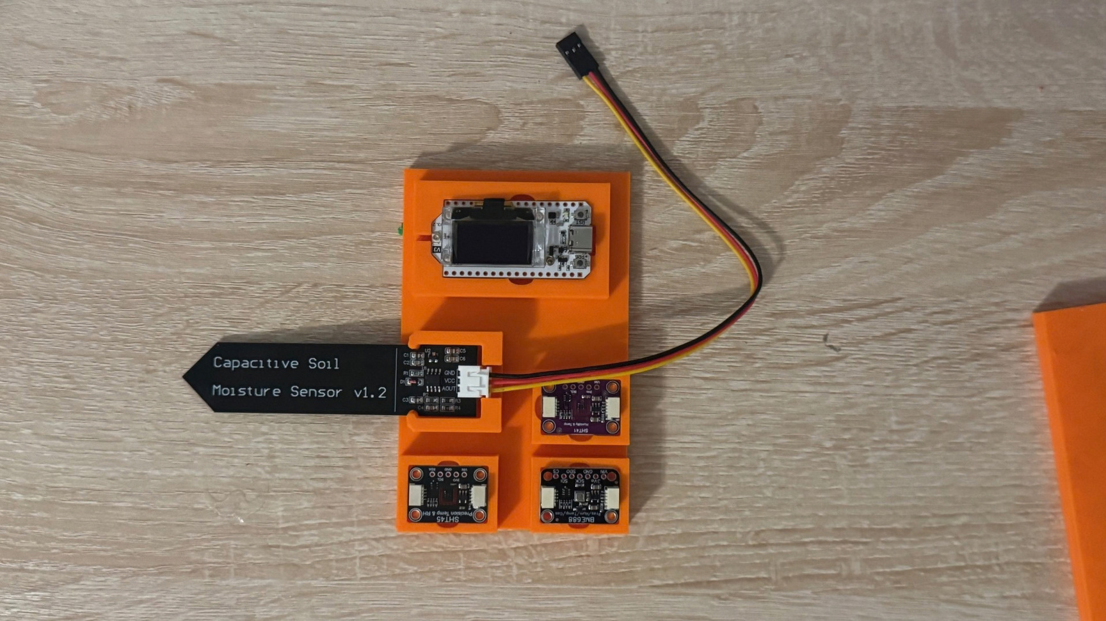

Hardware
Prototyping
In hardware, we have physical 3D models to press-fit the sensors in, as well as a sizing estimate of how big the module will be
More Improvement
I have also built a diagram showing how the build will most likely be shaped. This will give us a valid estimate of how much area the device would take up.
In addition to that, we are close to completing the hardware code for the onboard module. The next steps for finishing it would be to write code to send the data collected over LoRa.

Slide 4
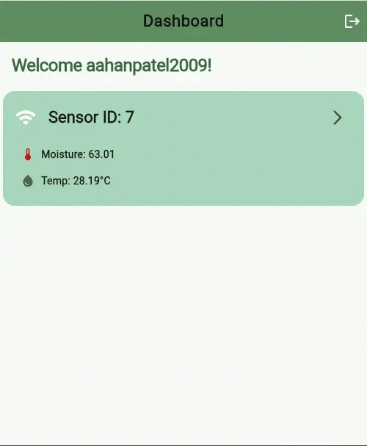
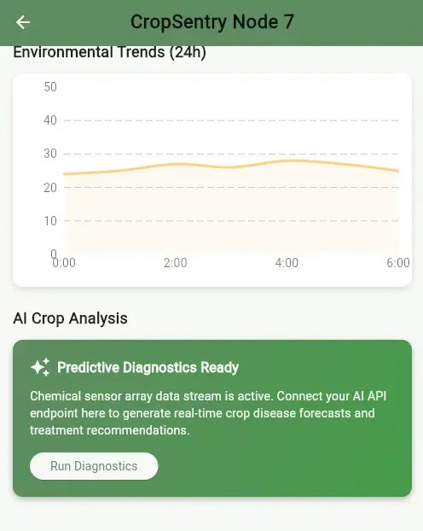
Software
Looking Foward
Aahan is working on continuing the backend and is currently programming data integration throughout the app. The current goal is to get data flowing through the frontend as soon as realistically possible.
We have also recently received permission to use the Museum of Aviation’s new GEAR Lab server for app and device computation, which we will be actively working on to integrate all fields of software onto their machine.
CropSentry App
Over the last few weeks, Aahan coded the frontend app for CropSentry. In it, you can make an account, add multiple devices, view an informational graph, and, looking further, review an AI summary of your information.

Slide 5
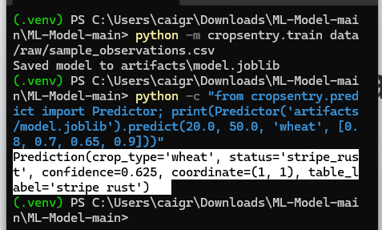
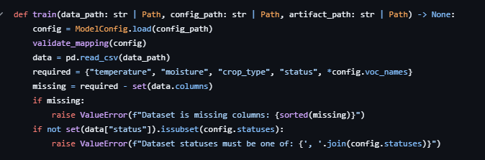
Machine Learning
What is it?
The CropSentry Machine Learning System predicts whether a crop observation is healthy or has stripe_rust from temperature, moisture, crop type, and a fixed-order list of VOC measurements. Yellow-rust observations are grouped under the stripe_rust status.
Progress Made
So far, Jay has coded the model to make a prediction based on a given data value. It prints 5 output variables so the user can see what a potential concern would be within their crop.

Slide 6


See our work
GitHub Link
If anyone is interested in keeping up with the CropSentry project, you can find our GitHub Organization link here:

Slide 7

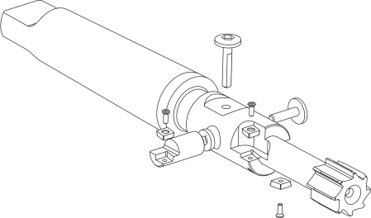
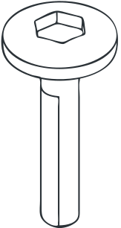

Q/A
Thank you for being a part of this presentation! Any questions are appreciated.

