Slide 1


CropSentry
Update
Presentation

Slide 2


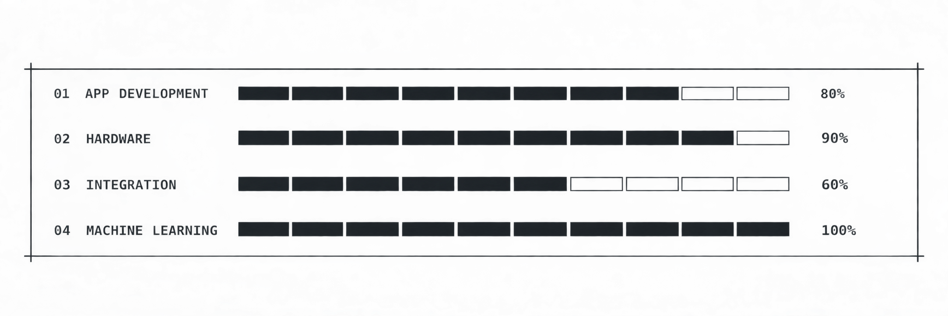
General Update
Where we are
What we’ve done
Where we plan to be
Currently, we are moving into the final design and moving towards the testing phase for our project. We are planning to complete it in the near future.
So far, we have completed the AI model for our machine learning design and are integrating it into our system. We have also put extensive effort into completing our hardware and software designs.
Looking forward, we want to submit to the Congressional App Challenge (6 days for final submission) as well as doing heavy backend integration with all of our fields of IoT.

Slide 3
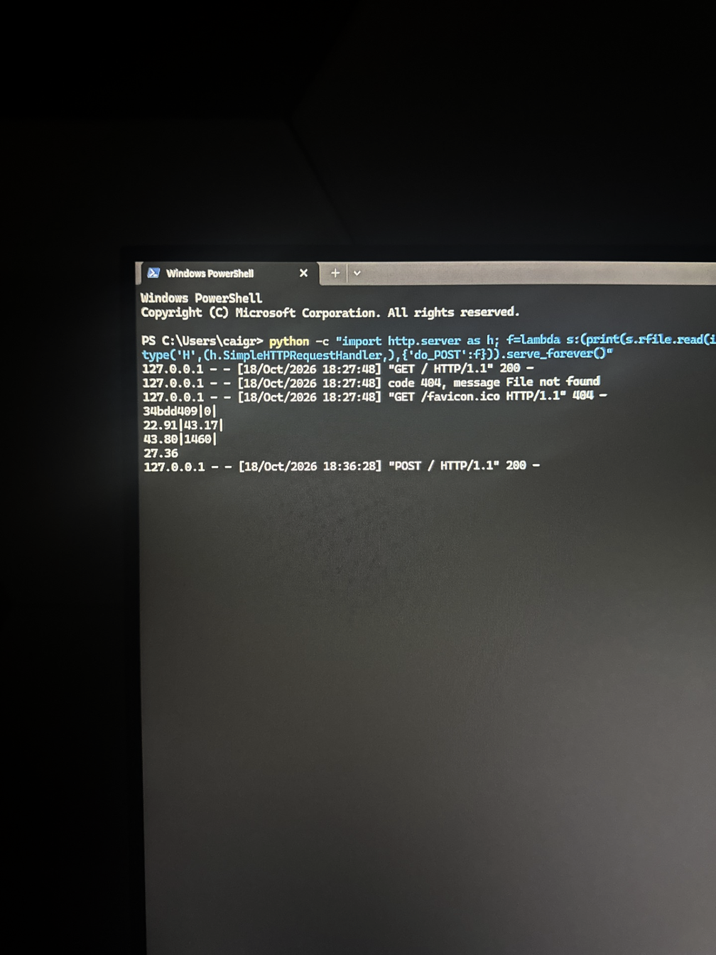
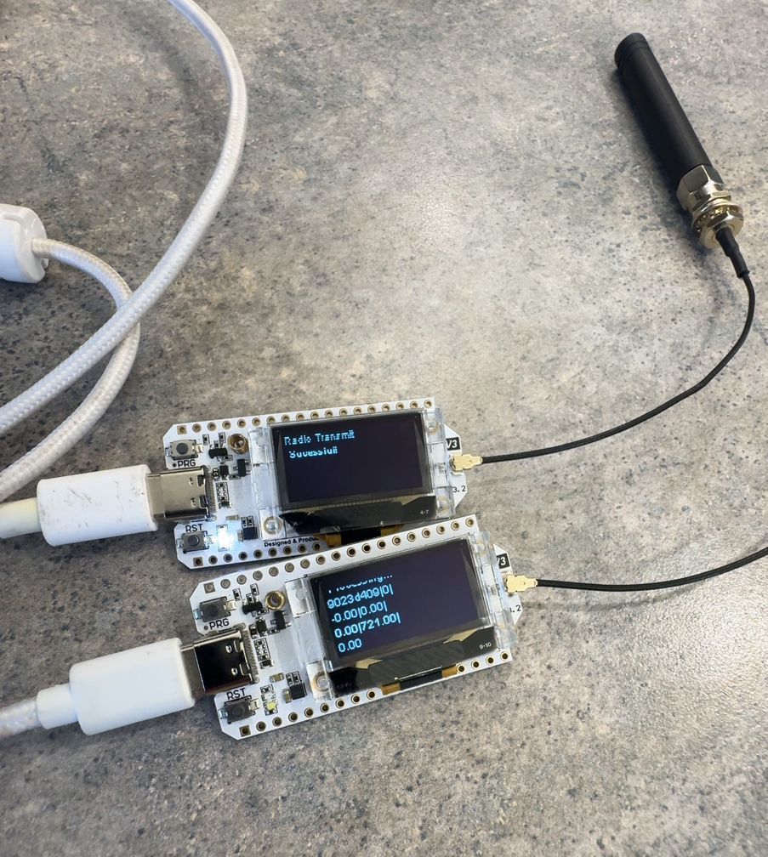
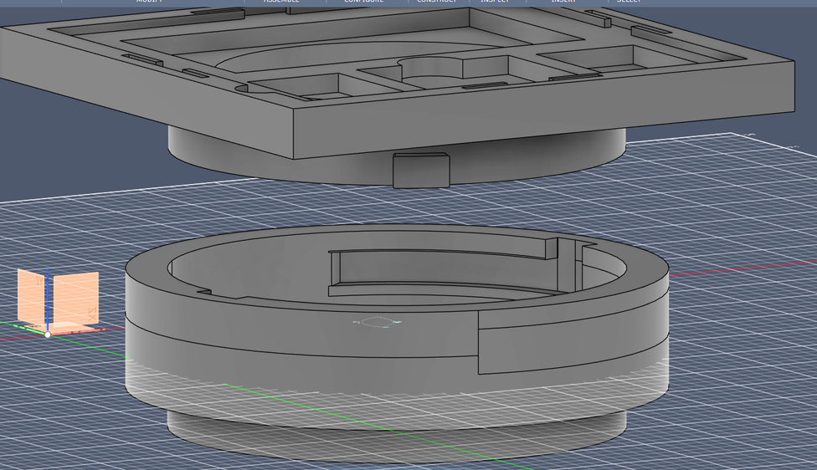
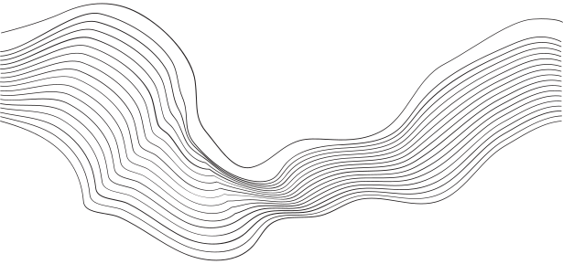
Hardware
3D Fabrication
In the 3D modeling part of the design, Cai has completed the twist-fit lock for the box, as well as individual fits for each component. He has also designed small boxes with airflow to hold the components.
Hardware Coding
As of now, the hardware code is working and functional. It collects data from all sensors, uses LoRa to send it to another module, and then sends it over WiFi to a server so the data can be updated in the app.

Slide 4
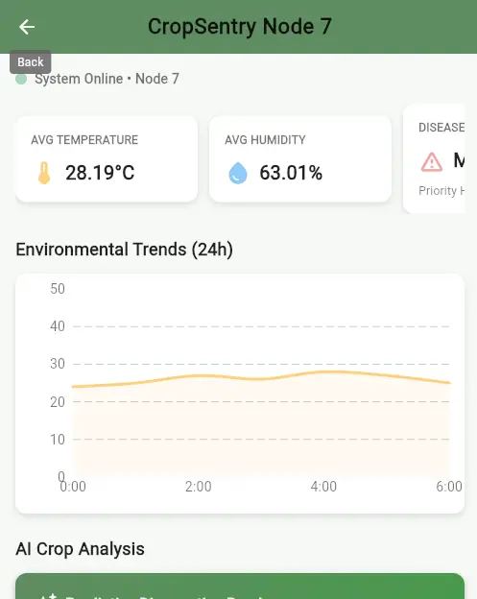
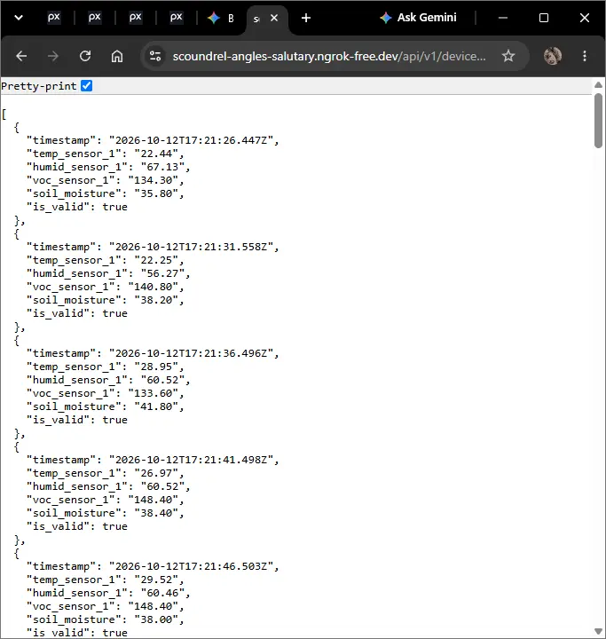
Software
Server and Data Integration
Aahan has also been working on the server integration with all our designs so we can get data flowing as soon as possible. Right now, he has been testing with nGrok’s local server system.
In addition to all of this, he and Dylan Nham (CropSentry Collaborator) have been looking into UI color gradient designs for the app and all things involved with the user interface.
CropSentry App Backend
Aahan has been working on designing key parts of the backend, such as the connection between the app and the server, additional testing code, and security code to ensure data safety.

Slide 5
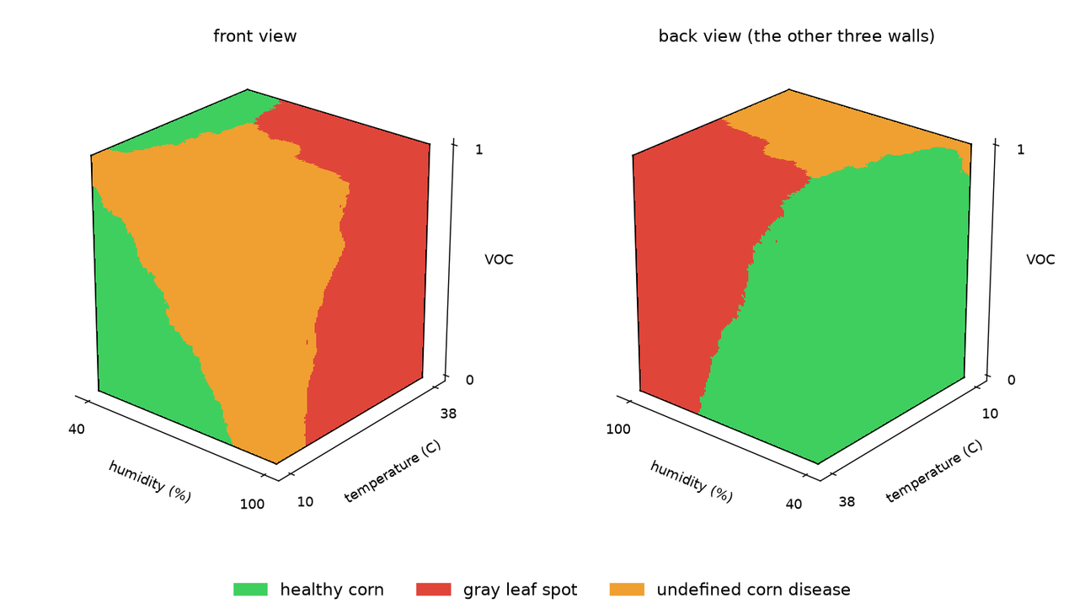
Machine Learning
Progress
These last few weeks, Jay completed the Machine Learning Model for CropSentry. The goal of it is to assess information and data provided by the hardware and make a decision on whether the condition is up to standard or not.
Next Steps
The next step with the Machine Learning model is to integrate it into the process so we get data flowing through every system as soon as possible. Aahan is working heavily on mass integration with the server and information passing through it.

Slide 6
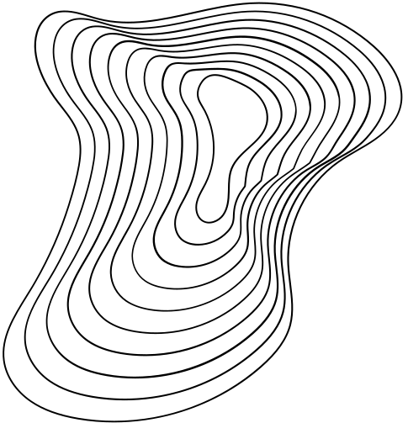
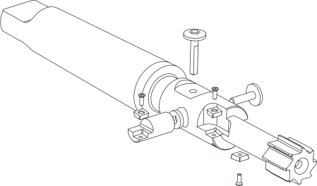
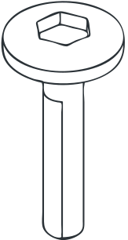

Q/A
Thank you for being a part of this presentation! Any questions are appreciated.

