Slide 1

CropTomato
Brunel University London
Embedded Systems Engineering
IoT Applications Prototyping 14 March 2020

Slide 2
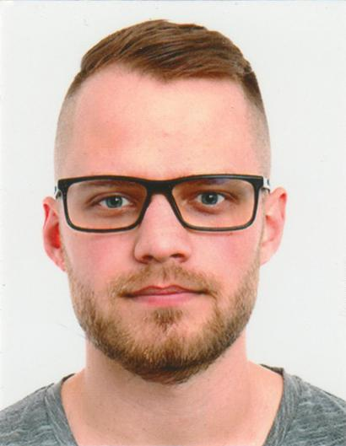
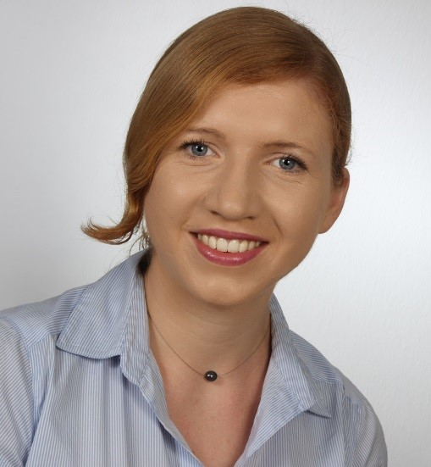
Hello!
We are Kevin and Vanessa
We want to improve colour-blind people’s lives.

Slide 3
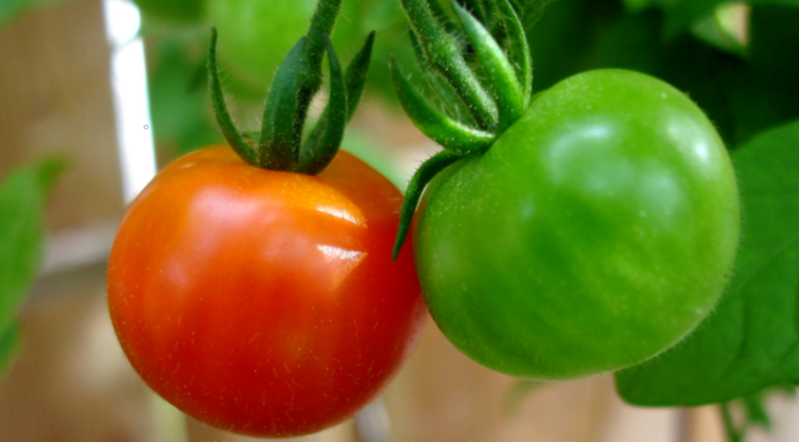
Question:
Notes:
Can you tell which tomatoe is ready to be cropped?

Slide 4
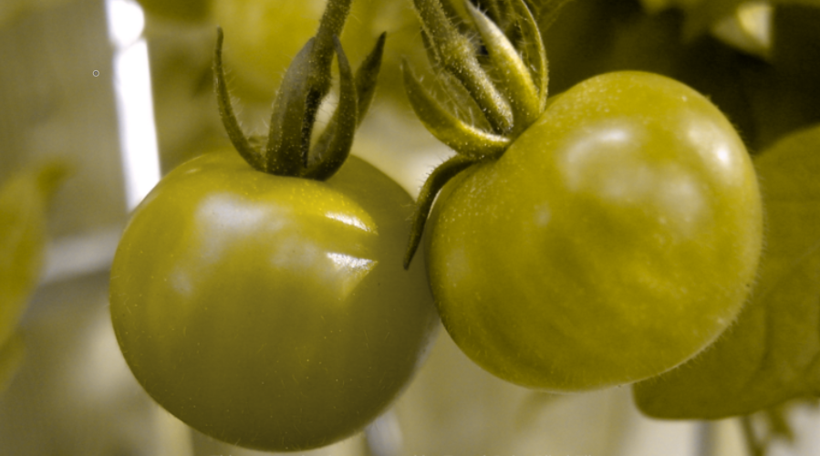
What IF...
Notes:
...you are colour blind? (initial problem)
[1]

Slide 5
This is WHY we solve the problem through technology
Description:
Declaration of the degree of
ripeness of tomatoes in real-time.
Notes:
Problem description

Slide 6
Target Groups:
Private persons
Gardeners and farmers with a colour blindness disability
Commercial users
Planters employing harvesters
Notes:
Focus on private persons with colour blindness disabilty with the the possibility of adaptation for commercial use cases.

Slide 7
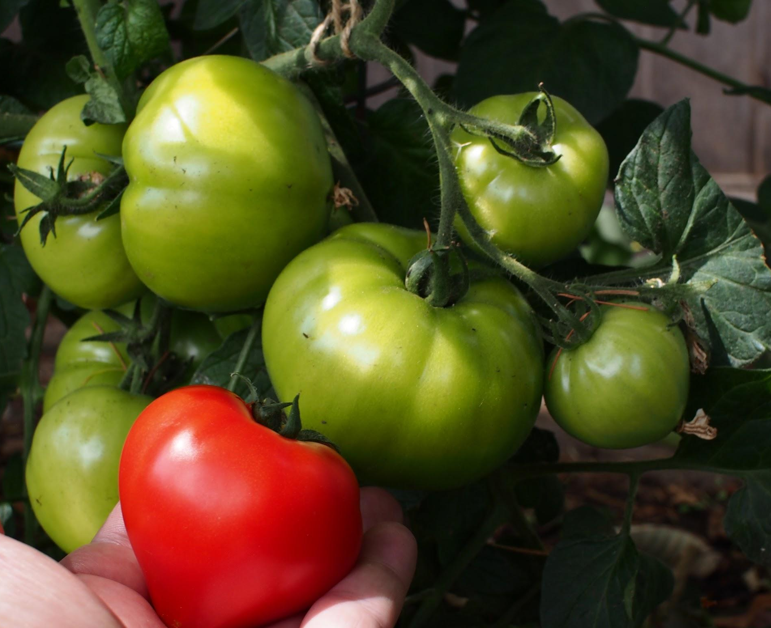
Criteria
General Criteria
Size & shape
Degree of hardness
Surface structure
Smell
Flavour
Visual Criteria
Size
Colour
Anomalies
Notes:
Criteria for classification of degree of maturity to determine tomatoes ready to be cropped.
Anomalies for over-ripeness (not to be considered)

Slide 8
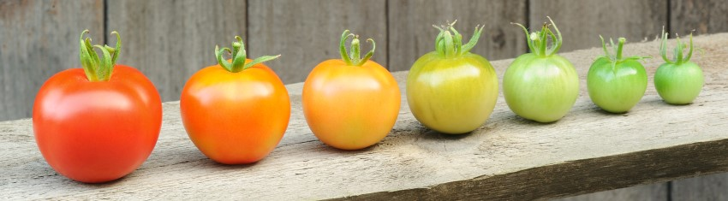
Degree of ripeness of tomatoes in three stages
Green – Unripe
Light Red – Half-ripe
Red – Ripe

Slide 9
Classification
Class | Colour | Degree of Maturity
1 | Green | Unripe
2 | Light Red | Half-ripe
3 | Red | Ripe
Notes:
Non-croppable -- storable -- croppable
Theoretically class 4: overripe → cannot be determined by image detection
[2]

Slide 10
Neural Networks
Dataset Creation
Model Training
Model Export
Model Integration into Android App
1
2
3
4
Notes:
1: single tomatoe only
[3]

Slide 11
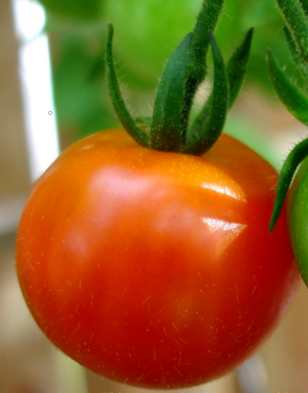
Mobile App
Place your screenshot here
Display tomato ripeness and propose harvest decision
Ripe (98%)
Ready to crop

Slide 12
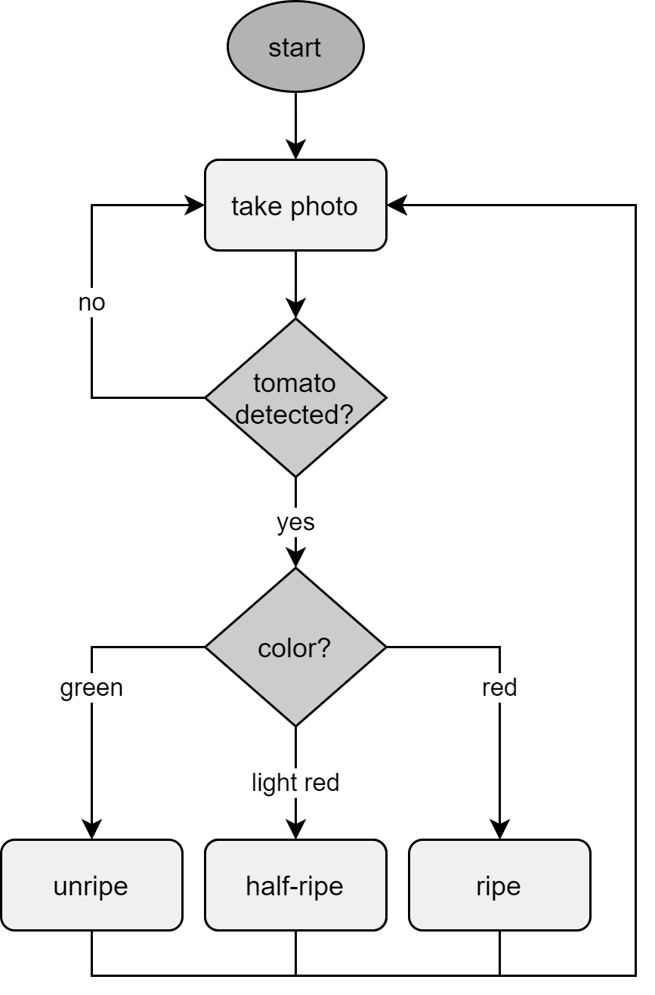
Flowchart

Slide 13
Thanks!
Any questions?
You can find us at:
GitHub

Slide 14
References
[1] https://www.allaboutvision.com/conditions/colordeficiency.htm
[2] Elhariri E., El-Bendary N., Fouad M.M.M., Platoš J., Hassanien A.E., Hussein A.M.M. (2014) Multi-class SVM Based Classification Approach for Tomato Ripeness. In: Abraham A., Krömer P., Snášel V. (eds) Innovations in Bio-inspired Computing and Applications. Advances in Intelligent Systems and Computing, vol 237. Springer, Cham
[3] http://neuralnetworksanddeeplearning.com/chap1.html

