Slide 1
CSE 574 Lecture 2: Problem Representation and Uninformed Search
Professor: Stephanie Gil
Email: sgil@asu.edu (Office hours M 12-1pm BYENG 386)
TAs: Sushmita Bhattacharya sbhatt55@asu.edu (Office hours M 5-6 BYENG 392)
Weiying Wang wwang239@asu.edu (Office hours Th 2:30-3:30 BYENG 392)

Slide 2
Last Time:
Types of Problems and Environments:
Fully vs. partially observable
Deterministic vs. stochastic
Episodic vs. sequential (i.e. what role does history play)
Static vs. dynamic
Discrete vs. continuous
Single-agent vs. multiagent

Slide 3
Classical Planning Assumptions
Finite state environment – set of states and actions is finite
Changes occur only in response to actions
i.e. if the actor does not act, the current state remains unchanged.
Does not include the possibility of actions by other actors or exogeneous events
Determinism – no uncertainty
We assume that we can predict with certainty what state will be produced if action a is performed on state s
Excludes accidents, execution error, or nondeterministic actions (such as rolling dice)

Slide 4
Pros and Cons
Pros
Simple models to build
Simple to reason with these models
Cons
Does not always capture the full reality
May introduce costly errors

Slide 5
This Time
Problem representation
Uninformed search
Reading: Chapter 3 in Russel and Norvig text

Slide 6
Problem Formulation
The process of deciding what actions and states to consider (i.e. that are relevant) given a goal
We must know:
What are the states
What are the actions
Which actions lead to which states

Slide 7
Elements of a Well-Defined Problem
What is a problem?
Solution quality?
Measured by the path cost function
An optimal solution has the lowest path cost among all solutions
Initial state: where is the agent starting?
Actions: <action, successor>
Problem
Goal test: is a given state the goal state?
Path cost: numeric cost of each path. Step cost is c(x,a,y) for x initial state, action a, and next state y

Slide 8
Example Formulation: Vacuum World
States: agent is in one of two locations (L,R) which can be dirty or clean. How many states are there?
Actions: Left/Right/Suck
Goal: Clean up all the dirt. How many states are goal states?

Slide 9
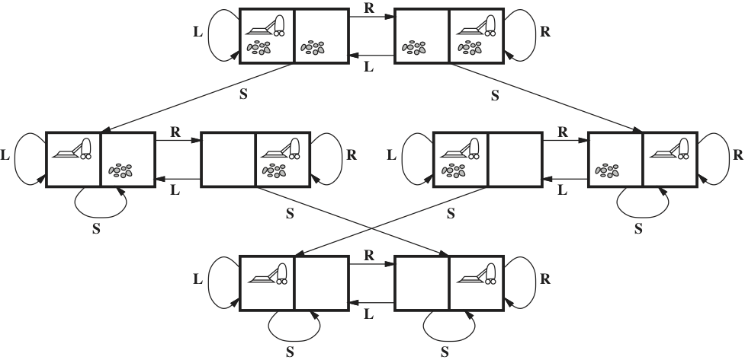
Example Formulation: Vacuum World
Successor Function: Generates the legal states resulting from trying the 3 actions <left,right,suck>
Goal Test: Are all squares clean?
Path Cost: Each step costs 1
State Space:
Q: What is the path cost for different initial states and actions?

Slide 10
Real World Problems
Route-finding problem (e.g. routing in computer networks, military operations, airline travel planning system)

Slide 11
Real World Problems
Route-finding problem (e.g. routing in computer networks, military operations, airline travel planning system)
States: Locations (and current time)
Initial state: Problem dependent
Successor Function: Returns the state resulting from taking any scheduled flight
Goal Test: Are we are the destination by some pre-specified time?
Path Cost: Can be monetary, wait time, flight time, etc

Slide 12
Real World Problems (cont)
Touring problem – closely related to route-finding but has an important difference: visit each city only once.
State space must include not only the current city but also previously visited cities
How does the state space compare to that of route-finding?
Traveling Salesman problem – a touring problem where the aim is to find the shortest tour
Robot Navigation – Generalization of the route-finding problem. Differences:
Robot can move in continuous space with an infinite set of possible actions and states
Robots must deal with errors in sensor readings and motor controls

Slide 13
Problem Formulation then What?
Now that we have the problem formulated correctly, what can we do next?
How do we generate a solution?
Search.

Slide 14
Automating the Solution Generation Part… Search
Search strategy: choice of which state to expand (depends on choice of states compatible with the successor function)
Measures of search performance
Completeness – is the algorithm guaranteed to find a solution when there is one?
Optimality – Does the strategy find the optimal solution?
Time Complexity – How long does it take to find a solution?
Space Complexity – How much memory is needed to perform the search?

Slide 15
Search
Repeated action in search: expand the current state (i.e. which states can the current state lead to?) and generate a new set of states
Search steps:
Choose state
Goal test
Expand state
Two termination conditions
Solution found
No more states left to be expanded

Slide 16
Search tree
A few definitions…
State
Parent node
Action
Path
Path cost g(n)
Depth

Slide 17
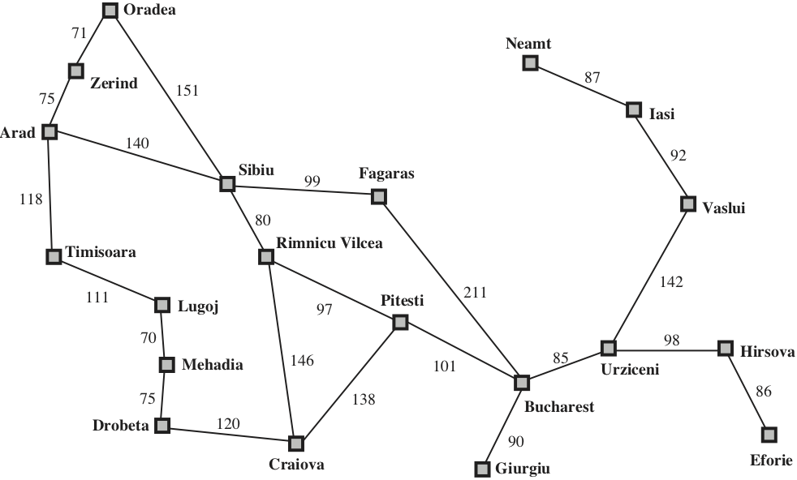
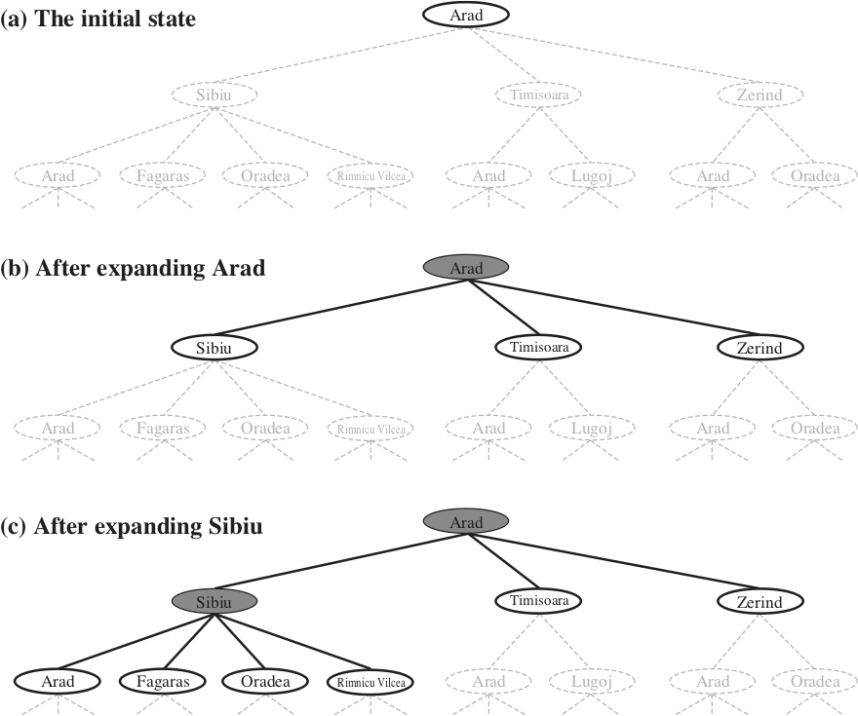
From a State Graph to a Search Tree
Complexity in AI – described in terms of 3 quantities
Branching factor b
Depth d
Maximum length of any path in the state space m
Fig 3.2 Russell and Norvig
Fig 3.6 Russell and Norvig

Slide 18
Uninformed Search Strategies
When you have no idea of whether one “non-goal state” is better than another
If we have a finite # of states, must the search tree have a finite number of nodes?
Is the # of nodes in the search tree the same as the # of states?
No. We can have cycles
No. Number of possible paths.
Fig 3.2 Russell and Norvig

Slide 19
Breadth-first Search
FIFO queue
All nodes are expanded at a given depth in the search tree before any nodes at the next level are expanded
Is BFS complete?
Is BFS optimal?
Airline route example…
LAX
HK
PHX
SFO
SIN
NY
Frankfurt
Tokyo

Slide 20
Complexity of BFS
Memory requirements of BFS?
Complexity of BFS?
*Exponential complexity search problems cannot be solved by uninformed methods for any but the smallest problem instances
Depth of 2, 0.11 seconds
Depth of 4, 11 seconds
Depth of 8, 31 hours
Depth of 10, 129 days….
O(b^{d+1})
O(b^{d+1})

Slide 21
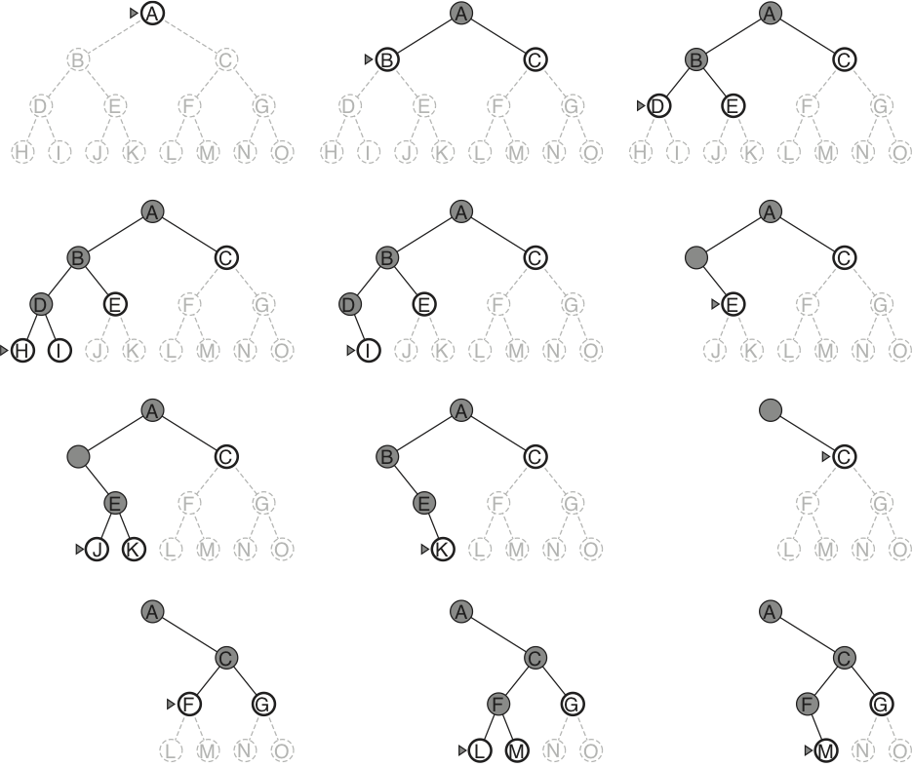
Depth-first Search
LIFO queue (a stack)
Fig 3.16 Russell and Norvig

Slide 22
Depth-first Search (cont)
Stores only a single path from the root to a lead node, along with unexpanded sibling nodes for each node on the path
What factors does memory depend on?
Is DFS optimal?
Is DFS complete?
What is the worst-case complexity? Better or worse than BFS?
b, m
What if C is the goal node?
What if there is a cycle? Or infinite depth?

Slide 23
Variations on BFS and DFS
Depth-limited Search
When is this a good idea?
Definition of diameter of the graph: greatest length amongst the shortest path between two nodes

Slide 24
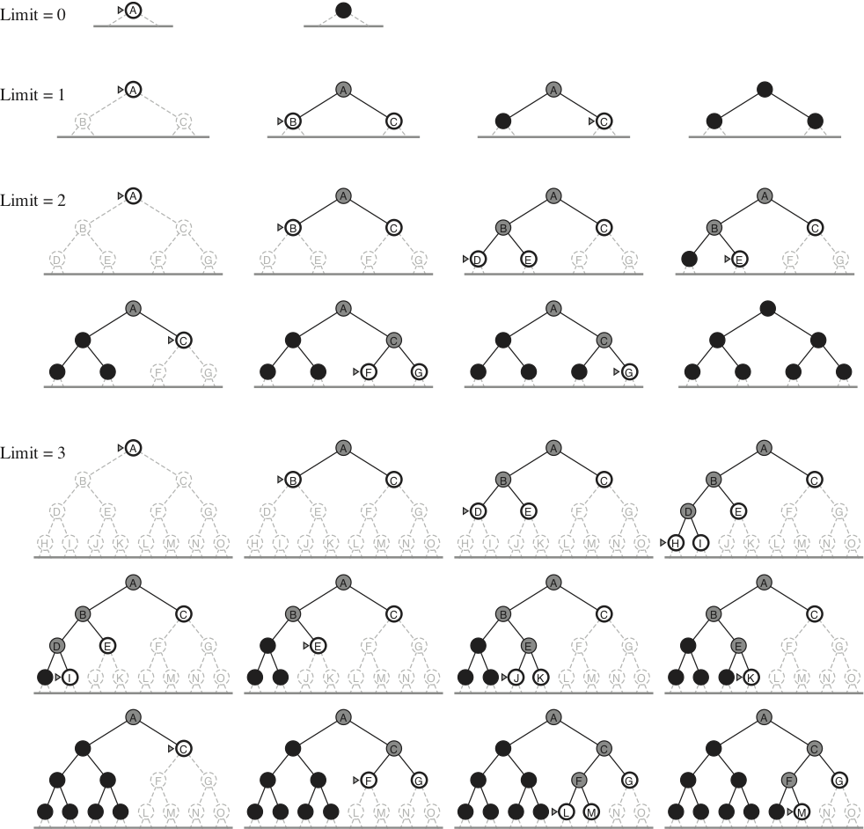
Variations of BFS and DFS (cont)
Iterative Deepening
Combines the best of DFS (modest memory req) and BFS (complete for finite b, optimal for some problems)
Fig 3.19 Russell and Norvig

Slide 25
Final Project Breakdown
Project proposal (P/F)
Literature review and outline with preliminary results (5%)
Presentation in class (15%)
Final report in double column 8 pages in IEEE format (15%)

Slide 26

Tentative project calendar
Final project proposal due
Final project lit review/prelim results due
Final project presentations
Final project presentations
Final project presentations
Final project presentations
Final project report due
Midterm will be on September 26th in class
We will strictly adhere to the class policy on late HW and project assignments. Please review the course syllabus.
There will be no makeup quizzes. In lieu of this we will drop the lowest two pop-quiz scores.

Slide 27
Remember HW 1 is due next week
Expected Pre-requisite Knowledge
Probability
Bayes’ Rule
Expectation
Linar Algebra
Algorithmic complexity
These topics will be tested in HW 1 out now
Office hours tomorrow and Monday

Slide 28
Next Time…
Informed search
Optimality
Maybe constraint satisfaction problems

