Slide 1
CSE 574 Lecture 3: Informed Search and Local Search
Professor: Stephanie Gil
Email: sgil@asu.edu (Office hours M 12-1pm BYENG 386)
TAs: Sushmita Bhattacharya sbhatt55@asu.edu (Office hours M 5-6 BYENG 392)
Weiying Wang wwang239@asu.edu (Office hours Th 2:30-3:30 BYENG 392)

Slide 2
Last Time:
Problem representation
States
Actions
Successor functions
Uninformed search
DFS
BFS
And variants like IDS
Today: readings Russell and Norvig ch 3.5, 4.1-4.3

Slide 3
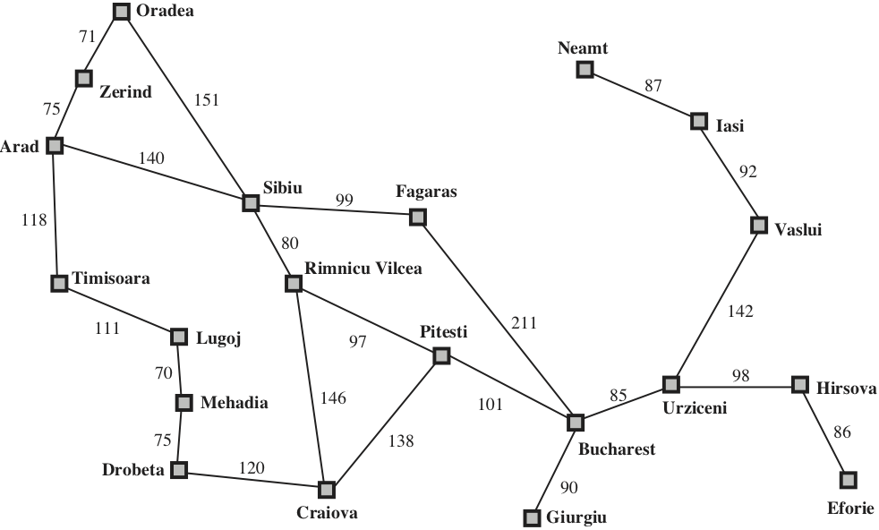
The Problem of Repeated States
We saw that desirable properties of BFS and DFS depend on finite branching factor and search tree depth
Different ways this can happen
Infinite states space or action space (e.g. continuous problems)
Repeated states and cycles
Fig 3.2 Russell and Norvig

Slide 4
How to Avoid Repeated States?
Problem: expanding states that have already been encountered and expanded before
For some problems, repeated states are unavoidable
Includes problems where actions are reversible
Idea: prune or avoid repeated states
For this problem we considered Depth-limited Search with l=9 (the graph diameter) being the maximum path length
Fig 3.2 Russell and Norvig

Slide 5
Repeated States (cont)
Depth-limited search may not always work – we don’t always have a good candidate for l
Two (or more) distinct actions can lead to one distinct state (and not detecting this can lead to an exponential sized graph…)
Fig 3.18 Russell and Norvig (2nd edition)

Slide 6
Detection of Repeated States
Detect repeated nodes before expanding – if a match is found then the algorithm has discovered two paths to the same state
Get around this by keeping visited states in memory
Points to a fundamental tradeoff between space and time complexity
Closed list – every expanded node and checks current node to closed list before expanding
Open list – the fringe of discovered by unexpanded nodes
New algorithm is called graph search instead of tree search

Slide 7
Optimality of Graph Search
The graph-search algorithm always discards the newly discovered path, even if it is shorter than the first path discovered
Is graph-search optimal for DFS? Example..?
New idea: before discarding a path, check if newly discovered path to a node is better than the originally discovered path. If yes, revise depths and path cost of node’s descendants.
How to tell if a new path is better?...

Slide 8
Informed Search
Evaluation function f(n)
Example: distance to the goal
Implemented as a priority queue that maintains the fringe in ascending order of f-values
Heuristic function h(n)
Estimated cost of cheapest path from node n to a goal node
What is a good candidate for h(n) in this case?
Fig 3.2 Russell and Norvig

Slide 9
Heuristic Functions
Characteristics of h(n):
Most common form in which additional knowledge of the problem is imparted to the search algorithm
Should underestimate the cost to the goal (admissible heuristics – more on this soon)
If n is the goal node then h(n)=0

Slide 10
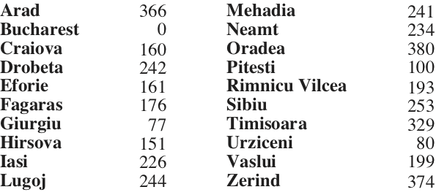
Greedy Best-first Search
Expands the node closest to the goal. Uses f(n)=h(n).
Example: perform greedy best-first search to get from Arad to Bucharest
253
Fig 3.2 Russell and Norvig

Slide 11
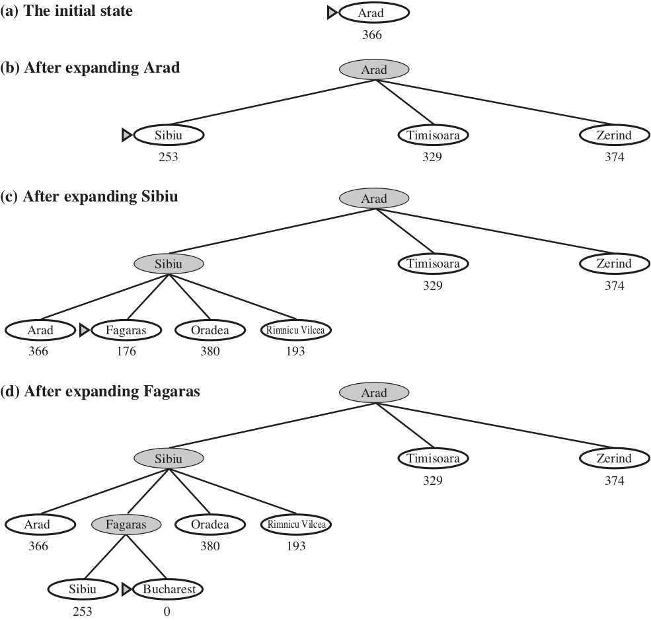
Greedy Best-first Search (cont)
Example: perform greedy best-first search to get from Arad to Bucharest
Is the solution optimal?
Fig 3.2 Russell and Norvig
Fig 4.2 Russell and Norvig 2nd edition

Slide 12
Characteristics of Greedy Search
Not optimal
Incomplete (like DFS it can start down an infinite path and never return to try others)
Worse case time and space complexity is O(b^{m}), where m is the maximum depth of the search space
A good heuristic can reduce complexity substantially

Slide 13
A* Search
Uses a different evaluation function
f(n) = g(n) + h(n)
f(n): the estimated cost of the cheapest solution through n
Provided that the heuristic function h(n) satisfies certain conditions, A* search is both complete and optimal
Path cost from start node to node n
Estimated cost of the cheapest path from n to the goal

Slide 14
Admissible Heuristics
Admissible heuristic – h(n) never overestimates the cost to reach the goal
Since g(n) is the exact cost to reach n, an immediate consequence is that f(n) never overestimates the true cost of a solution through n
What does this mean for missing an optimal solution?
Fig 4.2 Russell and Norvig 2nd edition

Slide 15
Importance of an Admissible Heuristic
General proof for A* optimal (using tree search) if h(n) is admissible:
Let G₂ be a suboptimal goal node
Let C* be the cost of the optimal solution
Does A* expand G₂?

Slide 16
A* and Graph Search
The previous proof does not hold for graph search. Why?
Two ways around this
Important concept, monotonicity (or consistency in Russell and Norvig text). Will come up again in Dynamic Programming!
Extend graph search to discard the more expensive of any two paths found to the same node.
Ensure that the optimal path to any repeated state is always the first one followed.

Slide 17

Monotonicity in the Heuristic
A heuristic h(n) is monotonic if for every node n and every successor n’ of n generated by action a, the estimated cost of reaching the goal from n is no greater than the step cost of getting to n’ plus the estimated cost of reaching the goal from n’
Example: Suppose that n’ is a sucessor of n
n’=Rimnicu Vilcea
n = Sibiu
$$h\left(n\right)≤c\left(n,a,n^{′}\right)+h(n^{′})$$
Exact cost to reach n’ from n by executing a
Estimated cost to reach the goal from n’
Show that f(n) along any path is nondecreasing such that f(n’)>= f(n) if h(n) is consistent

Slide 18
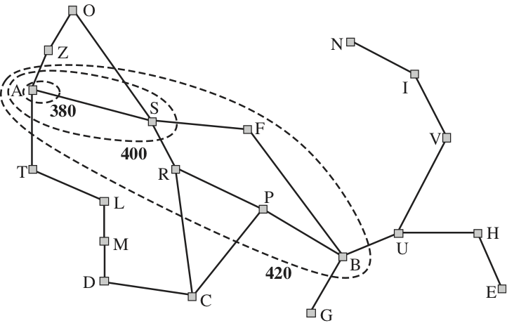
Monotonicity in the Heuristic (cont)
This means that the first goal node selected for expansion must be an optimal solution (since all later nodes will be at least as expensive)
This allows us to get around book-keeping!
Note that we can arrive at the goal node via a suboptimal path but this path won’t be expanded (e.g. Bucharest example)
Nodes inside a given contour have f-costs less than or equal to the contour value
Fig 3.25 Russell and Norvig

Slide 19
Local Search
Uses a single current state (rather than keeping track of multiple paths) and generally move only to neighbors of that state.
Typically, the paths followed by the search are not retained
When to use:
Use very little memory (often use a constant amount)
Can often find reasonable solutions in a large or infinite (i.e. continuous) state space for which previous systematic algorithms are unsuitable

Slide 20
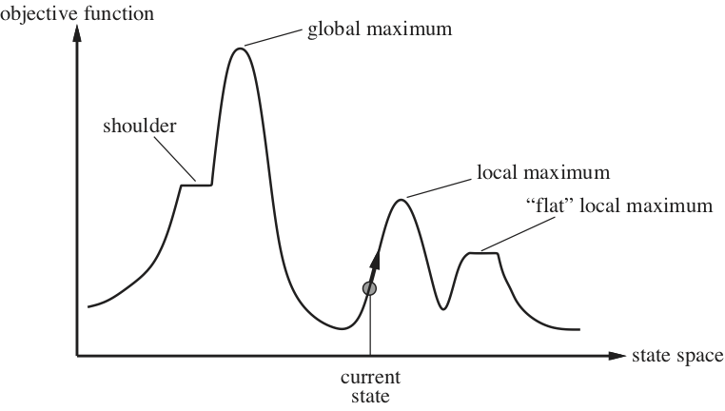
An Objective Function
These algorithms aim to find the best state according to an objective function (often replaces the ”goal test” and “path cost” of previous search methods)
The “goodness” of a state is described by a function
Fig 4.1Russell and Norvig

Slide 21
Hill Climbing
Pitfalls
Local maxima – may not every find solution
Non-smooth function
Stochasitc variants
Can escape local maxima
But still no guarantee of finding global maximum
Simple rule: pick the next state such that it improves the objective function

Slide 22
Next Time…
Adversarial Search (Russell and Norvig ch 5)
Constraint Satisfaction Problems (Russell and Norvig ch 6)
HW 1 due tomorrow (Tuesday) at 5pm
New HW out this week (HW and due date will be announced on Blackboard after HW1)
Quiz preparation:
Candidate quiz material: past lectures, assigned readings, HWs)
Focus on algorithms covered and algorithmic properties
Closed notes

