Slide 1
CSE 574 Lecture 5: Constraint Satisfaction Problems
Professor: Stephanie Gil
Email: sgil@asu.edu (Office hours W 12-1pm BYENG 386 changed due to Labor Day )
TAs: Sushmita Bhattacharya sbhatt55@asu.edu (Office hours W 6-7 BYENG 392 changed due to Labor Day )
Weiying Wang wwang239@asu.edu (Office hours Th 2:30-3:30 BYENG 392)

Slide 2
Last Time:
Practice pop quiz – please be ready by reviewing past readings and class notes at the start of every lecture
HW 2 is out – any questions?
Please bring them up early to avoid late submission (see syllabus for late assignment policy)
Adversarial search
Minimax algorithm
Alpha-beta pruning for large state spaces
Both are on the HW including an Alpha-beta pruning programming assignment (please start early and take advantage of office hours!)
This time: Constraint Satisfaction Problems (Russell and Norvig chapter 6)

Slide 3
Planning and Identification
Planning: A sequence of actions
The path to the goal is important
Paths have various costs and depths
Heuristics give problem-specific guidance
Identification: Assignments to variables
The goal itself is important, not the path
CSPs are specialized for identification problems
This is still a search problem

Slide 4
Constraint Satisfaction Problems (CSP)
Defined by a set of
Variables X₁,X₂,…,X_{n}
Constraints C₁, C₂,…,C_{m}
Assignment {X_{i}=v_{i}, X_{j}=v_{j},…}
A Solution to a CSP is a complete assignment that satisfies all constraints

Slide 5
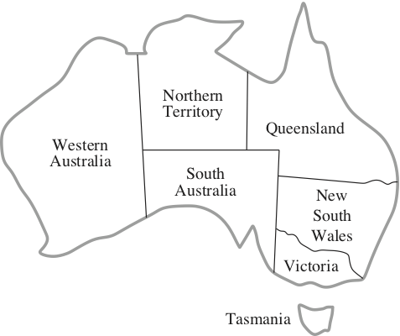
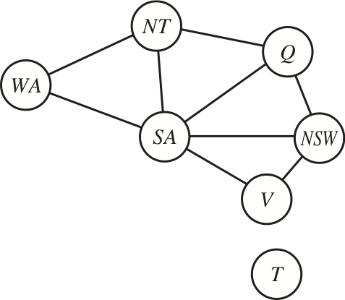
Representation of a CSP
Before we saw how representation of a problem as a graph helped us to formulate search over routes
Now we will use graphs to help us formulate constraints
Pairwise constraints between variables are denoted as an edge

Slide 6
CSP: Comparison to What We’ve Seen
Initial state: the empty assignment { }, in which all variables are unassigned
Successor function: a value can be assigned to any unassigned variable, provided that it does not conflict with previously assigned variables
Goal test: the current assignment is complete
Path cost: a constant cost (e.g. 1) for every step

Slide 7
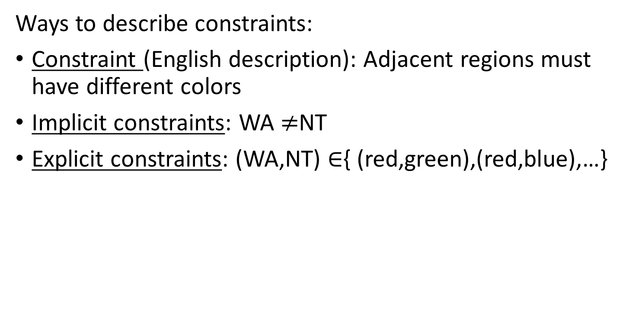
Example: Graph Coloring
Ways to describe constraints:
Constraint (English description): Adjacent regions must have different colors
Implicit constraints: WA $≠$NT
Explicit constraints: (WA,NT) $∈${ (red,green),(red,blue),…}

Slide 8


Another Example: N Queens
Is this a valid solution?
The state of each square
Variables: Xij
Domains: {0,1}
Constraints:
Explicit:
$$∀i,j,k \left(X_{ij},X_{ik}\right)∈\left\{\left(0,0\right),\left(0,1\right),\left(1,0\right)\right\}$$
$$∀i,j,k \left(X_{ij},X_{kj}\right)∈\left\{\left(0,0\right), \left(0,1\right), \left(1,0\right)\right\}$$
$$∀i,j,k \left(X_{ij},X_{i+k,j+k}\right)∈\left\{\left(0,0\right),\left(0,1\right),\left(1,0\right)\right\}$$
$$∀i,j,k \left(X_{ij}, X_{i+k,j−k}\right)∈\{\left(0,0\right),\left(0,1\right),\left(1,0\right)\}$$
Implicit constraint:
$$\sum_{ij}{X_{ij}=N}$$
What is happening on the square? Queen or no queen?
How to encode that queens cannot be on the same row or diagonal?
No two queens in same row
Constraints on queen placement
No two queens in same col
No two queens in same diag
There must be N queens on the board!
This constraint prevents the trivial solution of no queens on the board

Slide 9
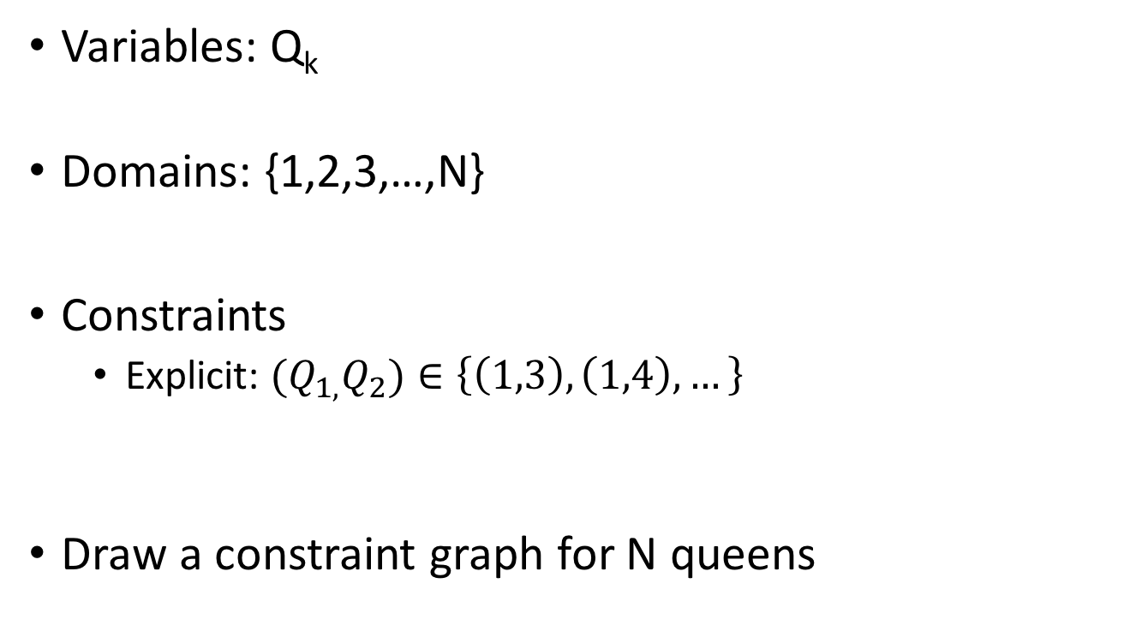
N Queens: Different Formulation
1 2 3 4
Variables: Q_{k}
Domains: {1,2,3,…,N}
Constraints
Explicit: ${(Q}_{1,}Q_{2})∈\left\{\left(1,3\right),\left(1,4\right),…\right\}$
Draw a constraint graph for N queens
Q₁
Q₂
Q₃
Q₄

Slide 10
Types of CSPs and Solution Time
Finite domains (the examples we’ve seen so far)
Size d means O(d^{n}) complete assignments
Infinite domains (integers, strings, etc)
Job scheduling where the variables are start/end times for each job
Linear constraints are solvable
Continuous variables
Start/end times for Hubble telescope operations
Linear constraints are solvable in polynomial time (the subject of linear programming LP)

Slide 11
Some Real World CSPs
Assignment problems: e.g. who teaches class
Timetable problems: e.g. which class is offered when and where?
Transportation scheduling
Factory scheduling
Fault diagnosis…

Slide 12
Standard Search Formulation
A standard template. Compare to what we’ve seen so far…
States – defined by the values assigned so far
Initial state – the empty assignment, { }
Successor function – assign a value to an unassigned value
Goal test – the current assignment is complete and satisfies all constraints

Slide 13
Solving CSPs: What Affects Efficiency?
Which variable is assigned next and in what order?
What are the implications of the current variable assignments on other unassigned variables
When a path fails, can search avoid repeating this failure in subsequent paths?

Slide 14
Solving CSPs: Backtracking
Variables:
WA, NT, Q, NSW, V, SA, T
Domain: {red, green, blue}
Try BFS on the map coloring problem
What about DFS?
Backtracking search is the basic uninformed algorithm for solving CSPs
{ }
WA=red
WA=green
WA=blue
WA=red
NT=green
WA=red
NT=blue
WA=red
NT=blue
Q=red

Slide 15
Revisit Ideas for Efficiency
Keys for speeding up the search:
Ordering: which variable should be assigned next?
In what order should its values be tried?
Filtering: can we detect inevitable failure early?
Structure: can we exploit problem structure?
Algorithms for solving CSPs that we will see next build upon these ideas for speeding up solution finding!

Slide 16
Forward Checking
A type of filtering
Idea: keep track of domains for unassigned variables and cross off bad options
Cross off values that violate a constraint when added to the existing assignment
Step 1: Assign the first variable. Remove conflicting values from other variable domains using the constraint graph
Step 2: Continue to the next variable. Again, remove conflicting values from remaining domains
Step 3: Assign next variable. If a domain is left empty, backtrack. (Don’t wait to get to the illegal assignment)
{WA=red}
{WA=red, Q=green}
{WA=red, Q=green, V=blue}

Slide 17
Name of the Game: Fail Fast
Borrowing some startup philosophy:
“Fail fast is a philosophy that values extensive testing and incremental development to determine whether an idea has value. An important goal of the philosophy is to cut losses when testing reveals something isn’t working and quickly try something else”

Slide 18
Arc Consistency
Extend forward checking concept:
Follow constraints all the way through the constraint graph

Slide 19
Limitations of Arc Consistency
Arc consistency does not detect all failures
Red
Red, Blue
Green, Blue
Green, Blue
Red, Blue
Red, Blue
Is this arc consistent?
Are there solutions remaining?
Is this arc consistent?
Are there solutions remaining?

Slide 20
Minimum Remaining Values (MRV)
How else can we “fail fast”?
Variable ordering
Minimum Remaining Values (MRV)
Choose the next variable for assignment as the one with the fewest number of legal values left in its domain

Slide 21
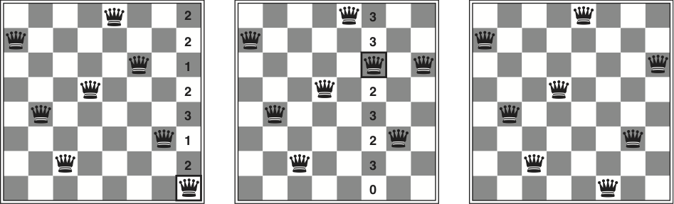
Local Search
Idea: start with an assignment
Successor function picks one queen and considers moving it elsewhere in its column
Heuristic for choosing a new value for the variable is to select the value that results in the minimum # of conflicts with other variables
This is the Minimum Conflicts heuristic

Slide 22
When to Choose Local Search?
Why not use a “fail fast” approach here?
This is not the “fail fast method” anymore…
When is it good to use local search?
Like most local search problems, it is best when we start with a good solution
Example 1: Online re-planning
Example 2: Airline schedules changing due to weather and fixing the schedule with a minimum # of changes
Example 3: This has been used to schedule observations for the Hubble telescope, reducing the time taken to schedule a week of observations from 3 weeks to 10 minutes

Slide 23
The Role of Structure
Idea: decompose the problem into many sub-problems
Example: Tasmania as an independent sub-problem
Another example: CSP problems are connected by a single path (or the constraint graph forms a tree)
Any tree structured CSP can be solved in time linear in the # of variables [see Russell and Norvig text]
We will see the concept of decomposition into sub-problems again with Dynamic Programming
Indeed a very common approach is to take advantage of structure in the problem

Slide 24
Next Time…
HW 2 due next Friday (Sept 14th at 5pm)
Introduction to Dynamic Programming
Markov Models!

