Slide 1
CSE 574 Lecture 11: Recitation
Professor: Stephanie Gil
Email: sgil@asu.edu (Office hours M 12-1p BYENG 386)
TAs: Sushmita Bhattacharya sbhatt55@asu.edu (Office hours M 5-6 BYENG 392)
Weiying Wang wwang239@asu.edu (Office hours Th 2:30-3:30 BYENG 392)

Slide 2
Announcements
HW 3 due this Friday at 5pm
Weiying office hours tomorrow (Thursday) 2:30-3:30pm
Midterm next week! Wednesday Oct 3 in class
Practice midterm out this week, review session for midterm next Monday Oct 1 in class
Final project proposal due next Friday Oct 5 by 5pm
Changes to next week’s office hours due to midterm
Myself and Sushmita office hours Monday regular time
Weiying office hours will move to Tuesday
I will hold additional office hours next week on Thursday to discuss final project proposals (this is in lieu of my office hours during the following week Monday Oct 8th)

Slide 3
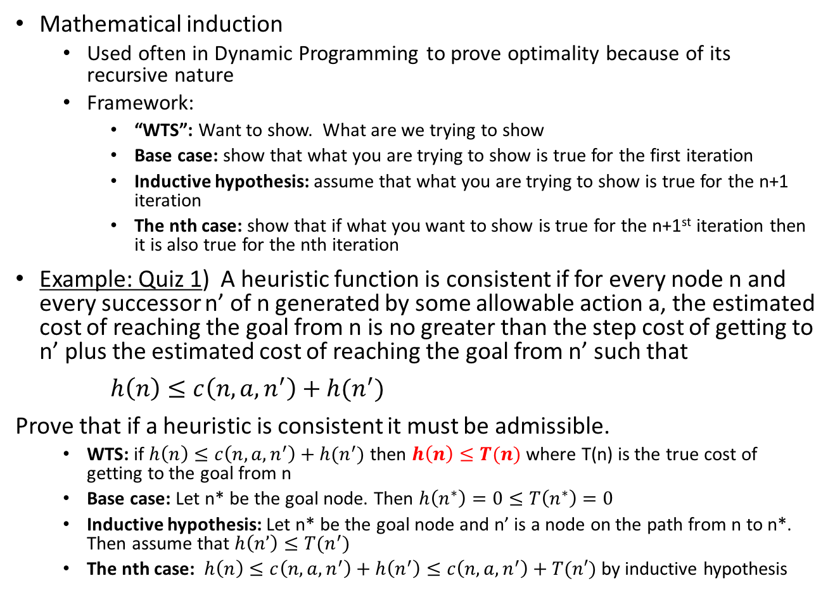

Mathematical Induction
Mathematical induction
Used often in Dynamic Programming to prove optimality because of its recursive nature
Framework:
“WTS”: Want to show. What are we trying to show
Base case: show that what you are trying to show is true for the first iteration
Inductive hypothesis: assume that what you are trying to show is true for the n+1 iteration
The nth case: show that if what you want to show is true for the n+1st iteration then it is also true for the nth iteration
Example: Quiz 1) A heuristic function is consistent if for every node n and every successor n’ of n generated by some allowable action a, the estimated cost of reaching the goal from n is no greater than the step cost of getting to n’ plus the estimated cost of reaching the goal from n’ such that
$h\left(n\right)≤c\left(n,a,n^{′}\right)+h(n^{′})$
Prove that if a heuristic is consistent it must be admissible.
WTS: if $h\left(n\right)≤c\left(n,a,n^{′}\right)+h(n^{′})$ then $h\left(n\right)≤T(n)$ where T(n) is the true cost of getting to the goal from n
Base case: Let n* be the goal node. Then $h\left(n^{∗}\right)=0≤T\left(n^{∗}\right)=0$
Inductive hypothesis: Let n* be the goal node and n’ is a node on the path from n to n*. Then assume that $h\left(n’\right)≤T(n^{′})$
The nth case: $h\left(n\right)≤c\left(n,a,n^{′}\right)+h\left(n^{′}\right)≤c\left(n,a,n^{′}\right)+T(n′)$ by inductive hypothesis
$$T(n)$$

Slide 4
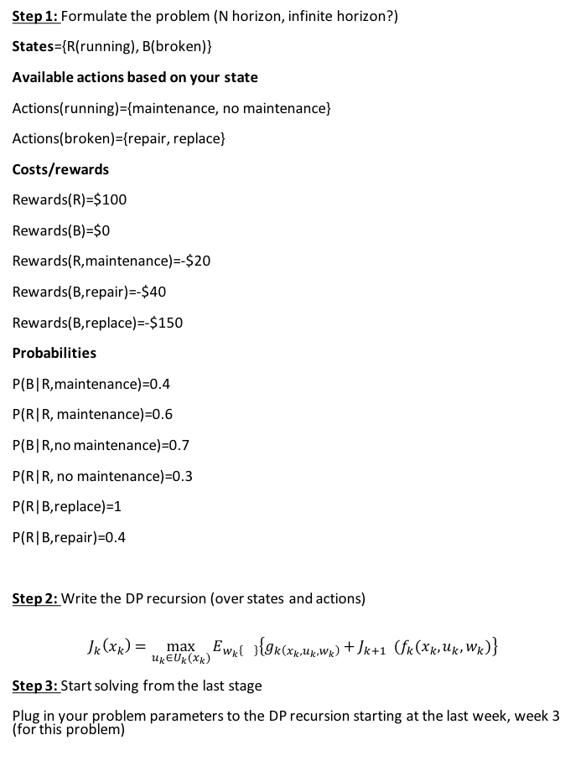
Dynamic Programming Formulation
Step 1: Formulate the problem (N horizon, infinite horizon?)
States={R(running), B(broken)}
Available actions based on your state
Actions(running)={maintenance, no maintenance}
Actions(broken)={repair, replace}
Costs/rewards
Rewards(R)=$100
Rewards(B)=$0
Rewards(R,maintenance)=-$20
Rewards(B,repair)=-$40
Rewards(B,replace)=-$150
Probabilities
P(B|R,maintenance)=0.4
P(R|R, maintenance)=0.6
P(B|R,no maintenance)=0.7
P(R|R, no maintenance)=0.3
P(R|B,replace)=1
P(R|B,repair)=0.4
Step 2: Write the DP recursion (over states and actions)
$$J_{k}\left(x_{k}\right)=\max_{u_{k}∈U_{k}(x_{k})}{E_{w_{k}\left\{\right\}}\left\{g_{k\left(x_{k},u_{k},w_{k}\right)}+J_{k+1} (f_{k}(x_{k},u_{k},w_{k})\right\}}$$
Step 3: Start solving from the last stage
Plug in your problem parameters to the DP recursion starting at the last week, week 3 (for this problem)

